Slide 1
Database 2015 Project 1
Last modified time : 2015-4-13 pm 3:42

Slide 2
Job Hunting System
Job hunting system
Employer register
Job seeker register
1. Post job information
2. Edit his/her own job information
3. Delete his/her own job information
4. View the list of all job seeker
5. View list of job vacancy
1. Fill in resume
2. View job vacancy list

Slide 3
Specification
Database
You need 7 tables
Table name : employer
Attribute | Type | Index
id | int | primary key , auto-increment
account | varchar
password | varchar
phone | varchar
mail | varchar

Slide 4
Specification
Database
You need 7 tables
Table name : location
Define these location by yourself
e.g. Taipei, Hsinchu, Tainan
Attribute | Type | Index
id | int | primary key , auto-increment
location | varchar

Slide 5
Specification
Database
You need 7 tables
Table name : occupation
Define occupation by yourself
e.g. Teacher, Doctor, Reporter……………..
Attribute | Type | Index
id | int | primary key , auto-increment
occupation | varchar

Slide 6
Specification
Database
You need 7 tables
Table name : recruit
Attribute | Type | Index | Description
id | int | primary key , auto-increment
employer_id | int | foreign key, references to employer table | who posted this job information
occupation_id | int | foreign key, references to occupation table
location_id | int | foreign key, references to location table
working_time | varchar
education | varchar |  | educational background requirement
experience | int |  | minimum of working experience
salary | int

Slide 7
Specification
Database
You need 7 tables
Table name : specialty
Define specialty by yourself
e.g. Beauty, Accounting, Design, Catering…………..
Attribute | Type | Index
id | int | primary key , auto-increment
specialty | varchar

Slide 8
Specification
Database
You need 7 tables
Table name : user
Attribute | Type | Index | Description
id | int | primary key , auto-increment
account | varchar
password | varchar
education | varchar |  | highest education
expected_salary | int
phone | varchar
gender | varchar
age | int
email | varchar

Slide 9
Specification
Database
You need 7 tables
Table name : user_specialty
Attribute | Type | Index | Description
id | int | primary key , auto-increment
user | varchar
specialty_id | int | foreign key, references to specialty table | what kind of specialty does the user(job seeker) have

Slide 10
Specification
Function
Employer
Register ( insert into employer table )
Log in
Log out
Post new jobs ( insert into recruit table )
Edit his/her own job information ( update recruit table)
Delete his /her own job (delete from recruit table)
View the list of all job seeker (user & user_specialty table)
View the list of job vacancy (recruit table)

Slide 11
Specification
Function
Job seeker
Register (insert into user table and user_specialty table)
Log in
Log out
View the list of job vacancy (recruit table)
Cannot view the list of job seeker

Slide 12
Specification
Foreign Key
Implement foreign key on the following pairs of tables
specialty <-> user_specialty
Delete some rows in user_specialty table if some rows in specialty table are deleted
location <-> recruit
Delete some rows in recruit table if some rows in location table are deleted
occupaion <-> recruit
Delete some rows in recruit table if some rows in occupation table are deleted
employer <-> recruit
Delete some rows in recruit table if some rows in employer table are deleted

Slide 13
Specification
Foreign Key
How to implement foreign key? What’s the SQL syntax of foreign key?
TA will have a in the near future!
or study by yourself :
http://www.w3schools.com/sql/sql_foreignkey.asp

Slide 14
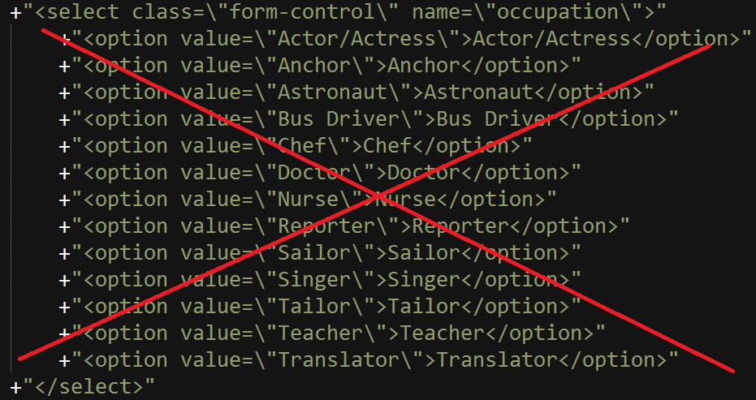
Specification
Do not show any location, occupation and specialty information in your source code like the following picture
User SQL syntax SELECT … FROM occupation or SELECT … FROM location instead

Slide 15
Specification
SQL syntax
Do not use mysql_xxxxx()
( mysql_connect, mysql_select_db, mysql_query……… )
Please use PDO or MySQLi
Why? TA will have a class about PDO in the near future!
or study by yourself :
http://php.net/manual/en/function.mysql-connect.php
http://tw2.php.net/manual/en/class.pdo.php
http://www.w3schools.com/php/php_mysql_connect.asp

Slide 16
Specification
Session
When log in or register successfully, write account into session
When log out, destroy session
User session to determine whether to show some specific function or page
For example :
cannot enter some page without log in as an employer
……………….. and so on

Slide 17
Specification
Account & Password
Employer’s account can be the same as job seeker’s account
Any two employer’s account must be different
Any two job seeker’s account must be different
Account and password cannot be empty string or whitespace

Slide 18
Specification
Password hash
Please store hashed password instead of plaintext password into your database
Why? TA will have a class about hash in the near future!
or study by yourself :
http://php.net/manual/en/function.crypt.php

Slide 19
Specification
Upload your source code & report to E3
One group, one report
Report can only be .pdf format which contains the following information
Name, student ID of your team members
URL of your webpage (can be accessed by TA while you demonstrate your website)
Notes:
Git no

Slide 20
Specification
Deadline : 2015-4-27 23:59:59
Hand in delay: delay one day, your score will be 20% off.
E.g. Delay one day: score*0.8
E.g. Delay two day: score*0.8*0.8
Demonstration time : undetermined

Slide 21
Q&A
If you have any question about this project, please post it on E3 forum

Slide 22
Website Example
Please check out website_example.pdf

