Slide 1
Simulation for Data collection and uploading in IoT island
Fangqi Liu 96121528 UciNetIDs: fangqil2
Te-Chih Chen 76285429 UciNetIDs: techihc
Jia-Wei Chiang 43688514 UciNetIDs: jiawec5

Slide 2
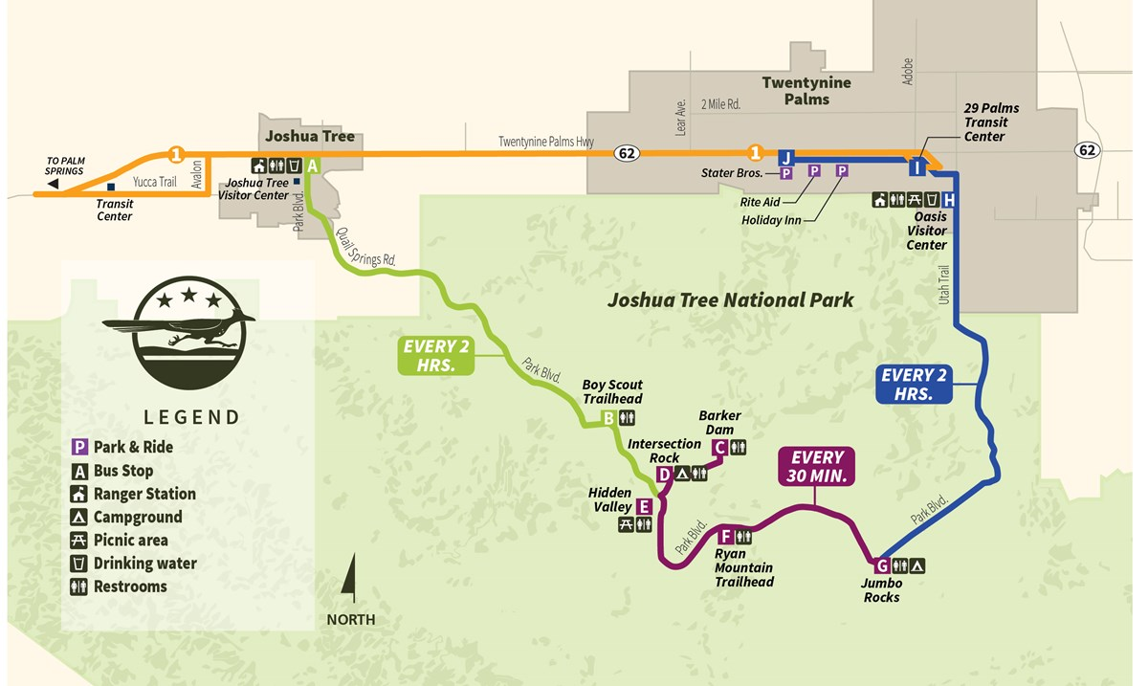
Definition for IoT island
Local networks of IoT devices operating in disconnected modes (are isolated with outside network) due to the loss of network infrastructures to achieve the connectivity to data processing center or cloud platforms.
Objective and solution
-> Objective : Transmitting sensing data to the network access points ( data upload point) .
-> Solution : Deploying data upload points into IoT island which can cover all monitoring area.
-> Optimization : Minimizing the cost of the upload point deployment within delay tolerance threshold.
Notes:
access

Slide 3
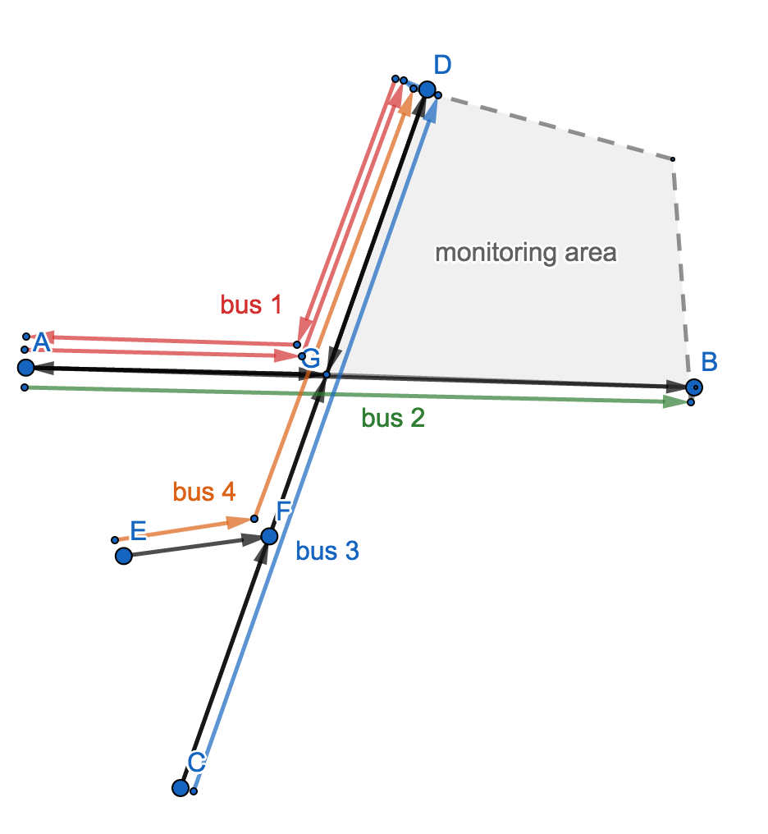
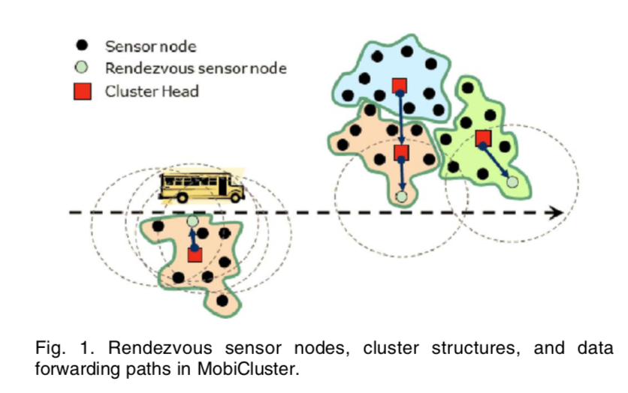
Characteristics of our working scenario
Sensors are deployed in certain area.
Clustering method : rendezvous-based approach, in which mobile sink can communicate the rendezvous point directly.
The routes and the schedules of buses are predefined.
Mounting the data collector on the public buses which act as the mobile sinks.

Slide 4
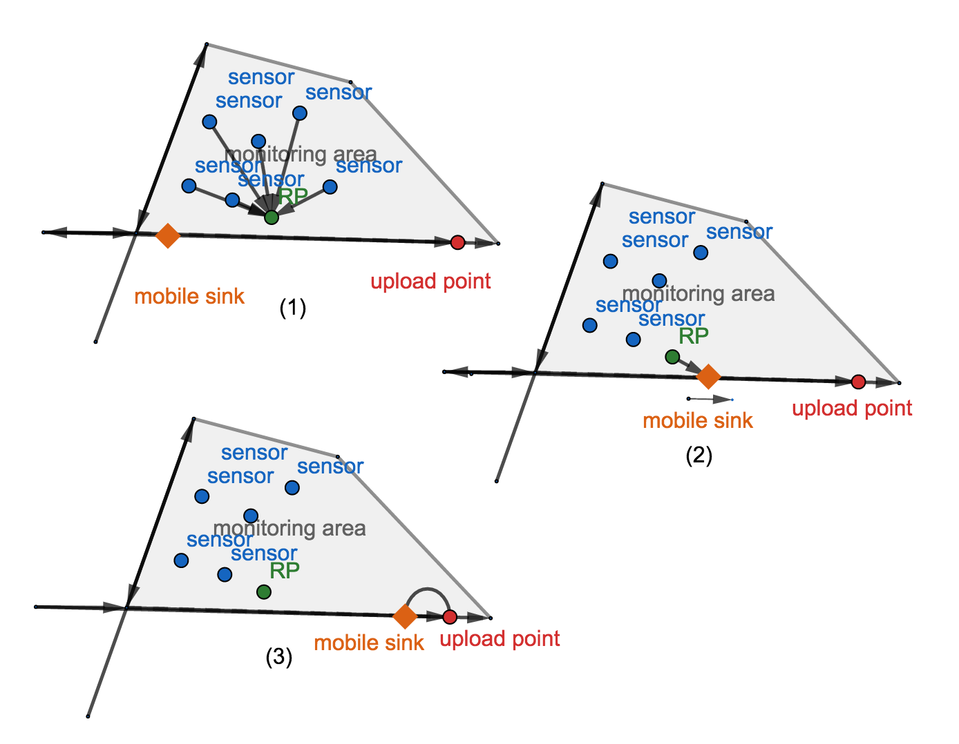
Setting simulation
1. Simulating the routes of mobile sinks (based on real bus routes).
2. Sensor clustering using Rendezvous-based approach.
3. Mobile sinks gathering data from RPs.
4. Mobile sinks upload data to upload point ( network access point ).

Slide 5
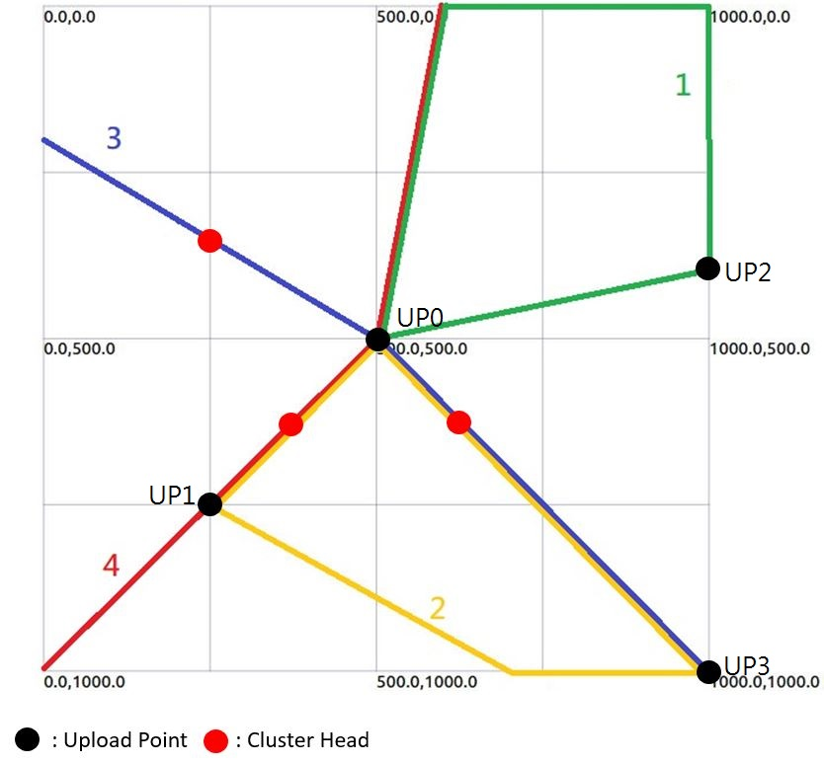
Mobility

Slide 6
Process of data transmission
Definitions of different points on the bus route map
- STA: clustering sensor nodes
- AP: cluster head
- MS: mobile sink
- UP: upload point
STA → AP → MS → UP
Clustering transmission: STA → AP
Point-to-point transmission
- Sending packets
- Receiving packets

Slide 7
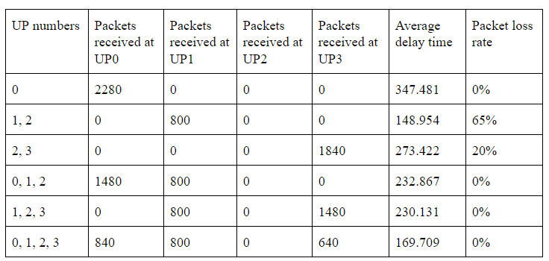
Results

Slide 8
Future works
Buses carrying MS may leave the bounded area
Prioritized data
Limited buffer capacity

