Slide 1


Minor Project - 2
Title:
Meta-heuristic Load Balancing Algorithms In Cloud Computing
Presented by:
Annie Jain(R214220179) Ayush Juyal(R214220316) Rishabh Anand(R2142201862)
Guided by:
Dr. Rajeev Tiwari
Professor (PL)
Cluster- Systemics
School of Computer Science

Slide 2
Content
Introduction
Problem Statement
Motivation
Objectives
Tech Stack
Design Diagram
Code
Flowchart
Working
SWOT Analysis
Application of the Project
PERT Chart
Objectives Covered
References

Slide 3
1. Introduction
In cloud computing, load balancing is a method of distributing workload throughout a certain cloud-based area. Enterprises had given permission for the applications to be controlled.
The cloud computing system had aided the companies in ignoring the traffic noise as well as the bad workload on the network.
Traditional scheduling algorithms are easier to implement but doesn't hold good for higher complexity problems.
It is becoming increasingly difficult to assign cloud tasks fairly so that the nodes within the cloud computing environment will have a balanced load as the field of cloud computing becomes more popular and at the same time, there are more intensive tasks waiting to be processed .

Slide 4
Contd.
Meta-heuristic algorithms are primarily based upon application of operators together with transition, assessment and resolution for imparting efficient scheduling techniques.
The assessment of Meta-heuristic algorithms are carried out based totally on computation time, useful resource utilization, response fee and scheduling fee.
The idea of differential evolution, a metaheuristic technique, is used in this project to present the Metaheuristic Load-Balancing-Based Clustering Technique, a revolutionary energy-efficient clustering protocol for load balancing.
The load balancer employs a variety of scheduling algorithms to decide which server should handle a request and then transmits it to the chosen server based on specified characteristics, such as availability or the current workload.

Slide 5
2. Problem Statement
Load balancing is one of the main challenges in cloud computing which is required to distribute the dynamic workload across multiple nodes to ensure that no single node is overwhelmed. Due to which it is difficult to optimally utilize the resources and hence degrading the performance of the system.

Slide 6
3. Motivation
The project aims to have the following features:-
Developing better load balancing algorithms than traditional algorithm.
Complex load balancing of workload across various virtual machine of data centre efficiently.
Improve the response time of the data centre.
Maximum utilization of same resources to get better performance.

Slide 7
4. Objectives
Make improved meta heuristic load balancing algorithm by combining it with other Meta heuristic Algorithm.
To give user the best algorithm for the customized configuration.
To optimize the cost of resources usage.
Developing meta heuristic load balancing algorithm for better workload distribution among VMs of data centers by improving Basic Meta Heuristic Algorithm .

Slide 8
5. Technology Stack
Development
Java SDK - Java 1.8
Cloud analyst
Cloud sim : version 2.1

Slide 9
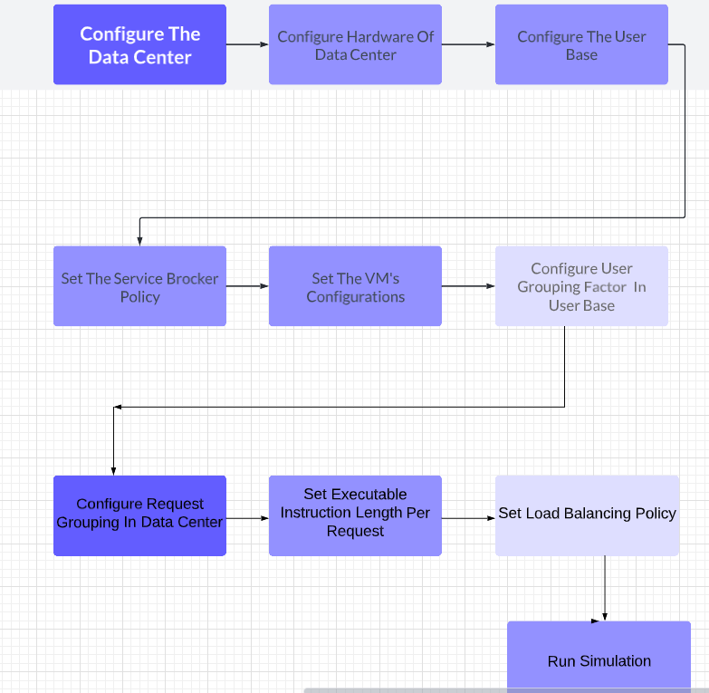
6. Design Diagram

Slide 10
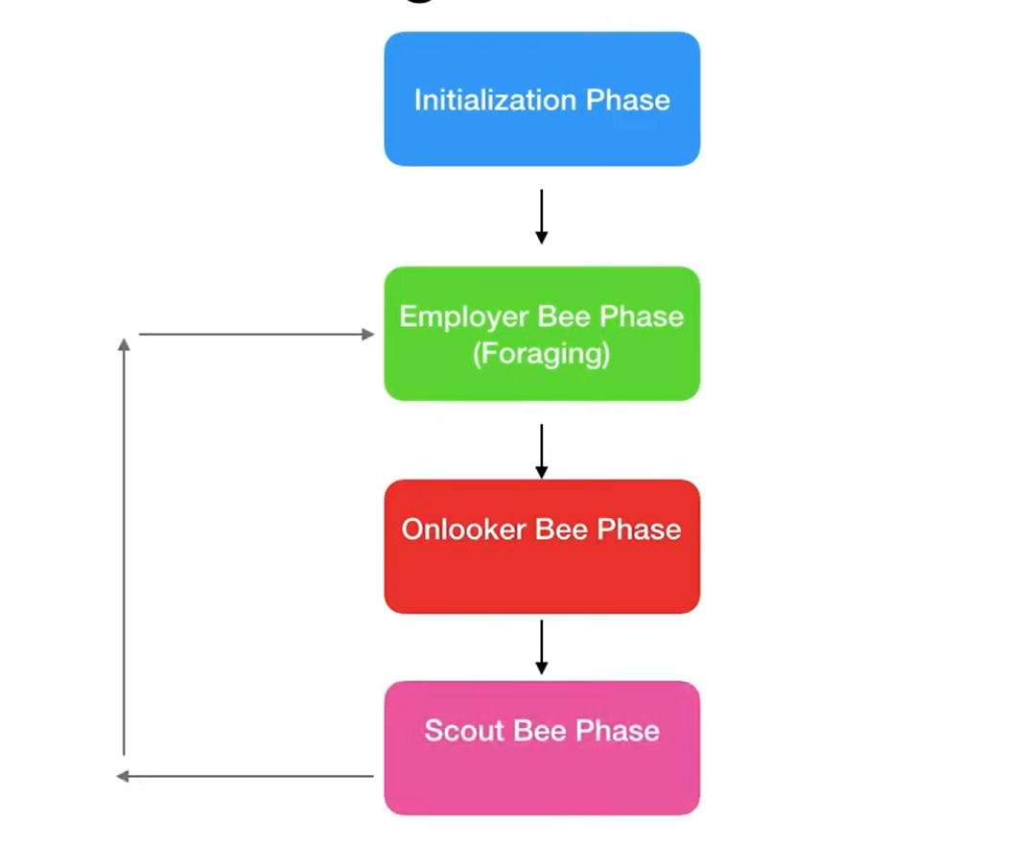
7. Implementation
1. Honey Bee + Simulated Annealing
Honey Bee:
The honey bee algorithm is a metaheuristic optimization algorithm inspired by the foraging behavior of honey bees. It works by simulating the behavior of bees in searching for food sources and communicating their discoveries to the rest of the hive. The algorithm has been applied to solve optimization problems in various fields, such as engineering, finance, and medicine.

Slide 11
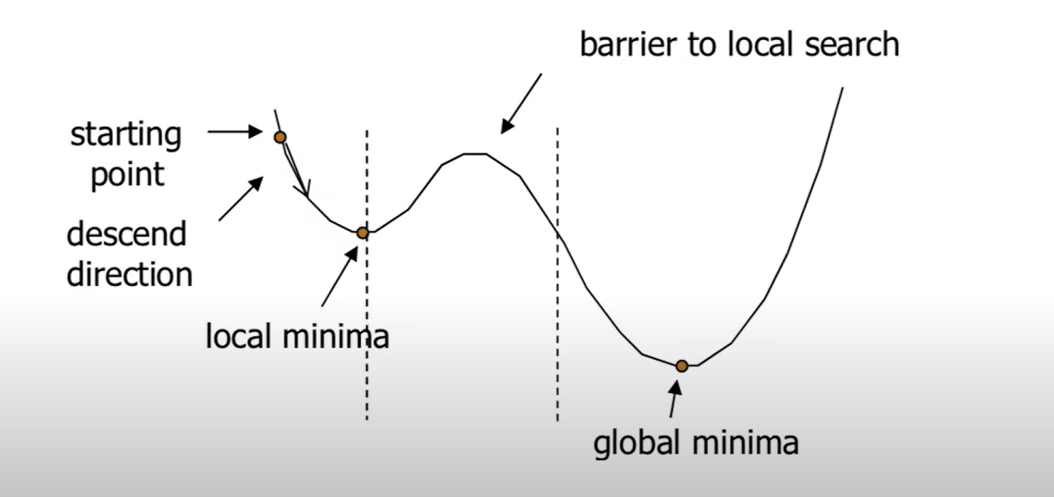
Simulated Annealing
Simulated Annealing is a metaheuristic algorithm used for optimization problems, especially in cases where finding the global optimum is challenging. The algorithm is inspired by the physical annealing process of heating and cooling metals to achieve a minimum energy state.
In the simulated annealing algorithm, a random initial solution is generated and iteratively modified in a probabilistic manner, allowing the algorithm to escape local optima. The algorithm gradually decreases the "temperature" parameter, which controls the amount of randomness in the solution, and thus, the probability of accepting worse solutions.

Slide 12
Code Implementation
honeyBee: This is the constructor function that initializes various parameters for the Honey Bee algorithm like the initial temperature, cooling rate, current temperature, and cutoff. It also initializes various maps like vmStatesList, vmAllocationCounts, and fitness.
getNextAvailableVm: This function is called when a cloudlet needs to be allocated to a VM. It returns the ID of the next available VM after allocating the current cloudlet to it. It also updates the currentTemperature and the vmAllocationCounts map.
cloudSimEventFired: This function is an implementation of the CloudSimEventListener interface. It is called when a cloudlet is allocated to a VM or a VM finishes processing a cloudlet. It updates the vmAllocationCounts and vmStatesList maps accordingly.
isSendScoutBees: This function is used to check if a scout bee needs to be sent out or not. It returns true if the VM allocated to the scout bee has processed more than cutoff cloudlets.
getScoutBee: This function returns the next VM that needs to be allocated a cloudlet. If there is no scout bee assigned, it assigns the first VM in the list. If the allocated scout bee has not processed more than cutoff cloudlets, it returns the scout bee. Otherwise, it sends out employed bees to explore other solutions and returns the best solution found by the onlooker bees.
MemorizeBestSource: This function returns the best solution found so far.
SendOnlookerBees: This function sends out onlooker bees to explore solutions and returns the best solution found.
SendEmployedBees: This function is used to send out employed bees to explore solutions.
calculation: This function is called by the employed bees to calculate the fitness of each solution. It calculates the fitness of each VM using the calculateFitness function and performs simulated annealing to explore other solutions.

Slide 13
calculateFitness: This function calculates the fitness of a VM based on the number of cloudlets processed by the VM.
getNeighborSolution: This function returns a neighboring solution based on the current solution using a random walk.
waggleDance: This function returns the best solution found by the bees by performing a waggle dance. It searches for the solution with the lowest fitness value.
SA Implementation
The calculation() function implements the employed bee phase of the artificial bee colony algorithm to calculate the fitness values of each virtual machine (VM). Then, it uses a simulated annealing (SA) algorithm to explore the search space by moving from one solution (i.e., VM) to another.
In the SA algorithm, the current solution is represented by the scoutBee variable, and the neighbor solution is represented by the getNeighborSolution() function. The fitness value of the current solution is represented by the currentSolutionFitness variable, and the fitness value of the neighbor solution is represented by the neighborSolutionFitness variable.
If the neighbor solution is better than the current solution (i.e., deltaE < 0), then the neighbor solution is accepted by setting the scoutBee variable to the neighbor solution. Otherwise, the neighbor solution is accepted with a certain probability calculated using the SA acceptance probability formula. If the neighbor solution is accepted, the scoutBee variable is set to the neighbor solution.

Slide 14
Advantages:
The advantages of using the SA algorithm in the above code are:
Optimization: The SA algorithm can be used to optimize the placement of cloudlets onto virtual machines (VMs) by finding the best solution that minimizes the fitness function. The fitness function used in the code calculates the task length of each cloudlet and the capacity of the VM, and then assigns a fitness value to each VM based on this calculation.
Efficiency: The SA algorithm can improve the efficiency of the load balancing process by ensuring that cloudlets are allocated to VMs in a way that minimizes the overall load on the datacenter. This is achieved by finding the best VM for each cloudlet based on the fitness function, and then allocating the cloudlet to that VM.
Flexibility: The SA algorithm is a flexible algorithm that can be used in a variety of different scenarios. It can be adapted to different fitness functions and different optimization problems, making it a versatile tool for load balancing and optimization.
Robustness: The SA algorithm is a robust algorithm that is not easily trapped in local optima. This means that it is able to explore a large search space and find global optima, even in complex optimization problems.

Slide 15
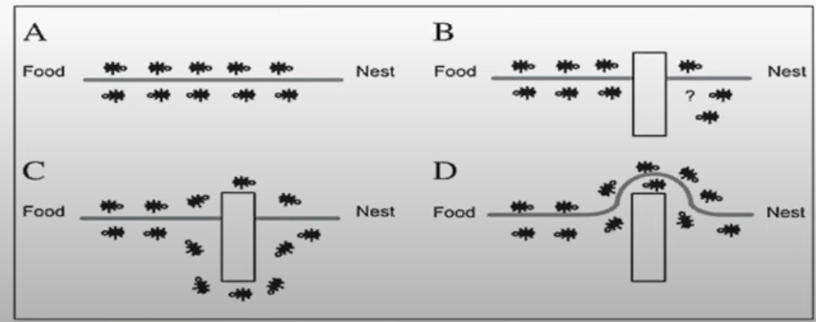
2. Ant Colony Optimization + Tabu Search
Ant Colony Optimization
Ant Colony Optimization (ACO) is a metaheuristic algorithm inspired by the behavior of ants in finding the shortest path between their colony and food sources. The algorithm is based on the idea of using a set of artificial ants that construct solutions by following a set of pheromone trails. The pheromone level of each trail is updated based on the quality of the constructed solutions. As the search progresses, the pheromone trails of better solutions are reinforced, leading to the emergence of better solutions over time. ACO has been successfully applied to various optimization problems, including the traveling salesman problem, vehicle routing problem, and job scheduling.

Slide 16
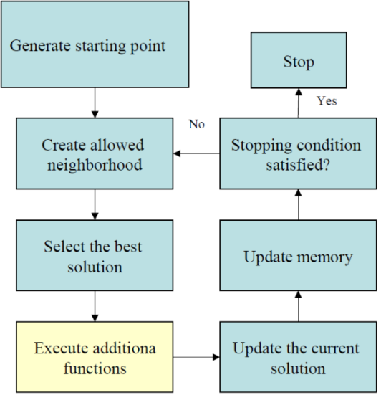
Tabu Search
Tabu search is a heuristic optimization algorithm that aims to find the optimal solution for a given problem by iteratively exploring the search space while avoiding previously visited solutions. It maintains a "tabu list" of recently visited solutions and restricts moves that would lead to these solutions. It also incorporates diversification strategies to escape local optima. The algorithm terminates when a stopping criterion is met, such as a maximum number of iterations or no improvement after a certain number of iterations.

Slide 17
Code Implementation
The AntColonyVmLoadBalancer class : is a subclass of the VmLoadBalancer class and implements the getNextAvailableVm method to allocate virtual machines (VMs) to physical hosts in a datacenter.
The algorithm starts by initializing: the pheromone matrix and creating a set of ants, which are used to explore the solution space. The ants move between VMs in the datacenter, updating the pheromone matrix as they go. The algorithm uses a tabu list to avoid assigning the same VM to a host multiple times in a row.
The Ant class represents an ant and contains methods for sending an ant to explore the solution space (SendAnt), fetching the final VM selected by the ant (FetchFinalVm), and processing the ant (ProcessAnt).
The computeProbability method: computes the probability of selecting a VM as the next destination for the ant, based on the pheromone levels and a score function that takes into account the current VM and the potential next VM.
The getNextVmNode: method selects the next VM for the ant based on the probabilities computed by the computeProbability method.
The UpdatePheromone: method updates the pheromone matrix based on the ant's movement between VMs.
The Evaporation method :is used to evaporate the pheromone levels, simulating the decay of pheromones over time.

Slide 18
Tabu Implementation
The tabu list is used in the getNextAvailableVm() method of the AntColonyVmLoadBalancer class. When this method is called, it first updates the tabu list by removing the oldest item if the list's size exceeds the tabu tenure limit. Then, it allows the ants to explore the solution space, during which the tabu list is passed to the ants. Once the ants have completed their exploration, the method finds the best available VM that is not in the tabu list and adds it to the list. Finally, the selected VM is allocated and returned.
Thus, the tabu list is used to prevent revisiting the same VMs repeatedly, which can help to explore different parts of the solution space and potentially find a better solution.
Advantages:
Prevents cycling: The tabu list prevents the algorithm from getting stuck in a cycle of repeating the same moves.
Promotes diversification: By forbidding previously explored solutions, the tabu list encourages the algorithm to explore different regions of the search space. This promotes diversification, which can lead to finding more optimal solutions
More robust: The Tabu Search Ant Colony Optimization algorithm is more robust to changes in the problem landscape and can adapt to different problem types more easily.

Slide 19
3. Ant Colony Optimization + Simulation Annealing
Code Implementation
getNextAvailableVm(): This method first initializes the pheromone matrix, the ants, and the counter if the counter is equal to 0. Then, it creates a new Ant object to find the next VM using the current pheromone matrix. After that, it runs the SendAnt() method for each ant to build the solutions. Then, it runs the saAlgorithm() method to optimize the solution found by the ants using the simulated annealing algorithm. Finally, it allocates the new VM to the next available VM using the allocatedVm() method and returns the ID of the new VM.
saAlgorithm(int currentVmId): This method optimizes the solution using the simulated annealing algorithm. The method initializes the nextVmId variable to currentVmId, sets the temperature and cooling rate, and initializes a random number generator. The while loop iterates until the temperature is less than 1e-8. In each iteration, it generates a random neighbor using the getNextVmNode() method, calculates the energy difference between the current and neighbor solutions using the scoreFunction() method, and decides whether to move to the neighbor solution or not based on the temperature and the energy difference. After each iteration, it decreases the temperature. Finally, it returns the ID of the selected neighbor.
Evaporation(): This method evaporates the pheromone trail by dividing each element in the pheromone matrix by the EVAPORATION_FACTOR.

Slide 20
Ant(double[][] ph): This method initializes an Ant object with a given pheromone matrix and sets the fakeVmId to the last index of the pheromone matrix.
SendAnt(): This method sends an ant to explore the pheromone trail and build a solution. It calls the ProcessAnt(true) method, which updates the pheromone trail.
FetchFinalVm(): This method returns the last VM visited by the ant without updating the pheromone trail. It calls the ProcessAnt(false) method.
ProcessAnt(boolean updatePheromones): This method sends an ant to explore the pheromone trail and build a solution. It starts with the fakeVmId and uses the getNextVmNode() method to find the next VM until it reaches the fakeVmId again. It updates the pheromone trail if updatePheromones is true. Finally, it returns the last VM visited by the ant.
getNextVmNode(int vmId): This method returns the next VM to visit using the pheromone matrix and the probability distribution. It first computes the probability distribution using the computeProbability() method, generates a random number between 0 and 0.5, and uses the probability distribution to select the next VM. If all the VMs have been visited, the next available VM is selected based on the VM with the highest pheromone level. This is done to ensure that all the VMs are visited at least once and the algorithm doesn't get stuck in a loop.

Slide 21
Advantage:
Escape Local Optima: SA can help the algorithm avoid getting stuck in a local optimum by allowing it to sometimes move to a worse solution with a certain probability. This way, the algorithm can explore the search space more thoroughly and potentially find a better solution.
Tolerance for Noise: SA is tolerant to noise in the fitness landscape. This means that the algorithm can still perform well even if the fitness values for different solutions are not exact or have some degree of randomness.
Convergence to Global Optimum: SA guarantee of converging to the global optimum if the temperature is cooled down sufficiently slowly. This means that if the algorithm is run for a sufficiently long time, it will eventually find the best solution.
Flexibility: SA can be easily adapted to different optimization problems by changing the cooling schedule, the score function, and the way neighbor solutions are generated. This makes it a versatile algorithm that can be used in a variety of scenarios.

Slide 22
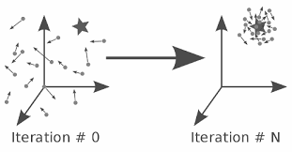
4. Honey Bee + Particle Swarm Optimization
Particle Swarm Optimization
Particle Swarm Optimization (PSO) is a computational intelligence technique inspired by the social behavior of birds flocking or fish schooling, in which individuals cooperate to find the best solution for a given problem. The PSO algorithm involves a set of particles or agents moving in a multidimensional search space, each particle represents a potential solution to the optimization problem. The particles are moved through the search space, and their positions are updated based on their own experience and the experience of their neighboring particles. Each particle maintains a memory of its best-known position and the best-known position in the swarm.
The PSO algorithm is commonly used to solve optimization problems such as function optimization, feature selection, image segmentation, and many others. It has been shown to be effective in finding near-optimal solutions in a variety of real-world applications, and it is particularly well-suited for problems where the search space is complex and difficult to explore with traditional optimization techniques.

Slide 23
Code Implementation
honeyBee(): This is the constructor of the honeyBee class. It takes a DatacenterController object (dcb) as input and initializes several instance variables, including the vmStatesList, vmAllocationCounts, and fitness maps. It also adds the honeyBee object as a listener for cloudlet-related events fired by the data center.
getNextAvailableVm(): This method overrides the getNextAvailableVm() method of the VmLoadBalancer abstract class. It selects a VM to allocate the next cloudlet to using the getScoutBee() method, which uses the PSO algorithm. It then updates the state of the selected VM in the vmStatesList map and returns the ID of the selected VM.
cloudSimEventFired() :This method implements the CloudSimEventListener interface and handles two types of events: EVENT_CLOUDLET_ALLOCATED_TO_VM and EVENT_VM_FINISHED_CLOUDLET. When a cloudlet is allocated to a VM, the method updates the vmAllocationCounts map to keep track of how many cloudlets are assigned to each VM. If the number of assigned cloudlets for a VM exceeds the cutoff value, the method updates the state of the VM in the vmStatesList map to busy. When a cloudlet finishes executing on a VM, the method updates the vmAllocationCounts and vmStatesList maps accordingly.
isSendScoutBees(int scoutBee): This method checks whether the selected scoutBee VM (identified by its ID) should be replaced by a new one in the PSO algorithm. If the number of cloudlets assigned to the scoutBee VM is less than the cutoff value, it returns false (meaning that the scoutBee should not be replaced). Otherwise, it returns true (meaning that the scoutBee should be replaced).

Slide 24
pso(): This method implements the PSO algorithm to select the best VM to allocate a new cloudlet to. It first initializes a swarm of particles, each representing a candidate solution (i.e., a VM to allocate the cloudlet to). It then evaluates the fitness of each particle (i.e., the quality of the solution), updates the best positions found so far by each particle, and updates the global best position found so far. Finally, it updates the positions and velocities of each particle based on the best positions found so far and continues the loop until a maximum number of iterations is reached. The method returns the best position found, which corresponds to the ID of the best VM to allocate the cloudlet to.
Particle class: This is a nested class that represents a particle in the PSO algorithm. Each particle maintains its current position and velocity in the search space, as well as the best position and fitness value found so far. The Particle class has two constructors, one for initializing a new particle with a random position and velocity, and one for initializing a particle with a given position and fitness value.
getScoutBee(): This method returns the ID of the VM (Virtual Machine) that will be used as the food source for honeybees. The method first checks if the scoutBee variable is -1. If yes, it means that the food source needs to be determined using the Particle Swarm Optimization (PSO) algorithm. If scoutBee is not -1, it checks if the current food source (VM) can be used. If yes, it returns the scoutBee VM. Otherwise, it invokes the SendEmployedBees() method to update the food source using the employed bees' information and returns the VM selected by SendOnlookerBees() method.
SendEmployedBees(): This method is used to update the food source using the information gathered by the employed bees. It loops through all the VMs and updates their fitness value by invoking the calculateFitness() method. If the fitness value of a VM is higher than the current food source, it replaces the food source with the VM.
SendOnlookerBees(): This method is used to select a new food source using the information gathered by the onlooker bees. It first calculates the total fitness value of all the VMs by looping through them and invoking the calculateFitness() method.

Slide 25
Then, it loops through all the VMs and selects a VM with a probability proportional to its fitness value. It returns the selected VM as the new food source.
calculateFitness(): This method calculates the fitness value of a VM based on the number of cloudlets allocated to it. The higher the number of cloudlets allocated to a VM, the lower its fitness value. The formula used to calculate the fitness value is: fitness = 1 / (1 + countCloudlets). The method takes the number of cloudlets allocated to a VM as input and returns the calculated fitness value.
Advantage:
PSO provides a solution by exploring the solution space with a swarm of particles moving towards the global best solution. This helps in achieving a good balance between exploration and exploitation of the solution space.
PSO does not require gradient information to optimize the problem. It can handle nonlinear and non-differentiable problems, which makes it suitable for solving complex optimization problems.
PSO has the ability to escape local optima due to the random movement of particles. This means that it can find the global optimal solution, not just the local optimal solution.
PSO is parallelizable, which makes it suitable for distributed computing environments. The algorithm can be easily scaled up to handle large-scale optimization problems.

Slide 26
5. Honey Bee + Tabu
Code Implementation:
import: The required packages are imported. These packages are necessary for the functioning of the program.
honeyBee: This is the constructor of the honeyBee class. It initializes the instance variables cutoff, scoutBee, vmStatesList, vmAllocationCounts, fitness, tabuList, and tabuTenure to their default values. It also sets the vmStatesList to the list of virtual machine states obtained from the DatacenterController object and registers the honeyBee object as a listener for CloudSim events.
getNextAvailableVm: This method is used to get the next available virtual machine (VM) for processing a cloudlet. It first calls the getScoutBee method to get a VM that is not on the tabu list. If the VM obtained is already on the tabu list, it calls the SendEmployedBees method to find a better VM. Finally, the method calls the allocatedVm method to mark the VM as allocated and returns the VM ID.
cloudSimEventFired: This method is called whenever a CloudSim event is fired. It checks whether the event is EVENT_CLOUDLET_ALLOCATED_TO_VM or EVENT_VM_FINISHED_CLOUDLET and updates the vmAllocationCounts and vmStatesList accordingly.
isSendScoutBees: This method is used to check whether a scout bee should be sent or not. It checks whether the vmAllocationCounts of the given VM is less than cutoff.

Slide 27
getScoutBee: This method is used to get the next VM to be used by a scout bee. If scoutBee is -1, it returns 0 if the vmStatesList is not empty, else it returns -1. If scoutBee is not -1, it checks whether the VM is on the tabu list. If not, it checks whether the VM should be sent as a scout bee or not. If the VM should be sent as a scout bee, it calls SendEmployedBees method to find a better VM.
MemorizeBestSource: This method calls the waggleDance method to get the best VM available.
SendOnlookerBees: This method returns the result of calling the MemorizeBestSource method.
calculation: This method is used to calculate the fitness value for each VM. It first clears the fitness map and then calculates the fitness value for each VM by calling the calculateFitness method.
calculateFitness: This method calculates the fitness value of a VM using the formula solValue = 1/(1000-solValue).
SendEmployedBees: This method is used to find the best VM using employed bees. It first calculates the fitness value of each VM by calling the calculation method. Then, it finds the VM with the best fitness value that is not on the tabu list. If a VM is found, it adds it to the tabu list and removes the oldest VM from the list if the list size exceeds tabuTenure.
waggleDance: This method is used to find the best VM using the waggle dance method. It finds the VM with the lowest fitness value and returns its ID.

Slide 28
Advantages:
Diversification: Tabu search prevents the algorithm from getting stuck in local optima by keeping track of previously visited solutions and preventing revisits. This promotes diversification and exploration of the search space.
Intensification: The algorithm maintains a list of recently explored solutions, called the tabu list, and avoids revisiting them. This encourages the search to focus on promising solutions that have not yet been explored.
Flexibility: Tabu search allows for flexible and customizable implementation by incorporating different types of memory structures, such as the tabu list and the fitness values, which can be adjusted to suit the specific problem being solved.
Efficiency: Tabu search is known to be an efficient and effective algorithm for solving combinatorial optimization problems, such as load balancing in cloud computing. The honeyBee algorithm can benefit from the efficiency of tabu search by finding optimal solutions in a shorter amount of time compared to other optimization algorithms.

Slide 29
6. Ant Colony + Cumulative Distribution Function
Code Implementation
The AntColonyVmLoadBalancer class extends the VmLoadBalancer class and overrides its getNextAvailableVm() method. It initializes a pheromones matrix, which stores the pheromone value between each pair of VMs. The algorithm uses Ant objects that traverse this matrix, updating the pheromone value along their path.
The main algorithm steps in getNextAvailableVm() method are:
Create Ant objects and send them to traverse the pheromones matrix.
Evaporate the pheromone from the pheromones matrix using the evaporatePheromones() method.
Calculate the final score of each VM using the Ant objects and select the next available VM with the highest score.
Allocate the selected VM and return its ID.
The Ant class represents an ant that traverses the pheromones matrix. It has a fakeVmId attribute, which is an integer value greater than the maximum VM ID. The ant starts from this node and moves to the next node based on the pheromone value and the score calculated using the scoreFunction() method. The ant updates the pheromone values using the UpdatePheromone() method as it moves along its path.
The computeProbability() method calculates the probability of selecting each VM as the next node to visit. It uses the scoreFunction() method to calculate the score of each VM and the CDF of these scores to calculate the probability distribution. The getNextVmNode() method selects the next VM node using the probability distribution.

Slide 30
Advantage
Better decision-making: The CDF provides a continuous probability distribution function that allows the algorithm to make a better decision when selecting the next VM for allocation. It calculates the probability of each VM's selection based on the fitness score function.
Efficient computation: The CDF uses the score function to calculate the probabilities of selecting each VM, which is computationally efficient as it avoids the need for a Monte Carlo simulation or other expensive techniques.
Improved convergence: The algorithm can converge to a better solution by using the CDF since it can capture the non-linearity of the search space more accurately. The CDF helps the algorithm to exploit good solutions and explore new ones more efficiently.
By using the cumulative distribution function to calculate the probabilities, the algorithm becomes more efficient and more accurate in selecting the next virtual machine. The use of the cumulative distribution function reduces the number of iterations required to select the next virtual machine, which leads to faster load balancing.

Slide 31
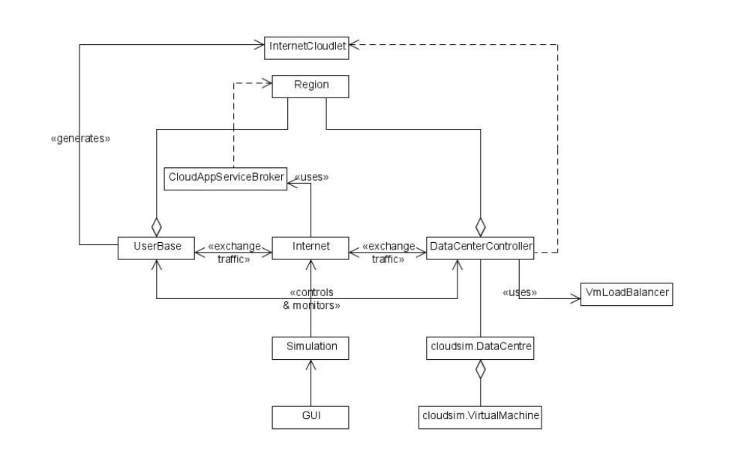
8. Flowchart

Slide 32
10. Application of the Project
Can be used in websites to manage the traffic spikes and prevent spikes on a single server.
Helps to minimize the user request response time of any application
Ensures performance and reliability of computing resources, both physical and virtual in various applications and websites.
For study purpose as how to improve basic algorithm to get better results.

Slide 33
11. SWOT Analysis Strength: The utmost strength of our project is that it is a real-time load balancing system which could help us to find the better load balancing algorithm for user defined configurations. It helps to compare load balancing algorithms on various parameters like data center response time, Data center process time, request servicing time. It could even tell us the cost of VM, memory, data transfer, and storage usage. Hence, we could predict which algorithm will help in better load balancing. Weakness: The weakness of our project is that we need to run the program again for the new configuration once run the simulation. Also, the log report can not be saved. For the project need JDK 8 along with cloud-sim 2.1. Opportunities: It can have wide range of valid possibility that this project can evolve into some bigger testing environment so to use the appropriate load balancing algorithm so that maximum utilization of resources can be done. This project can also be used for educational purposes, so that students can compare various algorithms and observes their behavior in different circumstances. Threats: There is no threat for our project since it is an offline real-time analysis tool. It gives output according to the configuration setup by the user. But if someone alter the cloud-sim library they results may change and we could not get the efficient load balancing algorithm

Slide 34
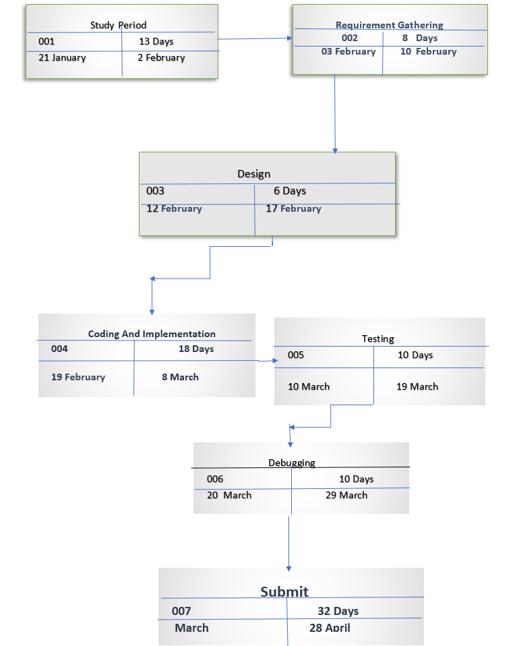
12. PERT Chart
Fig.6 Program Evaluation Review Technique Chart

Slide 35
13. Objectives Covered
Objectives | Status
Make improved meta heuristic load balancing algorithm by combining it with other Meta heuristic Algorithm. | done
To give user the best algorithm for the customized configuration. | Done
To optimize the cost of resources usage. | done
Developing meta heuristic load balancing algorithm for better workload distribution among VMs of data centers by improving Basic Meta Heuristic Algorithm | done

Slide 36
14. References
[1] Ajay Jangra, Neeraj Mangla, “An efficient load balancing framework for deploying resource schedulingin cloud based communication in healthcare, Measurement: Sensors”, Volume 25, 2023, 100584, ISSN 2665-9174 https://doi.org/10.1016/j.measen.2022.100584 https://www.sciencedirect.com/science/article/pii/S2665917422002185 [2] Afzal, S., Kavitha, G. Load balancing in cloud computing – A hierarchical taxonomical classification. J Cloud Comp 8, 22 (2019). https://doi.org/10.1186/s13677-019-0146-7 [3] Sara Tabaghchi Milan, Lila Rajabion, Hamideh Ranjbar, Nima Jafari Navimipour,“Nature inspired meta-heuristic algorithms for solving the load-balancing problem in cloud environments”, Computers & Operations Research, Volume 110, 2019, Pages 159-187, ISSN 0305-0548 https://doi.org/10.1016/j.cor.2019.05.022 https://www.sciencedirect.com/science/article/pii/S0305054819301352 [4] Suman Sansanwal, Nitin Jain, “An Improved Approach for Load Balancing among Virtual Machines in Cloud Environment”, Procedia Computer Science, Volume 215,2022, Pages 556-566, ISSN 1877-0509 https://doi.org/10.1016/j.procs.2022.12.058 https://www.sciencedirect.com/science/article/pii/S1877050922021299 [5] Agrawal, Priyanka & Gupta, Subhash & Choudhury, Tanupriya. (2021). Load Balancing Issues in Cloud Computing. 10.1007/978-981-16-4149-7_10. [6] Nuaimi, Klaithem & Mohamed, Nader & Nuaimi, M. & Al-Jaroodi, Jameela. (2012). A survey of load balancing in cloud computing: Challenges and algorithms. Network Cloud Computing and Applications (NCCA), 2012 Second Symposium on. 137-142. [7] Sidhu, Amandeep & Kinger, Supriya. (2005). Analysis of Load Balancing Techniques in Cloud Computing. INTERNATIONAL JOURNAL OF COMPUTERS & TECHNOLOGY. 4. 737-741. 10.24297/ijct.v4i2C2.4194. [8] Nuaimi, Klaithem & Mohamed, Nader & Nuaimi, M. & Al-Jaroodi, Jameela. (2012). A survey of load balancing in cloud computing: Challenges and algorithms. Network Cloud Computing and Applications (NCCA), 2012 Second Symposium on. 137-142. [9] Ren, Haozheng & Lan, Yihua & Yin, Chao. (2012). The load balancing algorithm in cloud computing environment. 925-928. 10.1109/ICCSNT.2012.6526078.

Slide 37
Thank You

