Slide 1

MICROSOFT MOVIE ANALYSIS
Breaking into the movie industry

Slide 2
SUMMARY
We analysed movie genre, profitability, budget and ratings to assess the types of movies which could bring greatest success to Microsoft.
From the analysis we found that drama movies were most commonly produced, followed by comedy and action,
releasing movies during mid-year and November yield highest profits and higher budgets drive ratings.

Slide 3
OUTLINE
01
04
02
05
03
Business Problem
Results
Objective and approach
Interpretation of results from visualisations.
Data
Conclusion
Data adopted in analysis
Recommendations
Methods
Preparation, analysis and modeling data

Slide 4

BUSINESS PROBLEM
Breaking into the movie industry.
What movies to produce?
Attributes to consider:
Movie Genre
Profitability
Budget vs. Ratings

Slide 5
DATA
IMBD
The Numbers
User generated report of movie titles, basic attributes and ratings.
Movie financial analysis and release dates.

Slide 6
METHOD
Data sets merged, cleaned and isolated main attributes. Using descriptive statistics and visualisations to highlight trends and correlations in the data to allow us to determine most successful movies.

Slide 7

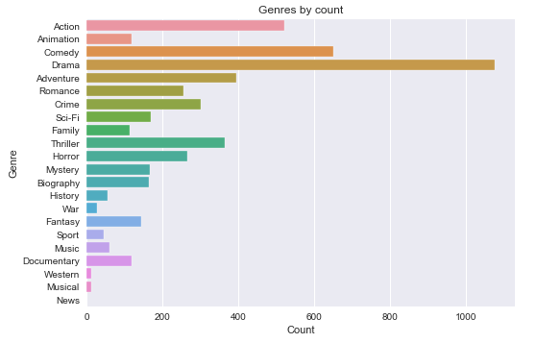
RESULTS (GENRE)
Drama, Comedy and Action

Slide 8
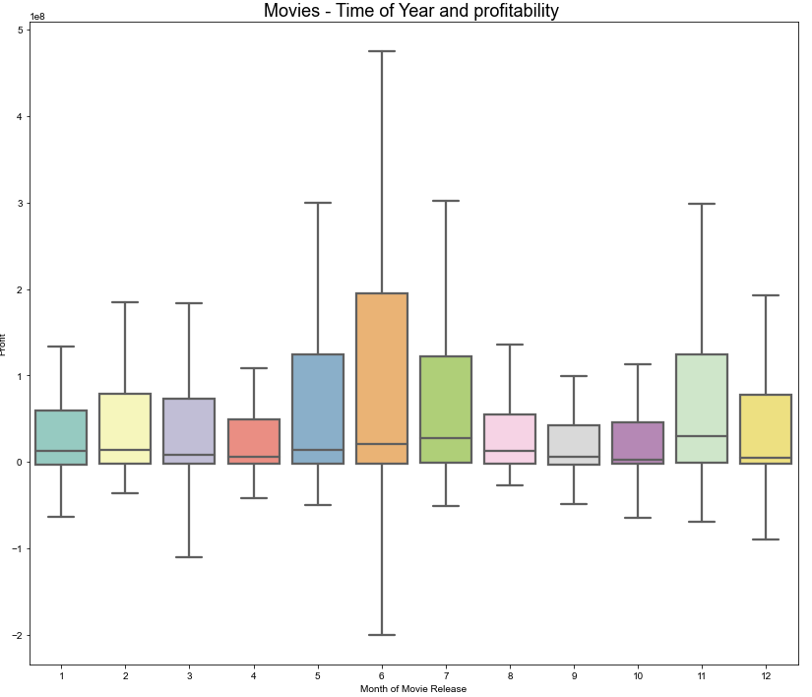
RESULTS (PROFIT)
Movies released in June are exceptionally profitable, followed by May, July and November.

Slide 9
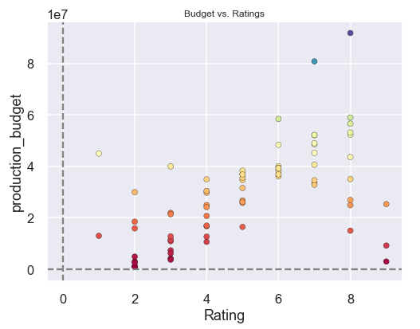
RESULTS (RATINGS)
Budget vs Ratings indicate a relatively strong relationship. Movie budget can increase it’s average rating score.

Slide 10

CONCLUSIONS
Recommendation 1: Produce drama, comedy and/or action movies.
Recommendation 2: Release movies between May and July and November.
Recommendation 3: Increase movie budgets for better ratings.

Slide 11
Next steps
There could be other variables that Microsoft may be interested in understanding to better establish the types of movies to produce. For instance, assessing localized data, or determining which types of studio and production teams are likely to produce greater success than others. Further analysis could yield additional insights to better understand what drove these results.

Slide 12
THANK YOU
annieliu@yahoo.com
https://github.com/annieliug/Microsoft-Movie-Analysis.git
linkedin.com/in/annieliu-lumi/

