Slide 1
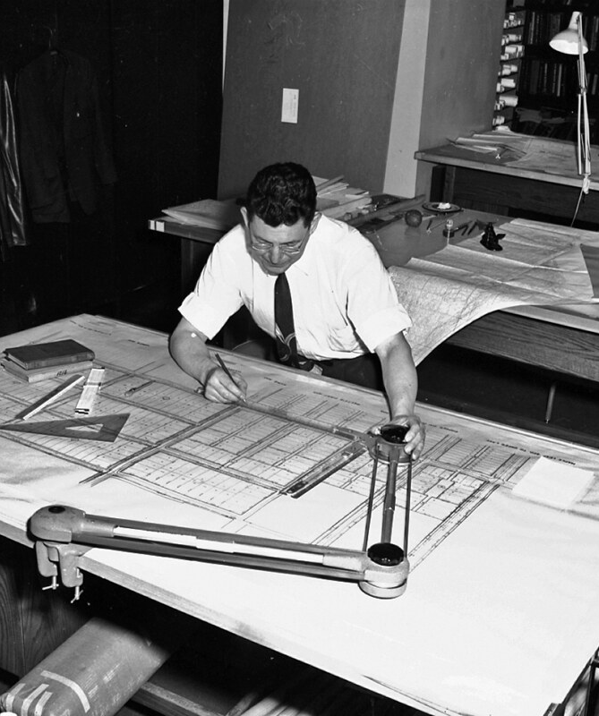
Engineer Your Learning
Designing a learning system to keep pace with your major
Learning Strategies
This Photo by Unknown Author is licensed under CC BY
Notes:
Introduction
Today is a continuation of the discussion from last session, not necessarily a separate “study skills” lecture
Students need to become intentional about “how they learn,” not simply how much work they complete
Todays goal is to build a learning system that can keep pace with the demands of your major with a focus on three areas
Plan –make enough time for learning
Practice – study in ways that actually test understanding
Connect – collaborate with faculty, peers, tutoring and other resources effectively

Slide 2
Reviewing depth of learning
3 styles
  Surface
  Strategic
  Deep
Identify what you know
What you don’t know
What Assumptions you are making
What additional information you need
What do I do next?
Notes:
3 styles of learning – what do you remember from last time
Learning isn’t about never getting stuck – it’s becoming better at recognizing when you are stuck and being able to choose an effective next action
Which of these question is easiest to answer? Which is hardest?
Metacognition isn’t just recognizing that you don’t understand something. It’s deciding what to do with that information.
Part of making that decision depends on knowing what level/depth of thinking/learning your course is requiring of you

Slide 3
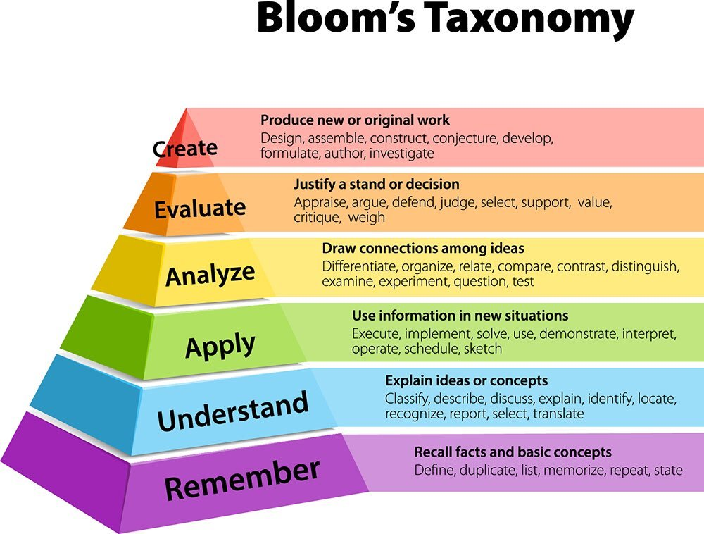
What level are you being asked to work
Most engineering courses will require you to apply, analyze and create
Your study methods need to practice at the appropriate level
Mismatch: Class/exam require application and analysis, but
Study was mostly rereading and recognition
What are some examples of effective study practices?

Slide 4
Recognition vs Knowing
Let’s discuss the benefits of these different approaches to a study session
Read over the problem examples from lecture and in your text until they make sense
Find a YouTube video of someone solving similar problems to give you a different perspective
Work through a new problem you have not tried before and explain each step as you work through it
What is each approach useful for?
Which approach gives the best evidence that you actually understand the material?
Performance without the answer in front of you gives you a better benchmark of your understanding
Notes:
Rereading examples can help orient you to a process and preview material
Watching another explanation can sometimes help clarify confusing ideas
Neither of these is inherently bad – the problem is when these become the endpoint of studying
Watching someone else solve a problem can produce a feeling of familiarity, “Yeah, that makes sense!”
But the real test is”
Can you begin without the solution?
Can you select the right approach?
Can you explain why it works
Can you adapt when something changes?
Lower levels of learning are ok! / How you've studied before or NOT
SARAH

Slide 5
What deep practice looks like
Time, focus, spaced repetition, consistency
Produce
  Start from a blank page. Work and solve from what you know
Explain
  Why this step, formula or approach makes sense (or doesn’t)
Vary
  Can I do it when the problem looks different or variables change
Check
  Where did I get stuck or make a mistake? What do I need to do next?
Notes:
About 10 min mark
Deep learning usually isn’t created by one special study technique
It comes from repeated, focused interaction with the material overtime – spaced repetition
Time – Focus – Spaced practice – consistency
Produce
Try the problem before looking at the example or solution
Retrieve what you know rather than immediately searching for it
Explain
Ask why each step makes sense
Explain your reasoning aloud, in writing, or to another person
Being able to calculate an answer is useful; being able to explain the process is stronger evidence of your understanding
Vary
Don’t only practice identical examples
Can you recognize which approach applies when the problem looks different
What happens when information, conditions or variables change
Check
Errors are useful information
Where did the reasoning break down
Was the problem conceptual, procedural, mathematical, or simply a misunderstanding of the question
Decide what to do next
Deep practice isn’t about making studying unnecessarily difficult. It is about giving yourself accurate feedback about your learning.

Slide 6
What Learning Strategies Does
1:1 Peer Tutoring
Embedded Tutoring
Clarify course concepts
Practice applying material
Prepare for exams and assignments
Develop course-specific study strategies
Identify question to ask your professors
Available in select courses
  CHEM 101
  CPSC 121
  ENSC 205
  MATH 157
  PHYS 121
Group sessions are generally open to all students not just those in the embedded course
Tutors work closely with faculty to coordinate content and study support
Specific exam prep sessions
Notes:
When your feedback tells you that you need help, These are part of the academic infrastructure of college.
Make this part of your process, tutors are a good sounding board to check your thought process or techniques.
Come early before there are big problems
Tutors can’t compensate for a lack of personal study plan or time
SARAH -

Slide 7
Mapping Out This Week
Step 1 – Fixed
  Class | Labs | Sleep | Meals | Work | Activities
Step 2 – Academic work
  Prepare | Solve | Complete | Review
Step 3 – Flexibility
  Where is your buffer when something takes longer?
Benchmark 2 hours outside of class for each hour of class
Using your preferred calendar or get one started
Notes:
About 16min mark
When is work for math actually happening?
If there is an exam Friday, when does preparation begin
When in this schedule can you work with a tutor/study group/ go to office hours
Don’t wait to “find time” to study.
A calendar tells us when study happens, but what does an actual successful study session look like?
Step 1 – Fixed
Class
Labs
Meals
Sleep
Work
Clubs/activities
Other fixed commitments
Step 2 – Academic work
When are you preparing for class?
When are you solving problems?
When are assignments happening?
When does exam preparation begin
Making time to answer these questions, look ahead and create a comprehensive plan
Step 3 – Flexibility
Where is there buffer in your schedule if an assignment takes twice as long as expected, something new comes up, you get sick…
Benchmark 2 hours outside of class for each hour of class
15-18 credits
30-36 outside hours
45-54 academic hours per week

Slide 8
What studying actually looks like
What did study actually look like when you were successful?
When did you start studying?
Did you study alone or with others?
How much problem solving did you do?
How did you know when you didn’t understand something?
When did you go to office hours?
After you got your first exam, did you change anything?

Slide 9
Studying longer isn’t always the answer
You've worked on a problem for 25 minutes. Once you see the solution, the calculations make sense, but you are having trouble deciding where to start.
What is one productive next step?
Notes:
30-35 depending on student co-presnter
Focused study session: persistence matters, but not if you are repeating ineffective strategies

Slide 10
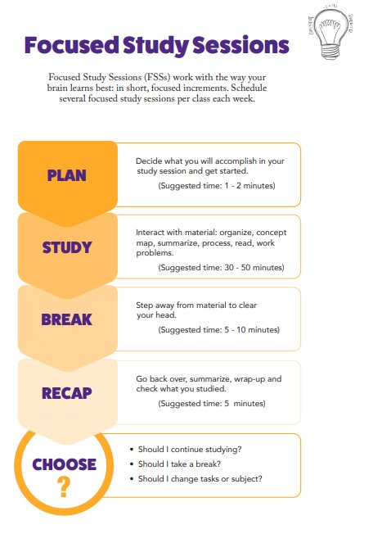

Slide 11
The goal of getting help is not to get unstuck on this problem. The goal is to become more capable on the next problem.
Notes:
Seeking help and working in a collaborative learning environment is the intentional structure of learning at GU.
There is a difference between seeking an answer and seeking understanding.
SARAH

Slide 12
Effective office hours
Student: “I don't understand any of this.”
versus:
Student: “I can follow the example until this step. I thought we should use ___ here, but the solution uses ___. Can you help me understand what tells me which approach applies?”
What is one question you currently have in a class?
How could you turn that question into a good question for office hours?
Notes:
Have students construct a question they want to ask a professor or tutor following an effective format based in “What I know, here is my reasoning, what I don’t know”
The same principles apply to test prep. You want your practice to expose your thinking before the exam does.

Slide 13
Exam Prep
Don’t let the exam be the first time you attempt something: without notes, under time pressure, from a blank page, with mixed problem types.

Slide 14
Exam prep
Study Like You Will Be Tested
During the Exam
Solve unfamiliar problems without notes.
Practice starting from a blank page.
Show your reasoning.
Mix problem types.
Practice under realistic time constraints.
Identify mistakes—not just correct answers.
Know what resources will/won't be available.
Preview the exam.
Start where you can demonstrate knowledge.
Don't get trapped on one problem, move on and come back.
Read the entire question.
Mark important constraints/units/information.
Show your work.
If stuck, write what you do know and identify what the problem is asking.
Notes:
An exam should not be a completely different activity from study. An effective study plan should be building in a way that supports test prep.

Slide 15
Putting your system into action
Plan
  One block of time I need to reserve for academic work each week is…
Practice
  One thing I will do to test my understanding instead of just reviewing is…
Connect
  One resource/person I will connect with before I am behind is…
Notes:
You don’t need to change everything about the way you study this week. Pick a few specific behaviors you can actually test.
I would like you to leave with 3 points in mind

Slide 16

Connect with a tutor
www.MyWCO.com/GUStudy

