Slide 1
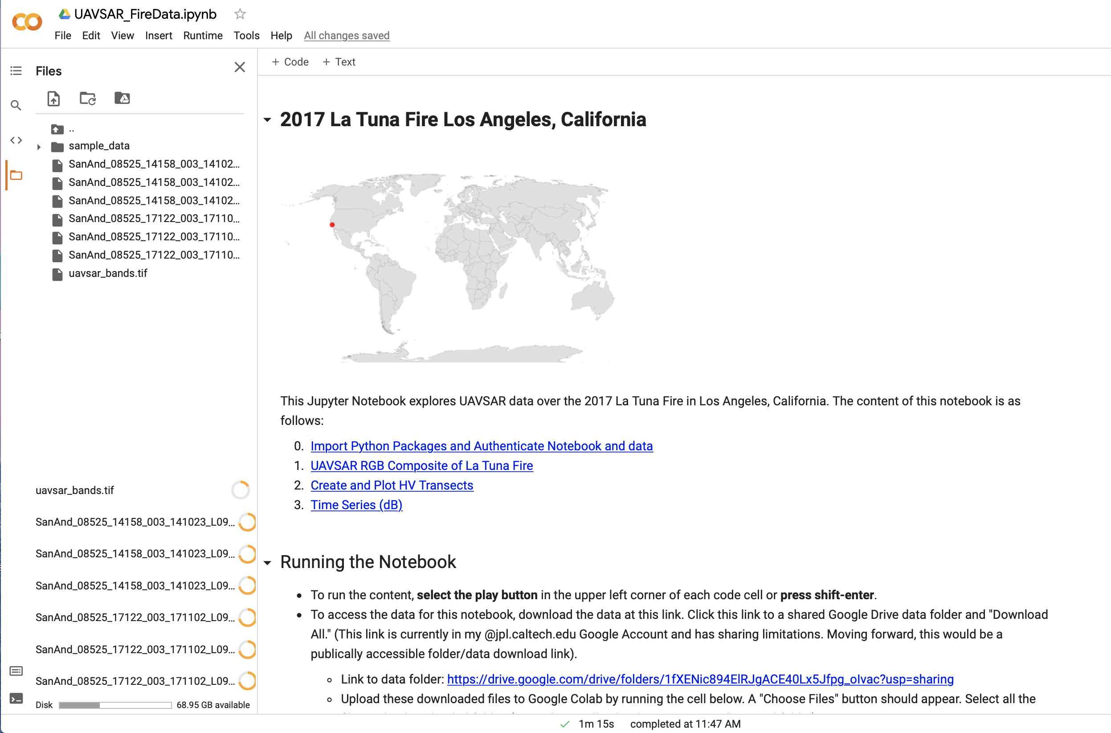
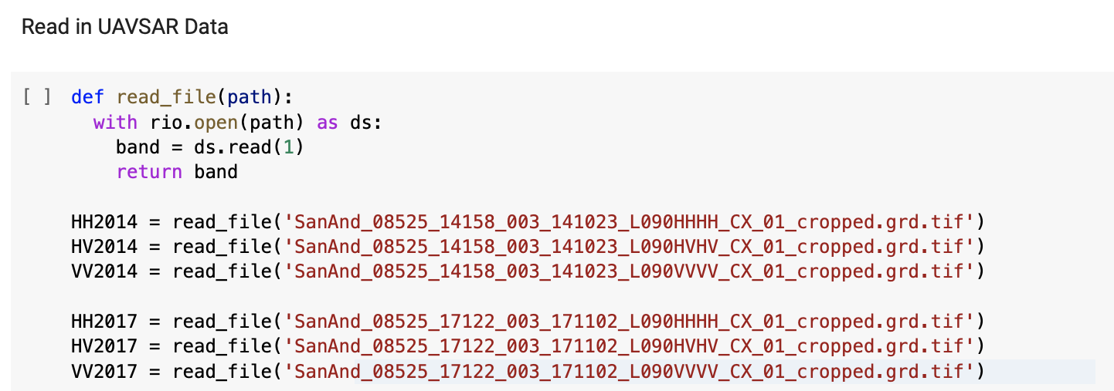
2) Click button to upload files
1) Click folder icon to expand the side panel
4) Read in with filename directly (no path needed)
3) Files uploading here

