Slide 1

PREDICTING PORTUGESE SECONDARY SCHOOL STUDENT PERFORMANCE
https://github.com/annieptba/data1030_project.git
ANNIE PHAN (Banner ID: B01309278)

Slide 2
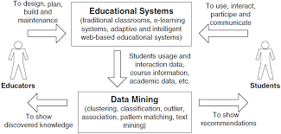
CONTENT OVERVIEW
1. Introduction
2. EDA 3. Methods
4. Results
5. Outlook

Slide 3
1. Introduction
Problem:
Regression: predict students’ final scores (continuous, integer values from 0 to 20) using first and second period grades and other social, economic, and education factors
Classification: classify students’ final performance (categorical values ‘good’, ‘fair’, ‘poor’) using first and second period grades and other social, economic, and education factors
Data overview and source
Implications:
Original research:
What type of courses can be offered to attract more students? Is it possible to predict student performance?
What are the factors that affect student achievement?
My model explorse these similar questions but look further into demographic factors such as family support, romantic relationships, alcohol consumption, and internet access.
Project: “Using Data Mining To Predict Secondary School Student Performance” by Cortez and Silva in 2008
Method: binary classification (pass/fail), classification with 5 levels ( I very good → V insufficient), regression, with a numeric output that ranges between (0%) and (100%)
Result: students’ final grades can be predicted by the first and/or second school period grades and also other relevant features
https://archive.ics.uci.edu/ml/datasets/student+performance
1,044 instances (students) including 395 Mathematics class students and 649 Portuguese language class students
33 features

Slide 4
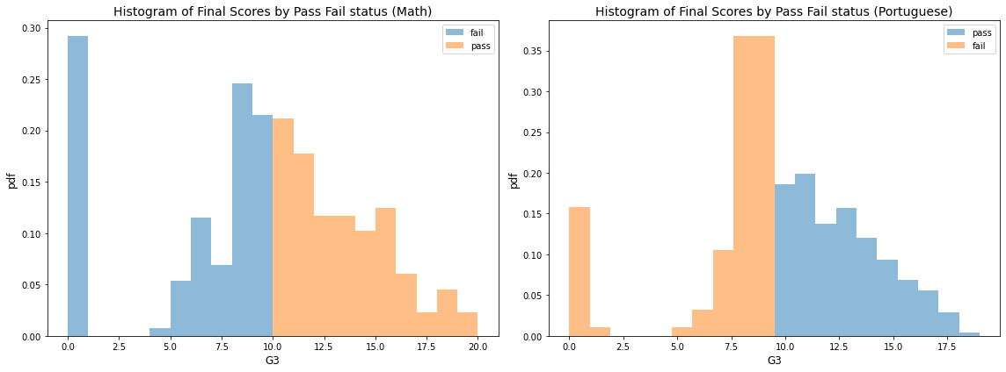
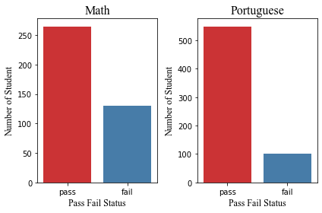
2. EDA – final grades and pass fail overview
More students have a higher Portuguese score than Math scores. This poses questions about Math vs Portuguese teaching level of Portuguese schoolss
% of students who fail is quite high: 32.9% for Math and 15.4% for Portuguese

Slide 5
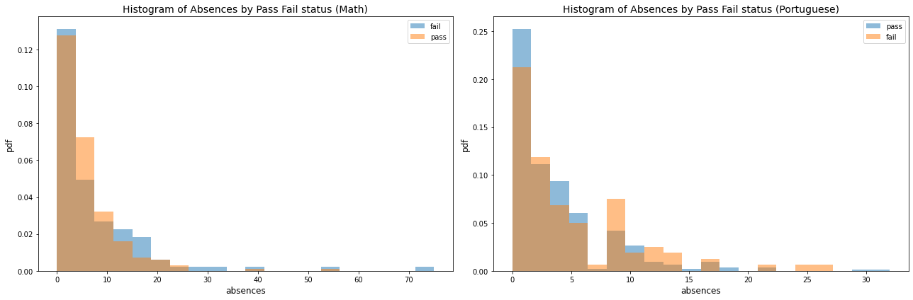
2. EDA – PASS FAIL STATUS AND ABSENCES
Students have more absences in Math than Portuguese → students may be less interested or struggle more with this subject
More students who had higher absences were able to pass Portuguese than Math, which again suggests that Math is harder than Portuguese for the students
why students are absent more in Math
how or if they are struggling with the subject,
what can be done to improve

Slide 6
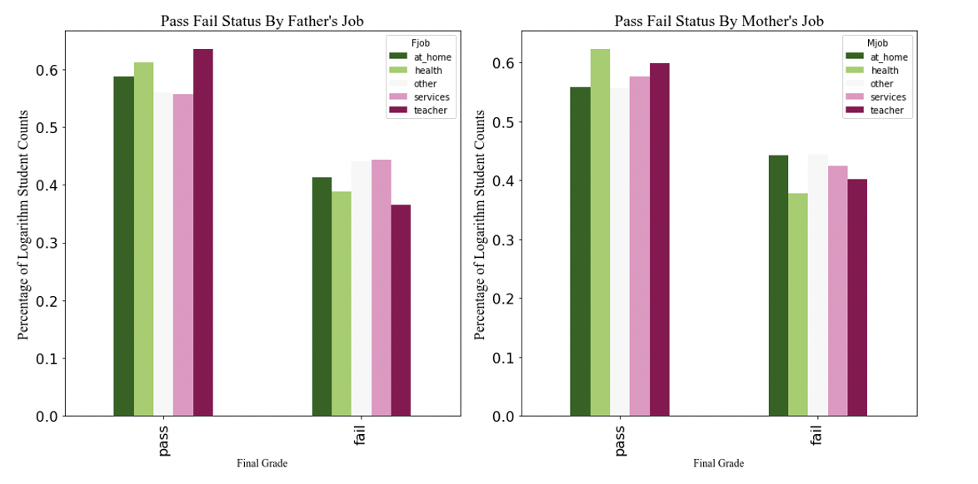
2. EDA – PASS FAIL STATUS AND PARENTS’JOBS
correlation between the parents’ job and students’ performance
more students pass if their parents are in a “highly educated” field, such as health or teacher and vice versa.
there isn’t a significant different between the number of students who pass and fail with respect to the mother or father’s job, which suggests that both parents’ jobs are equally important.
suggests some degree of socioeconomic inequality in education

Slide 7
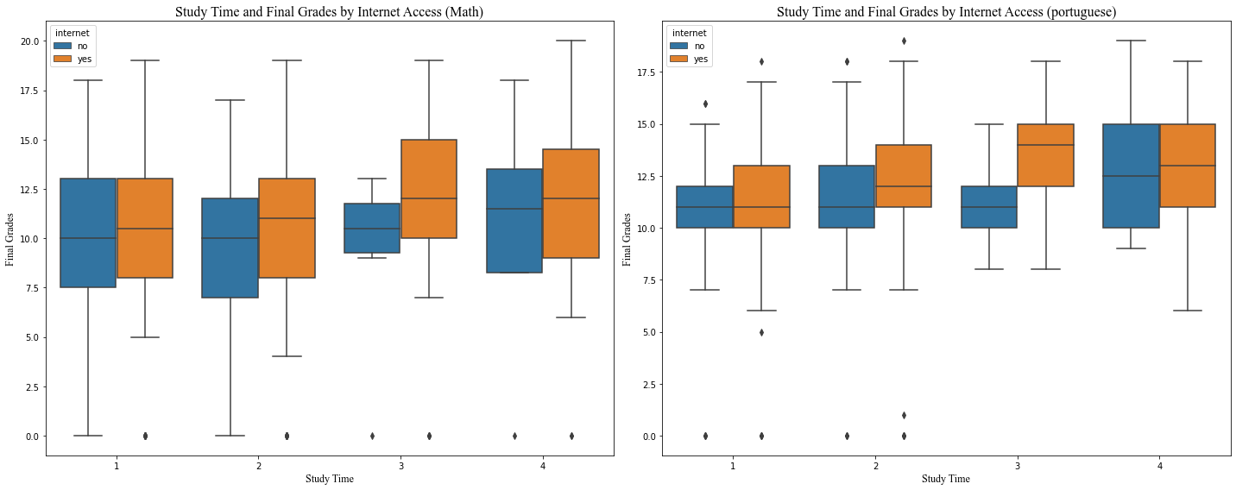
2. EDA – STUDYTIME, FINAL GRADE, INTERNET ACCESS
students who have internet have higher grades than those who don’t → internet is quite important for studying.
for students who study less in both subjects, there is a smaller difference in the final grades between those who don’t have internet and those who do compared to students who study more → strong students are more effective at using the internet for studying
→needs to be more research into what the students do on the Internet, how much time do they dedicate their internet use to studying, and how schools can assist students in using the Internet for more education purposes.

Slide 8
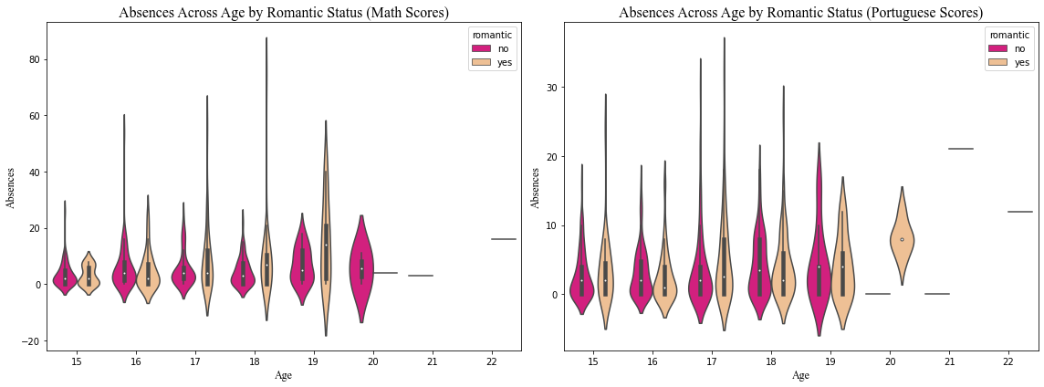
2. EDA – ABSENCES, AGE, ROMANCE
students who are in a relationship have more absences than those who don’t. → suggests that relationships can distract students from school.
In math, students between 17 – 19 years old have the most absences and are in a relationship more.
In Portuguese, there are more students who are in a relationship than Math, and these students also have more absences → suggests that either students in Math are more “disciplined” or math is harder and require students to study more.

Slide 9
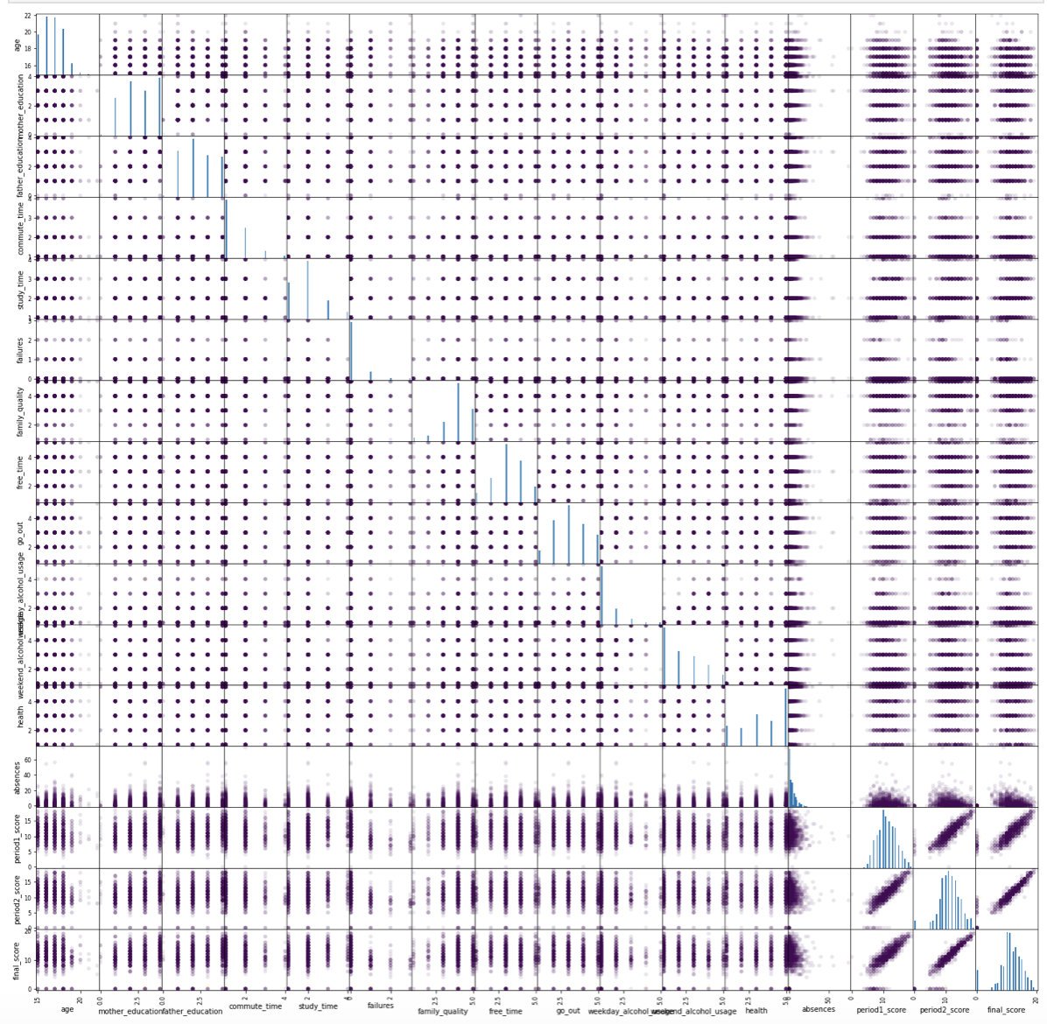
2. EDA – SCATTER MATRIX
a strong positive relationship between the 1st and 2nd period scores and final scores, signaling that score prediction can be quite accurate.
relationships between final scores and other variables aren't s obvious.

Slide 10
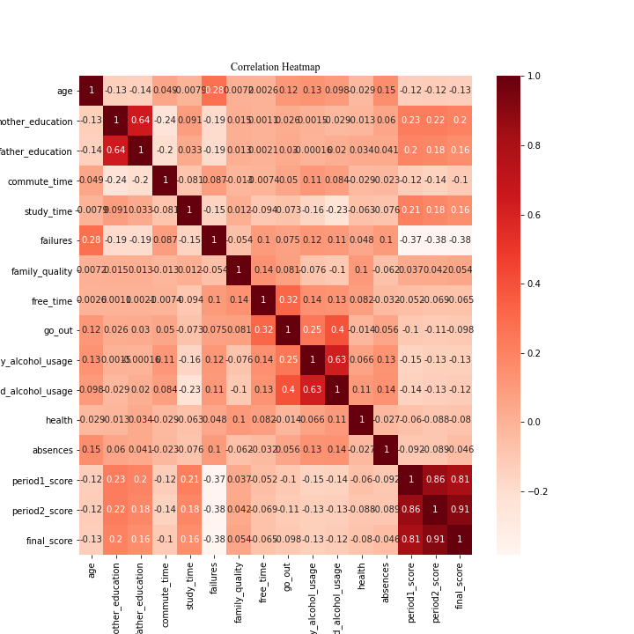
2. EDA - CORRELATION HEATMAP
a strong positive relationship between the 1st and 2nd period scores and final scores, signaling that score prediction can be quite accurate
final scores also seem to have quite strong positive relationships with the mother and father's education and study time
other positive but weaker relationships between finals cores and other variables include family quality and free time
a negative relationship between final age and scores, which can be because the materials get harder
a weak negative relationship between health and final scores, raising concerns about mental health.

Slide 11
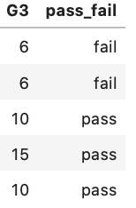
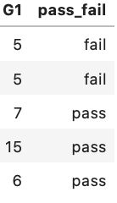
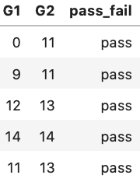

3. METHODS – machine LEARNIJG MODELS & FEATURE IMPORTANCES
create an additional feature called “pass_fail” which denotes that a student fail if their score us below 10 and pass if otherwise.
Splitting: Both data sets are IID, relatively small, and don’t have group structure, time series, and missing values → basic train_test_split and a KFold split
Preprocessing: ordinal features already encoded, OneHotEncoder on the remaining non-bounded/ranked, categorical features and the MixMaxEncoder on the bounded continuous features, LabelEncoder on the target variable
choose accuracy score because my datasets are both balanced (0.671 Class 1 for Math and 0.846 Class 1 for Portuguese)
measure uncertainties due to splitting and non-deterministic ML models, I loop through 10 random states and calculate the mean and standard deviation of the test scores
additional cross-validation confusion matrix and ROC curve
developed an ML pipeline using K-Fold Cross Validation (GridSearchCV),
3 sub-models: Model 1 consists of all midterm and final scores, Model 2 consists of only the first midterm scores and final scores, and Model 3 consists of no midterm and only final scores

Slide 12
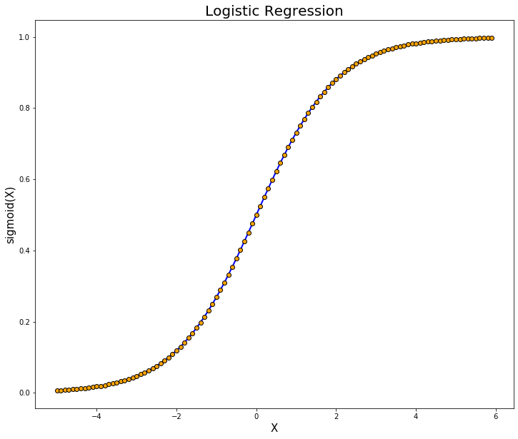

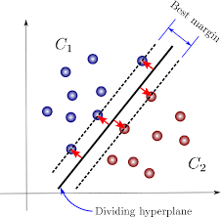
3. METHODS – machine LEARNIJG MODELS & FEATURE IMPORTANCES
3 ML algorithms: logistic regression, random forest classifier, support vector classifier.
Hyperparameter tuning
LogisticRegression(penalty='l1', solver='saga', max_iter=10000, random_state = 20)
Tune: 'logisticregression__C': np.logspace(-2,2, num=8)
RandomForestClassifier(n_estimators = 100,random_state=random_state)
Tune: ‘randomforestclassifier__max_depth’: np.linspace(2,30,num=9,dtype=int)
Tune: 'randomforestclassifier__max_features': np.linspace(0.25,1,5)
SVC(random_state = 20)
Tune 'svc__C': np.logspace(-3,4,num=8)
Tune: ‘svc__gamma': np.logspace(-3,4,num=8)
Feature importance
LR: perturbation, linear coefficients, SHAP (LinearExplainer).
RFC: perturbation, random forest metrics, SHAP (TreeExplainer).
SVC: perturbation and SHAP (KernelExplainer).

Slide 13
4. RESULTS –MODEL PERFORMANCE
highest accuracy from Model 1 because the algo have more score information to leverage from to predict the performance, accuracy score erodes over Model 2 and Model 3 because the algo have less score information to predict from.
Model 2 performs pretty well, and its results fit into an academic context because it allows schools and teachers to identify weak students early on to take necessary actions

Slide 14
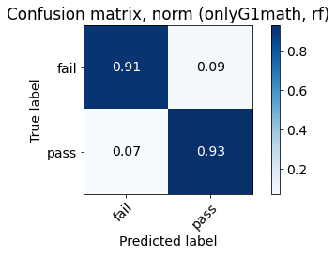
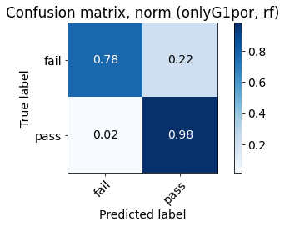
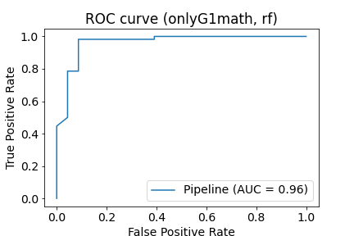
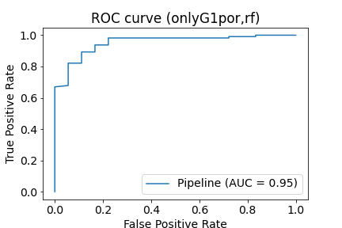
4. RESULTS – CONFUSION MATRICES AND ROC CURVES
Math, Model 2:
Random Forest Classification (n_estimators = 100, random_state = 42, max_depth = 9, max_features = 0.625)
Test accuracy: 0.924
Portuguese Model 2:
Random Forest Classification (n_estimators = 100, random_state = 42, max_depth = 2 max_features = 0.625)
Test accuracy: 0.954
Model 2 is quite accurate and allows the most actionable insights for educators to help teachers improve students performance before it’s too close to the end of the semester
Display Random Forest Classification’s Confusion Matrix and ROC Curves for Model 2 for both the Math and Portuguese dataset because these were the best models

Slide 15
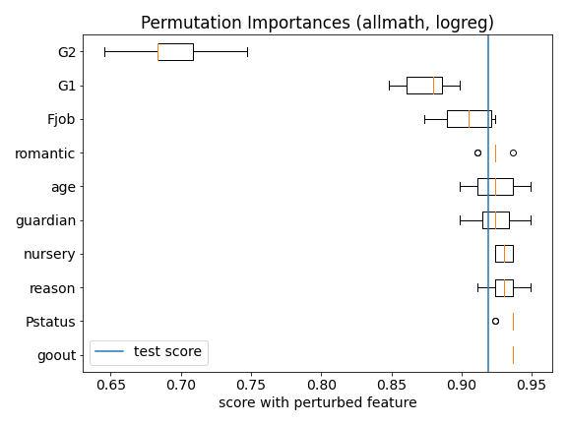
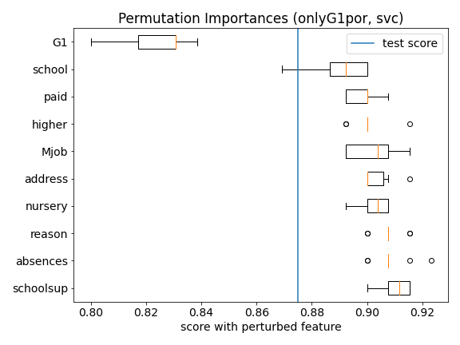
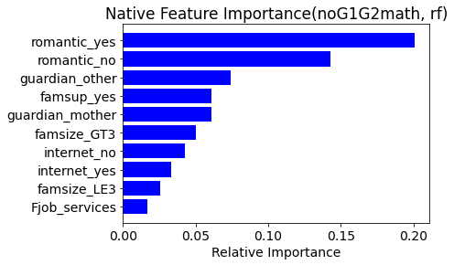
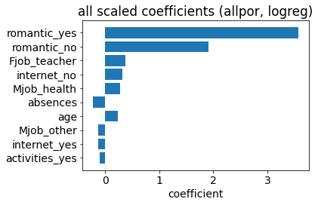
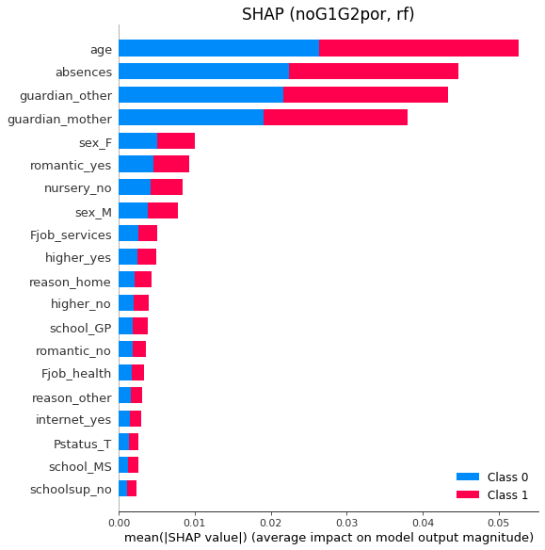
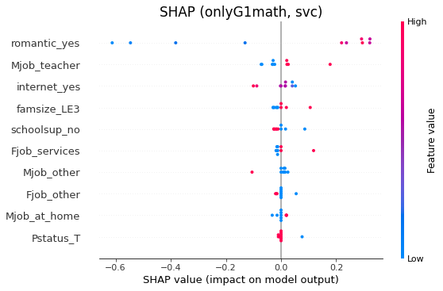
4. RESULTS – FEATURE IMPORTANCES (GLBOAL)
Features importance varies by model, but there are some commonality.
For Models 1 and 2, the midterm scores are the most important features.
Other important features are romantic status, internet access, the jobs of the parents, absences, and school supplement and fam supplement.
Some of the least important features are health, family size & relationship, and travel time.
Educators should focus on helping students navigate adolescent relationships in a way that could positively impact their performance, work closely with parents of students who have weak performance, and provide more supplement when necessary.

Slide 16
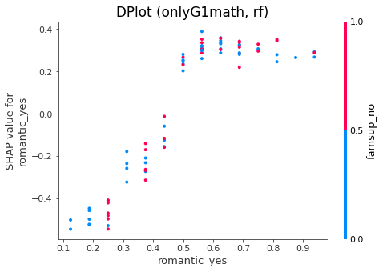
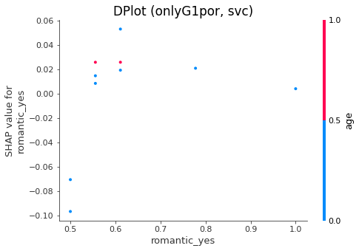
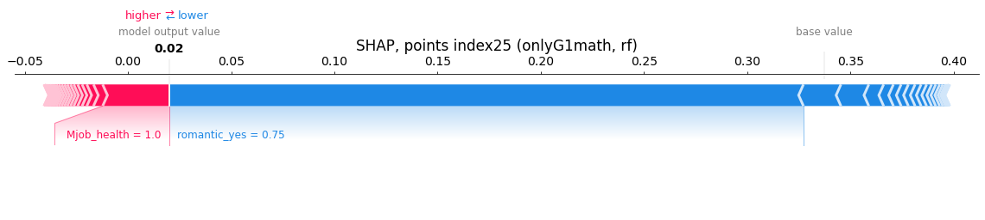
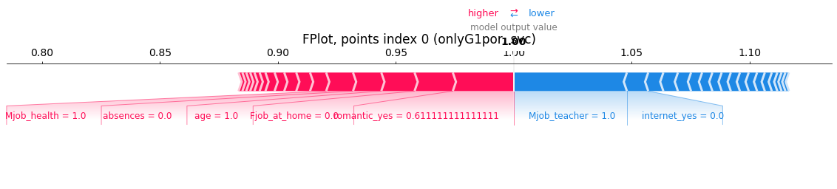
4. RESULTS – FEATURE IMPORTANCES (LOCAL)

Slide 17
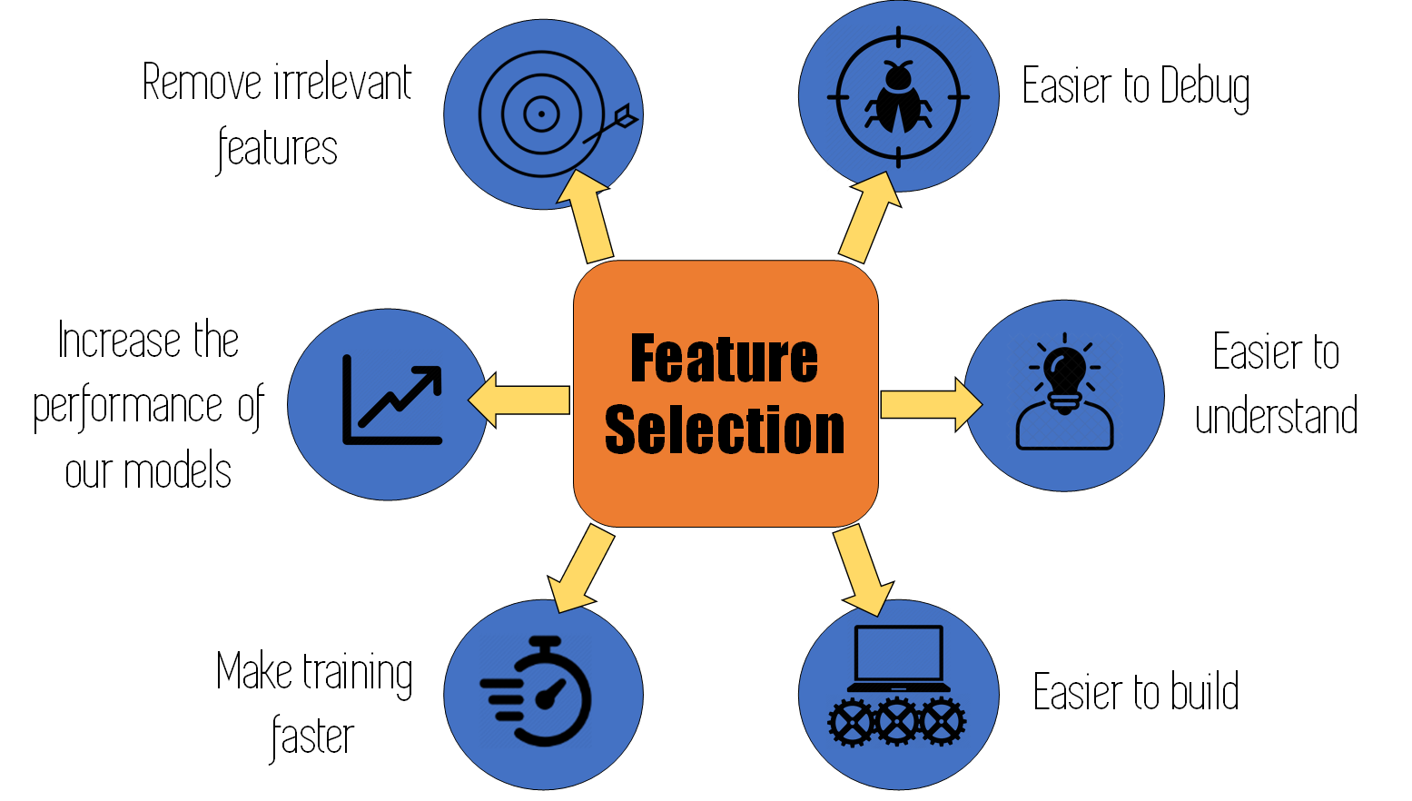
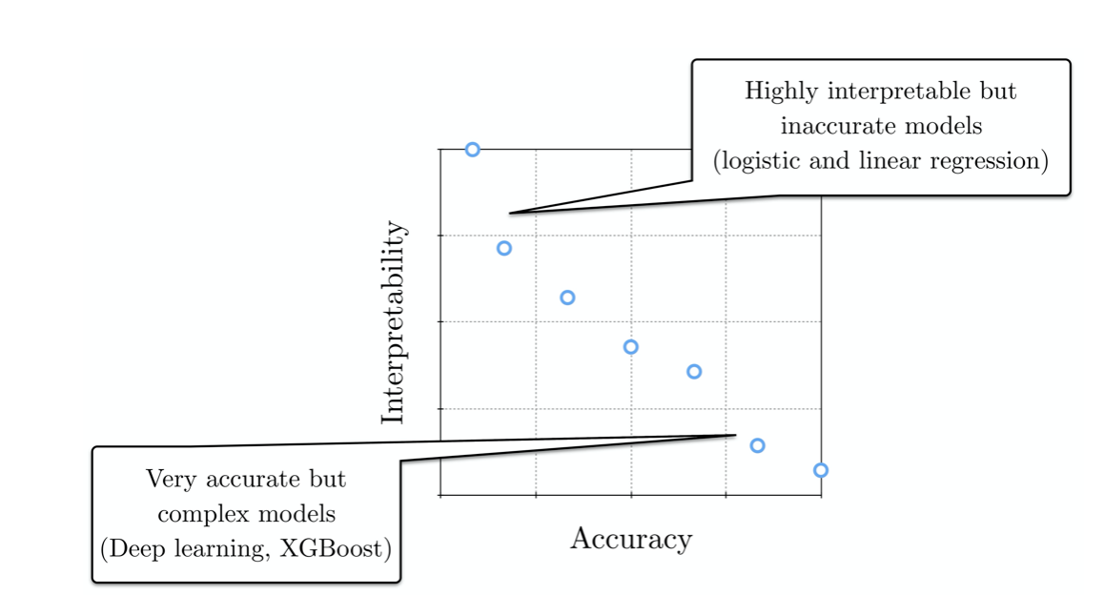
4. OUTLOOK
Weak spots: used all features for prediction
Improvement suggestions: feature selection, feature engineering, multi-class classification, more complex ML models such as XGBoost, PCA, KNN, etc.
Additional info: homework scores, school attitude, prior exposure to the subject, enjoyment of the subjects, more continuous or ordinal features, students’ performance in more countries, more holistic measures of academic performance, such as average grades across the school year or school attitude should be considered.

