Slide 1

PREDICTING PORTUGESE SECONDARY SCHOOL STUDENT PERFORMANCE
https://github.com/annieptba/data1030_project_-portugese-secondary-student-performance.git
ANNIE PHAN (Banner ID: B01309278)

Slide 2
Introduction
Problem:
Regression: predict students’ final scores (continuous, integer values from 0 to 20) using first and second period grades and other social, economic, and education factors
Classification: classify students’ final performance (categorical values ‘good’, ‘fair’, ‘poor’) using first and second period grades and other social, economic, and education factors
Data overview and source
Implications:
Original research:
What type of courses can be offered to attract more students? Is it possible to predict student performance?
What are the factors that affect student achievement?
My model explorse these similar questions but look further into demographic factors such as family support, romantic relationships, alcohol consumption, and internet access.
Project: “Using Data Mining To Predict Secondary School Student Performance” by Cortez and Silva in 2008
Method: binary classification (pass/fail), classification with 5 levels ( I very good → V insufficient), regression, with a numeric output that ranges between (0%) and (100%)
Result: students’ final grades can be predicted by the first and/or second school period grades and also other relevant features
https://archive.ics.uci.edu/ml/datasets/student+performance
1,044 instances (students) including 395 Mathematics class students and 649 Portuguese language class students
33 features

Slide 3
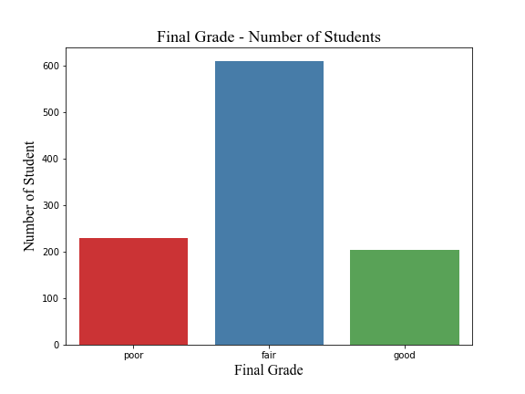
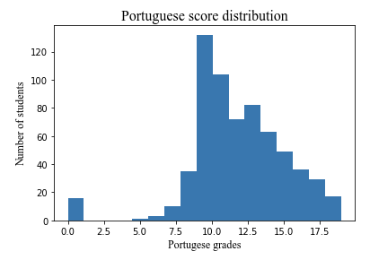
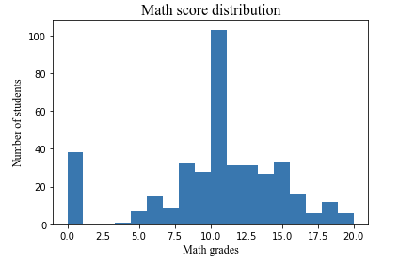
EDA – HISTOGRAMS AND BAR CHARTS
Show us what you think was the most interesting, unexpected, or important insight that you gained during EDA. Present at least three different informative visualization types.
Around 60% of the students have a fair performance, but 20% of them have a poor and 20% have good performance. This is a very high % of students have a poor performance and fit with the idea that many Portuguese students were underperforming.
It seems like more students have a higher Portuguese score than Math scores. This poses questions about Math vs Portuguese teaching level of Portuguese schools.

Slide 4
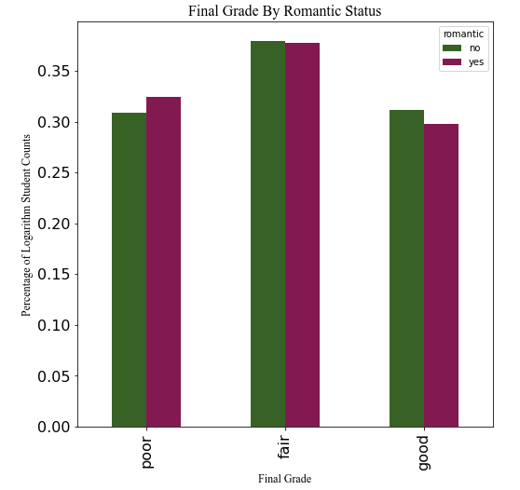
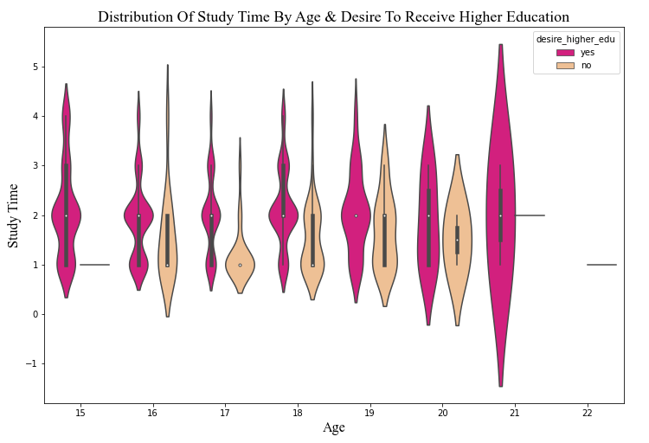
EDA – BAR & VIOLIN PLOTS
more students who don't have a relationship have better final grade performance and vice versa, though the disparity isn't significant.
signals that students should not be in a relationship
positive relationship between study time and desire to achieve higher education.
the older the students get, the more they want to achieve higher education
students who don't want to achieve higher education quite close to those who want to

Slide 5
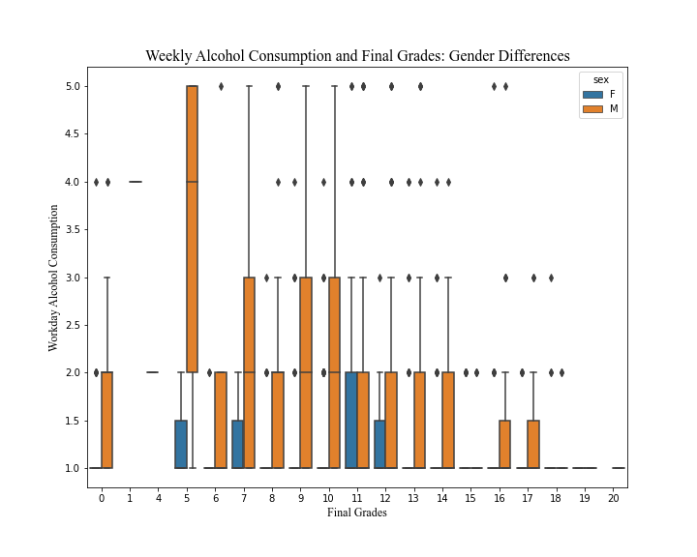
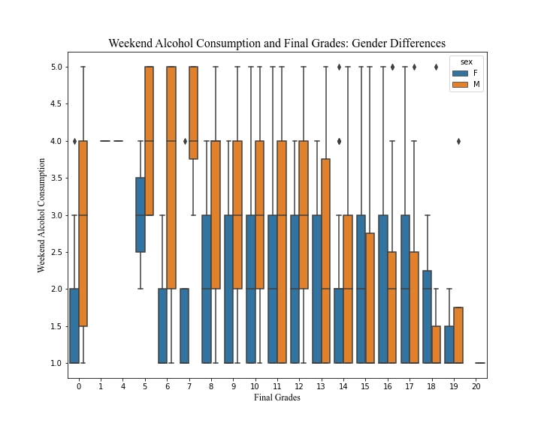
EDA - BOXPLOTS
demonstrate final grades across measures of distributions of students' weekend and weekday alcohol consumption, classified by gender.
students who have less alcohol consumption tend to get higher grades and vice versa
more male students consume alcohol than female students
drink significantly more on the weekend than weekday
some intervention and educational efforts should be executed to teach students about appropriate drink habits

Slide 6
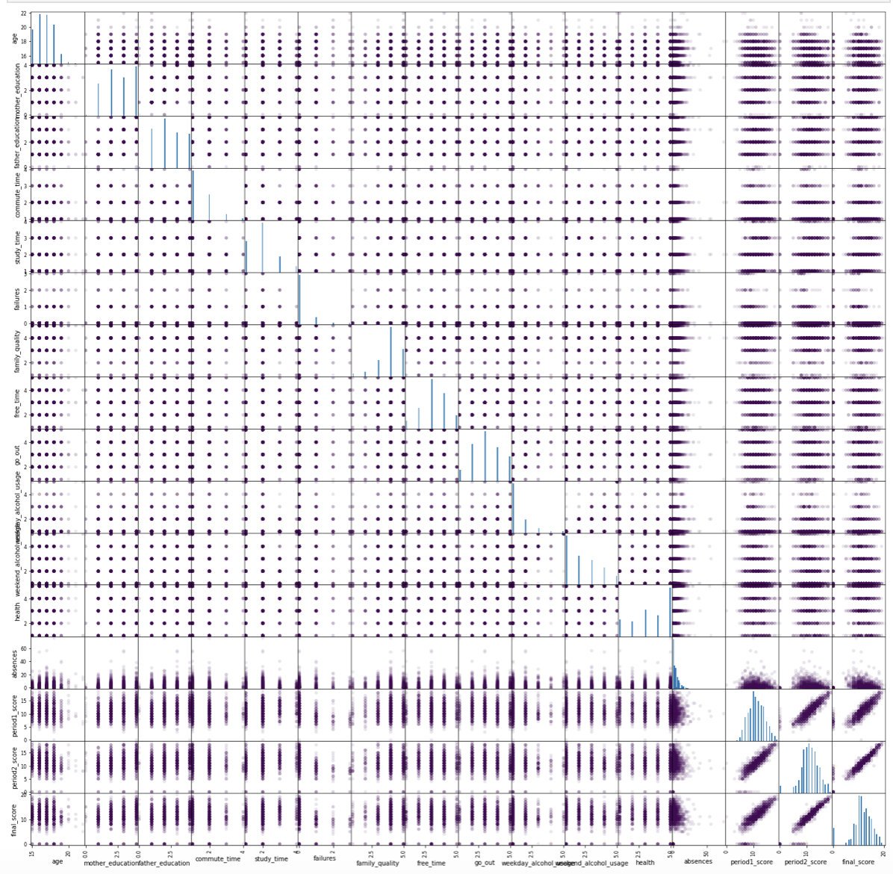
EDA – SCATTER MATRIX
a strong positive relationship between the 1st and 2nd period scores and final scores, signaling that score prediction can be quite accurate.
relationships between final scores and other variables aren't s obvious.

Slide 7
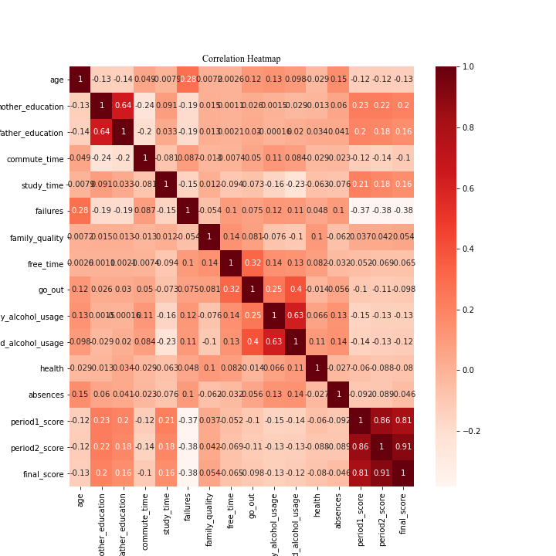
EDA - CORRELATION HEATMAP
a strong positive relationship between the 1st and 2nd period scores and final scores, signaling that score prediction can be quite accurate
final scores also seem to have quite strong positive relationships with the mother and father's education and study time
other positive but weaker relationships between finals cores and other variables include family quality and free time
a negative relationship between final age and scores, which can be because the materials get harder
a weak negative relationship between health and final scores, raising concerns about mental health.

Slide 8
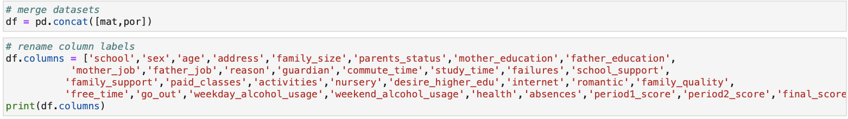
PREPROCESSING – MERGE AND CREATE NEW VARIABLE
Merge two datasets
Create ‘final_grade” column
good’ performance if score from 15 to 20
‘fair’ performance if score from 10 to 14
‘poor’ performance if score below 9

Slide 9
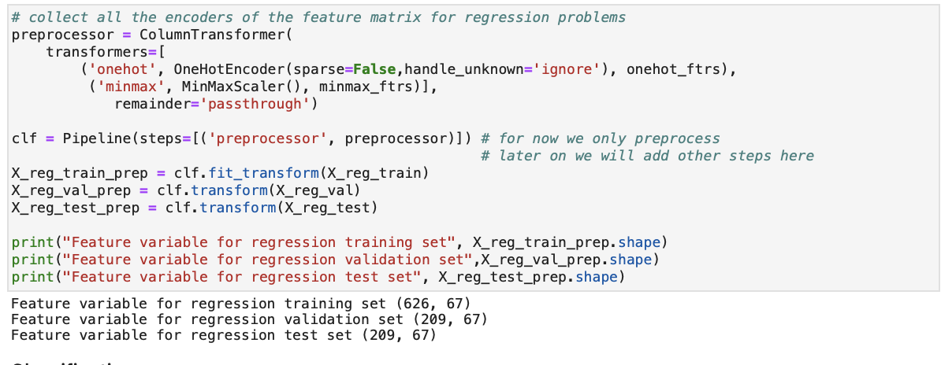
PREPROCESSING - REGRESSION
Target variable: final score
Basic split: 60% of the data in train, 40% validation, and 40% set because the dataset is IID.
626 points in the train set, 209 in the validation and 209 in the test set

Slide 10
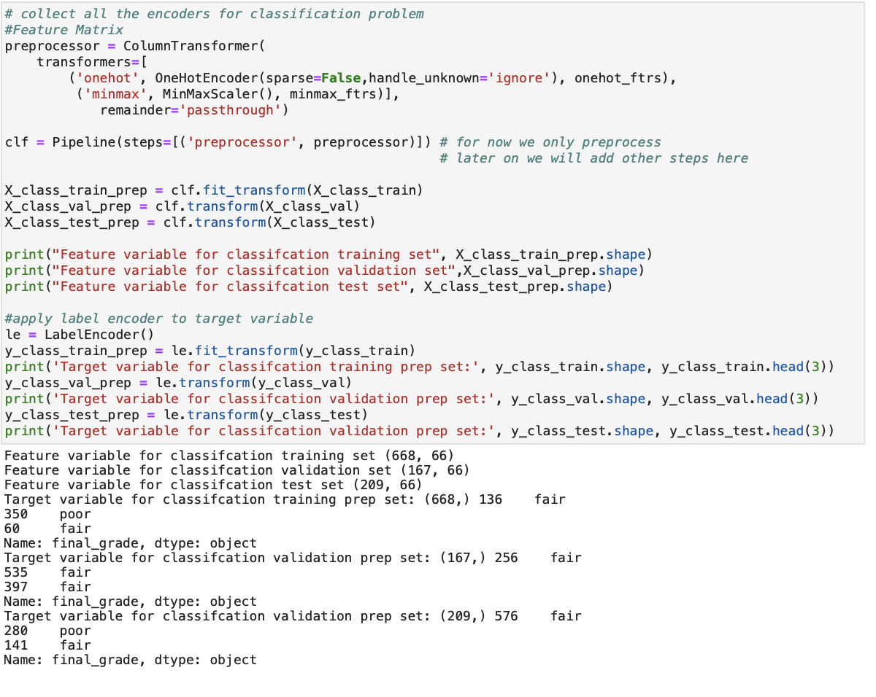
PREPROCESSING - CLASSIFICATION
Target variable: final_grade (, drop the “final_score” column
K-fold split to shuffle the data , ensure enough randomness and reduce errors because the dataset is small. 20% of the data in test and split the other set into 5.
668 points in the train set, 167 in validation and 209 points in the test set.
Apply a Label Encoder to the target variable ‘final_grade’

Slide 11
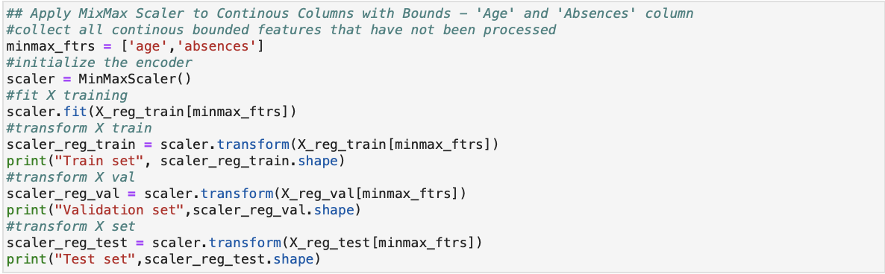
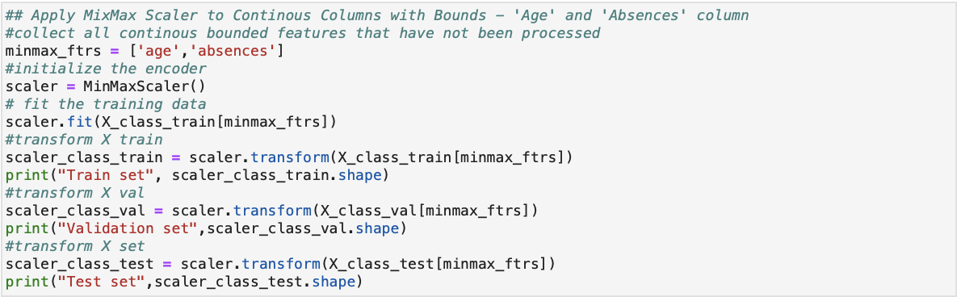
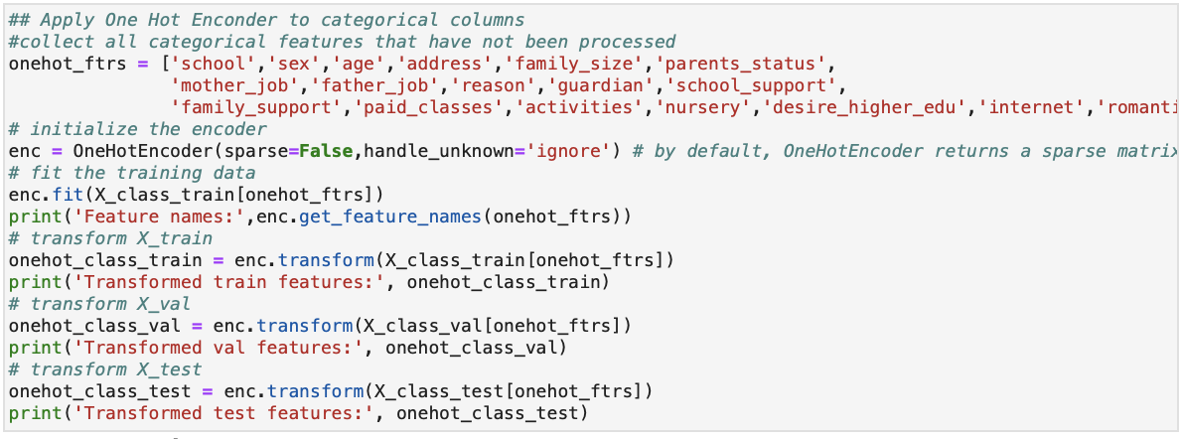
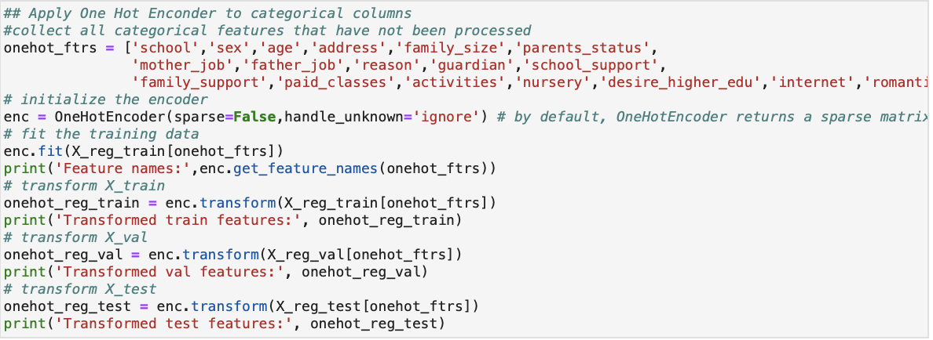
PREPROCESSING – ENCODERS FOR FEATURE MATRIX
only apply encoders to the columns that haven’t been processed yet
apply the MixMaxEncoder to the ‘age’ and ‘absences’ columns because they both have bounded features (‘age’ ranges from 15 to 22 and ‘absences’ ranges from 0 to 93)
apply the One Hot encoders to the categorical columns that have ‘yes’-‘no’ features because they haven’t been encoded yet (the 'school', 'sex', 'age',' address', 'family_size',' parents_status', 'mother_job', 'father_job',' reason','guardian', 'school_support', 'family_support', 'paid_classes',' activities', 'nursery', 'desire_higher_edu', 'internet', 'romantic' columns).
REGRESSION
CLASSIFICATION

