Slide 1
LANGUAGES
DIFFERENCE BETWEEN ENGLISH AND MOTHER TONGUE

Slide 2
MALAYALAM
Malayalam is the mother tongue of Kerala.
It’s an ordinary language of peoples here.
According to 14 districts,slang of the language is different.
Thunjathu ezhuthachan is known as the father of malayalam.

Slide 3
ENGLISH
English is the global language of the world.
Its familiar to the whole world.
Each and every person in the world should be educated in this language.
It is the West-Germanic language that was first spoken in early medieval England.

Slide 4
DIFFERENCE BETWEEN ENGLISH AND MALAYALAM
ENGLISH
MALAYALAM

Slide 5
ENG V/S MAL
English is a West Germanic language that was first spoken in early medievel England and eventually became a global lingua franca.
Malayalam is a Dravidian language spoken in the Indian state of Kerala and the union territories of Lakshadeep and Puducherry.
ENGLISH
MALAYALAM

Slide 6
Combination of mothertongue and english

Slide 7
MAL-ENG
COMPARISON
Specialities
ENGLISH-Germanic language
MALAYALAM-Dravidian language

Slide 8
English
Importance of speaking English according to other languages……….

Slide 9
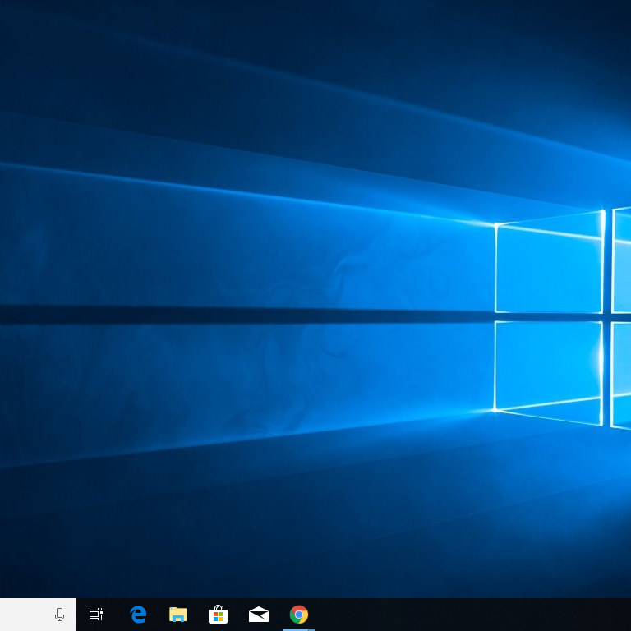
ENGLISH OPENED THE WINDOW OF KNOWLEDGE

Slide 10
THANKS
PRESENTED BY AISWARYA AND AMRITHA

