Slide 1

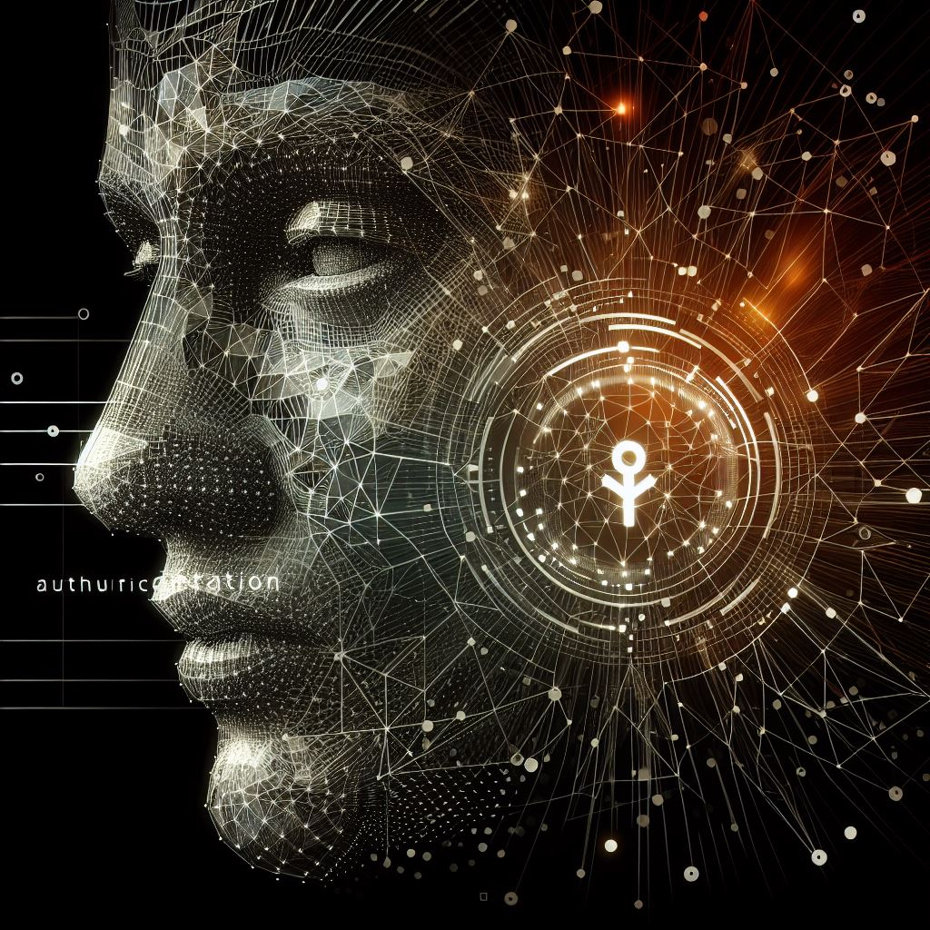
Face Authentication Using Quantum Neural Networks

Slide 2
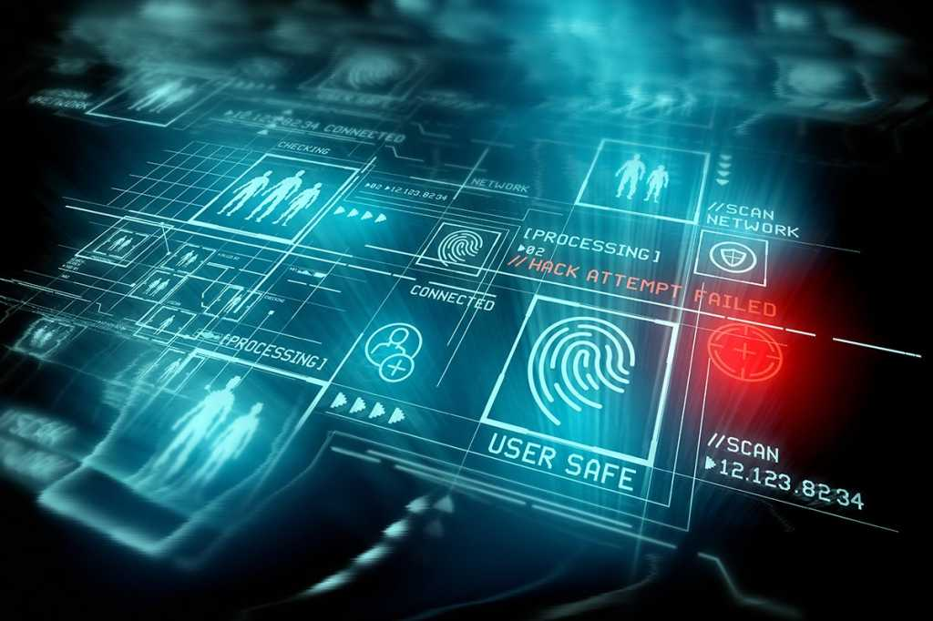
Problem Statement
In the modern day, biometrics are extensively used in various sectors, including companies and personal gadgets. However, traditional security measures such as PINs, passwords, and facial recognition are vulnerable to threats, especially with the rise of deep fake technology. Our innovative concept, Facial Recognition Using Q-CNN, offers a solution that leverages quantum technology. Unlike traditional methods, our approach provides enhanced security through the utilization of Quantum Convolutional Neural Networks (Q-CNN)."

Slide 3
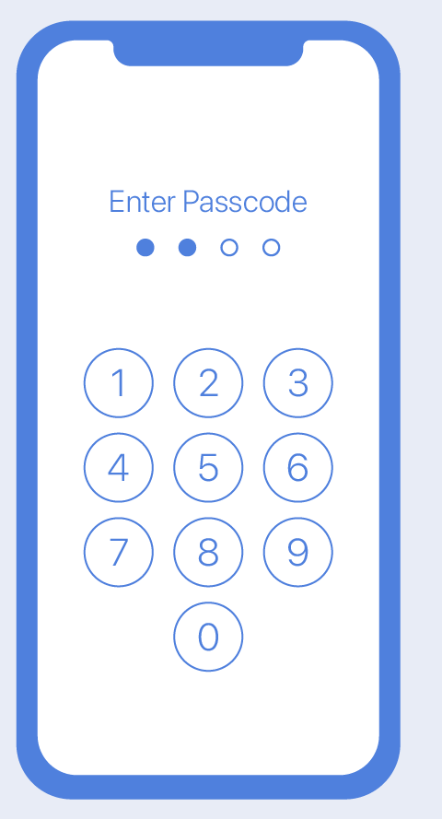
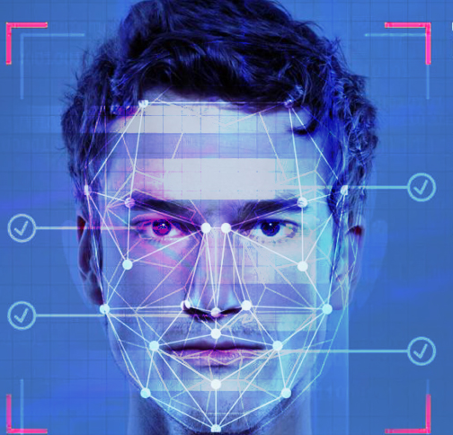


Existing Solution
(PIN)
Facial and Retina
Fingerprint
Voice

Slide 4
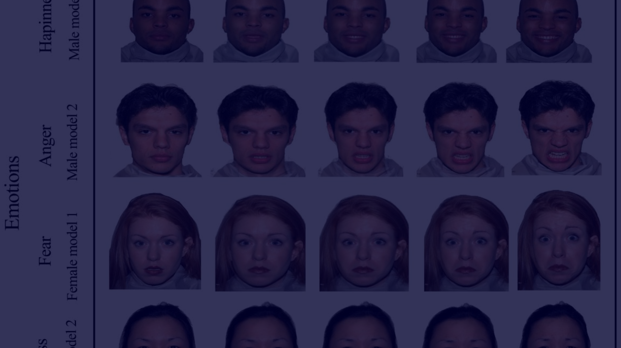
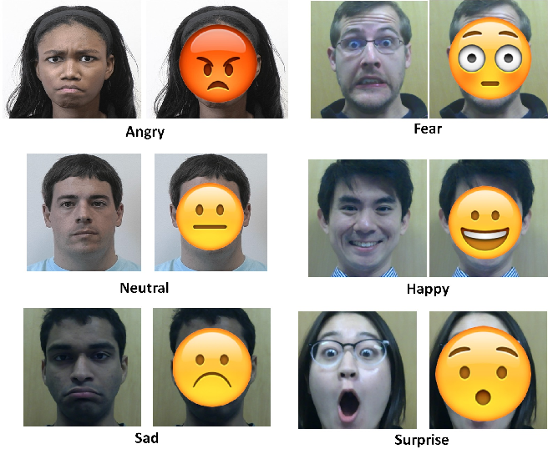
Solution
Our solution involves defining emojis (emotional faces) for users to react with in order to unlock.
We check various facial features such as open or closed eyes, open or closed mouth, raised eyebrows, and tongue in or out.
Users enroll their faces with selected emojis, creating patterns such as 'happy emoji + sad emoji + fear emoji.
When the user reacts with this pattern, the face is authenticated using QCNN (Quantum Convolutional Neural Network) features.
Our solution combines facial recognition with emotional reactions, adding an additional layer of security to the authentication process.

Slide 5
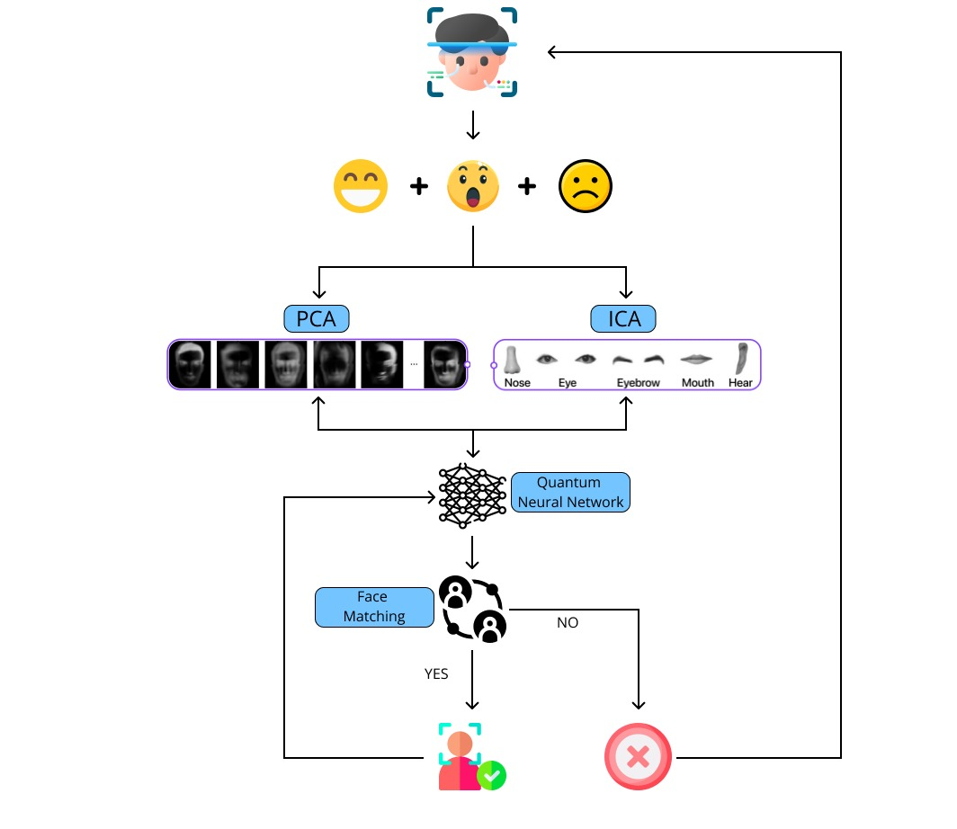
Process Flow
Detect face
Find mouth, eye, eyebrow
Mouth - open or close
Tongue - out or in
Eye - wink left, wink right, or neither
Eyebrows - raised or squished
Compare from predefined emoji library
Set as pattern
Capture the images of mouth, eye, eyebrow
When login, compare the same or not

Slide 6
Key Features
1
Emotion-Based Authentication
2
Quantum Convolutional Neural Network (QCNN) Features
Implementing facial recognition integrated with emotional reactions.
Utilizing quantum features for enhanced security measures.
3
Pattern-Based Unlocking
4
User-Friendly Experience
Empowering users to create secure unlocking patterns with emojis.
Making advanced security measures user-friendly and accessible.

Slide 7
Expected Outcomes
In traditional methods, we use PINs and passwords for
biometric purposes, which can lead to a high possibility
of data frauds. In response, our concept offers
innovative and unbreakable security using quantum
technology, providing high security and a user-friendly experience.

Slide 8
References(Research Papers)

