Slide 1

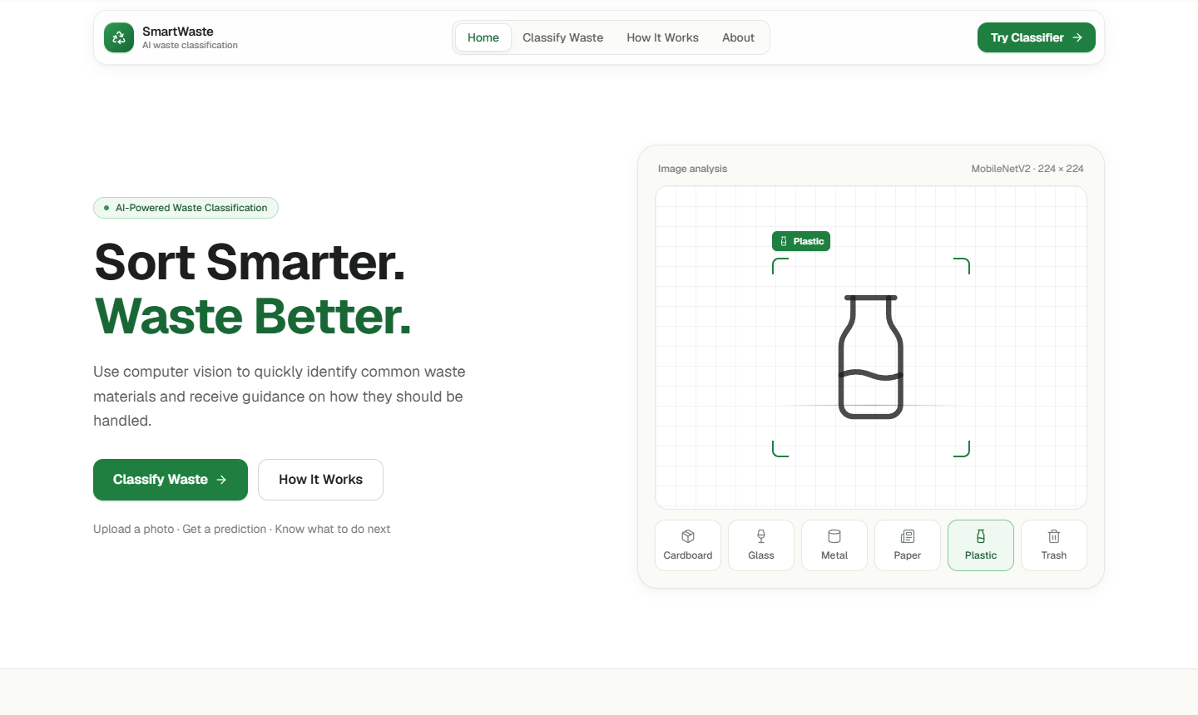
SmartWaste
AI waste classification that runs entirely in your browser
MobileNetV2 · ONNX Runtime Web · Next.js
Notes:
SmartWaste identifies the material of a waste item from a photo and explains how to dispose of it. Everything runs in the browser.

Slide 2




What it does
Upload a photo
JPG, PNG or WEBP, up to 20 MB
Get a prediction
Cardboard, glass, metal, paper, plastic or trash, with a confidence score for each
Learn how to dispose
Recyclability and handling tips for every category
Notes:
Three steps for the user: upload, see the predicted class with confidences, read disposal guidance.

Slide 3





How it works
Upload
Preprocess
Classify
Result
User picks a photo
Decode and resize to 224×224 RGB
MobileNetV2 (ONNX) runs in the browser
Softmax over 6 classes plus guidance
Private by design: images never leave the device. No upload, no server.
Notes:
Preprocessing matches the training pipeline exactly, so browser predictions match the Keras model.

Slide 4
Data and model
Dataset
Transfer learning
6,111
MobileNetV2 with ImageNet weights
Stage 1: train the new head on a frozen base
Stage 2: fine-tune the top layers
Augmentation, dropout and class weights against overfitting
Exported to ONNX and verified against Keras on all 917 test images
images from TrashNet and RealWaste
6
70/15/15
classes
train / val / test split
Notes:
TrashNet gives clean single-object photos; RealWaste adds cluttered, real-world photos. The split is stratified with a fixed seed and checked for overlap.

Slide 5
84.4% test accuracy
84.0%
macro F1 on 917 held-out test images
Why two datasets
A TrashNet-only model scored 47.0% on RealWaste photos. Combined training reaches 84.8%.
Notes:
Evaluated once on the held-out test set. Accuracy is similar on both sources: 83.9% on TrashNet images and 84.8% on RealWaste images.

Slide 6
Limitations and tech stack
Limitations
Built with
Only six categories: every image is assigned to one
Common errors: plastic vs. glass, metal vs. glass, cardboard vs. paper
Clutter, several items or poor light can fool it
Disposal rules vary by location
Next.js, React, TypeScript, Tailwind CSS
TensorFlow / Keras for training
ONNX Runtime Web for inference
Vercel for hosting
Live demo
smartwaste-cv.vercel.app
Notes:
Be upfront: the model is a six-class classifier and can be confidently wrong on cluttered photos.

