Slide 1
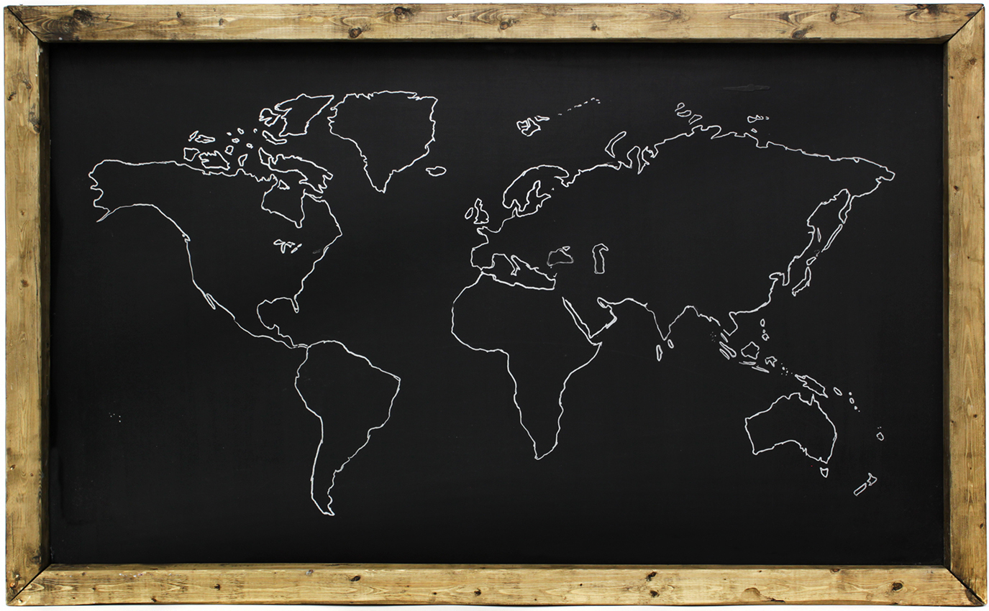
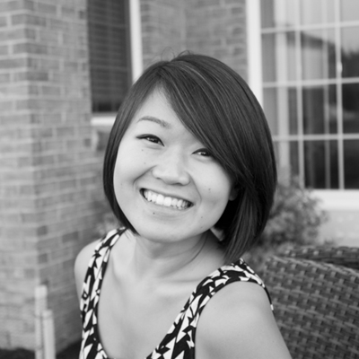

MISTI Global Teaching Labs
IAP 2014 Application
I want to teach because I want to convey my love for discovery and learning to others.
I’ve taught classes for MIT SPLASH, was a tutor in high school for Algebra, Pre-Calc, and Calculus. I also taught a summer camp in Qingdao, China to ~30 students. Recently, I worked on an educational game at Microsoft to teach children programming.
I’ve tried to continuously make it a part of my life, whether it be teaching classes for MIT SPLASH to just helping out classmates whenever I can help out. I’m genuinely interested in teaching, and I love the feeling and sense of accomplishment that comes with it
Annie Tang
Architecture
2014
I would like to teach a math subject. I really enjoyed 18.01 and 18.02 at MIT and I tutored math subjects in High School. If possible, I would love to teach a computer science class because I really like programming and I think it is a very useful skill to have.
Having studied Latin for 5 years, I have always been very interested in Roman Culture. During my senior year of High School, my AP Latin class was going to go on a trip to Italy, but it never went through. I’ve been wanting to go ever since!
No Italian language or culture classes taken
After my freshman year, I did MISTI China and went to Hong Kong to do research at the University of Hong Kong. In high school, I spent a summer in Qingdao, China teaching children English.

