Slide 1
Rent Capture or Regional Forces?
Fiscal Interaction in Metropolitan Areas
O’Neill School of Public and Environmental Affairs
Steven Craig, Oscar Galvez-Soriano, Annie Yu-Hsin Hsu, Janet Kohlhase
ABFM Conference · September 24, 2026

Slide 2
Introduction
SECTION 1

Slide 3
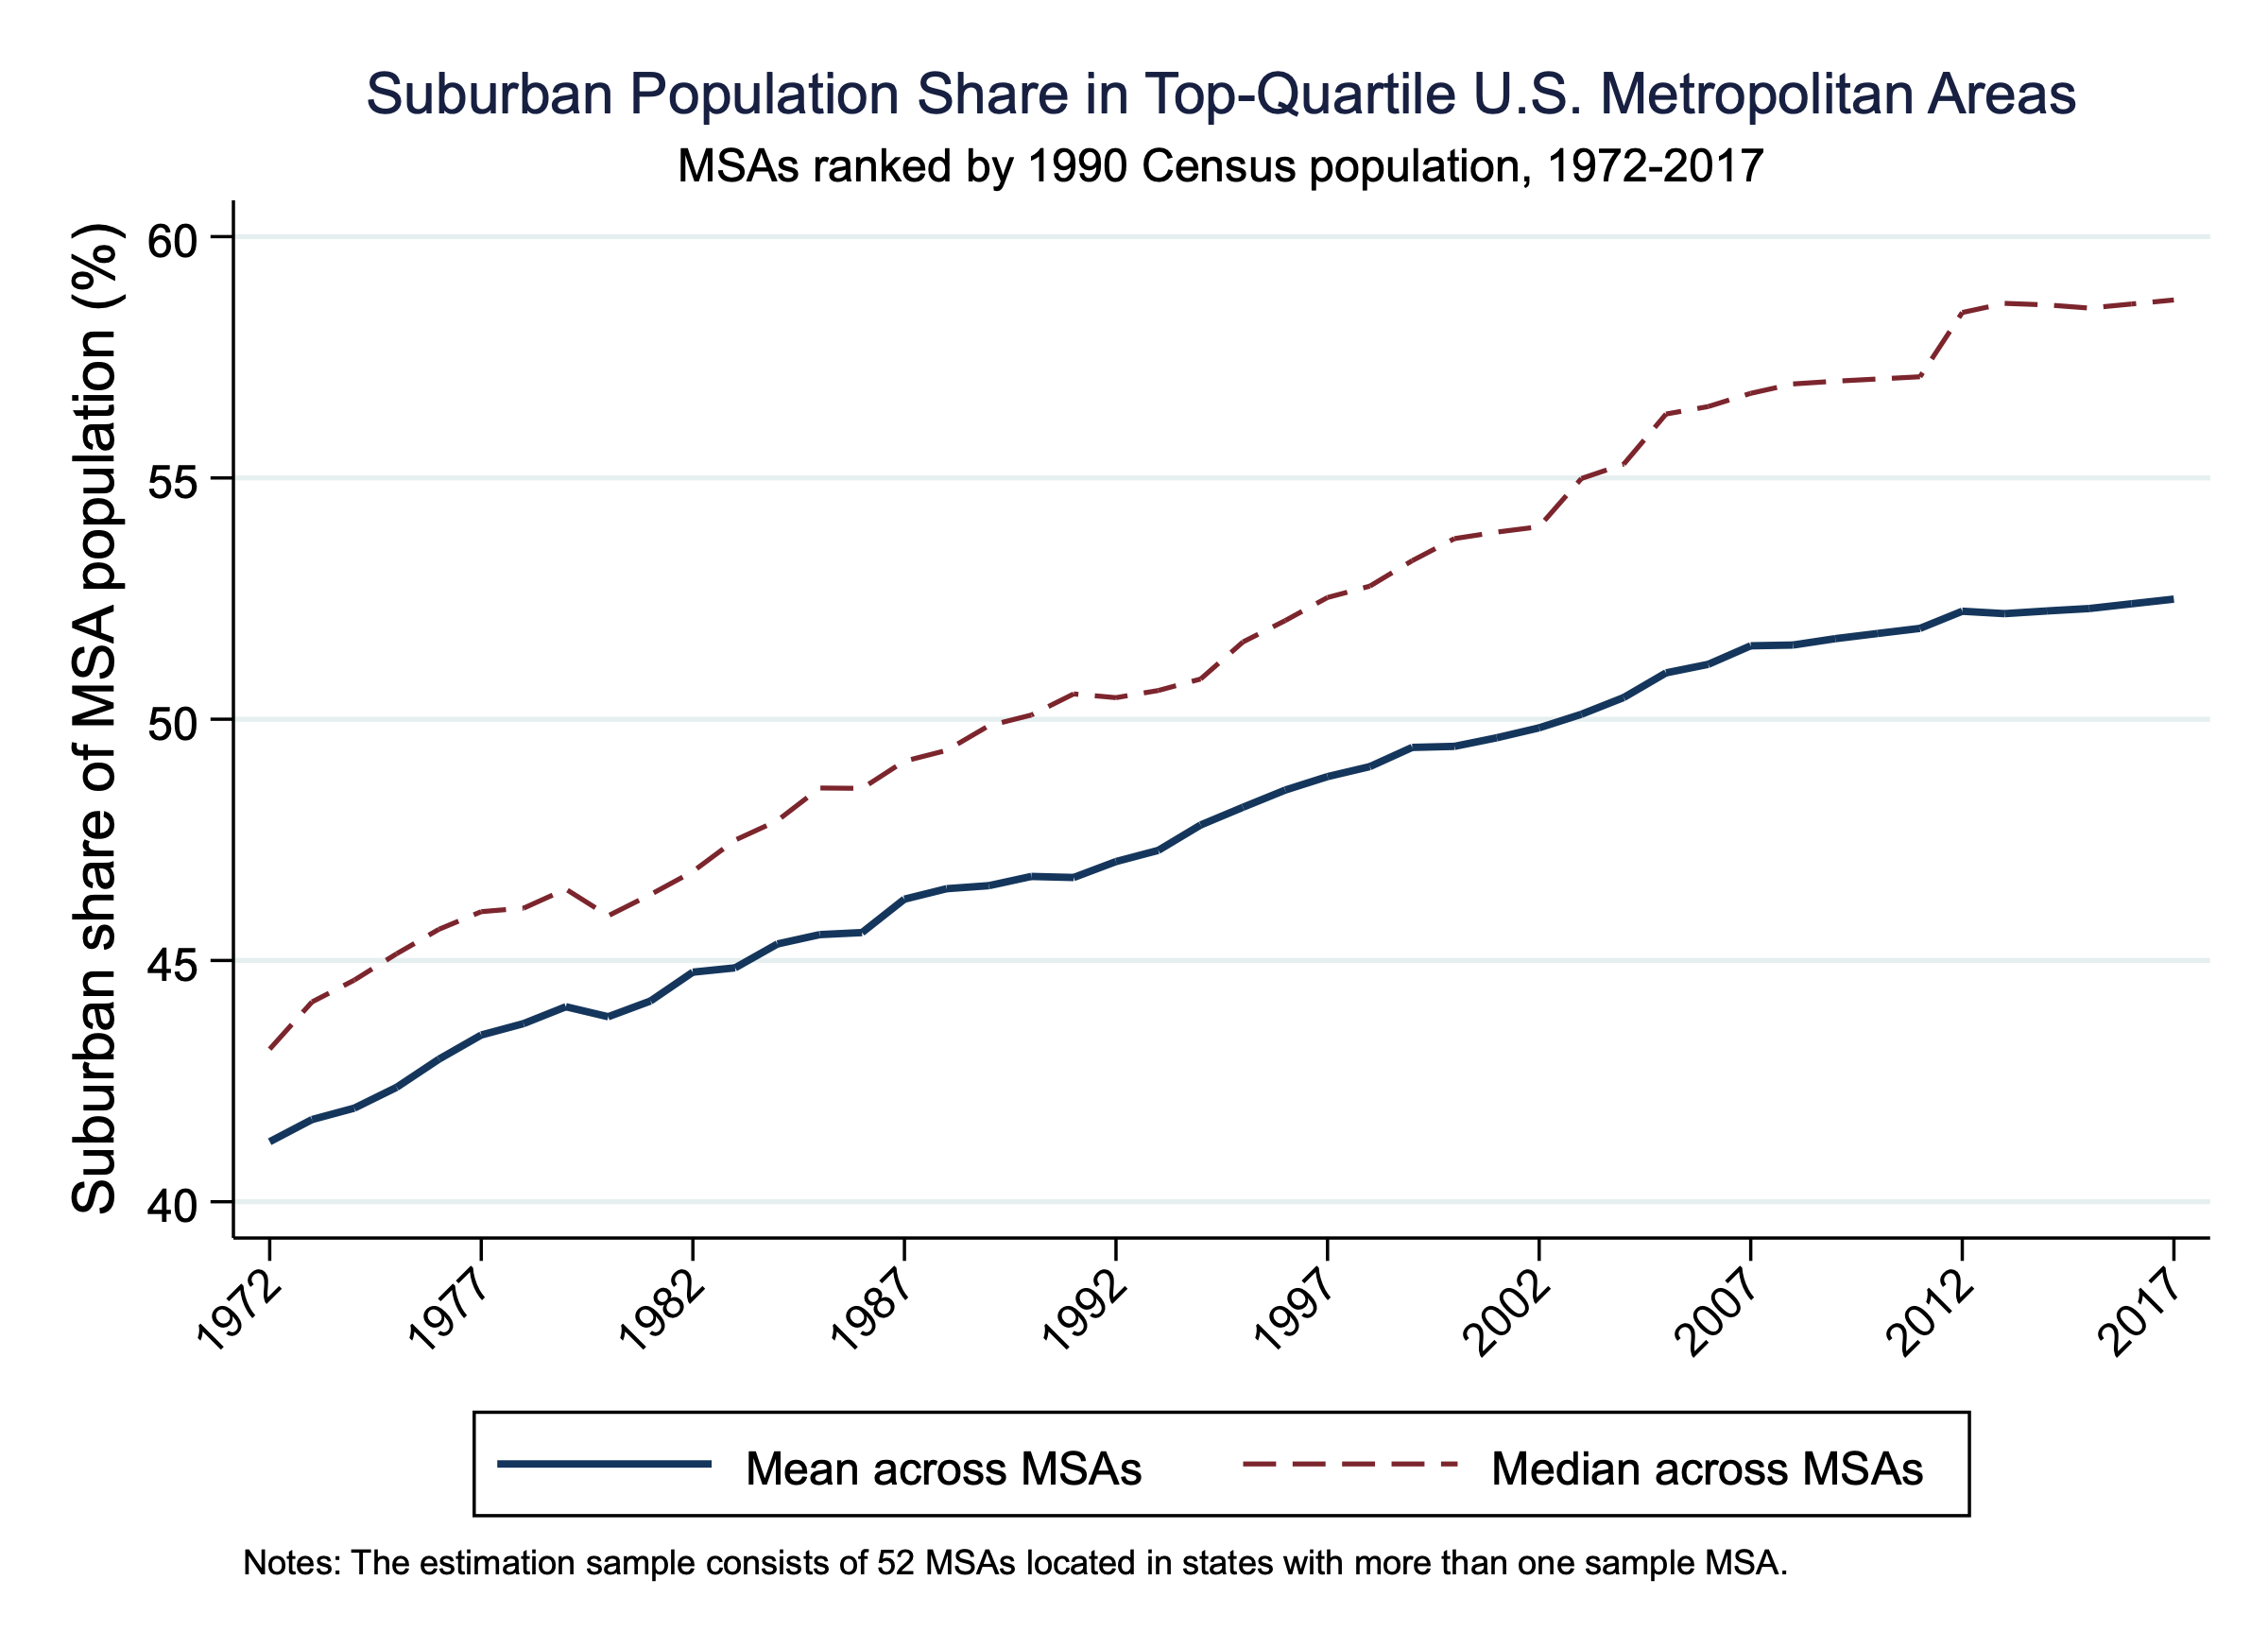
Metropolitan fiscal restructuring in the long run:
Suburban population shares have increased substantially
Suburbanization reallocates tax bases across jurisdictions
Rent Capture or Regional Forces?
Notes:
*Central cities retain broader service mandates and legacy costs
*Fiscal outcomes exhibit strong city–suburb co-movement
The average suburban population share rises from roughly 41 percent to 52 percent in this sample.
This raises a fiscal question: how do central-city budgets adjust as population and economic activity increasingly locate in the suburbs?

Slide 4
Research question:
What drives metropolitan fiscal co-movement?
Strategic interaction:
  Central-city budgets respond to suburban fiscal expansion through strategic, political, or service-demand channels.
Common regional shocks:
  Cities and suburbs share labor markets, housing demand, and state institutions.
Contribution:
  Compare central-city tax and expenditure responses.
  Assess sensitivity to regional controls.
  Trace fiscal adjustment over multiple horizons.
Rent Capture or Regional Forces?
Notes:
The empirical challenge is to separate directional fiscal response from shared regional economic forces
*Fiscal spillovers: Central-city budgets respond to suburban fiscal changes.
*Our contribution is to examine both the composition and timing of central-city fiscal responses.
*These comparisons help assess whether the evidence supports a persistent revenue–expenditure asymmetry.

Slide 5
Conceptual Framework:
Rent Capture and Fiscal Fundamentals
Rent extraction mechanism
  Besley and Case (1995): political agency framework
  Some incumbents may set taxes above service cost
  Empirical implication: revenue growth without proportional service expansion
Why central cities may have fiscal slack?
  Legacy infrastructure and rigid expenditure commitments
  Broader service mandates and relatively immobile tax bases
  Potential for asymmetric fiscal response to suburban expansion
Rent Capture or Regional Forces?
Notes:
*Revenue–expenditure asymmetry can be consistent with fiscal retention, but it can also reflect adjustment lags or differences in spending responsibilities.
*I therefore treat the gap as a mechanism diagnostic that requires further evidence.
(cumulative/lag)

Slide 6
Competing Mechanism:
Strategic interaction and common regional shocks
Brueckner (2001, 2003): Tax competition in spatial equilibrium
  Strategic fiscal responses can generate city–suburb co-movement
  Shared economic conditions can generate similar patterns
  Common institutional constraints
Empirical prediction:
  Division-by-year effects absorb broad regional shocks
  Concern: how to separate directional fiscal response from shared regional economic forces
Rent Capture or Regional Forces?
Notes:
*The same positive correlation can emerge when governments respond strategically or when they face common shocks.
*Division-by-year effects address broad regional shocks, although metropolitan-specific shocks may remain.

Slide 7
Empirical Design
SECTION 2

Slide 8
Data
Fiscal Data: U.S. Census Bureau’s Annual Survey of State and Local Government Finances
Population Data: U.S. Census Bureau’s Population and Housing Unit Estimates Dataset
Employment Data: Census Bureau’s County Business Patterns
Building Permits Survey (BPS): U.S. Census Bureau
FHFA House Price Index: U.S. Federal Housing Finance Agency
Migration Data: IRS SOI Migration data (ongoing)
Quasi-experimental extension: New Jersey State digital library, Indiana Department of Local Government Finance (ongoing)
Baseline period: 1972-2017 (subsample: 1990-2017)
Top Quartile US MSAs: 68 MSAs (preferred IV sample: 52 in the multiple-MSA-states)
Rent Capture or Regional Forces?
Notes:
Saiz?
*The labor and housing controls cover smaller samples, so I compare specifications within each matched sample.

Slide 9
Empirical Strategy
Estimating central city fiscal response to suburban fiscal expansion
  Endogeneity addressed using an IV strategy
  Instruments: suburban fiscal growth in other MSAs (out-of-state; within-state)
Testing mechanism via expenditure composition
  Examine heterogeneous responses across spending categories:
  Basic services: fire, police, libraries, parks, highways
  Transfers: health, hospitals, welfare, housing
  Other operations: corrections, judicial/legal, etc.
Rent Capture or Regional Forces?
Notes:
Endogeneity: reverse causality, simultaneity, omitted variables
I first estimate how central-city fiscal outcomes move with suburban fiscal growth. I then examine whether the responses differ across revenue and expenditure categories.

Slide 10
Summary Statistics:
Central cities and their suburbs, 1972–2017
Variable | All MSAs: City | All MSAs: Suburbs | City exceeds suburbs (%) | Multiple-MSA states: City | Multiple-MSA states: Suburbs | City exceeds suburbs (%)
Total revenue | 2,094.9 (1,315.9) | 1,076.8 (698.3) | 94.5 | 2,147.9 (1,385.2) | 1,114.4 (721.2) | 92.7
Total taxes | 688.4 (457.0) | 384.8 (234.9) | 78.9 | 708.4 (478.0) | 397.1 (211.0) | 78.4
Current operations | 1,415.9 (971.7) | 798.9 (574.4) | 77.2 | 1,477.4 (1,028.3) | 834.6 (604.7) | 77.0
Basic expenditure | 444.8 (153.7) | 284.0 (121.0) | 56.7 | 441.1 (154.1) | 282.8 (123.8) | 55.9
Transfer expenditure | 177.6 (339.6) | 41.5 (77.2) | 327.9 | 186.5 (375.0) | 45.5 (85.6) | 309.9
Other expenditure | 539.9 (508.9) | 285.3 (288.3) | 89.2 | 547.5 (517.9) | 288.1 (279.0) | 90.0
Observations | 3,128 | 3,128 |  | 2,392 | 2,392
MSAs | 68 | 68 |  | 52 | 52
Rent Capture or Regional Forces?
Notes:
monetary units: dollars per capita
price base year: 2000
Central cities have higher fiscal levels than their surrounding suburbs.
This provides context for differences in fiscal responsibilities, while the regressions focus on changes over time.

Slide 11

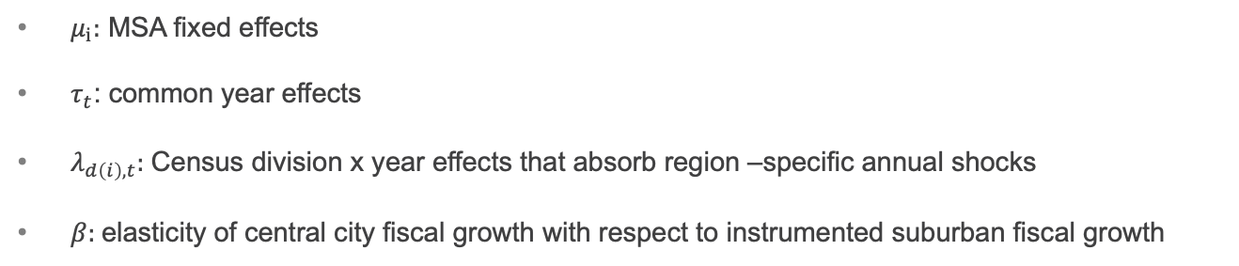

Main Specification
$$Δy_{it}^{CC}=β\hat{Δy_{it}^{Sub}}+μ_{i}+τ_{t}+ε_{it}$$
$$Δy_{it}^{CC}=β\hat{Δy_{it}^{Sub}}+μ_{i}+λ_{d\left(i\right),t}+ε_{it}$$
$μ_{i}:$ MSA fixed effects
$τ_{t}$: common year effects
$λ_{d\left(i\right),t}$: Census division x year effects that absorb region –specific annual shocks
$β:$elasticity of central city fiscal growth with respect to instrumented suburban fiscal growth
Rent Capture or Regional Forces?
Notes:
The comparison changes the time effects from national to division-specific.
The first specification absorbs national year shocks, while the second allows shocks to differ across Census divisions.
This comparison shows how sensitive the estimated response is to broader regional conditions.

Slide 12
The IVs use fiscal changes outside the focal MSA
$$Δy_{it}^{Sub}=π_{in}Z_{it}^{in}+π_{out}Z_{it}^{out}+μ_{i}+λ_{d\left(i\right),t}+u_{it}$$
In-state IV: suburban fiscal growth in other MSAs in the same state
Out-of-state IV: suburban fiscal growth in other MSAs outside the focal state, constructed leave-one-out
Relevance: external suburban growth predicts local suburban growth
Exclusion assumption: conditional on controls, the instrument affects central-city outcomes through local suburban fiscal growth
Rent Capture or Regional Forces?
Notes:
*The instrument draws on suburban fiscal growth outside the central city’s state.
*Its relevance is observable in the first stage, while its exclusion restriction requires that remaining external shocks do not directly affect central-city outcomes.
Q: what does the IV actually identify? Ans: Identification comes from the component of suburban fiscal change predicted by external suburban fiscal movements.

Slide 13
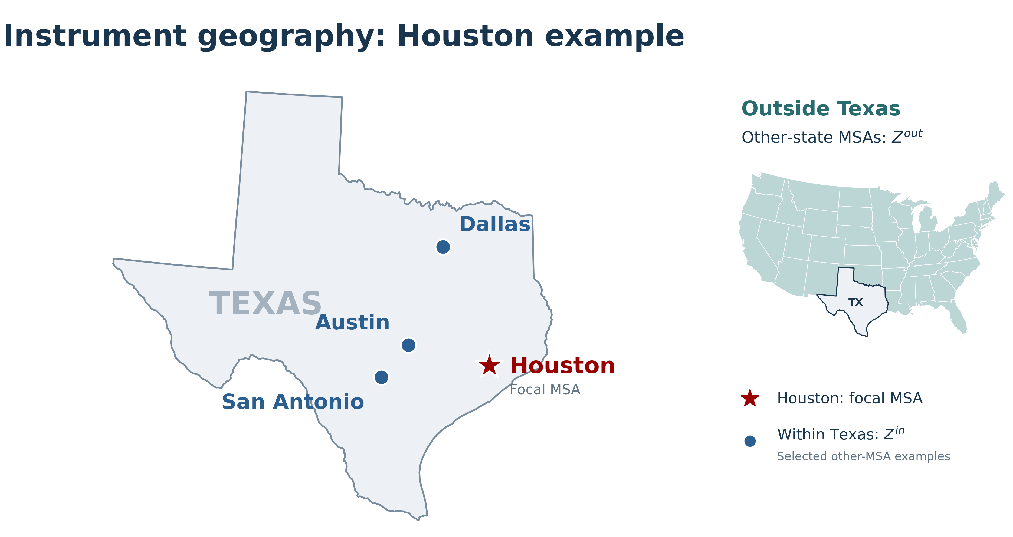
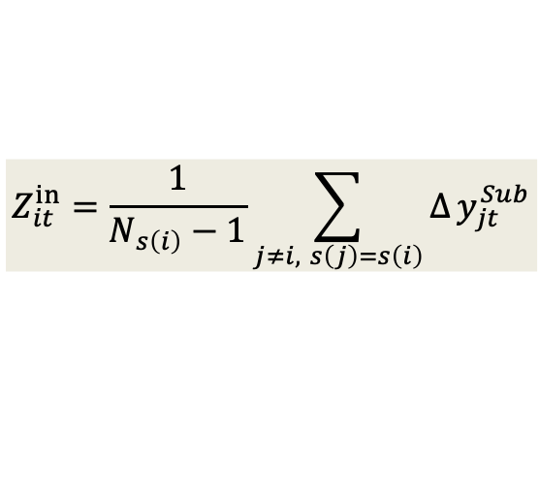
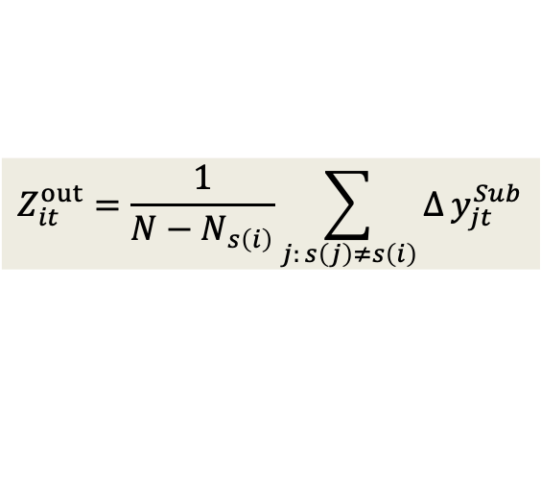
The IVs compare the focal MSA with external suburban fiscal changes
$$Z_{it}^{in}=\frac{1}{N_{s\left(i\right)}−1}\sum_{j≠i, s\left(j\right)=s\left(i\right)}{Δ}y_{jt}^{Sub}$$
$$Z_{it}^{out}=\frac{1}{N−N_{s\left(i\right)}}\sum_{j: s\left(j\right)≠s\left(i\right)}{Δ}y_{jt}^{Sub}$$
Identification uses external fiscal co-movement after MSA and regional-year controls; strength and pre-outcome timing provide observable diagnostics
Rent Capture or Regional Forces?
Notes:
*Each observation entering the instrument is another MSA’s suburban fiscal aggregate. For Houston, the preferred instrument uses those aggregates from outside Texas.

Slide 14
Out-of-state variation carries the informative first stage
Included IVs | Regional controls | KP F | Interpretation
Both IVs | Division x Year | 21.22 – 42.37 | Adequate combined first stage
Out-state only | Division x Year | 32.12 - 46.05 | Strong
In-state only | Division x Year | 0.01 - 11.46 | Unstable
The preferred diagnostic specification uses the strong out-of-state instrument alone.
Rent Capture or Regional Forces?
Notes:
*The out-of-state instrument provides substantially more first-stage information than the in-state instrument in this diagnostic sample.
*This motivates the instrument choice, while exclusion remains a separate identifying assumption.
Why? 關鍵是要區分：「同州其他 MSA 的 suburban fiscal changes 跟本 MSA suburbs 可能很 correlated」和「在你的 regression controls / FE 之後，這個 IV 還剩多少 independent identifying variation」。KP F 衡量的是後者。Raw correlation 確實可能很高，但 conditional first stage 可以很弱。
1. In-state IV 的 variation 很容易被 year / regional FE 吃掉: In-state fiscal variables can be highly correlated in levels or raw changes, while having little residual predictive power after fixed effects.
2. In-state IV 的 effective peer group 很小: 如果某個 state 在你的 top-quartile MSA sample 裡只有 2–3 MSAs，那對每個 MSA 而言，in-state instrument 可能其實只是由 1–2 個 other MSAs construct 出來。所以雖然 geographically/institutionally 它們很 related，statistically 它其實是個 noisy leave-one-out measure。
* out-state isolates variation that is less mechanically tied to the focal city's state-level fiscal environment。

Slide 15
Results
SECTION 3

Slide 16
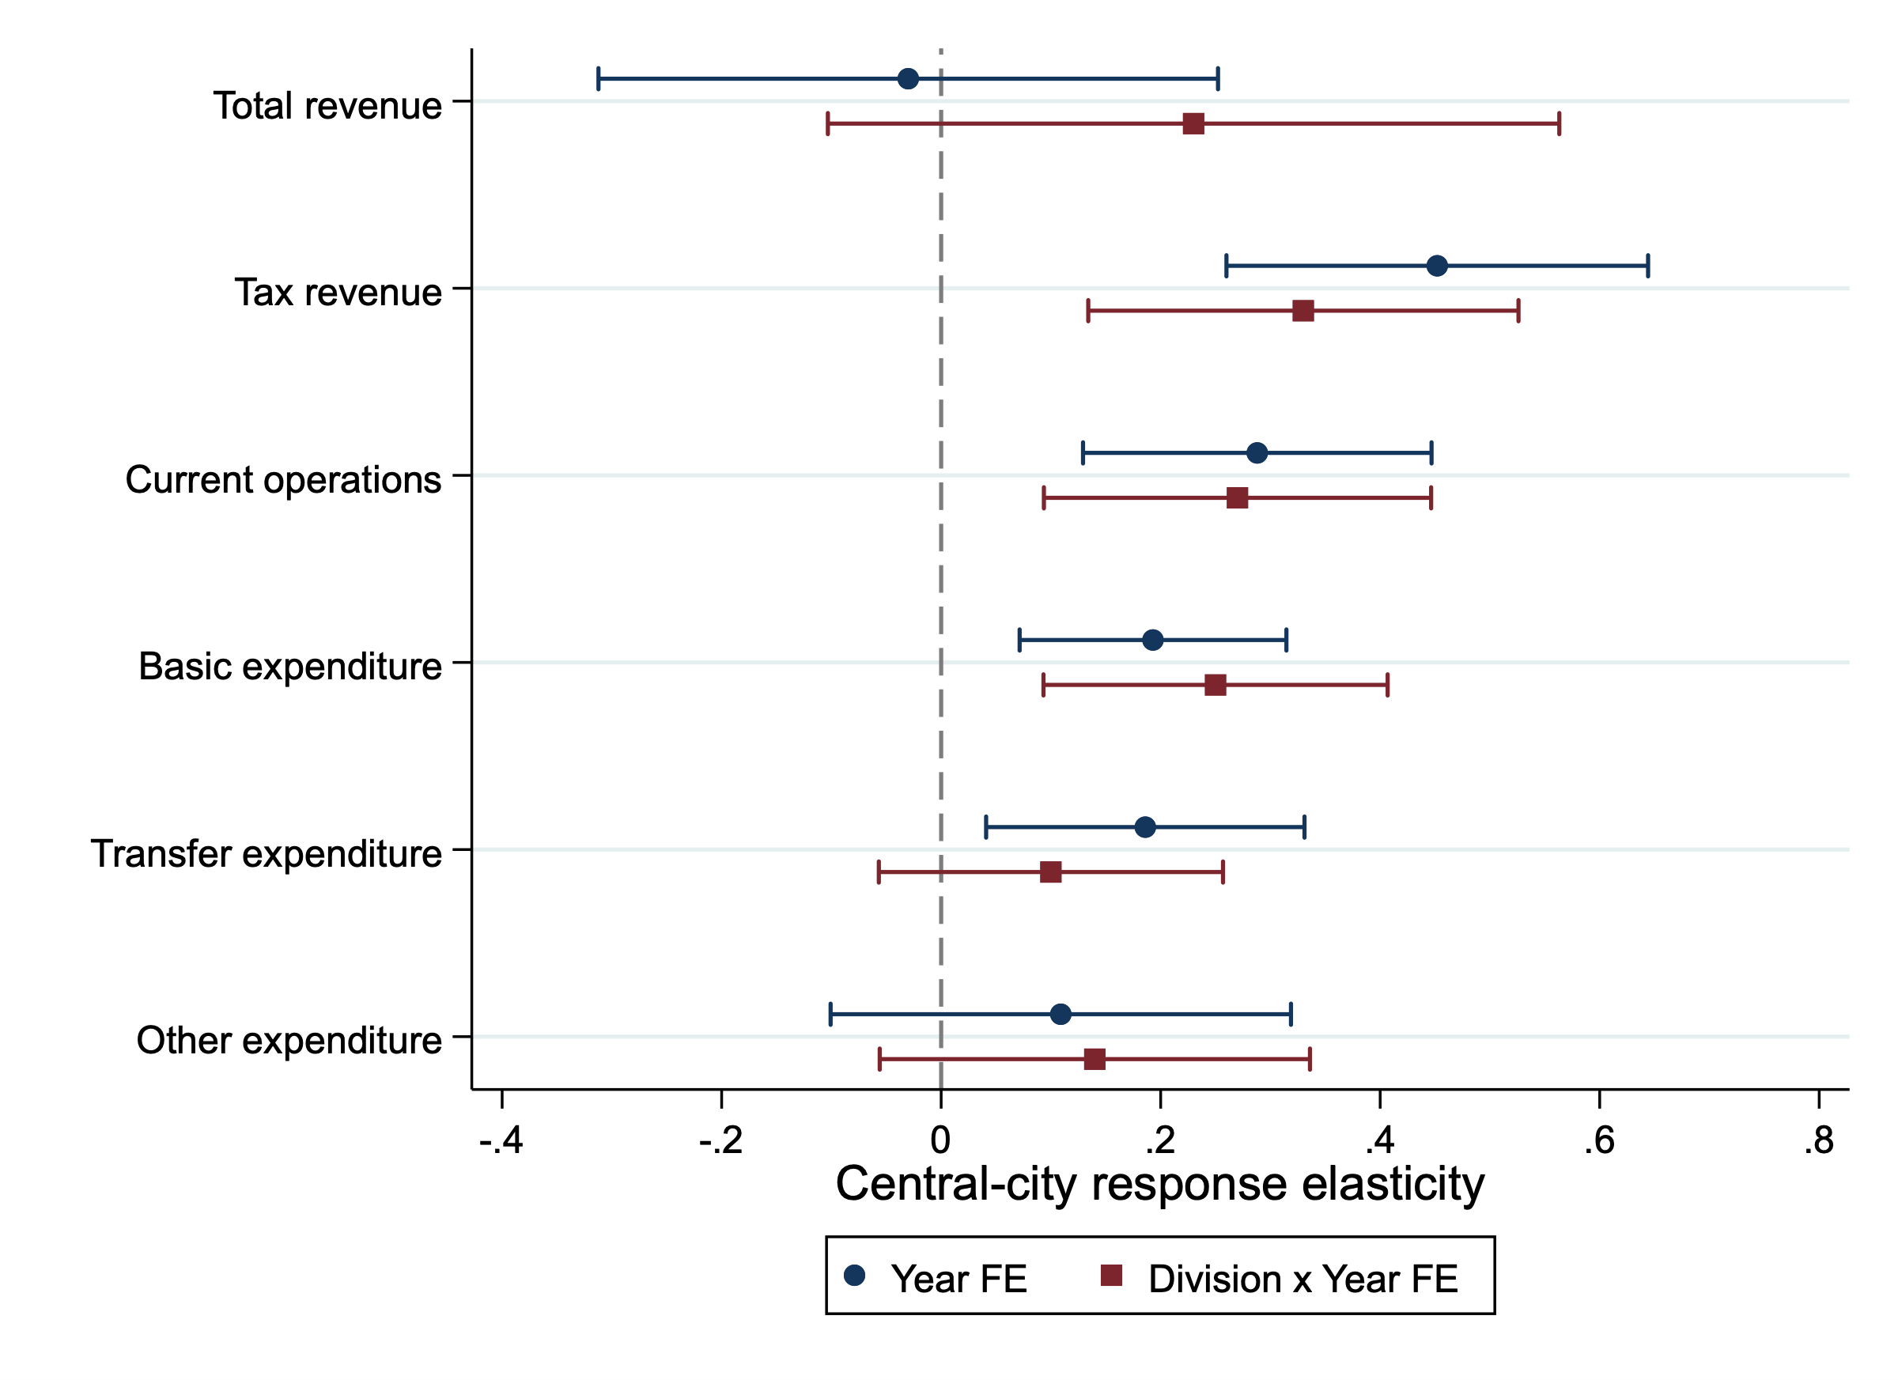
Division-by-year effects attenuate the benchmark response
Tax responses exceed basic-expenditure responses in point estimates.
Moving from Year FE to Division-by-year FE attenuates the estimates, but the tax response remains economically meaningful.
Rent Capture or Regional Forces?
Notes:
Out-of-state IV only; 2SLS estimates with 95% CIs. Link to the full table
Q: When suburban fiscal activity increases, how do central cities respond?
“The benchmark results suggest that central cities respond more strongly on the revenue side than on the expenditure side. The natural next question is: where does that tax response come from?”
Tax revenue has a larger estimated response than basic expenditure in the benchmark comparisons.
The reduction under division-by-year effects shows that the magnitude is sensitive to how we account for regional conditions.

Slide 17
Opening the “regional forces” black box
Sample and specification | Tax response（SE） | BE response（SE） | N
MSA FE + Year FE： baseline specification | 0.452*** （0.098） | 0.193*** （0.062） | 2,340
MSA FE + Division × Year FE | 0.33** （0.10） | 0.25*** （0.08） | 2,340
MSA FE + Year FE + MSA-specific trends | 0.465*** （0.100） | 0.184*** （0.061） | 2,340
Labor sample： baseline specification | 0.455*** （0.118） | 0.173** （0.075） | 1,300
＋ labor-demand shock | 0.455*** （0.119） | 0.173** （0.073） | 1,300
with Division × Year FE | 0.301*** （0.110） | 0.271** （0.107） | 1,300
BPS／HPI sample： baseline specification | 0.423*** （0.142） | 0.161* （0.0854） | 943
＋building permits | 0.418*** （0.144） | 0.160* （0.0852） | 943
＋HPI growth | 0.425*** （0.145） | 0.149* （0.0800） | 943
＋building permits ＋HPI growth | 0.424*** （0.145） | 0.161** （0.0785） | 943
with Division × Year FE | 0.244** （0.120） | 0.343*** （0.110） | 943
Labor and housing controls produce little change within matched samples.
Division-by-year effects have a larger impact on the Tax–BE comparison.
Rent Capture or Regional Forces?
Notes:
Out-of-state IV only; 2SLS estimates with 95% CIs. Link to the full table
Regional-controls ladder table: out-state IV only
*Within the labor and housing samples, adding the observed regional controls changes the estimates very little.
*Division-by-year effects have a larger influence, suggesting that these observed controls do not capture all of the relevant regional variation.

Slide 18
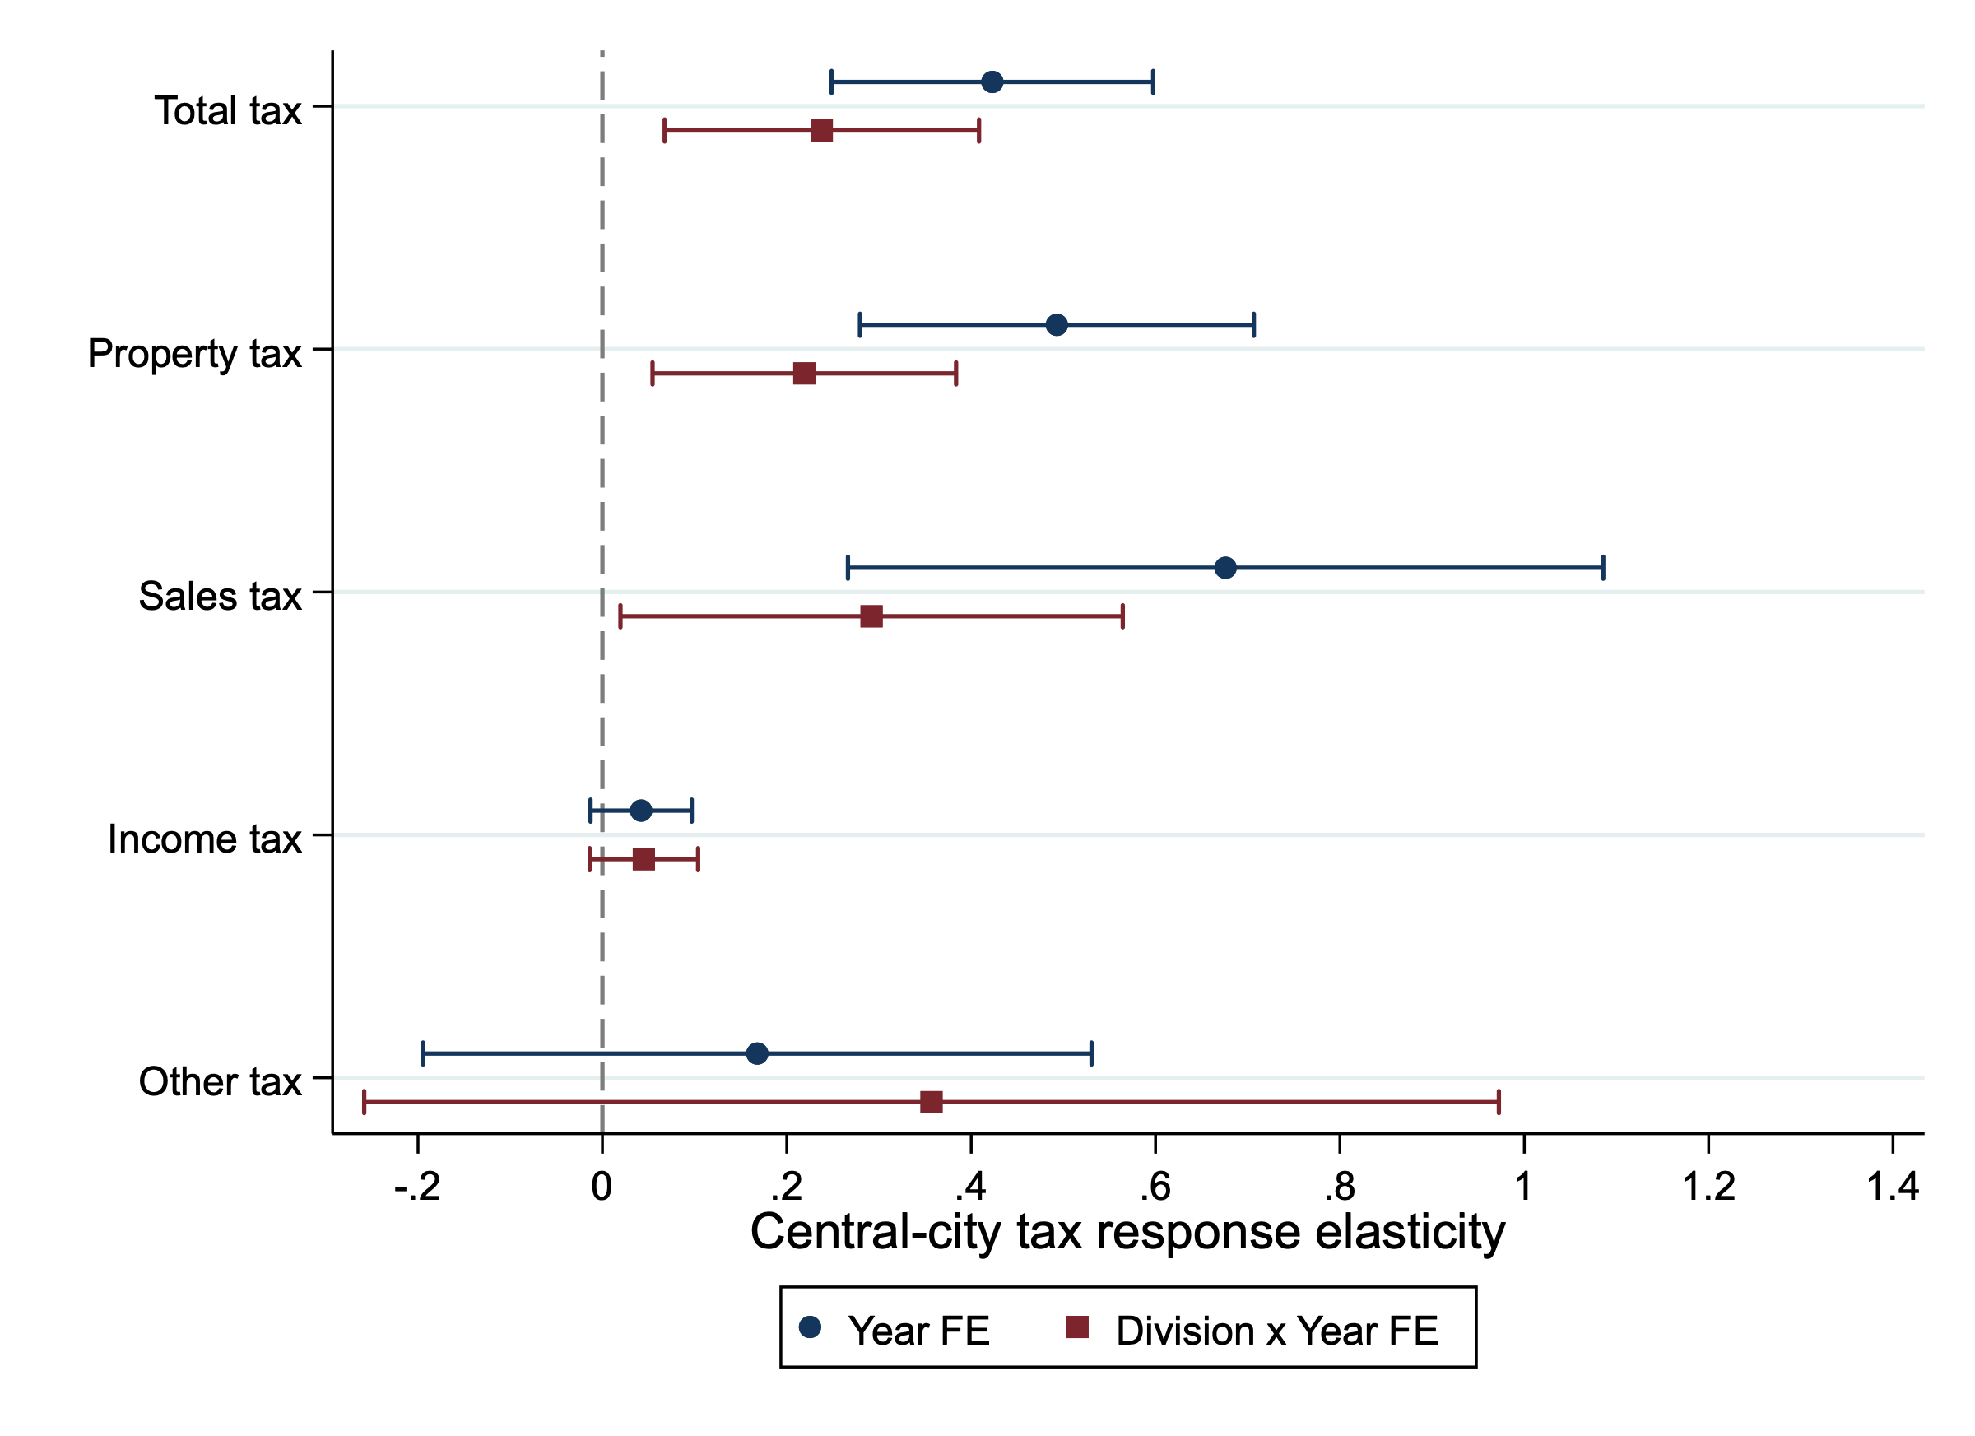
The tax response is concentrated in property and sales taxes
Positive responses in property and sales taxes.
Little evidence of an income-tax response.
Rent Capture or Regional Forces?
Notes:
Out-of-state IV only; 2SLS estimates with 95% CIs. Link to the full table
Which tax categories are driving the aggregate tax response?
“The aggregate tax response is not coming uniformly from all revenue sources. It appears to be concentrated in property and sales taxes, while the income-tax response is essentially zero.”
“So far these are contemporaneous responses. But if this is a meaningful fiscal adjustment rather than a one-year fluctuation, we should also ask whether the response accumulates over time.”
Regional-year effects attenuate magnitudes, but total, property, and sales tax responses remain positive.
The positive estimates are clearest for property and sales tax revenues. These results identify the revenue categories involved, although they do not separately identify changes in tax rates and tax bases.

Slide 19
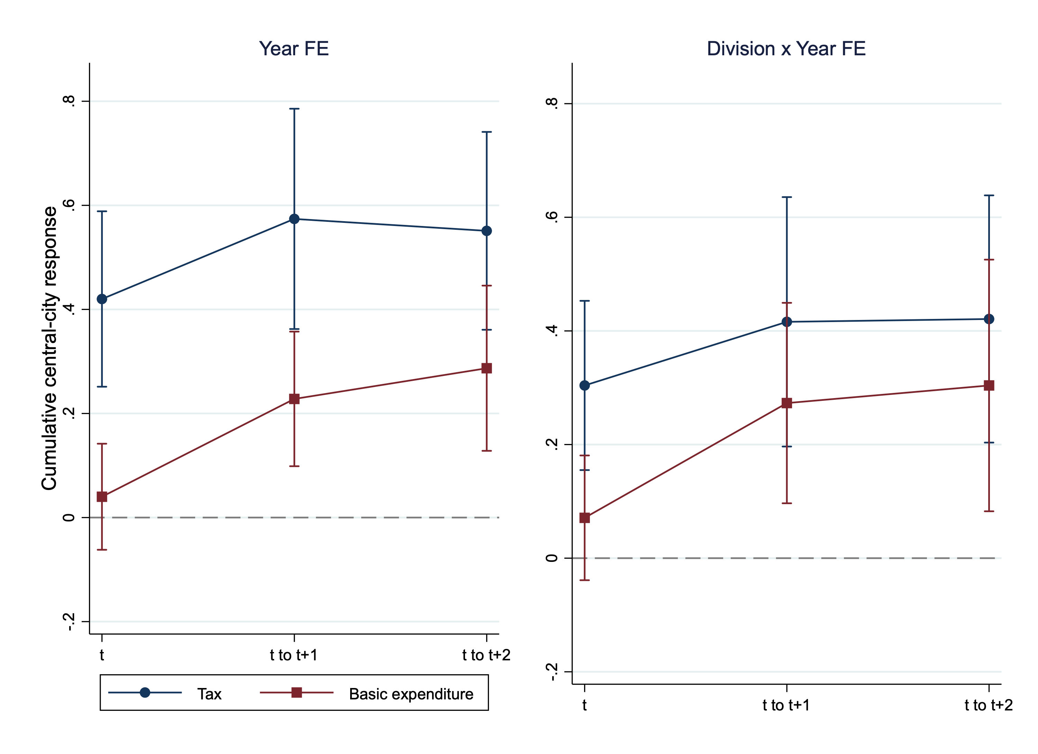
Division-by-year effects narrow the cumulative Tax–BE gap
The tax response extends beyond the contemporaneous period.
The Tax–BE gap narrows at cumulative horizons under division-by-year effects.
Rent Capture or Regional Forces?
Notes:
Out-of-state IV only; 2SLS estimates with 95% CIs. Link to the full table.
equality table 顯示：在 Division-by-year FE 下，Tax–BE 差距到 cumulative horizon 已經不顯著了。
Figure 3 — Dynamic cumulative response
Does the fiscal response persist or accumulate?
“The revenue response is not purely contemporaneous.
Under both specifications, the cumulative tax response remains positive over the next two years.
Basic expenditure also rises, but the revenue response is generally larger, especially under the simpler Year FE specification.”
“This pattern is consistent with a revenue response that is not fully translated into basic expenditure, although the gap becomes less sharp under stronger regional controls.”
With year FE, cumulative Tax exceeds BE through t+2.
With regional-year FE, the responses converge after t.

Slide 20
Identification and Robustness
SECTION 4
Notes:
Before drawing an economic interpretation from these patterns, I address three alternative explanations.

Slide 21
No evidence of reverse timing
Pre-outcome | Year FE | Division × year FE
City Tax, t−2 | −0.029 (0.069) | −0.013 (0.067)
City Tax, t−1 | 0.055 (0.060) | −0.016 (0.065)
City BE, t−2 | 0.003 (0.067) | −0.016 (0.073)
City BE, t−1 | 0.034 (0.050) | 0.030 (0.068)
Joint p-value | 0.862 | 0.959
N per equation | 2,920 | 2,920
No individual placebo is statistically significant.
The four pre-outcomes are jointly insignificant under both FE structures.
Rent Capture or Regional Forces?
Notes:
Reverse timing/pre-trend concern:
“Fundamental concern: Could central-city outcomes have moved before the suburban fiscal change?”
“Before interpreting these patterns economically, I want to address three alternative explanations. The first is reverse timing.”
“The pre-outcomes are individually and jointly insignificant, which is reassuring against a simple reverse-timing story.”
“The second concern is whether the apparent revenue–expenditure asymmetry is actually statistically distinguishable.”
*Neither the individual nor the joint placebo tests reject zero coefficients on earlier city fiscal outcomes.
*These results are reassuring about timing, although they do not establish the exclusion restriction.

Slide 22
Is the tax–expenditure gap statistically meaningful?
Fixed effects | Horizon | Tax (SE) | BE (SE) | Equality p
Year | t | 0.420*** (0.086) | 0.040 (0.052) | < .001
Year | through t+1 | 0.574*** (0.108) | 0.228*** (0.066) | .001
Year | through t+2 | 0.551*** (0.097) | 0.287*** (0.081) | .010
Division × year | t | 0.304*** (0.076) | 0.071 (0.056) | .005
Division × year | through t+1 | 0.416*** (0.112) | 0.273*** (0.090) | .208
Division × year | through t+2 | 0.421*** (0.111) | 0.304*** (0.113) | .297
N per equation |  | 2,920 | 2,920
At the contemporaneous horizon, the difference is significant under both FE specifications.
With division-by-year FE, equality is not rejected at cumulative horizons.
Rent Capture or Regional Forces?
Notes:
“Interpretation check: Are tax and basic expenditure really different??”
“At the contemporaneous horizon, the difference is significant under both FE specifications. But once we move to cumulative horizons, the two become statistically indistinguishable under the stronger fixed effects.”
“The strongest evidence for revenue–expenditure asymmetry is contemporaneous; over longer horizons, the distinction weakens once we absorb division-specific time shocks.”
“That raises a third question: could the cumulative pattern simply reflect persistence in city fiscal variables themselves?”
*The contemporaneous tax response exceeds the basic expenditure response under both fixed-effects specifications. With division-by-year effects, the cumulative differences are no longer statistically significant, but the equivalence test still does not establish that the responses lie within 0.10 of each other.

Slide 23
Fiscal persistence does not explain the cumulative estimates
Division × year FE outcome | No lag controls | + Lagged city Tax and BE
Tax at t | 0.304*** (0.076) | 0.315*** (0.079)
BE at t | 0.071 (0.056) | 0.071 (0.056)
Cumulative Tax through t+1 | 0.416*** (0.112) | 0.423*** (0.115)
Cumulative BE through t+1 | 0.273*** (0.090) | 0.279*** (0.083)
Cumulative Tax through t+2 | 0.421*** (0.111) | 0.430*** (0.114)
Cumulative BE through t+2 | 0.304*** (0.113) | 0.314*** (0.104)
N per equation | 2,920 | 2,851
Adding lagged city tax and basic expenditure barely changes the coefficients.
The cumulative pattern does not appear to be driven simply by fiscal persistence.
Rent Capture or Regional Forces?
Notes:
“Maybe city tax today predicts city tax tomorrow, so your cumulative effect is mechanical.”
“Adding lagged city tax and basic expenditure barely changes either the coefficients or the first-stage strength.”
“So the cumulative pattern does not appear to be driven simply by fiscal persistence.”
*The coefficients remain similar when lagged city Tax and BE are included. Because the lagged-control specification uses a smaller sample, this comparison combines the effects of adding controls and changing the sample.

Slide 24
Interim Takeaway
Rent Capture or Regional Forces?
The response is concentrated in property and sales taxes and persists beyond the contemporaneous period.
The tax–expenditure difference narrows under stronger regional controls and over longer horizons.

Slide 25
Quasi-experimental validation (ongoing)
SECTION 5

Slide 26
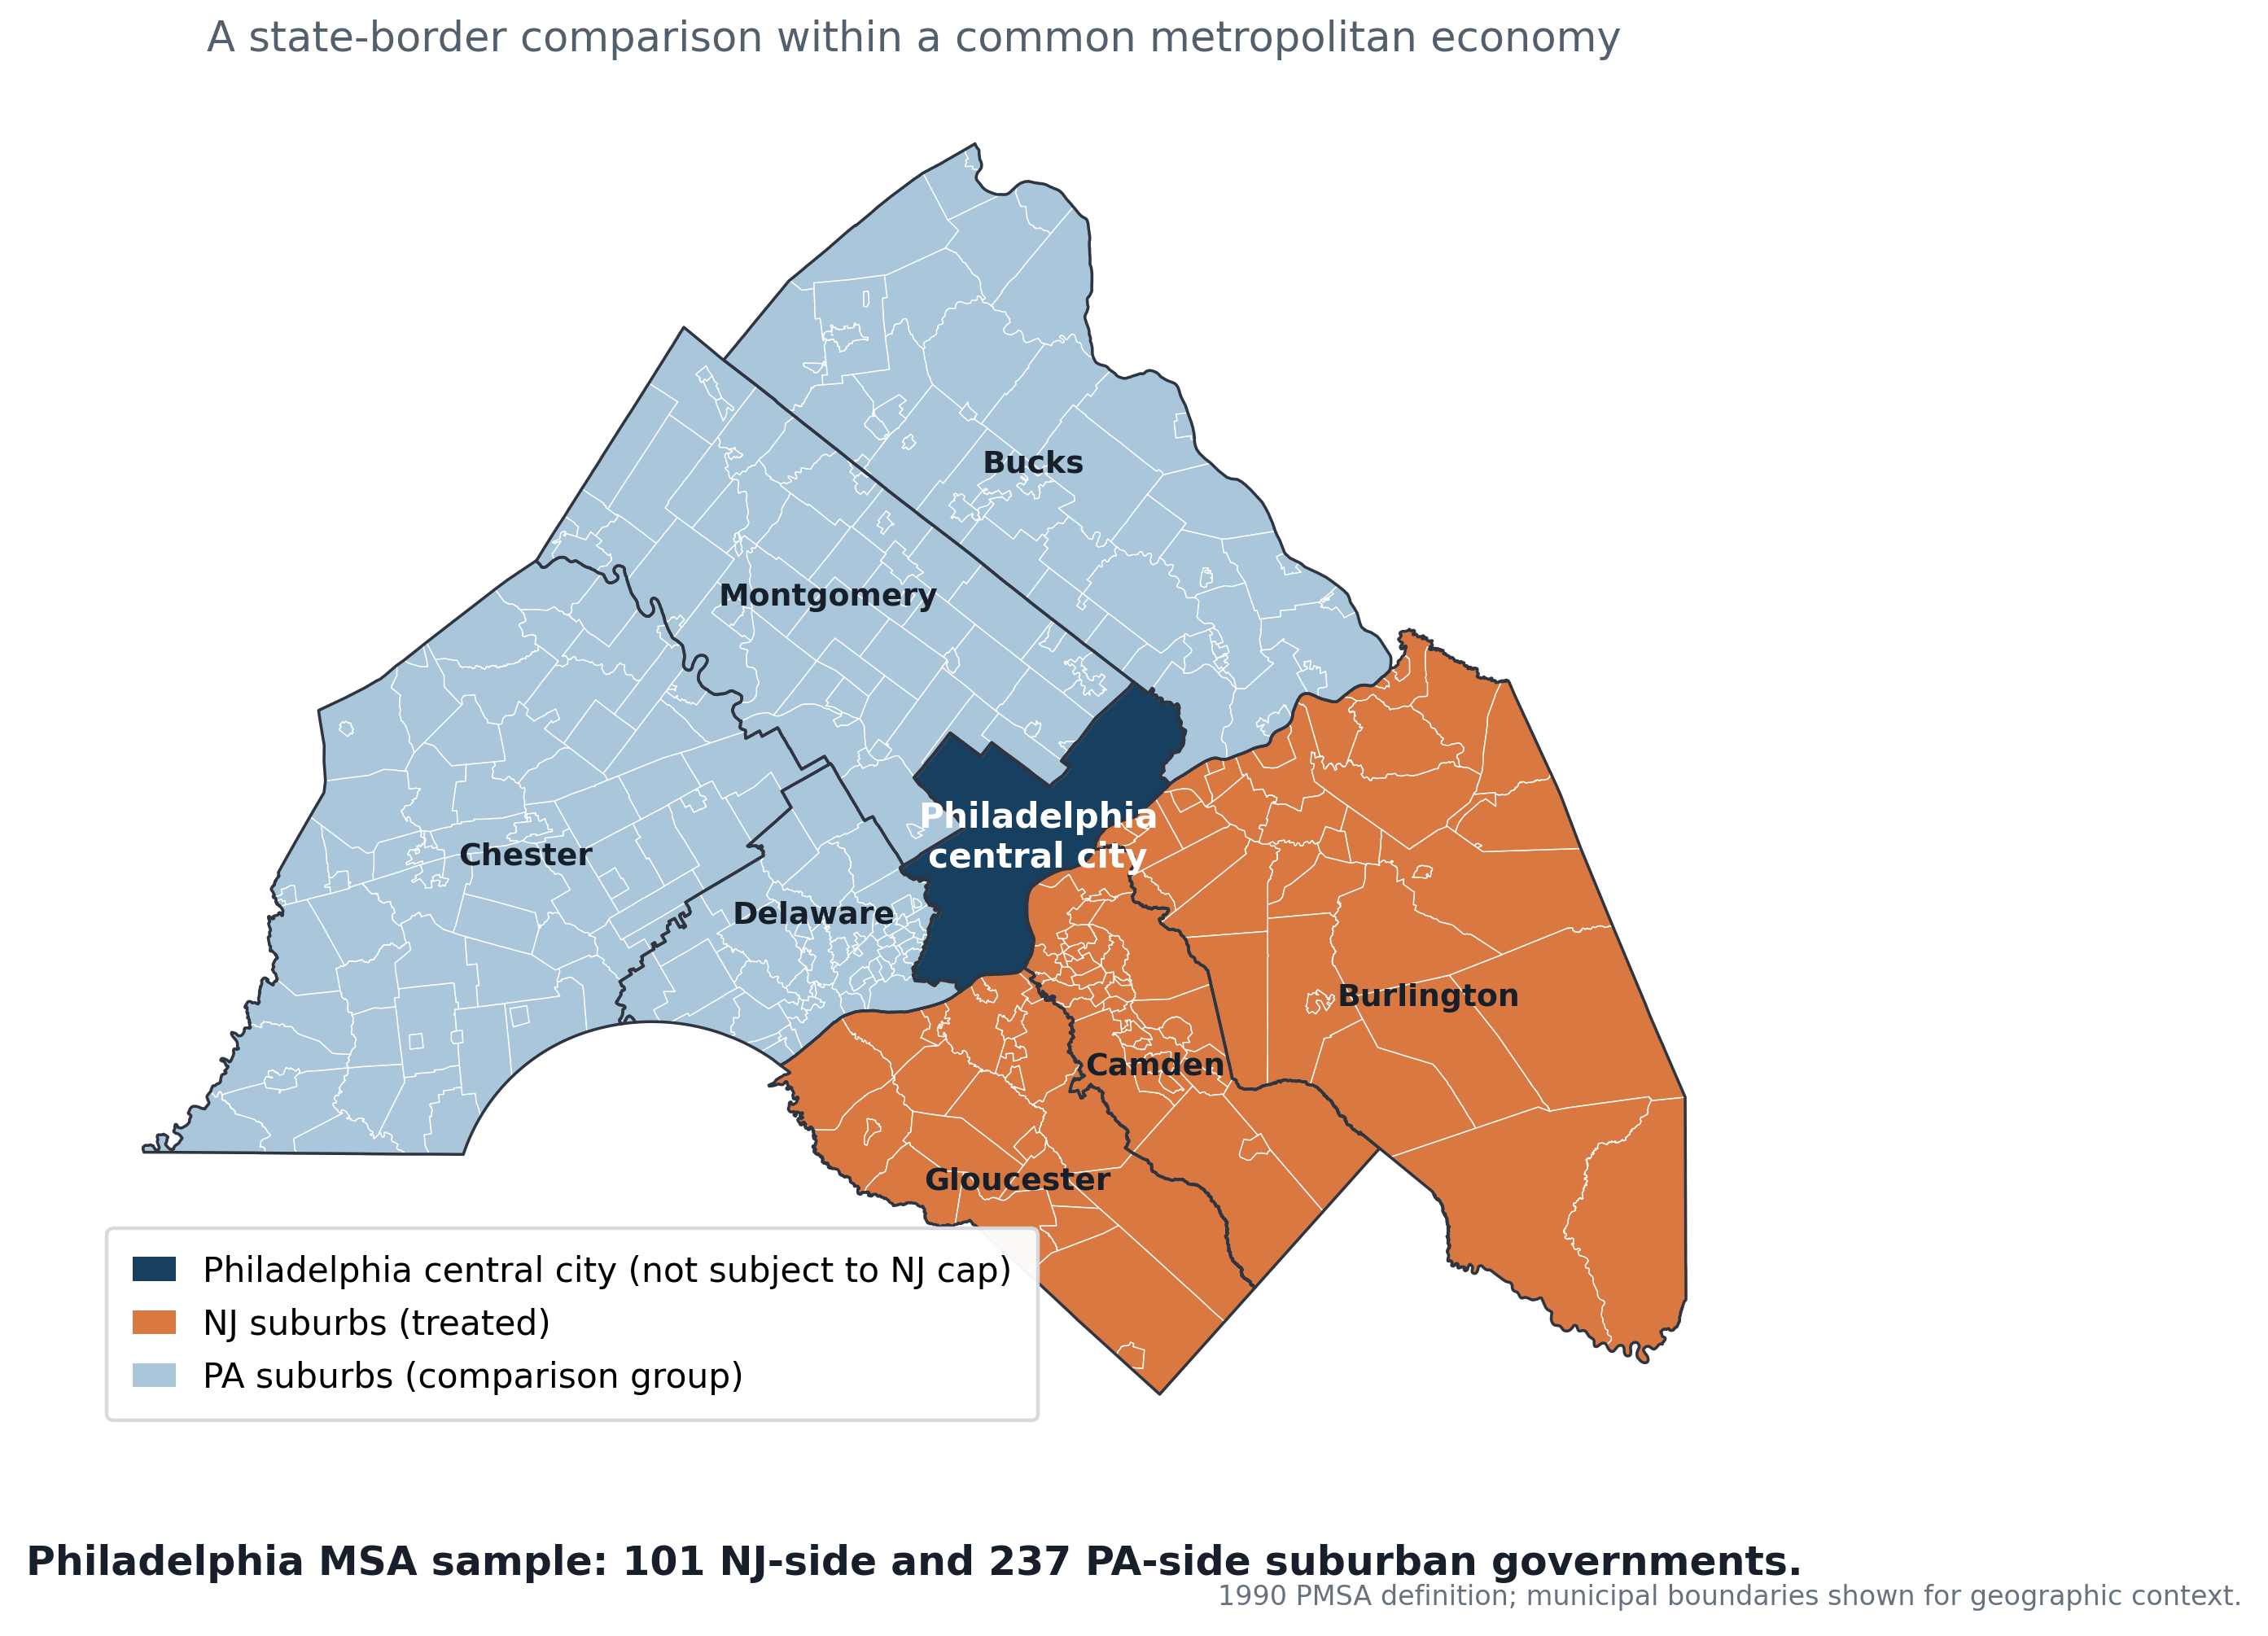
Ongoing design 1: New Jersey’s Property-Tax Levy Caps
2007 law: 4% levy-growth cap, with statutory exceptions.
2010 law: 2% cap, applicable to calendar-year budgets beginning in 2011.
Setting: NJ and PA suburbs within the Philadelphia metropolitan area.
Rent Capture or Regional Forces?
Notes:
2007: New Jersey limited annual property-tax levy growth to 4% for municipalities, counties, and fire districts, subject to waivers and statutory exclusions.
2010: The cap was tightened to 2%, with fewer waivers and modified exclusions.
Identification: Compare fiscal outcomes across suburban governments exposed to the same metropolitan economy but located on opposite sides of the New Jersey–Pennsylvania policy border.
External validation: We additionally examine New Jersey’s 2007 and 2010 levy caps within the Philadelphia metropolitan area, providing a second policy setting with a different statutory mechanism.
This setting provides policy variation across suburbs within the same metropolitan economy. The first task is to establish the suburban fiscal response, followed by a credible comparison for Philadelphia’s own response.

Slide 27
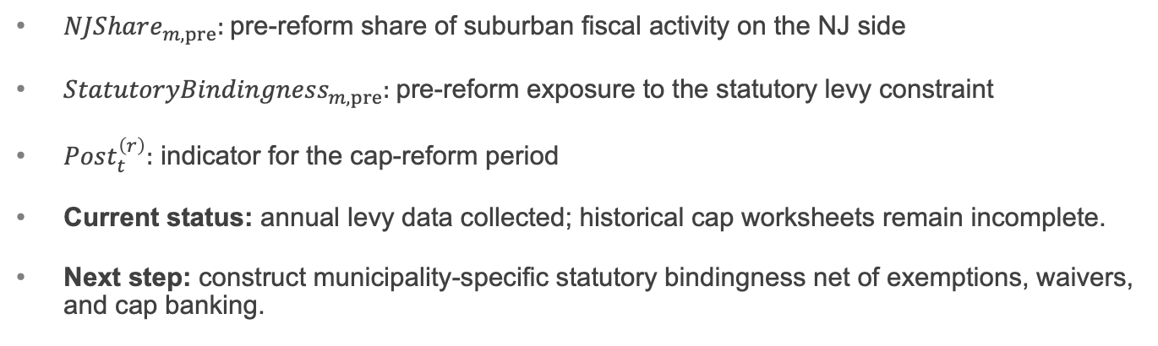

Ongoing design 1: New Jersey’s Property-Tax Levy Caps
$$E_{m}=NJShare_{m,pre}×StatutoryBindingness_{m,pre}$$
$$Z_{mt}^{\left(r\right)}=E_{m}×Post_{t}^{\left(r\right)}, r∈\left\{4\%,2\%\right\}$$
$NJShare_{m,pre}:$pre-reform share of suburban fiscal activity on the NJ side
$StatutoryBindingness_{m,pre}:$pre-reform exposure to the statutory levy constraint
$Post_{t}^{\left(r\right)}:$ indicator for the cap-reform period
Current status: annual levy data collected; historical cap worksheets remain incomplete.
Next step: construct municipality-specific statutory bindingness net of exemptions, waivers, and cap banking.
Rent Capture or Regional Forces?
Notes:
Proposed instrument
The proposed exposure measure combines predetermined suburban exposure with the timing of the cap reforms. Historical worksheets are still needed to distinguish statutory bindingness from a proxy based on earlier levy growth.

Slide 28
Preliminary levy-exposure diagnostic: Philadelphia-Area NJ Municipalities
Levy paths differ by the exposure measure.
Substantial pre-reform trends require further investigation.
Rent Capture or Regional Forces?
Notes:
Not causal event-study evidence.
It should be: Descriptive first-stage pattern
Or Evolution of the bindingness gradient around the reforms
And say:
“This is not yet the reduced-form treatment effect. It documents whether predetermined statutory exposure translates into differential levy growth around the two reforms.”
Municipalities with greater pre-reform bindingness exhibit systematically different levy paths around the 2007 introduction and the 2010 tightening.
The institutional design uses this predetermined cross-sectional exposure—not the statutory reform dates alone—to isolate differential treatment intensity.
Say: This graph documents how levy paths differ across the exposure measure, including substantial differences before the reform. I therefore treat it as a preliminary diagnostic while refining the exposure construction and counterfactual.

Slide 29
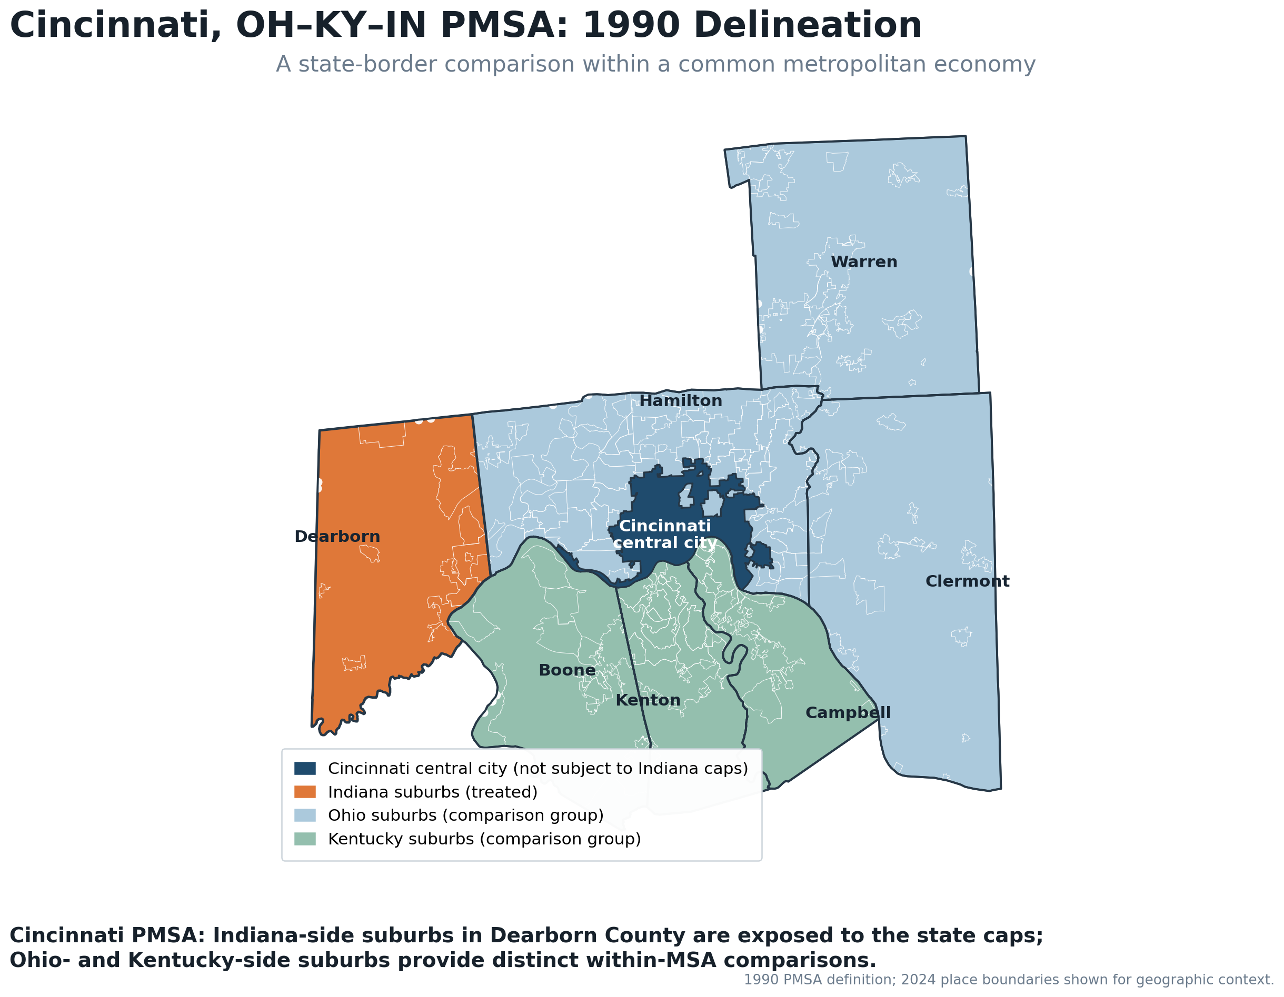
Ongoing design 2: Indiana Property-Tax Circuit-Breaker Caps
Phased implementation culminated in the full caps in 2010.
Indiana-side suburbs were directly exposed; Cincinnati and the Ohio/Kentucky sides were outside Indiana’s statutory regime.
Rent Capture or Regional Forces?
Notes:
The Cincinnati metropolitan area spans three states. Indiana-side suburbs in Dearborn County were exposed to Indiana’s property-tax caps, while Ohio- and Kentucky-side suburbs provide two geographically distinct comparison groups within the same metropolitan economy. Cincinnati’s central city, located in Ohio, was not directly subject to the Indiana policy.
“Indiana’s property-tax caps have been studied previously, particularly their incidence and the incentives created among overlapping taxing units. Our use of the reform is different. We exploit the fact that metropolitan economies cross state borders and ask whether a fiscal constraint imposed on Indiana-side suburbs changes the fiscal behavior of an untreated central city.”
Existing evidence: Indiana’s caps generated heterogeneous revenue losses and strategic incentives across overlapping local governments (Ross et al. 2015), with broader regional consequences documented through simulation-based analysis (Thaiprasert et al. 2013).
This paper: We use cross-state variation within metropolitan areas to test whether cap-induced fiscal constraints on Indiana suburbs affect untreated central cities.
Say: Indiana’s caps create policy exposure on one side of the Cincinnati metropolitan area. Cincinnati itself lies outside Indiana, allowing us to investigate fiscal spillovers while still accounting for other cross-border economic effects.
Indiana’s Phased Property-Tax Caps:
2008 reform
2009 transitional caps
2010 full 1%–2%–3% caps
Circuit-breaker credits create revenue losses for local taxing units
Cross-border geography:
Indiana-side suburbs in Dearborn County were exposed to the caps; Cincinnati and the Ohio/Kentucky suburban governments were outside Indiana’s statutory regime.

Slide 30
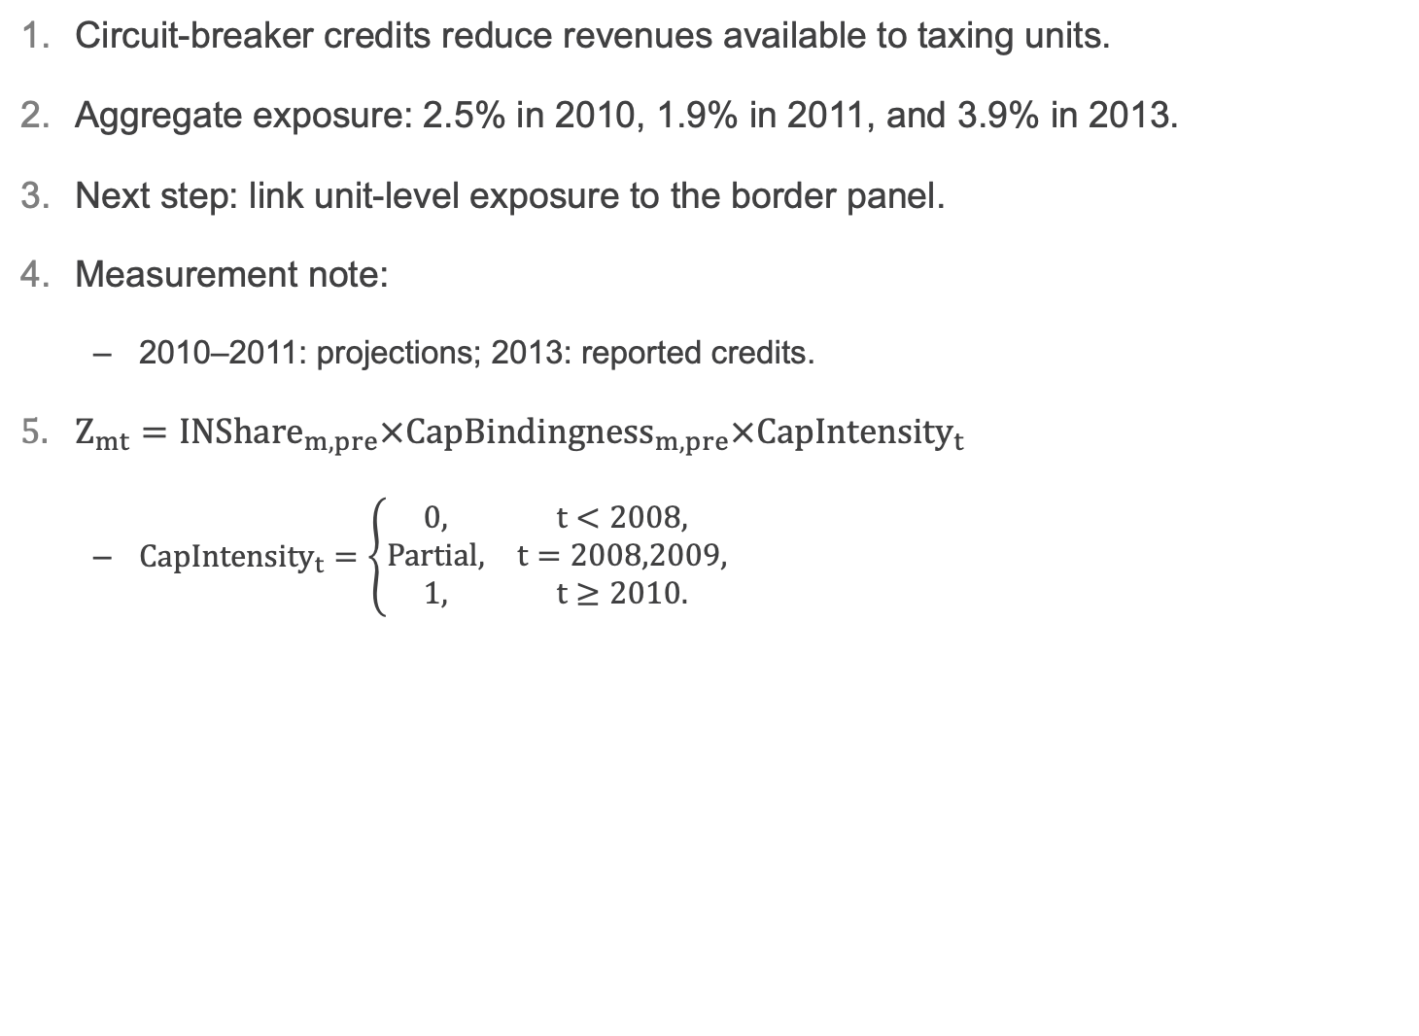
Ongoing design 2: Indiana Property-Tax Caps
Circuit-breaker credits reduce revenues available to taxing units.
Aggregate exposure: 2.5% in 2010, 1.9% in 2011, and 3.9% in 2013.
Next step: link unit-level exposure to the border panel.
Measurement note:
  2010–2011: projections; 2013: reported credits.
$Z_{mt}=INShare_{m,pre}×CapBindingness_{m,pre}×CapIntensity_{t}$
  $CapIntensity_{t}=\left\{\begin{matrix}0, & t<2008, \\ \text{Partial}, & t=2008,2009, \\ 1, & t≥2010.\end{matrix}\right.$
Rent Capture or Regional Forces?
Notes:
Unlike a conventional levy cap, Indiana’s circuit breaker does not mechanically constrain the certified local levy.
It caps the taxpayer’s liability and converts the excess into a credit, which becomes a direct revenue loss for local taxing units.
The newly obtained DLGF records show that this exposure was economically meaningful and highly uneven across the 21 Indiana-side governments in the Cincinnati metropolitan area.
Indiana’s property-tax caps limit taxpayers’ liabilities. County auditors apply circuit-breaker credits to amounts above the caps, reducing revenue received by local taxing units.
Across Dearborn County’s 21 general-purpose governments, official DLGF credit estimates equaled 2.5% of levy in 2010, 1.9% in 2011, and 3.9% of abstract levy in 2013.
Exposure varied substantially across governments. In 2013, credits reached 10.5% of levy in Greendale, 9.6% in West Harrison, and 7.7% in Aurora.
Next step: Merge annual unit-level credits into the Cincinnati border panel and compare Indiana suburbs with the Ohio and Kentucky sides.
The records show economically meaningful and uneven exposure across local governments. Cross-year comparisons require care because the earlier files contain projections and the levy denominators differ.

Slide 31
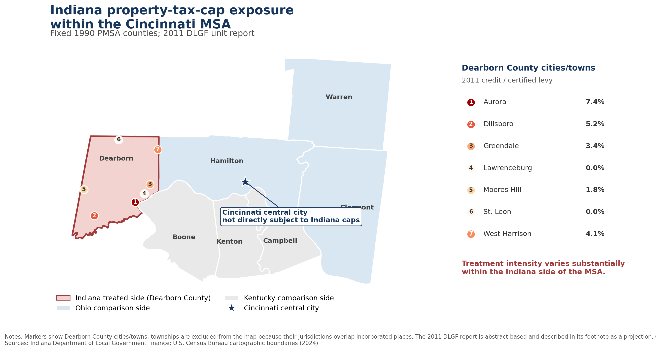
Notes:
Say: This map shows the identifying geography and the variation in exposure across Indiana-side municipalities. I am using these records to develop the suburban first stage, alongside a separate levy-cap design in New Jersey.

Slide 32
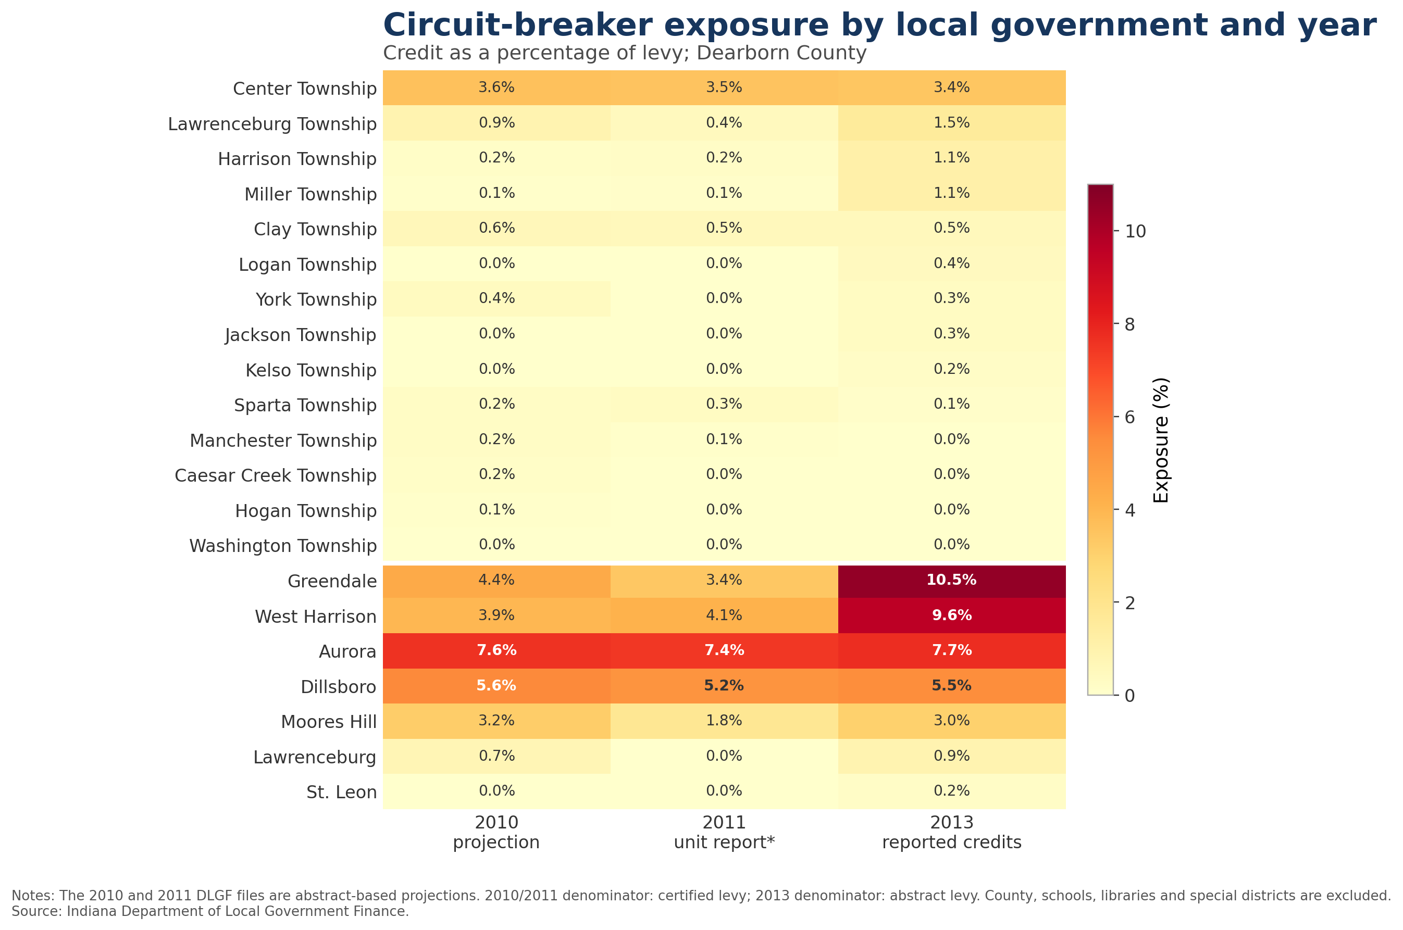
Notes:
Say: The detailed values show that exposure is concentrated in particular municipalities, while many townships have little recorded exposure. These differences help guide the construction of treatment intensity.

Slide 33
Conclusion
Central-city tax responses are positive, especially for property and sales taxes.
The Tax–BE gap narrows at longer horizons and under division-by-year effects.
Evidence for persistent rent capture remains limited; institutional designs are ongoing.
Rent Capture or Regional Forces?
Notes:
1.Suburban fiscal expansion predicts an increase in central-city tax revenue, concentrated in property and sales taxes.
2.The contemporaneous expenditure response is smaller, but the tax–expenditure gap narrows over longer horizons and under division-by-year fixed effects.
3.These patterns provide limited evidence of short-run fiscal retention, while also indicating an important role for common regional forces.
4.Ongoing institutional designs will test whether externally induced suburban fiscal constraints generate corresponding central-city responses.
5.Takeaway: Central cities raise tax revenue when suburban fiscal activity expands, but the evidence points to short-run fiscal retention rather than persistent rent capture, with common regional forces explaining part of the relationship.
Say: The central finding is a positive tax response whose interpretation depends on regional controls and adjustment timing. Establishing whether this reflects causal fiscal spillovers or rent capture is the next step of the institutional analysis.

Slide 34
Appendix / Q&A

Slide 35
Appendix: Benchmark IV — Year Fixed Effects
First stage and 2SLS estimates using the out-of-state instrument only
 | Total revenue | Tax revenue | Current operations | Basic expenditure | Transfer expenditure | Other expenditure
Panel A. First stage
Out-of-state IV | −10.625*** (1.905) | −14.419*** (1.691) | −10.970*** (1.792) | −14.006*** (1.886) | −9.413*** (1.701) | −15.836*** (1.958)
N | 2,340 | 2,340 | 2,340 | 2,340 | 2,337 | 2,340
Panel B. Structural equation (2SLS)
Suburban fiscal growth | −0.030 (0.144) | 0.452*** (0.098) | 0.288*** (0.081) | 0.193** (0.062) | 0.186* (0.074) | 0.109 (0.107)
Kleibergen–Paap F | 31.13 | 72.70 | 37.49 | 55.18 | 30.60 | 65.43
asd
Notes: Standard errors in parentheses. * p<0.10, ** p<0.05, *** p<0.01. Preferred instrument: leave-one-out out-of-state suburban fiscal growth.

Slide 36
Appendix: Benchmark IV — Division × Year Fixed Effects
First stage and 2SLS estimates using the out-of-state instrument only
 | Total revenue | Tax revenue | Current operations | Basic expenditure | Transfer expenditure | Other expenditure
Panel A. First stage
Out-of-state IV | −12.64*** (2.12) | −17.44*** (2.63) | −12.88*** (1.90) | −16.20*** (2.50) | −8.82*** (1.55) | −14.97*** (2.33)
N | 2,340 | 2,340 | 2,340 | 2,340 | 2,337 | 2,340
Panel B. Structural equation (2SLS)
Suburban fiscal growth | 0.23 (0.17) | 0.33** (0.10) | 0.27** (0.09) | 0.25** (0.08) | 0.10 (0.08) | 0.14 (0.10)
Kleibergen–Paap F | 35.54 | 43.83 | 46.05 | 42.11 | 32.12 | 41.35
Notes: Standard errors in parentheses. * p<0.10, ** p<0.05, *** p<0.01. Preferred instrument: leave-one-out out-of-state suburban fiscal growth.

Slide 37
Instrument comparison
Kleibergen-Paap first-stage F-statistics across instrument sets
Preferred IV: Out-of-state suburban fiscal variation provides both stronger conditional relevance and cleaner separation from focal-state fiscal policy shocks.
Notes:
First-stage relevance
• Joint IV specification: generally adequate first stage
• Out-of-state IV: remains strong across FE specifications
• In-state IV: weak/unstable once Division × Year shocks are absorbed
Exclusion consideration
Same-state suburbs may share:
• State aid formulas
• Tax/expenditure limitations
• State fiscal reforms
• Other statewide fiscal shocks
Out-of-state IV reduces exposure to these common state-policy channels.
Q: But couldn't out-of-state suburbs also be affected by national shocks that directly affect your central cities?
Ans: Yes. Moving out of state does not by itself eliminate common national or regional shocks. That's why the specification includes year fixed effects, and in the more demanding specification, division-by-year fixed effects, together with the regional controls. The motivation for the out-of-state construction is narrower: it removes the direct common-state-policy channel while the fixed effects and controls address broader common shocks.
整套 identification strategy 串起來了：
State-level common shocks→​Exclude same-state peers
National common shocks→Year FE
Regional common shocks→ Division×Year FE
Observable regional conditions​→Regional controls​​

Slide 38
Diagnostic: Why Prefer the Out-of-State IV?
Outcome | Raw In | Raw Out | Year FE In | Year FE Out | Div×Year In | Div×Year Out
TR | .252 | .286 | .091 | −.459 | −.178 | −.406
TT | .424 | .298 | .296 | −.563 | −.005 | −.510
CO | .301 | .344 | .125 | −.474 | −.137 | −.431
BE | .318 | .335 | .152 | −.501 | −.096 | −.440
TranE | .078 | .101 | .022 | −.275 | −.225 | −.238
OE | .290 | .236 | .186 | −.532 | −.118 | −.469
The in-state instrument is not inherently uncorrelated with suburban fiscal changes.
Rather, much of its predictive content is associated with common geographic/time variation; once division-by-year shocks are absorbed, very little independent variation remains for tax revenue.
Notes:
out-of-state IV 有一個非常值得注意的結果: raw correlation 是 positive，但是 conditional relationship 是 strongly negative。
所以 out-of-state IV 的 strength 並不是來自 simple raw comovement。
反而是：$\text{common aggregate variation removed} ⇒ \text{strong conditional relationship emerges}.$
而且這個 pattern 六個 outcomes 幾乎全部一致，所以不像 accidental noise。
這也很好地解釋：Why can the out-of-state KP F be strong even though raw correlation isn't particularly impressive?
因為 first-stage F/KP F 看的是 conditional first stage，不是 raw correlation。

Slide 39
Tax decomposition regression table
Fixed effects | Total tax | Property | Sales | Income | Other | KP F / N
Year FE | 0.423*** (0.089) | 0.493*** (0.109) | 0.676*** (0.209) | 0.042 (0.028) | 0.168 (0.185) | 30.09 / 2,340
Division × Year FE | 0.238*** (0.087) | 0.219*** (0.084) | 0.292** (0.139) | 0.045 (0.030) | 0.357 (0.314) | 18.51 / 2,340
Property and sales-tax components carry most of the total-tax response; income-tax responses are small and statistically imprecise.
Notes: Standard errors in parentheses. * p<0.10, ** p<0.05, *** p<0.01.

Slide 40
Regional controls and first-stage strength
Sample and specification | Tax response （SE） | Tax KP F | BE response （SE） | BE KP F | N
MSA FE + Year FE： baseline specification | 0.452*** （0.098） | 72.70 | 0.193*** （0.062） | 55.18 | 2,340
MSA FE + Division × Year FE | 0.33** （0.10） | 43.83 | 0.25*** （0.08） | 42.11 | 2,340
MSA FE + Year FE + MSA-specific trends | 0.465*** （0.100） | 71.97 | 0.184*** （0.061） | 54.97 | 2,340
Labor sample： baseline specification | 0.455*** （0.118） | 62.30 | 0.173** （0.075） | 46.06 | 1,300
＋ labor-demand shock | 0.455*** （0.119） | 62.26 | 0.173** （0.073） | 46.74 | 1,300
with Division × Year FE | 0.301*** （0.110） | 27.03 | 0.271** （0.107） | 28.83 | 1,300
BPS／HPI sample： baseline specification | 0.423*** （0.142） | 48.29 | 0.161* （0.0854） | 46.55 | 943
＋building permits | 0.418*** （0.144） | 46.57 | 0.160* （0.0852） | 46.20 | 943
＋HPI growth | 0.425*** （0.145） | 46.24 | 0.149* （0.0800） | 46.55 | 943
＋building permits ＋HPI growth | 0.424*** （0.145） | 45.93 | 0.161** （0.0785） | 46.01 | 943
with Division × Year FE | 0.244** （0.120） | 26.55 | 0.343*** （0.110） | 34.37 | 943
Notes:
Out-of-state IV only; 2SLS estimates with 95% CIs. Link to the full table
This table reports the full set of matched-sample comparisons and first-stage diagnostics. It helps distinguish changes associated with the controls from changes associated with sample coverage.

Slide 41
Robustness check:
Baseline characteristics interacted with year effects
Baseline exposure × Year | Tax response （SE） | Tax KP F | BE response （SE） | BE KP F | N
Suburban population share | 0.460*** （0.099） | 77.57 | 0.220*** （0.062） | 52.84 | 2,340
Fragmentation: Numbers of suburban govts | 0.446*** （0.098） | 75.42 | 0.193*** （0.062） | 55.12 | 2,340
Fiscal dependence | 0.477*** （0.104） | 74.58 | 0.204*** （0.061） | 68.37 | 2,340
Spatial structure: average ring | 0.442*** （0.097） | 76.92 | 0.202*** （0.060） | 62.21 | 2,340
Notes:
Baseline characteristics: 1972
Say: These specifications allow fiscal trajectories to differ with baseline metropolitan characteristics. The estimates remain close to the Year FE benchmark, providing an additional sensitivity check.

Slide 42
Expanded-Sample Robustness:
Out-of-State IV Using 68 MSAs
Outcome | Year FE | Division × Year FE
Total Revenue | 0.060 (0.121) | 0.17 (0.13)
Tax Revenue | 0.436* (0.086) | 0.33* (0.08)
Current Operations | 0.248*** (0.067) | 0.17* (0.07)
Basic Expenditure | 0.150** (0.052) | 0.17** (0.06)
Transfer Expenditure | 0.190** (0.058) | 0.11 (0.06)
Other Expenditure | 0.091 (0.087) | 0.06 (0.07)
MSAs | 68 | 68
KP F-stat., range | 31.8–84.4 | 30.5–72.7
Expanded-sample estimates closely track the 52-MSA benchmark, indicating that the results are not driven by the original sample restriction required for the in-state IV.
Notes:
The main specification retains the 52-MSA common sample inherited from the original two-instrument design. This appendix re-estimates the preferred out-of-state-IV specification on the expanded 68-MSA sample. The additional 16 MSAs are located in states represented by a single sampled MSA, for which the in-state leave-one-out instrument is unavailable but the out-of-state instrument remains well defined.
The 52-MSA restriction is inherited from our original specification using both in-state and out-of-state instruments. Because the in-state instrument cannot be constructed for states represented by only one MSA, that specification restricted the common sample to 52 MSAs. Once we move to the preferred out-of-state instrument alone, that restriction is no longer necessary. As a robustness check, I therefore expand the sample back to all 68 MSAs. The results are very similar—for example, the tax-revenue coefficient is 0.44 with year fixed effects and 0.33 with division-by-year fixed effects—so the main findings are not driven by the original 52-MSA sample restriction.

Slide 43
Appendix: Ongoing design 1: New Jersey’s Property-Tax Levy Caps
NJ exposure-gradient diagnostic: statewide sample
Notes:
Not causal event-study evidence.
It should be: Descriptive first-stage pattern
Or Evolution of the bindingness gradient around the reforms
And say:
“This is not yet the reduced-form treatment effect. It documents whether predetermined statutory exposure translates into differential levy growth around the two reforms.”
A similar exposure pattern appears in the statewide sample. The pre-reform movement remains important, so the broader sample does not resolve the identification issue.

Slide 44
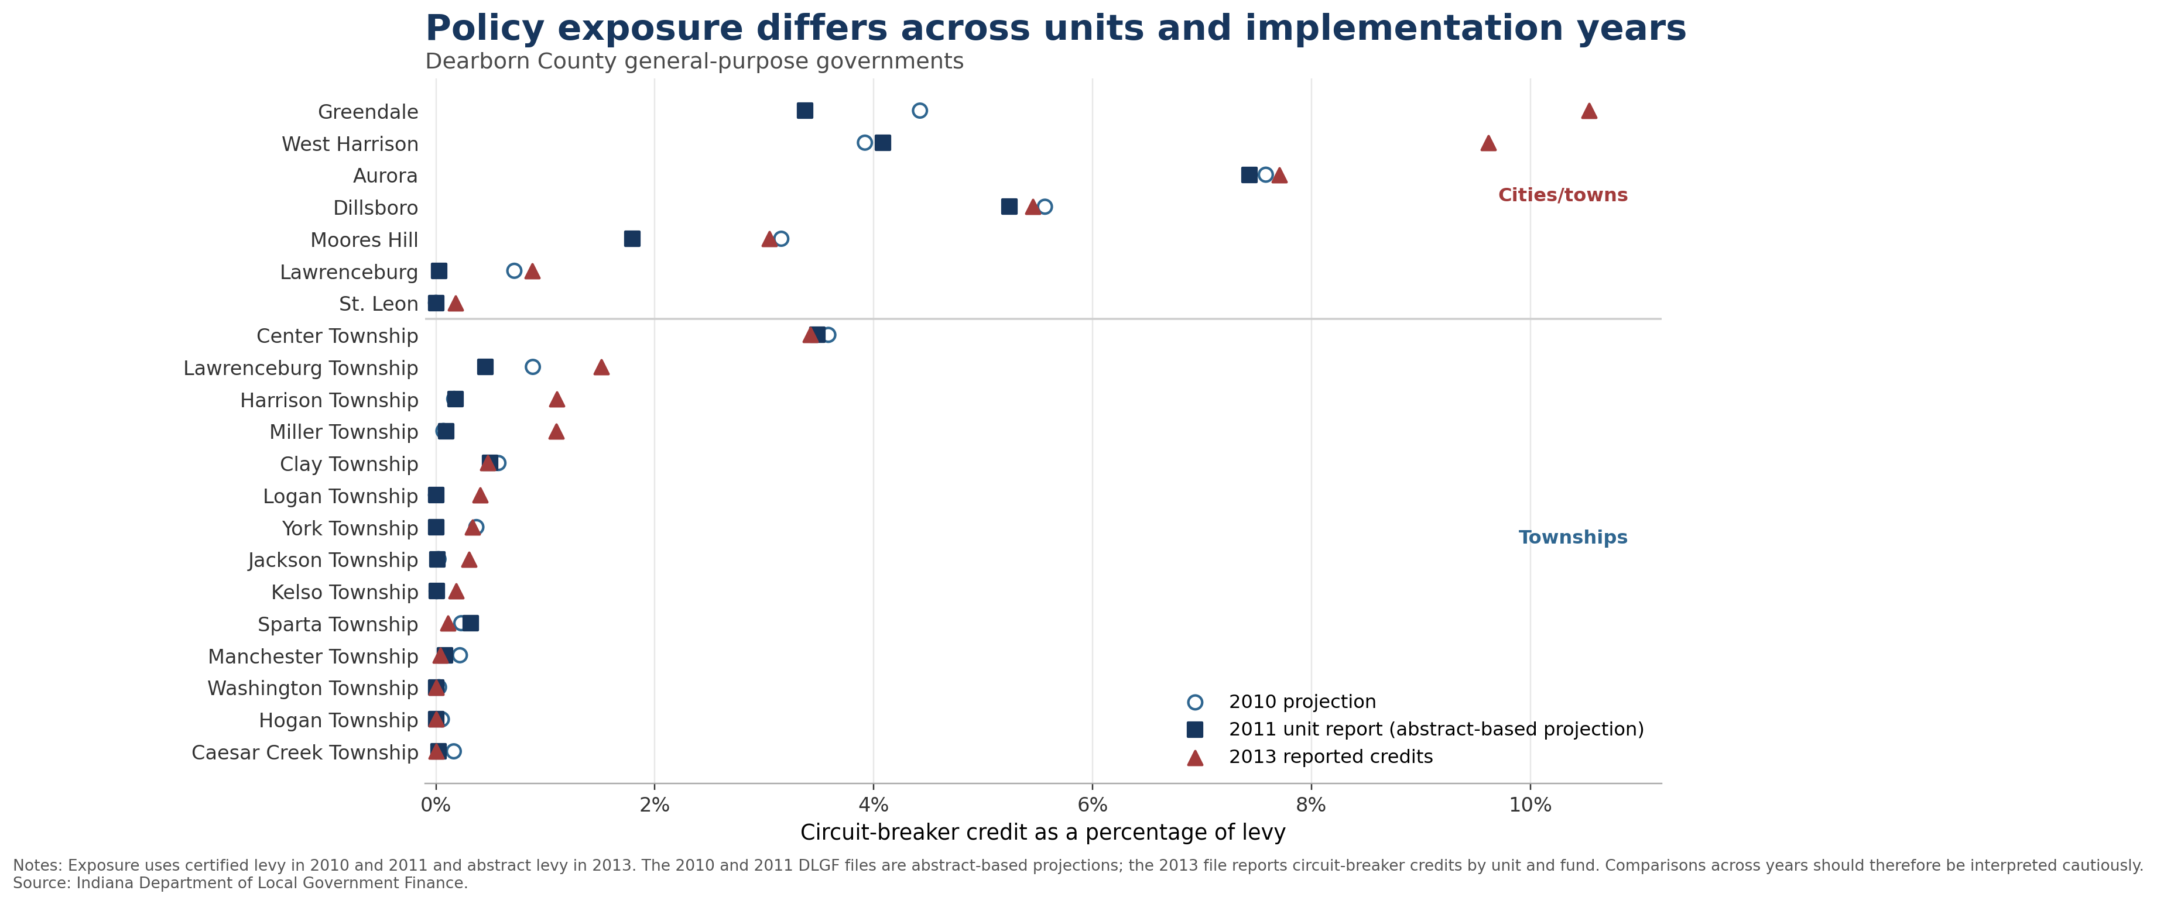
Notes:
Say: Exposure differs substantially across municipalities and townships. The differences across years reflect both economic variation and changes in the underlying reporting measures.

Slide 45
Q: Why not include state x year fixed effects?
State x year FE absorb most identifying variation.
Leaving insufficient residual variation to estimate the IV specification.
Conclusion: State x year FE over-saturate the model.
Notes:
When state-by-year fixed effects are included, the out-of-state instrument has essentially no residual variation after jointly absorbing metropolitan-area and state-year fixed effects. Therefore, the model is not identified under this specification.
Because the identifying variation in the out-of-state instrument is exhausted by state-year fixed effects; the preferred Division × Year specification is the most demanding regional-time control that still preserves meaningful first-stage variation.
Potential concern
State-specific fiscal rules and macroeconomic shocks may jointly affect central cities and suburbs.
Division × year FE may not fully absorb them.
Say: “I actually tried State-by-Year fixed effects. The problem is that they absorb essentially all of the residual variation in the instrument, so there isn't enough variation left to identify the first stage. Division-by-Year fixed effects are therefore the most demanding geographic-by-time controls that I can include while retaining usable IV variation.”
Say: “I tested State-by-Year fixed effects, but they absorb nearly all of the identifying variation in the instrument, leaving insufficient residual variation to estimate the IV specification. Division-by-Year fixed effects therefore provide the most demanding geographic-by-time controls that remain feasible with the current identification strategy.”
Say: “Yes, it tells us that the identifying variation is geographically structured, which is why I don't treat the fixed-effects exercise as sufficient evidence for the exclusion restriction. That's also why I add the regional-control ladder, pre-outcome tests, and the quasi-experimental validation designs.”

Slide 46
Q: Why should we believe the out-of-state IV satisfies the exclusion restriction?
Year FE absorb national fiscal and macroeconomic shocks. Division × year FE absorb broad region-specific annual shocks. MSA-specific trends allow metropolitan areas to follow different long-run paths. Labor-demand, building-permit, and HPI controls produce relatively little change within matched samples. Pre-outcome tests show no evidence that the instrument predicts earlier central-city fiscal outcomes.
Therefore:
  identification does not rely on distance alone;
  the evidence becomes more demanding as common regional forces are progressively absorbed.
Notes:
Potential concern
Out-of-state suburban fiscal changes may reflect broader national or regional shocks.
Those shocks could directly affect the focal central city.
Geographic separation alone does not establish exclusion.

Slide 47
Q: Why are first-stage coefficients negative?
IV validity requires:
  relevance; exclusion; not a predetermined first-stage sign.
Identification uses residual relative fiscal movements, not aggregate growth.
I therefore do not give the negative coefficient a structural interpretation.
The key diagnostic is whether external variation strongly predicts focal suburban fiscal changes.
Notes:
Potential concern
A negative relationship may appear counterintuitive if the IV is described as common suburban fiscal growth.
Do not say
“The negative coefficient proves fiscal competition.”
“It reflects substitution.”

Slide 48
Q: Is this really rent capture if expenditures catch up later?
I would not characterize the current results as persistent rent capture.
The strongest evidence is a short-run fiscal asymmetry:
  taxes respond quickly; basic expenditure responds more slowly.
The wedge narrows:
  under stronger regional controls; over longer horizons.
This is why the institutional designs are important for distinguishing mechanisms.
Notes:
Potential concern
The contemporaneous Tax–BE gap may be temporary.
At cumulative horizons, BE responses become larger.
Under Division × Year FE, equality cannot be rejected at longer horizons.

Slide 49
Q: Why focus on basic expenditure rather than total expenditure?
Basic expenditure captures visible local public-service provision:
  police; fire; highways; parks; libraries.
It is therefore a natural service-output counterpart to the tax response.
But the paper does not rely exclusively on BE.
Results are also reported for:
  Current operations; transfers; other expenditures; total revenue.
Notes:
Potential concern
Rent capture should arguably be evaluated against total spending.
Basic expenditure is only one subset of spending.

Slide 50
Q: Could the tax response simply reflect tax-base growth rather than strategic fiscal behavior?
This is exactly the motivation for the regional-controls ladder.
Within matched samples:
  labor-demand controls have little effect;
  building permits have little effect;
  HPI growth has little effect.
Division × Year FE produces the larger attenuation.
Therefore observable housing and labor channels do not appear to account for the full relationship.
Notes:
Potential concern
Suburban growth may coincide with:
metropolitan house-price growth;
construction;
employment growth;
migration.
Central-city property and sales taxes could rise mechanically.

Slide 51
Q: Why does the Tax–BE gap shrink so much under
Division × Year FE?
Yes, part of the Year-FE relationship appears to reflect broad regional forces.
That is substantively important rather than merely a robustness failure.
The remaining Division × Year estimate isolates a narrower source of fiscal interaction.
The tax response remains positive, while the relative BE response becomes stronger at longer horizons.
Conclusion: The comparison between Year FE and Division × Year FE helps separate common regional co-movement from the residual city–suburb fiscal relationship.
Notes:
Potential concern
This may imply that the baseline result is largely driven by regional shocks.

Slide 52
Q: Why are the out-of-state-only estimates different from the both-IV estimates?
The two specifications use different combinations of first-stage variation.
The in-state and out-of-state instruments need not identify exactly the same margin of suburban fiscal change.
The in-state instrument is weak as a standalone source of identifying variation.
Therefore the preferred out-state-only estimate puts weight on the cleaner and stronger source of first-stage variation.
Notes:
Potential concern
Different instrument sets appear to generate different 2SLS estimates.
Could this indicate invalid instruments or heterogeneous treatment effects?

Slide 53
Could your exclusion restriction fail because the same shocks affect out-of-state suburbs and central cities directly?
National year effects absorb shocks common across all MSAs.
Division × year FE absorb geographically heterogeneous annual shocks.
Housing and labor controls address specific observable transmission channels.
Pre-outcome tests provide a timing diagnostic.
Notes:
Potential concern
Examples:
federal policy;
interest rates;
national housing cycles;
national labor demand.

Slide 54
Q: What does the IV estimate actually identify?
The coefficient is an elasticity of central-city fiscal growth with respect to instrument-induced suburban fiscal growth.
It is not necessarily:
  the average response to every possible suburban fiscal change;
  a universal structural reaction function.
Identification comes from the component of suburban fiscal change predicted by external suburban fiscal movements.
Notes:
“The IV estimate is local to instrument-induced suburban fiscal changes.”
“So I interpret it as the central-city response to the component of suburban fiscal growth predicted by external suburban fiscal movements.”

