Slide 1
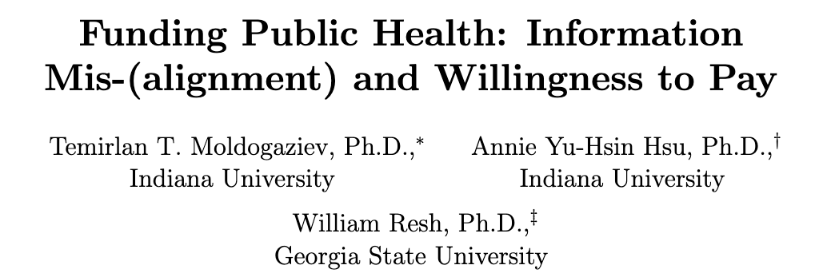
APPAM 2025 Annual Conference
Seattle, WA
November 13, 2025
Notes:
Hi everyone, I am Annie Hsu.
Today, I will present our study examining how information alignment and mis-alignment– especially between President Trump and the CDC during COVID-19--- affect individuals’ willingness to pay (WTP) to public health.

Slide 2
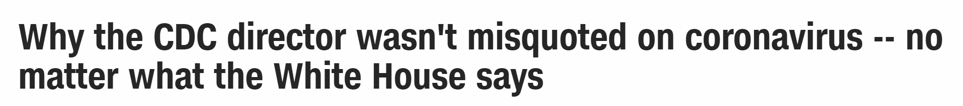
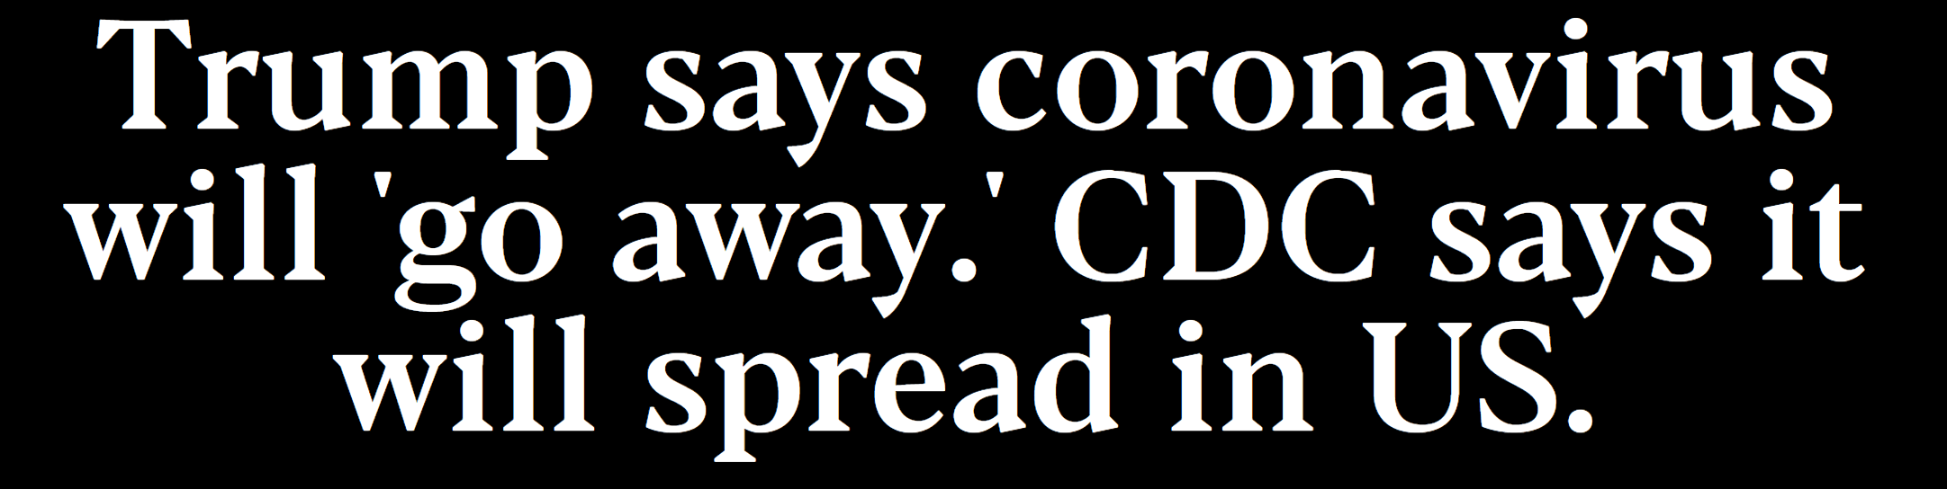
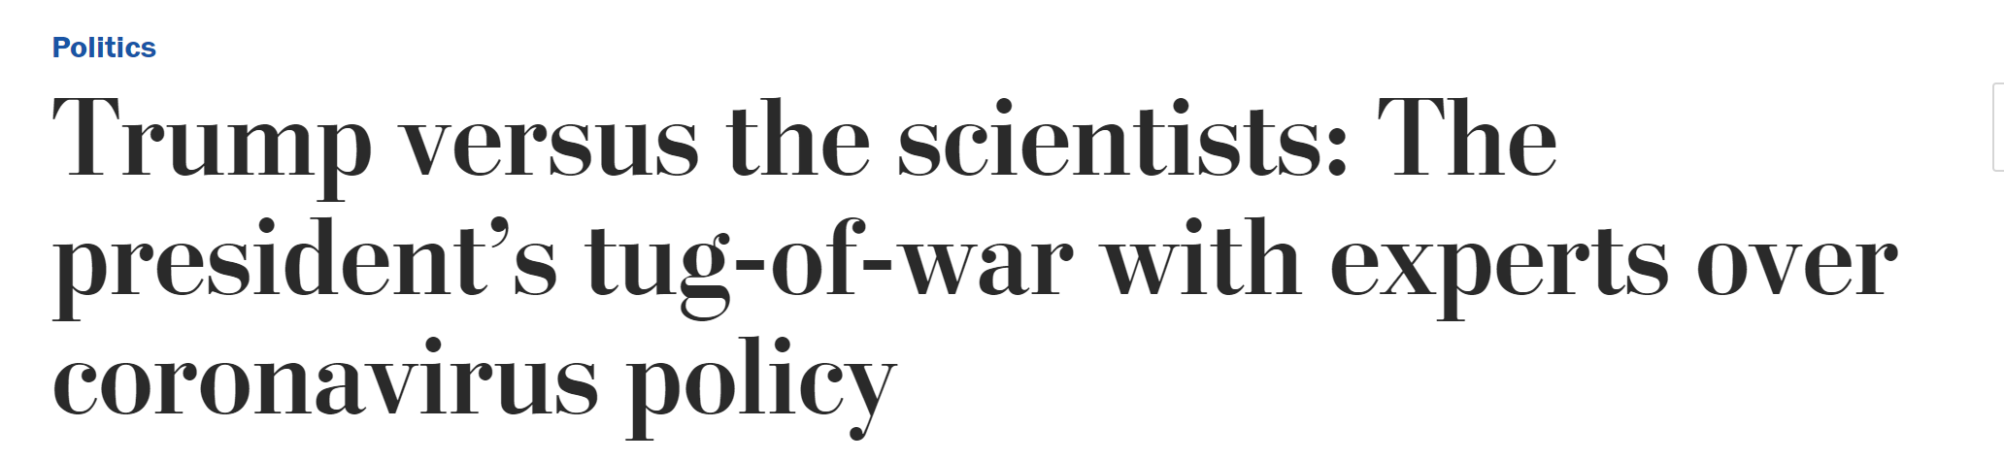
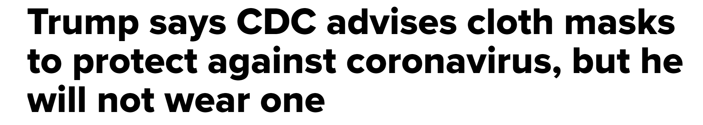
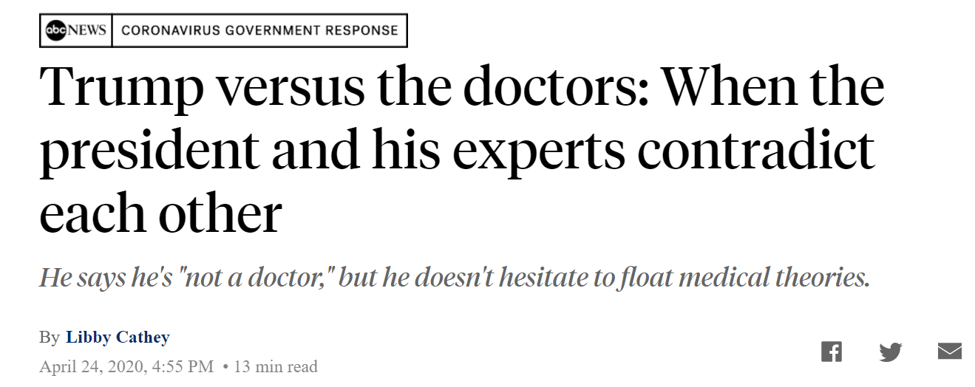
Notes:
These news headlines describe the situation that occurred during the COVID-19 pandemic. If time permits, I will also share some additional work exploring the misalignment between President Biden and the CDC, although our main focus today is on the misalignment between President Trump and the CDC.

Slide 3
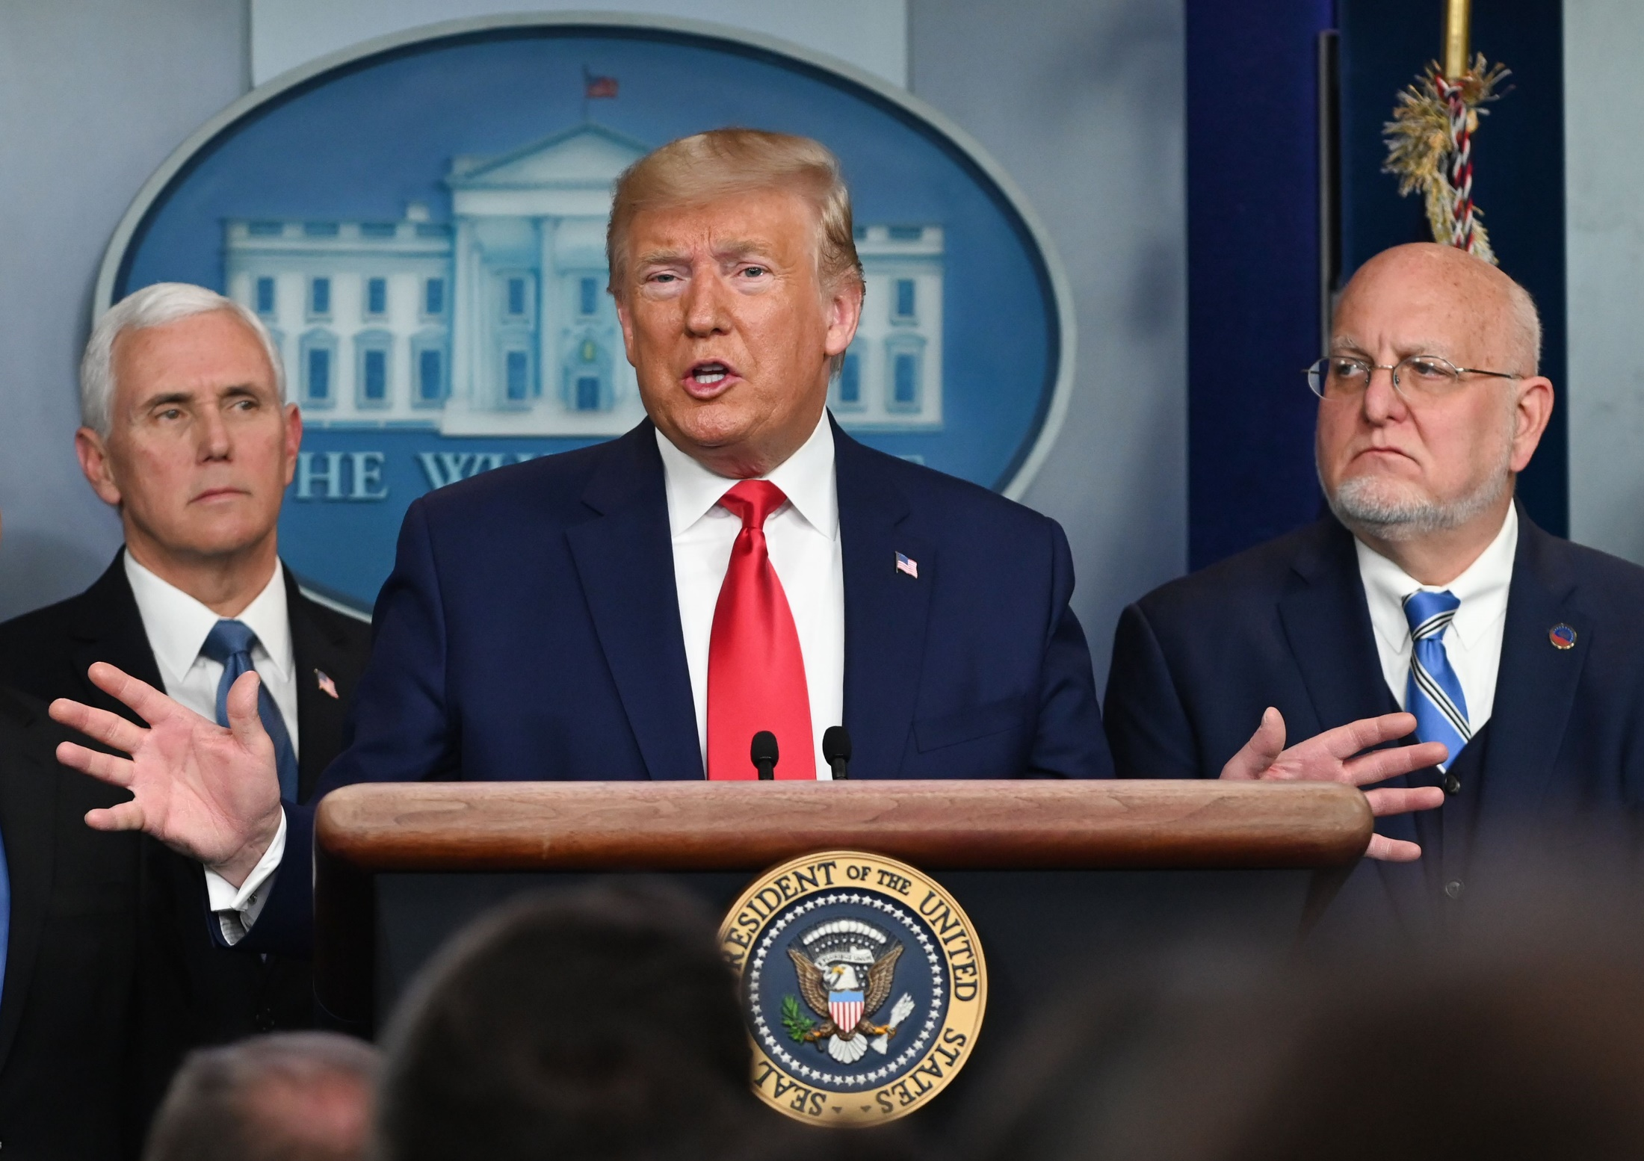
CDC Director, Robert Redfield
Notes:
Here are the CDC Director, Robert Redfield, and President Trump.

Slide 4
An Introduction
Setting: COVID-19 as a coarse shock/crisis in the United States; covers all individuals at the same time with a magnitude that does not to go unnoticed by anyone; it is “clear” that something “needs to be done”, but what: individual choices vs. societal choices?
Information misalignment and multiple sources: Conflicting messages from President Trump and the CDC, often pronounced from the same platforms on the same day.
Research Questions:
  Does information (mis-)alignment matter for WTP for Public Health?
  Does mission (mis-)alignment—mission salience and mission valence, and trust in source mediate the link for WTP for Public Health?
Notes:
Covid-19 created a nationwide crisis where clear action was needed,
but the public received mixes and conflicting messages from the government and health authorities.
For example, President Trump and the CDC often delivered contradictory statements about COVID-19 severity, masking, and vaccines— sometimes even on the same day.
This brings us to two research questions:
1. Does information alignment or mis-alignment influence individuals’ WTP for public health?
2. Do factors such as mission alignment and trust in the source mediate this relationship?

Slide 5
Literature on WTP
Informational treatments are also significant for individual WTP taxes (Brunner et al 2024), bond referenda and project benefit details (Ivonchyk 2024)
Information alignment helps; but does mis-alignment affect WTP for public health (given that what to do is uncertain with COVID-19).
  Trust in the source of information is critical: an assessment of the “trustee’s” integrity, competence, and beneficence.
  But, in a highly polarized political environment, it is likely that trust or “encapsulated interest” is correlated with partisan identification– became very visible with COVID-19.
Notes:
Previous work shows that informational treatments can significantly affect people’s WTP—whether for taxes, bonds, or public projects. Another relevant strand of research emphasizes trust in the information source. During COVID-19, trust was highly correlated with partisanship, which made effective communication more difficult.

Slide 6
Literature on WTP
Other prior literature
  Just because there is a “big” crisis, individuals are not necessarily willing to support more public spending, pay more taxes, or prioritize the problem area over others.
  Mission Alignment: Salience and Valence are positively related to organizational support (including monetary support).
  “Salience” games through symbolic and substantive activities to secure external resources.
  Salience and Valence and Emotional/psychological factors of crises.
  Does information treatment interact with mission salience and valence, trust in source
Notes:
Finally, research on mission alignment suggests that organizational salience and valence increase public support, and crises tend to amplify these effects.
Our experiment integrates these literatures into one framework.

Slide 7
Survey Experiment: Information Treatment
EVERYONE gets general information about COVID-19 and Trump’s statements
TREATMENT Group: gets 3 examples of CDC statements that are divergent from Trump’s statements
  Case fatality rates (CFR)
  Vaccine timeline
  Mask importance
Notes:
We conducted a survey experiment where all respondents received baseline Covid-19 information, including Trump’s statements.
The treatment group additionally received three examples of CDC statements that contradict Trumps’:
CFR, Vaccine, Mask
This design cleanly isolates the effect of highlighting institutional misalignment (?)

Slide 8
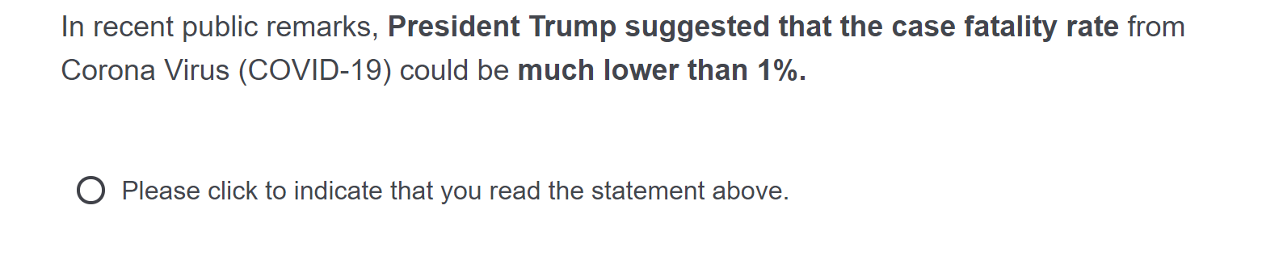
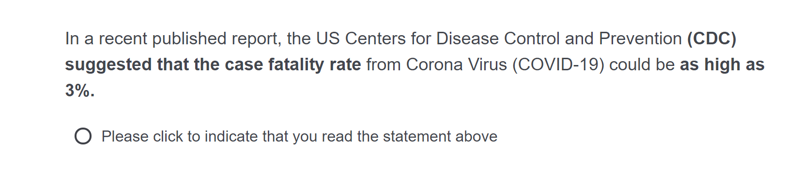
Treatment: Case Fatality Rates
Trump’s position on CFR:
CDC’s position on CFR:

Slide 9
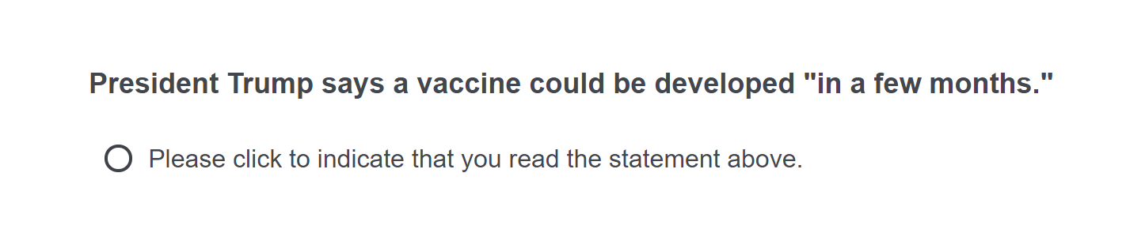
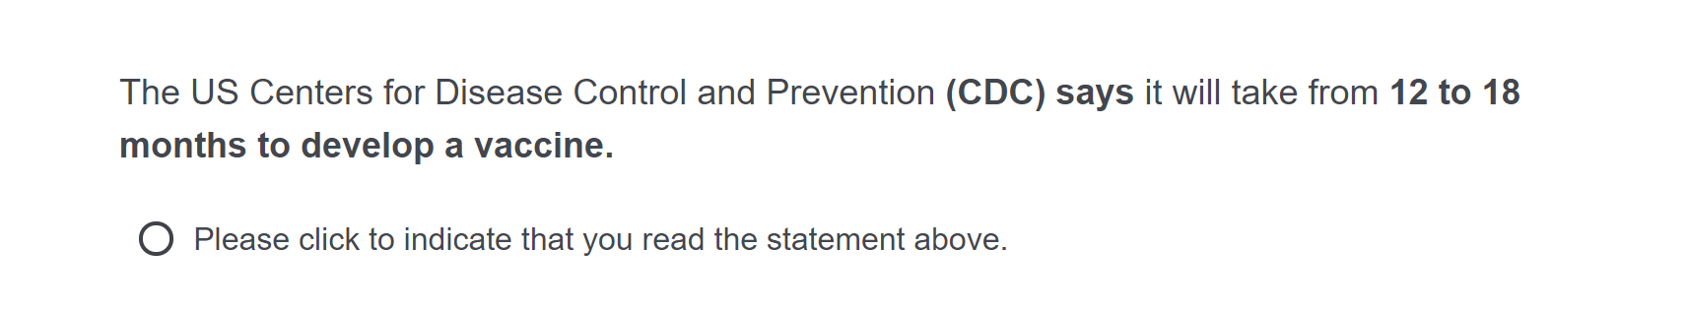
Treatment: Vaccine development
Trump’s position on when a vaccine may be ready:
CDC’s position on when a vaccine may be ready:

Slide 10
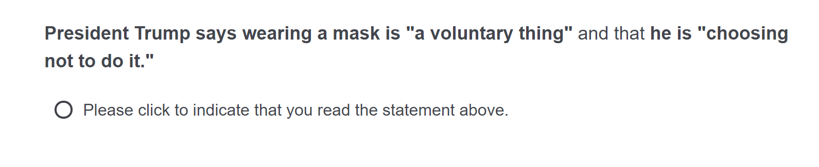
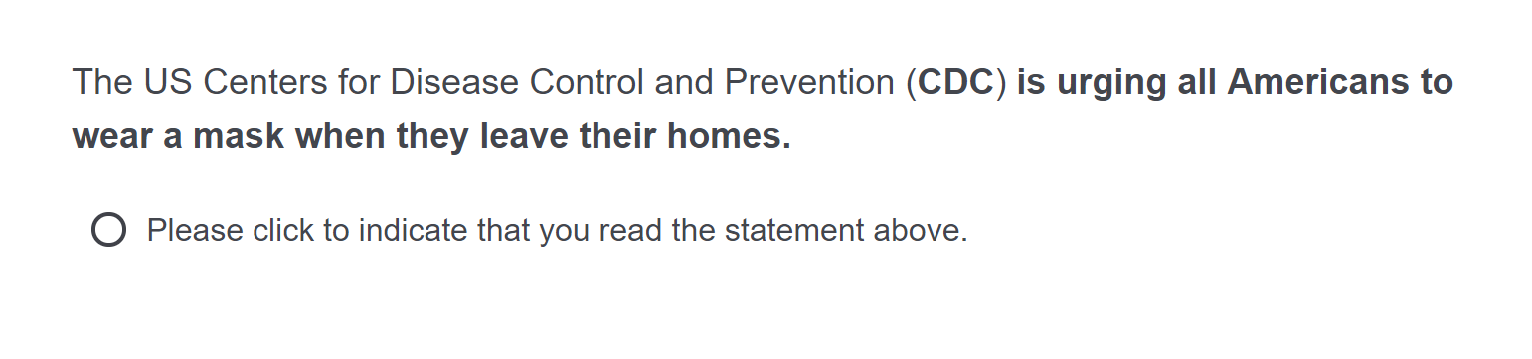
Treatment: Importance of Mask Wearing
Trump’s position on the importance of masks:
CDC’s position on the importance of masks:

Slide 11
Survey Experiment: Data Collection
In a survey, we asked >1,000 US voters about their WTP to address the COVID-19 public health crises.
  Three WTP outcomes of interest: Main FOCUS
    Willingness to support more public health spending
    Willingness to accept tax increases
    Preference for public health vs. the economy
  Three individual choice outcomes of interest
    Wearing mask, quarantining, personal hygiene
Data collected by mTurk (~500) and Qualtrics (~500) in the 1rst wave
  Good balance between treatment and control groups
  mTurk steers more “liberal” but results appear to be unaffected
Notes:
We collected data from over 1000 US voters through Mturk and Qualtrics
We focus on three main outcomes:….
The sample is balanced across groups, and robustness checks indicate that platform-based ideological differences do not drive results.

Slide 12
Results for WTP Spending
Notes:
Our main results show that:
No significant effect of misaligned information on WTP for increased public health spending.
--
Here are our main results for WTP for public health.
Let me walk you through the graphs one by one.
First, in the top-left panel, we compare the average WTP between the control group and the treatment group.
You can see the bar heights are similar.
Statistically, the treatment has no significant effect on WTP.
This tells us that simply exposing respondents to misaligned information between the President and the CDC does not change their willingness to support increased public health spending.
2. ---
Next, the top-right panel incorporates “mission salience” by asking how important respondents think about the CDC’s mission.
These salience measures come from questions we included in the survey, and we split respondents into 5 levels; from “not at all important” to “extremely important”.
Across every salience level, treatment and control bars almost in parallel. Again, no significant treatment effect occurs.
Even people who think the CDC’s mission is “very important” or “extremely important” do not significantly change their WTP when exposed to misaligned information.
3. ---
The bottom-left figure looks at mission valence—whether respondents see CDC does good for the society. And we split respondents into 5 levels from “strongly disagree” to “strongly agree”
We see differences in baseline WTP across valence categories, which is expected– people who view the CDC more positively tend to support more spending.
the pattern remains consistent: control and treatment groups look very similar within each category.
So mission valence does not amplify or mitigate the effect of misalignment, because we simply don’t find a treatment effect.
4. --
Finally , the bottom-right panel conditions on whether respondents said they trust the CDC as their preferred information source.
Even here, where we might expect the strongest reaction to misalignment, the treatment bars and the control bars remain nearly identical.
So even among those who trust the CDC, misaligned messaging does not significantly change WTP.
---
So the key takeaway from this set of results here is simple:
We find no significant evidence that misaligned information between the President and the CDC affects people’s WTP for public health.
Even when we account for mission salience, valence or trust– variables we collected throughout the survey– the null effect persists.

Slide 13
Results for WTP Tax Increase
Notes:
No significant effect on willingness to accept tax increases
---
This null effect also holds for the other two outcomes variables we examine—support for tax increases and prioritizing public health over the economy– where misaligned information similarly shows no significant effect.

Slide 14
Results for WTP PHE vs. Economy
Notes:
No significant shifts in preferences between prioritizing public health versus the economy
So overall, null effects dominate
These null results indicate that while messaging influences personal behaviors (like masking and distancing)
It does not necessarily change individuals’ willingness to commit fiscal resources.
Public spending attitudes appear more anchored to pre-existing political preferences, and less responsive to new information (?)

Slide 15
Take-Aways from the Study
Null effects prevail for WTP
At the same time, we know that informational disagreements were critical for individual behaviors such as masking, staying indoors, hygiene behaviors
  individual choices vs societal choices?
Conclusion:
  Despite intense and conflicting information during Covid 19, individuals’ WTP for public health did not meaningfully change
  Trust and mission alignment remain important for understanding public attitudes, but they may influence behavior more than fiscal willingness
  For policymakers and public health agencies, this highlights the challenge of building financial support during a crisis– even when the crisis is highly salient
Next?
Notes:
So what should we take away from this?
First, mixed messaging clearly created confusion and influenced how people behaved day-to day.
However, this confusion did not translate into broader public support for increased government spending on public health.
This suggests a meaningful distinction between:
-individual behavioral responses (which are sensitive to information) and
-collective fiscal preferences (which remain largely fixed) (?)
To conclude:
1. despite intense and conflicting information during Covid 19, individuals’ WTP for public health did not meaningfully change
2. Trust and mission alignment remain important for understanding public attitudes, but they may influence behavior more than fiscal willingness
3. For policymakers and public health agencies, this highlights the challenge of building financial support during a crisis– even when the crisis is highly salient
Thank you, and I look forward to your questions.

Slide 16
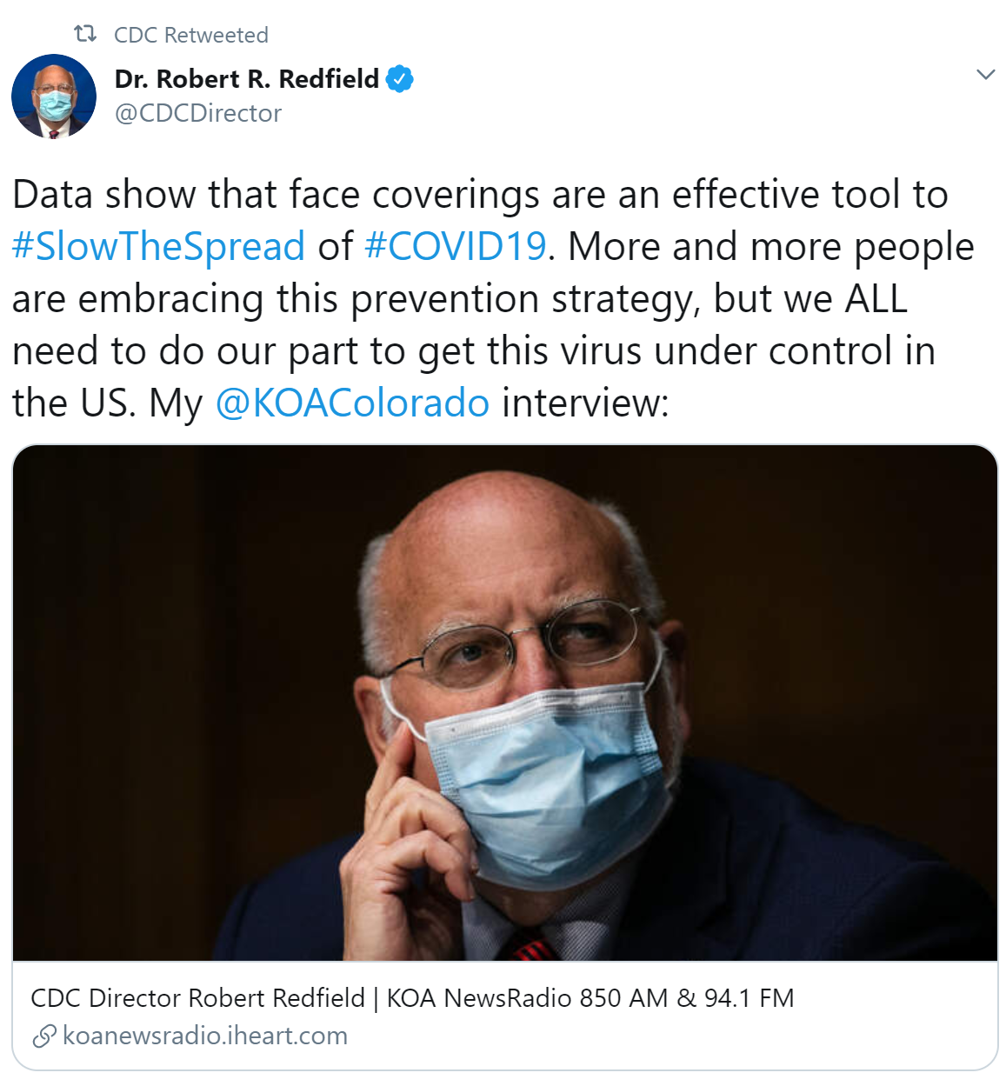
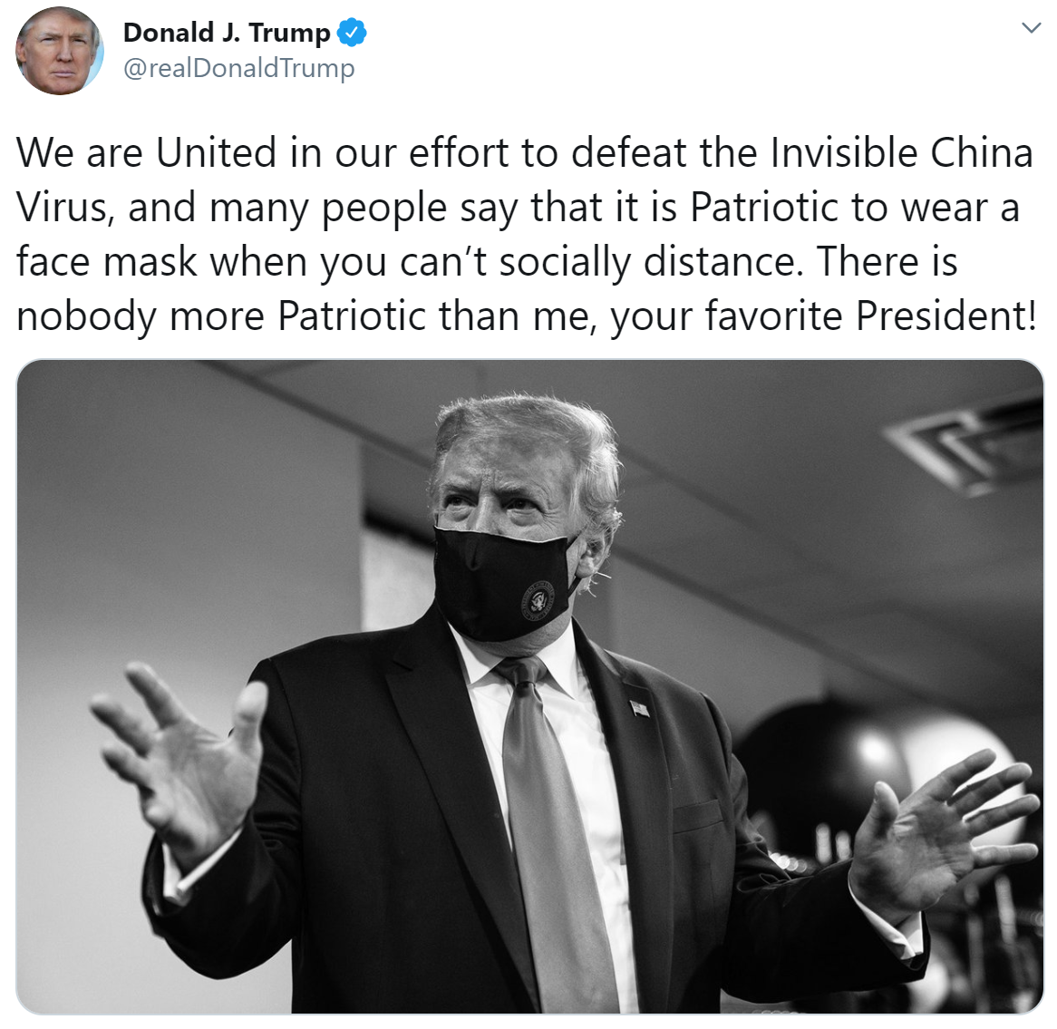
In the end, even Trump changed his position

Slide 17
Supplementary
Mixed messaging and updating individual positions

Slide 18
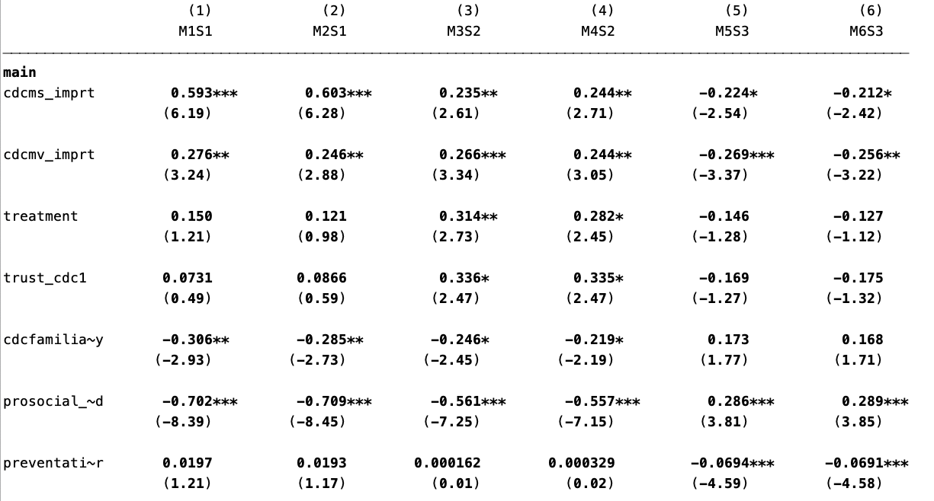
OLM Regression Results (odds ratios)

Slide 19
Regression Results
Notes:
“Trust is the foundation of any successful relationship — including the relationship between the government and the governed. And during a pandemic like this one, it’s no abstract matter.”

Slide 20
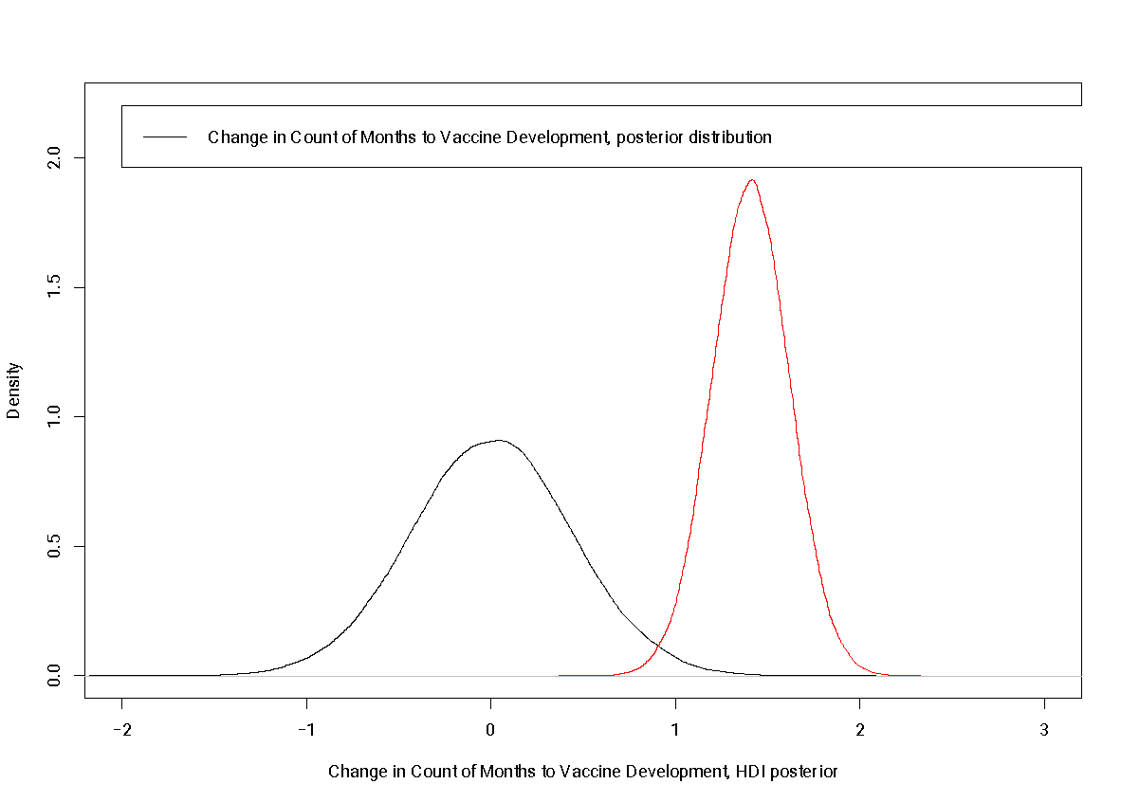

Slide 21
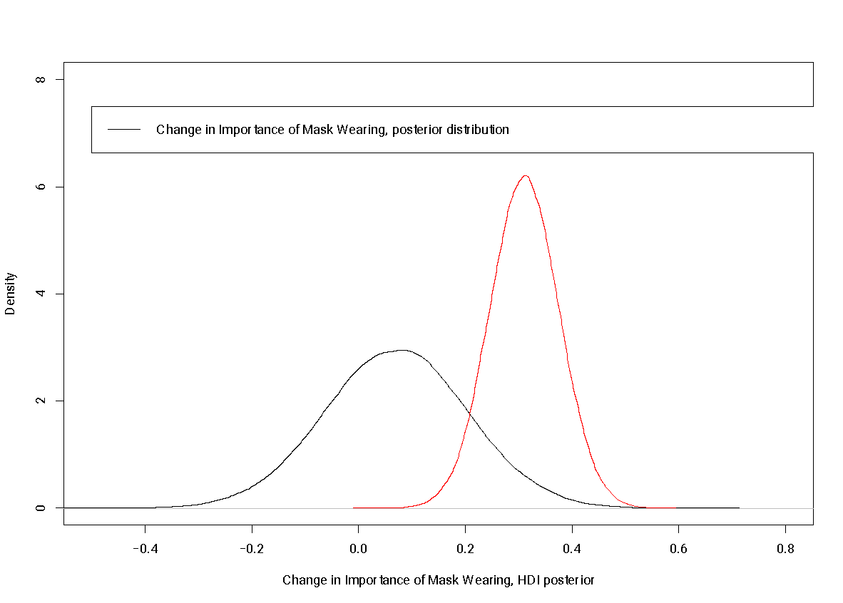

Slide 22
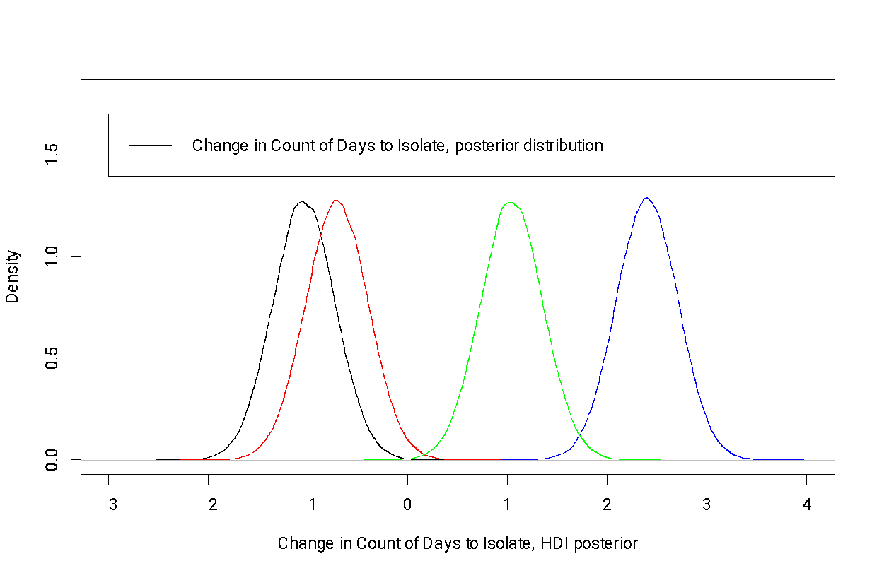
Biden against CDC
Biden with CDC
CDC Only
Biden Only
Notes:
Blue – biden
Green – biden vs cdc
Red – biden & cdc
Black - cdc

Slide 23
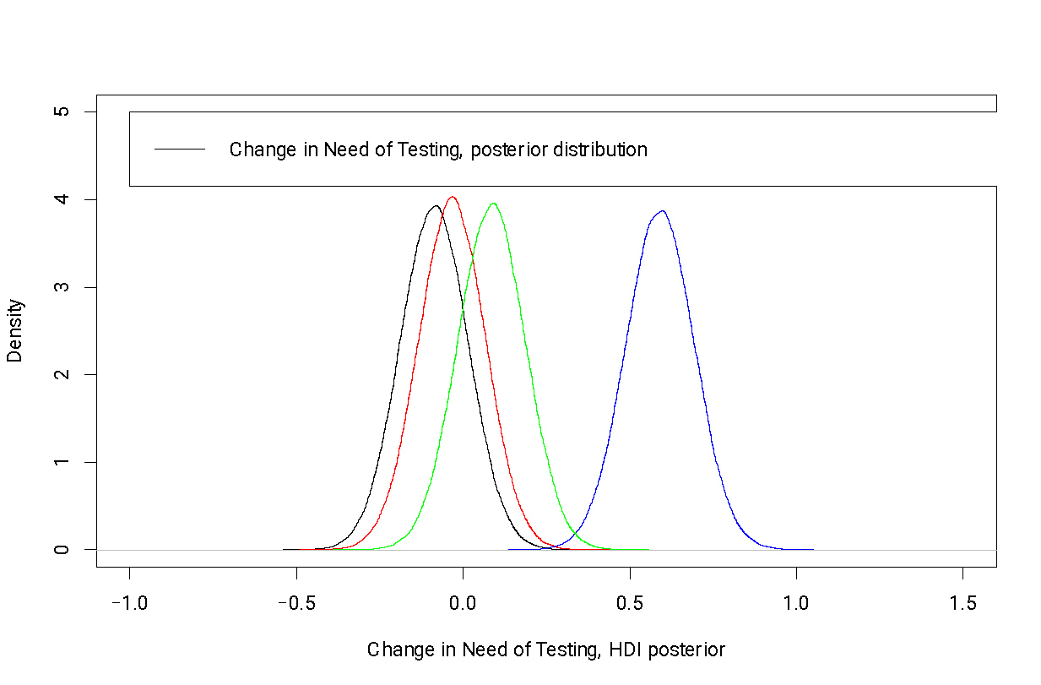
Biden with CDC
Biden against CDC
Biden Only
CDC Only

Slide 24
Take-Aways from Mixed Messaging Experiment
Inconsistency in institutional messaging matters!
People update their priors according to the information to which they are exposed.
  But not all information sources are equal.
Voters updated their priors on points of uncertainty about the crisis more towards CDC than to Trump
  NOTE: *when they are exposed to the CDC’s position*
Voters updated their priors on points of uncertainty about the crisis more towards Biden than to CDC: attacks on organizational credibility?
Notes:
In a supplementary experiment, we examined how individuals update their beliefs when exposed to messages from Biden versus CDC.
We find that:
-People update more toward CDC than Trump when exposed to CDC information
-But update more toward Biden than CDC when exposed to Biden’s information
This suggests institutional credibility is malleable, and can be challenged or downgraded when political actors attack the institution
This is particularly important for public agencies during crises– credibility is both an asset and a vulnerability
To summarize:
-mixed messages matter for belief updating
-but not necessarily for willingness to pay
-trust and mission alignment remain essential
-and political context shapes how public health institutions are perceived.
Understanding this distinction helps explain why public health agencies struggled with consistent public support, even when individual health behaviors were clearly affected.
Thank you.

