Slide 1
Discussion of “Prudent projections? An Analysis of German States’ Budget Forecasts”
Buettner and Herdegen
Discussant: Annie Hsu

Slide 2
Summary
Importance of Accurate Budget Forecasts:
National level: often overly optimistic, resulting in larger-than-expected deficits
Subnational Pessimism: may stem from higher perceived costs of negative fiscal shocks and limited debt-financing options
German States’ Budget Bias:
Hypothesis: a systematic downward (pessimistic) bias
Research Approach: Using an asymmetric loss function model and 45 years of data, the study explores how forecast bias varies across different forecast horizons and tests for patterns of pessimism

Slide 3
Conclusion
A consistent downward bias in budget balance forecasts
Actual deficits are smaller and surpluses larger than anticipated
The bias varies depending on the forecast horizon: the bias is most pronounced in the short term and diminishes over medium-term forecast horizons
Contribution:
1. Offer new insights into the pessimism observed in fiscal forecasts at the subnational level
2. Examine how forecast bias changes based on the length of the forecast horizon

Slide 4
Might be interested to consider…
1. Budget balance: bt
Forecast of tax revenues (usually up to 5 years ahead) and then the government makes plans about expenditures in the coming year
Tax revenue forecasts often undergo revisions (Beetsma et al. 2009; Cimadomo 2016)
To what extent are the government's expenditure plans adjusted in response to revisions in tax revenue forecasts? Additionally, how much do errors in tax revenue forecasts impact the final budget balance?

Slide 5
Might be interested to consider…
2. Revenue forecasts may be influenced by political motivations if policymakers aim to justify higher expenditures or project a more optimistic view of the economy (Jochimsen and Lehmann 2017; Pina and Venes 2011)
Errors-in-variables problems
Biased estimates in the empirical estimation

Slide 6
Might be interested to consider…
3. The link between revenue forecast errors and budgetary outcomes might be mismeasured, if fiscal policymakers actively react to the revenue forecasts by changing tax rates
Lower taxes in reaction to a high revenue forecast affect the final revenues and, thus, the forecast error while possibly leaving the budget balance unchanged
This would result in underestimating the true impact of the forecast errors
Aside from the real estate transfer tax introduced in 2006, the German states lack tax sovereignty, which limits their ability to implement significant tax changes based on relatively high or low revenue forecasts

Slide 7
Might be interested to consider…
4. Data?
Produced by the governments or an independent fiscal institution?
Do states have the ability to politically influence the forecasts?
Some evidence:
The budget balances of German states may be influenced by their political orientations and institutional structures (Jochimsen and Nuscheler 2012)
Or by the socio-economic background of political leaders (Hayo and Neumeier 2014)

Slide 8
Might be interested to consider…
5. Business cycle?
Unlike the German federal government, the expenditures of German states are not influenced by business cycle fluctuations
Cyclical fluctuations primarily impact public expenditures through changes in unemployment, as unemployment benefits are administered at the federal level
Business cycle fluctuations primarily impact the budget balance through changes in revenues

Slide 9
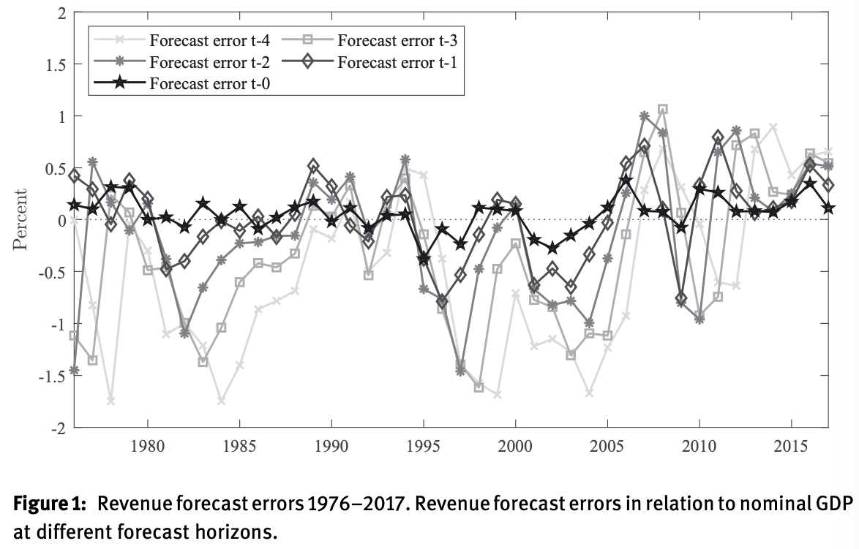
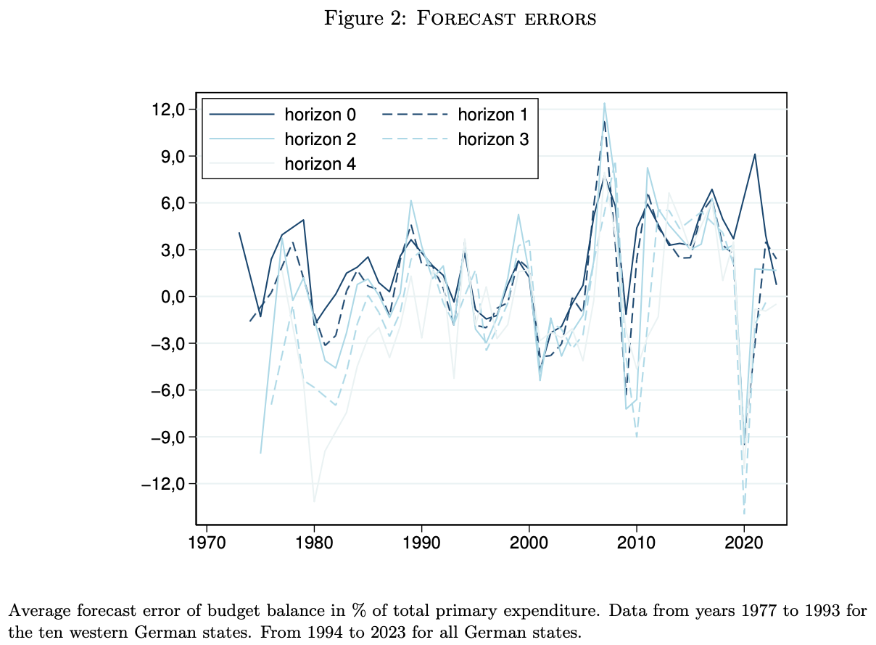
One normalizes by GDP, while another normalizes by total primary expenditure
Before 2017, there were several examples of negative revenue forecast errors. Notably, during the financial crisis, these errors translated into significant budget balance errors ranging from +12% to -9%
However, negative revenue forecast errors were also observed prior to 1985, 2000, and 2005, yet they did not result in budget balance errors of a similar magnitude
This raises the question of whether the previous statement still holds or if there might be hidden factors influencing state spending during those periods
Notes:
Figure 1: From Ademmer and Hogrefe (2022)

