Slide 1
Chapter 1
Introduction to Corporate Finance
Copyright 2022 © McGraw Hill LLC. All rights reserved. No reproduction or distribution without the prior written consent of McGraw Hill LLC.

Slide 2
Learning objectives
Define the basic types of financial management decisions and the role of the financial manager.
Explain the goal of financial management.
Articulate the financial implications of the different forms of business organization.
Explain the conflicts of interest that can arise between managers and owners.

Slide 3
Chapter outline
Finance: A Quick Look.
Corporate Finance and the Financial Manager.
Forms of Business Organization.
The Goal of Financial Management.
The Agency Problem and Control of the Corporation.
Financial Markets and the Corporation.

Slide 4
Cash flow and financial statements: a closer look
Financial topics are usually grouped into five main areas:
Corporate finance is the focus of this textbook.
Investments deals with financial assets (For Example, stocks and bonds).
Career paths in this field include becoming a financial advisor, portfolio manager, or security analyst.
Financial institutions are businesses that deal primarily in financial matters (For Example, banks and insurance companies).
International finance careers generally involve international aspects of either corporate finance, investments, or financial institutions.
Fintech is the combination of technology and finance.
Notes:
Section 1.1

Slide 5
Corporate finance and the financial manager
What is corporate finance?
Corporate finance, broadly speaking, is the study of ways to answer these three questions:
What long-term investments should you take on (That is, what lines of business will you be in and what sorts of buildings, machinery, and equipment will you need?)
Where will you get the long-term financing to pay for your investment? Will you bring in other owners or will you borrow the money?
How will you manage your everyday financial activities, such as collecting from customers and paying suppliers?
Notes:
Section 1.2
Imagine that you were to start your own business. No matter what type you started, you would have to answer these three questions in some form or another.

Slide 6
The financial manager
Owners (That is, stockholders) of large corporations are usually not directly involved in making business decisions, especially on a day-to-day basis
Corporations employ managers to represent the owners’ interests and make decisions on their behalf.
Financial management function is usually associated with a top officer of the firm, such as a vice president of finance of the chief financial officer (C F O).
Vice president of finance coordinates activities of the treasurer and the controller.
Controller’s office handles cost and financial accounting, tax payments, and management information systems.
Treasurer’s office is responsible for managing the firm’s cash and credit, financial planning, and capital expenditures.

Slide 7
Practice question
The controller, rather than the treasurer, is typically responsible for which one of the following functions?
A. Depositing cash receipts
B. Processing cost reports
C. Analyzing equipment purchases
D. Approving credit for a customer
E. Paying a vendor
Notes:
Answer: B

Slide 8
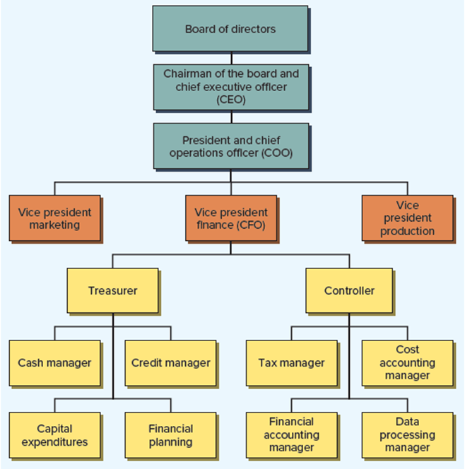
A sample simplified organizational chart - figure 1.1
Access the text alternative for slide images.
Notes:
Figure 1.1 is a simplified organizational chart that highlights the finance activity in a large firm.

Slide 9
Practice question
Usually, the treasurer of a corporation reports directly to the:
A. board of directors
B. chair of the board
C. chief executive officer
D. president
E. vice president of finance
Notes:
Answer: E

Slide 10
Financial management decisions
The financial manager must be concerned with three basic types of questions:
Capital budgeting is the process of planning and managing a firm’s long-term investments.
Evaluating the size, timing, and risk of future cash flows is the essence of capital budgeting.
Capital structure is the mixture of debt and equity maintained by a firm.
How much should the firm borrow (That is, what mixture of debt and equity is best)?
What are the least expensive sources of funds for the firm?
Working capital management refers to a firm’s short-term assets and liabilities.
Notes:
Provide some examples of capital budgeting decisions: should the firm open another store, develop and market a new program, and/or purchase a particular type of computer system.
Be sure to define debt and equity.
Provide some questions about working capital management that must be answered:
How much cash and inventory should we keep on hand?
Should we sell on credit? If so, what terms will we offer, and to whom will we extend them?
How will we obtain any needed short-term financing? Will we purchase on credit, or will we borrow in the short term and pay cash? If we borrow in the short term, how and where should we do it?

Slide 11
Practice question
Which one of the following questions involves a capital budgeting decision?
A. How many shares of stock should the firm issue?
B. Should the firm purchase a new machine for the production line?
C. Should the firm borrow money to acquire new equipment?
D. How much inventory should the firm keep on hand?
E. How much money should be kept in the checking account?
Notes:
Answer: B

Slide 12
Forms of business organization
Large firms in the U.S. are almost all organized as corporations.
Three different legal forms of business organization exist, each with its own advantages and disadvantages for the life of the business, the ability of the business to raise cash, and taxes:
Sole proprietorship.
Partnership.
Corporation.
Notes:
Section 1.3
A key observation is that as a firm grows, the advantages of the corporate form may come to outweigh the disadvantages.

Slide 13
Sole proprietorship
Sole proprietorship is a business owned by a single individual.
Advantages include the following:
Simplest type of business to start.
Least regulated form of organization.
Owner keeps all the profits.
Disadvantages include the following:
Owner has unlimited liability for business debts.
All business income is taxed as personal income.
Life of sole proprietorship is limited to owner’s life span.
Amount of equity that can be raised is limited to the amount of the proprietor’s personal wealth.
Ownership may be difficult to transfer.
Notes:
There are more proprietorships than any other type of business, and many businesses that later become large corporations start out as small proprietorships.
With the passage of the Tax Cuts and Jobs Act of 2017, up to 20 percent of business income may be exempt from taxation (the specific rules are too complex to cover here).

Slide 14
Partnership
A partnership is a business formed by two or more individuals or entities.
General partnership versus limited partnership.
Advantages and disadvantages are basically the same as those of a proprietorship.
Primary disadvantages of sole proprietorships and partnerships are the following, which add up to a single, central problem of the inability to raise cash for investment:
Unlimited liability for business debts on the part of the owners.
Limited life of the business.
Difficulty of transferring ownership.
Notes:
General partnership versus limited partnership:
In a general partnership, all the partners share in gains or losses, and all have unlimited liability for all partnership debts, not just some particular share.
In a limited partnership, one or more general partners will run the business and have unlimited liability, but there will be one or more limited partners who will not actively participate in the business. A limited partner’s liability for business debts is limited to the amount that partner contributes to the partnership.
The way partnership gains (and losses) are divided is described in the partnership agreement.
As with sole proprietorships, beginning in 2018, up to 20 percent of a partner’s income may be exempt depending on various rules spelled out in the Tax Cuts and Jobs Act of 2017.

Slide 15
Corporation
A corporation is a business created as a distinct legal entity composed of one or more individuals or entities.
Legal “person,” separate and distinct from its owners with many of the rights, duties, and privileges of an actual person.
Stockholders and managers are usually separate groups.
Advantages include the following:
Ownership can be readily transferred.
Life of corporation is unlimited.
Limited liability for stockholders.
Significant disadvantage includes the following:
Double taxation, meaning corporate profits are taxed twice, first at the corporate level when they are earned and again at the personal level when they are paid out
Notes:
Forming a corporation involves preparing articles of incorporation (or a charter) and a set of bylaws.
The articles of incorporation must contain a number of things, including the corporation’s name, its intended life (which can be forever), its business purpose, and the number of shares that can be issued.
The bylaws are rules describing how the corporation regulates its existence.
The ability of large corporations to raise cash can be lifesaving. In 2020, the COVID- 19 virus decimated the cruise ship industry. Even so, Norwegian Cruise Line, the world’s third-largest such company, was able to raise $2.2 billion at the height of the pandemic, enough to keep the company afloat (no pun intended) for well over a year with no ships sailing.

Slide 16
A corporation by another name…
Corporate form of organization has many variations worldwide.
May be referred to as joint stock companies, public limited companies, or limited liability companies.
A benefit corporation is for profit, but it has three additional legal attributes:
Accountability refers to the fact that a benefit corporation must consider how an action will affect shareholders, employees, customers, the community, and the environment.
Transparency means that, in addition to standard corporate reports, a benefit corporation must provide an annual report detailing how the company pursued a public benefit during the year, or any factors that inhibited the pursuit of this goal.
Purpose refers to the idea that a benefit corporation must provide a public benefit, either to society as a whole or the environment.
Notes:
The exact laws and regulations for the corporate form of organization differ from country to country, of course, but the essential features of public ownership and limited liability remain.

Slide 17
Practice question
A firm owned by a single person who has unlimited liability for the firm’s debt is called a:
A. corporation
B. sole proprietorship
C. general partnership
D. limited partnership
E. Limited liability company
Notes:
Answer: B

Slide 18
Practice question
A firm owned by two or more people who each have unlimited liability for all of the firm’s debts is called a:
A. corporation
B. sole proprietorship
C. general partnership
D. limited partnership
E. Limited liability company
Notes:
Answer: C

Slide 19
Practice question
Which one of the following statements regarding corporations is correct?
A. The majority of firms in the US are structured as corporations
B. Undistributed corporate profits are taxable income to the shareholders
C. Corporations can have an unlimited life
D. Shareholders are protected from all potential losses
E. Shareholders directly elect the chief financial officer
Notes:
Answer: C

Slide 20
Goal of financial management
In a for-profit business, the goal of financial management is to make money or add value for the owners
What are some possible financial goals of a corporation?
Goals tend to fall into two classes:
Profitability goals relate to different ways of earning or increasing profits (For Example, sales, market share, and cost control).
Goals focused on controlling risk (For Example, bankruptcy avoidance, stability, and safety).
From the stockholders’ point of view, what is a good financial management decision?
Goal of financial management is to maximize the current value per share of the existing stock.
Notes:
Section 1.4
Possible financial goals of a corporation:
Survive.
Avoid financial distress and bankruptcy.
Beat the competition.
Maximize sales or market share.
Minimize costs.
Maximize profits.
Maintain steady earnings growth.

Slide 21
A more general goal
What is the appropriate goal when the firm has no traded stock?
Maximize the market value of the existing owners’ equity.
Goal does not imply the financial manager should take illegal or unethical actions to increase the value of equity in the firm.
Sarbanes-Oxley Act (That is, “S O X”), enacted in 2002, is intended to protect investors from corporate abuses.
Key requirements of S O X include the following:
Section 404 requires each company’s annual report to have an assessment of the company’s internal control structure and financial reporting.
Officers of corporation must review and sign annual reports.
Annual report must list any deficient in internal controls.
Notes:
Because of its extensive reporting requirements, compliance with SOX can be very costly, which has led to some unintended results. Since its implementation, hundreds of public firms have chosen to “go dark,” meaning that their shares are no longer traded on the major stock exchanges, in which case SOX does not apply.

Slide 22
Practice question
The Sarbanes-Oxley Act of 2002 is a governmental response to:
A. decreasing corporate profits
B. the terrorist attacks on 9/11/2001
C. the harm caused to stock markets by SARS, MERS, COVID, and other pandemics
D. deregulation of the stock exchanges
E. management greed and abuses
Notes:
Answer: E

Slide 23
The agency problem and control of the corporation
Relationship between stockholders and management is called an agency relationship.
Exists when someone (the principal) hires another (the agent) to represent his or her interests.
The agency problem is the possibility of conflict of interest between the stockholders and management of a firm.
Agency costs refer to the costs of the conflict of interest between stockholders and management.
Indirect agency costs are lost opportunities.
Direct agency costs come in two forms:
Corporate expenditures that benefits management but costs the stockholder (For Example, luxurious and unneeded corporate jet).
Expense that arises from the need to monitor management actions.
Notes:
Section 1.5

Slide 24
Practice question
Which of the following actions would be considered an agency problem?
A. An owner of a sole proprietorship takes company office supplies for personal use
B. Both partners in a general partnership close the office early one day to go skiing
C. A manager in a corporation buys shares of the company’s stock when the price falls
D. A manager in a corporation makes online personal travel arrangements during work hours
E. A shareholder in a corporation sells shares of the company’s stock when the price rises
Notes:
Answer: D

Slide 25
Do managers act in the stockholders’ interests?
Managerial compensation:
Management will frequently have a significant economic incentive to increase share value for two reasons:
Managerial compensation is usually tied to financial performance in general and often to share value in particular.
Managers who are successful in pursuing stockholder goals will be in greater demand in the labor market and thus command higher salaries.
Control of the firm:
Stockholders ultimately control the firm, as they elect the board of directors, who in turn hire and fire managers.
Existing management may be replaced by stockholders via proxy fights and takeovers.
Notes:
Whether managers will, in fact, act in the best interests of stockholders depends on two factors.
First, how closely are management goals aligned with stockholder goals? This question relates, at least in part, to the way managers are compensated.
Second, can managers be replaced if they do not pursue stockholder goals?
A proxy is the authority to vote someone else’s stock. A proxy fight develops when a group solicits proxies in order to replace the existing board and thereby replace existing managers.

Slide 26
Practice question
Which one of the following grants an individual the right to vote on behalf of a shareholder?
A. Proxy
B. Bylaws
C. Indenture agreement
D. Stock option
E. Stock audit
Notes:
Answer: A

Slide 27
Stakeholders
Management and stockholders are not the only parties with an interest in the firm’s decisions.
Employees, customers, suppliers, and even the government all have a financial interest in the firm.
A stakeholder is someone other than a stockholder or creditor who potentially has a claim on the cash flows of the firm.
Such groups will also attempt to exert control over the firm, perhaps to the detriment of the owners.

Slide 28
Financial markets and the corporation
A financial market is just a way of bringing buyers and sellers together to buy and sell debt and equity securities.
Most important differences between financial markets concern the types of securities that are traded, how trading is conducted, and who the buyers and sellers are.
Primary vs. secondary markets:
In a primary market transaction, the corporation is the seller, and the transaction raises money for the corporation.
Public offerings involve selling securities to the general public.
Private placements are negotiated sales involving a specific buyer.
A secondary market transaction involves one owner or creditor selling to another.
Serve as a means for transferring ownership of corporate securities.
Notes:
Section 1.6

Slide 29
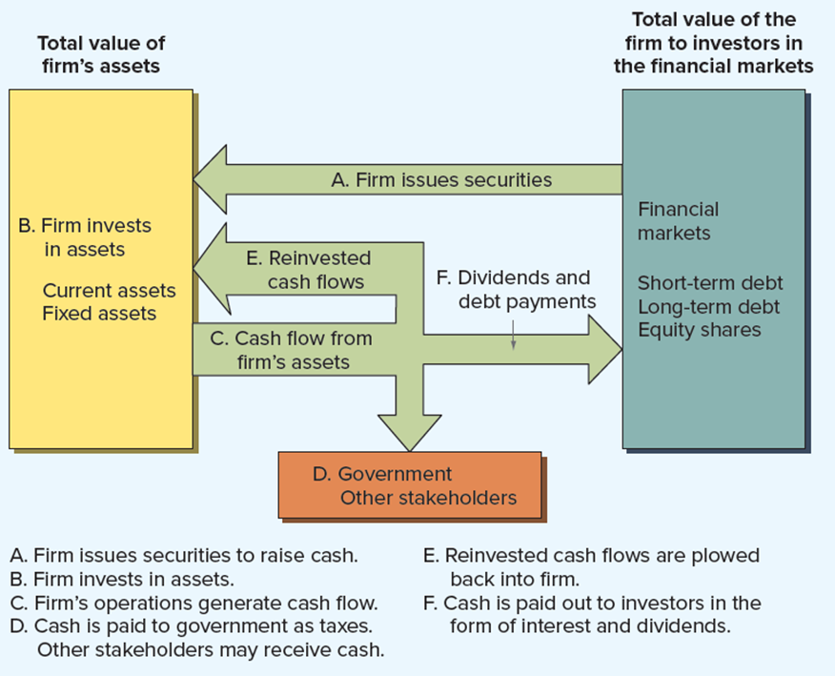
Cash flows between the firm and the financial markets
Notes:
The interplay between the corporation and the financial markets is illustrated in Figure 1.2. The arrows in Figure 1.2 trace the passage of cash from the financial markets to the firm and from the firm back to the financial markets.
Suppose we start with the firm selling shares of stock and borrowing money to raise cash. Cash flows to the firm from the financial markets (A). The firm invests the cash in current and fixed assets (B). These assets generate cash (C), some of which goes to pay corporate taxes (D). After taxes are paid, some of this cash flow is reinvested in the firm (E). The rest goes back to the financial markets as cash paid to creditors and shareholders (F).

Slide 30
Financial markets and the corporation 2
There are two types of secondary markets:
Dealer markets in stock and long-term debt are called over-the-counter (O T C) markets, meaning the dealers are connected electronically instead of transacting in a central location.
Auction markets differ from dealer markets in two ways:
An auction market or exchange has a physical location.
Primary purpose is to match those who wish to sell with those who wish to buy (with dealers playing a limited role), whereas most of the buying and selling is done by the dealer in a dealer market.
Largest organized auction market is New York Stock Exchange (N Y S E), while a large O T C market (Nasdaq) exists for stocks.
Stocks that trade on an organized exchange are said to be listed on that exchange, with exchanges having different criteria (For Example, asset size and number of shareholders).
Notes:
There are many large and important financial markets outside the United States, of course, and U.S. corporations are increasingly looking to these markets to raise cash. The Tokyo Stock Exchange and the London Stock Exchange (TSE and LSE, respectively) are two well-known examples.
The NYSE has the most stringent requirements of the exchanges in the United States. For example, to be listed on the NYSE, a company is expected to have a market value for its publicly held shares of at least $100 million.

Slide 31
END OF CHAPTER
CHAPTER 1

