Slide 1
2022 – 2023 Consumer Financial Protection Bureau (CFPB) Complaint Report
Annie He
Last Updated: December 10, 2023

Slide 2
Executive Summary
Consumer Financial Protection Bureau (CFPB) is a federal agency that aims to achieve and maintain a safer financial marketplace environment for consumers.
Responsible for enforcing all US financial laws
Works with other federal agency to achieve its mission
Objective: build a report that shows the data containing consumers’ complaints from 2022-2023 and provide recommendations to improve the complaint process
Key findings:
225,563 complaints received between 2022-2023
Top 3 companies receiving complaints: Experian Information Solutions Inc., Equifax, Inc., and Transunion Intermediate Holdings, Inc.
Top 3 issues reported by consumers: reports containing incorrect information, improper use of reports, and problem with a credit reporting company’s investigation into an existing problem
Companies’ responses: 224,912 closed/resolved, 351 in-progress, 299 untimely responses from consumers, and 1 hasn’t received a response from a company
Recommendations: establish a system to follow up companies and consumers to decrease the number of untimely response reports

Slide 3
Introduction
Consumers who are interested in filing a complaint will visit the CFPB website: Learn how the complaint process works | Consumer Financial Protection Bureau (consumerfinance.gov)
Obtained CFPB complaint datasets from the Google BigQuery’s public dataset collection
Used SQL in Google BigQuery to perform data pull and Tableau to create graphs and mapping pictures
Google BigQuery - Enable the BigQuery sandbox | Google Cloud
Tableau - Discover | Tableau Public

Slide 4
Objective
Build a report that shows the data containing complaints to CFPB from 2022-2023 and provide recommendations to improve the complaint process

Slide 5
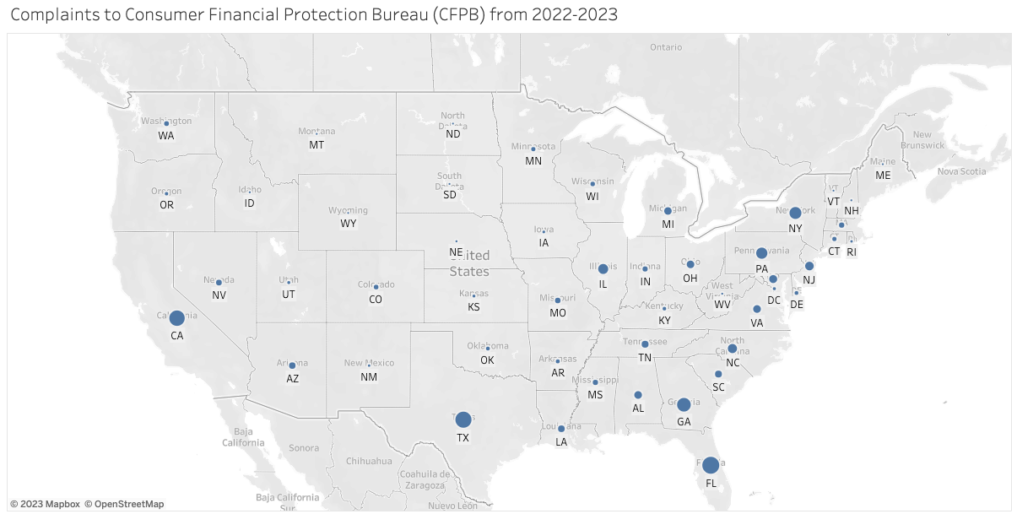
Number of Complaints Submitted Based on States
Key takeaways
Top 3 states: Florida (27,350), Texas (24,697), and California (22,724)
More populous states will generally have more CFPB complaints

Slide 6
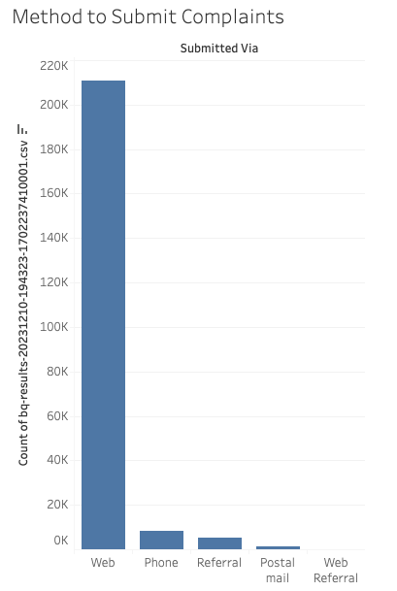
Method to Submit Complaints
Key takeaways:
Top 3: Web (210,701), Phone (8,152), and Referral (5,182)
A considerable amount of people prefer to submit their complaints on the website
Easy and quick to submit complaints along with supporting documents

Slide 7
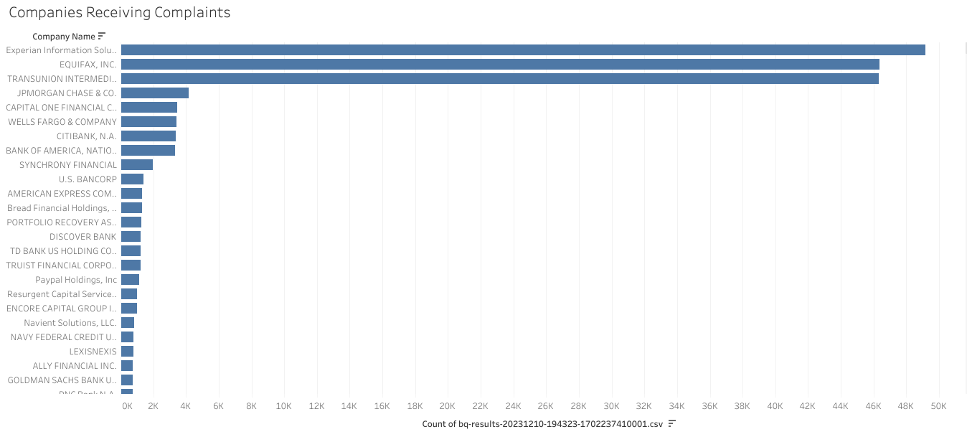
List of Companies Receiving Complaints in Descending Order Based on Total Count
Top 3 companies: Experian Information Solutions, Inc. (49,161), Equifax, Inc. (46,357), and Transunion Intermediate Holdings, Inc (46,310).

Slide 8
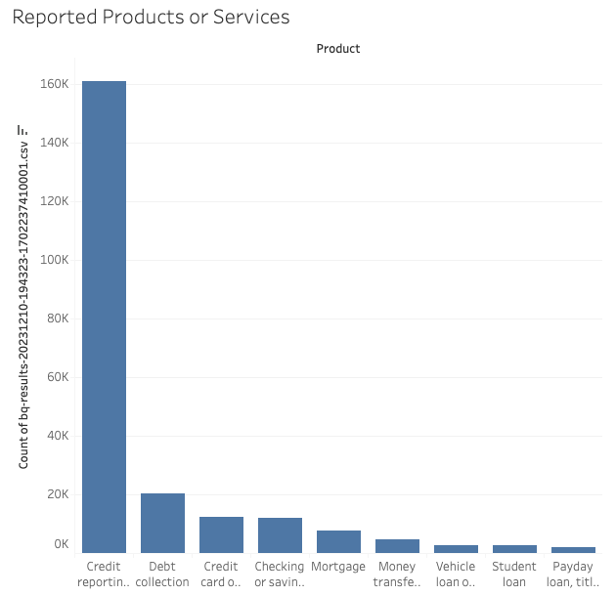
Reported Products or Services
Top 3:
Credit reporting, credit repair services, or other personal consumer reports – 160,815
Debt collection – 20,379
Credit card or prepaid card – 12,361

Slide 9
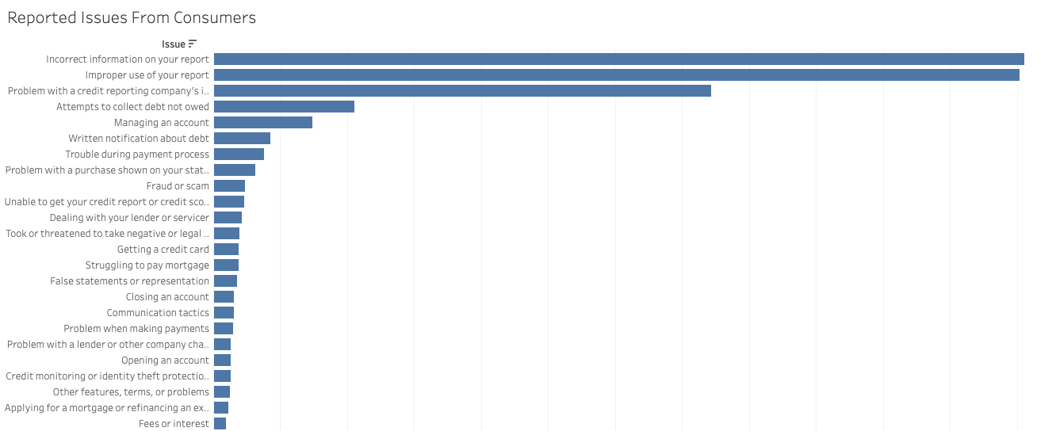
Reported Issues From Consumers
Top 3 issues: reports containing incorrect information (60,550), improper use of reports (60,183), and problem with a credit reporting company’s investigation into existing problem (37,183)

Slide 10
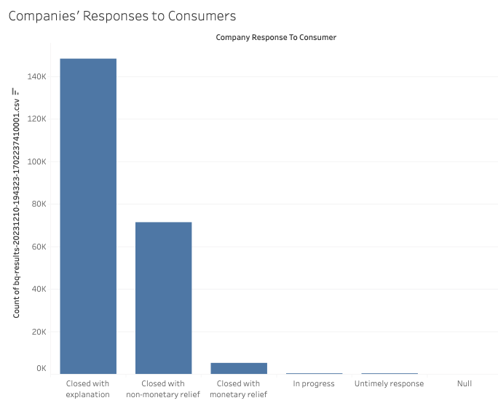
Companies’ Responses to Consumers
Top 3:
Closed with explanation – 148,323
Closed with non-monetary relief – 71,371
Closed with monetary relief – 5,218

Slide 11
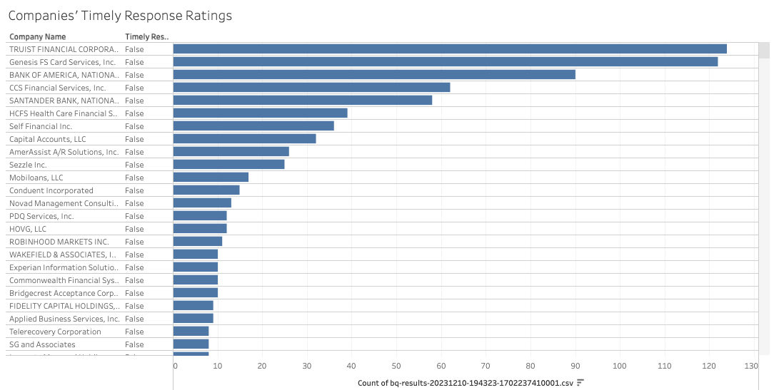
Companies’ Timely Response Ratings – “Untimely”
Top 3 companies with poor timely ratings: Truist Financial Corporation (124), Genesis FS Card Services, Inc. (122), and Bank of America, National Association (90)

Slide 12
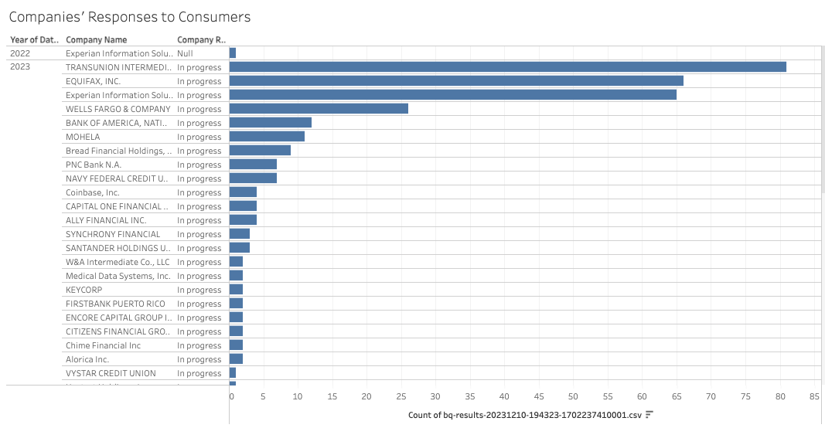
In-Progress and No-Response Reports
Top 3 companies with in-progress cases: Transunion Intermediate Holdings, Inc. (81), Equifax, Inc. (66), and Experian Information Solutions, Inc. (65); No-response: Experian Information Solutions, Inc. (1)

Slide 13
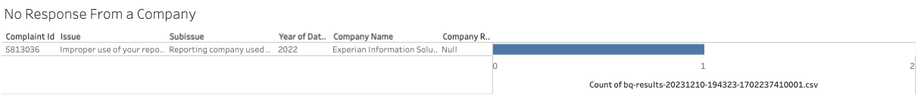
No Response From a Company
Issue: Improper use of reports
Subissue: reporting company used a report incorrectly
Year: 2022
Company Name: Experian Information Solutions, Inc.
Complaint ID: 5813036
From the CFPB website: it states that the “company has responded to the consumer and the CFPB and chooses not to provide a public response” - Search the Consumer Complaint Database | Consumer Financial Protection Bureau (consumerfinance.gov)
The company has responded to the complaint in private and probably forgot to indicate that the issue is closed

Slide 14
Conclusion
CFPB’s impressive ability to get cases resolved or closed is evident
Out of 225,563 cases, 224,912 cases are resolved/closed, which is roughly 99%!
To decrease the number of untimely responses, a more robust system that can follow up on both consumers and companies is recommended
It would be beneficial to have additional information such as
the population of the states that are mentioned in the “Number of Complaints Submitted Based on States” slides
the company’s ability to provide a response in a timely manner and what factors that may negatively impact the company’s ability to provide such a response
the partnerships between different federal agencies to achieve the mission
the dates that a case is open and closed

Slide 15
Thank You!
Do you have any questions, comments, or suggestions? Contact me.
Email: anniezhe0@gmail.com
LinkedIn: https://www.linkedin.com/in/anniezhe0
Link to the Tableau data visualization: Complaints to Consumer Financial Protection Bureau 2022-2023 | Tableau Public

