Slide 1
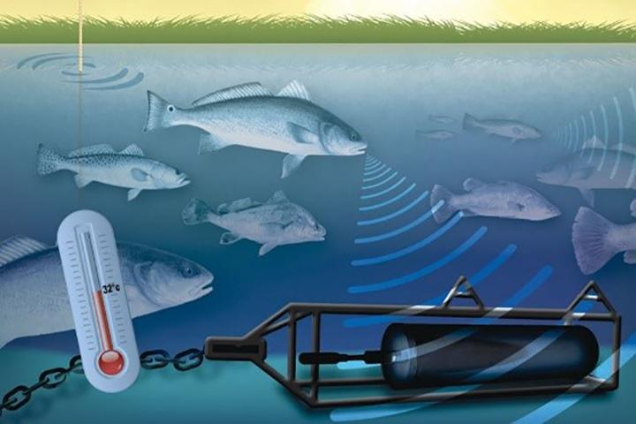

Project 1: Ensemble Learning
Presented by:
ADOU Kouamé Mathurin
KENNE Annine Duclaire
Nancy Fosua Boakye
MEGNE CHOUDJA Pauline Ornela

Slide 2

Introduction
Models
Data Preprocessing
Results and Discussion
Conclusion

Slide 3

Introduction
To help create innovative model which better improves ML models, we carried out this project.
Objectives
Analyze and preprocess the data.
Build and train different models including logistic regression, SVM, FCN and decision tree.
Combine those models based on different ensemble learning approaches.
3

Slide 4
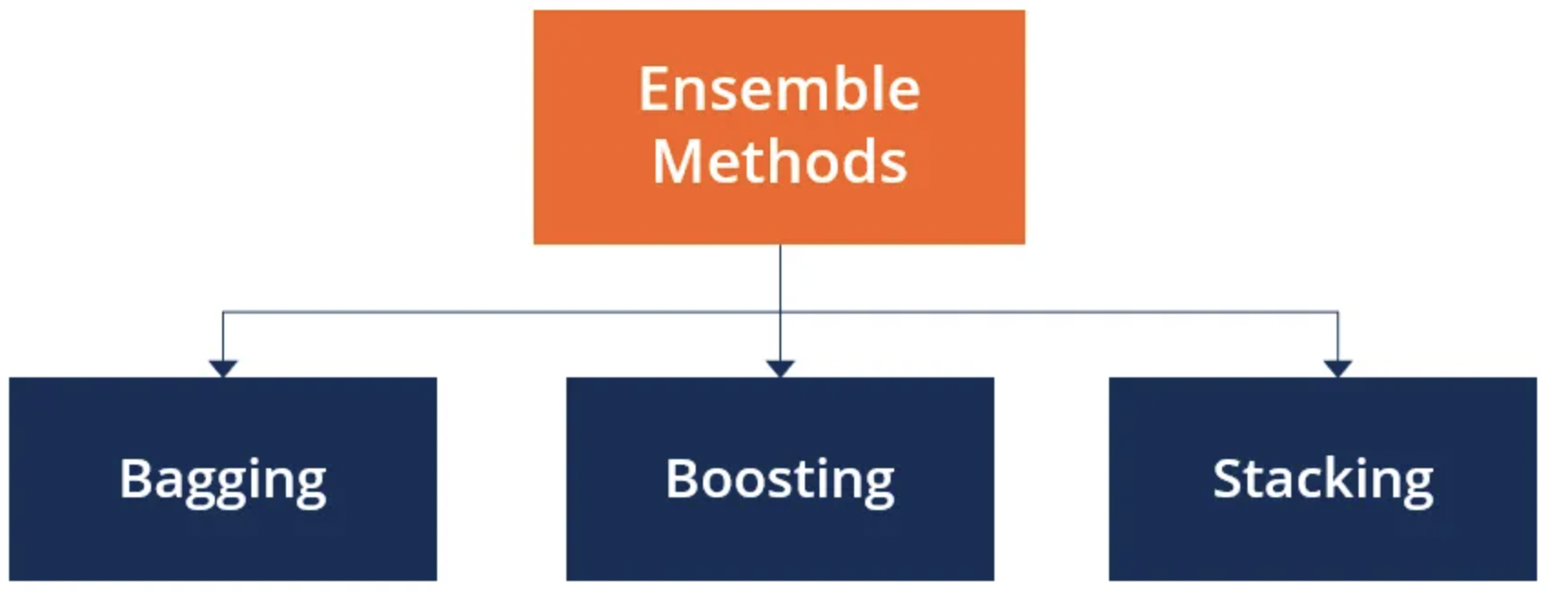
Machine Learning Models
Ensembling Learning is a meta approach which aims to seek better performance by combining the predictions from multiple models.
Figure 1 : Ensemble methods

Slide 5
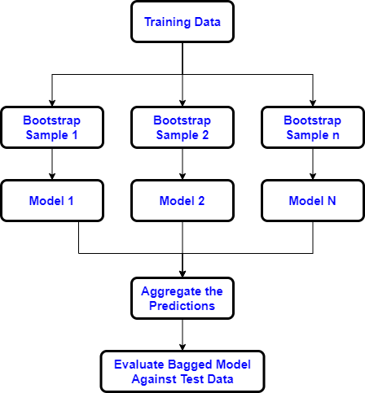
Machine Learning Models
Bagging Method
Figure 3 : Bagging principle

Slide 6
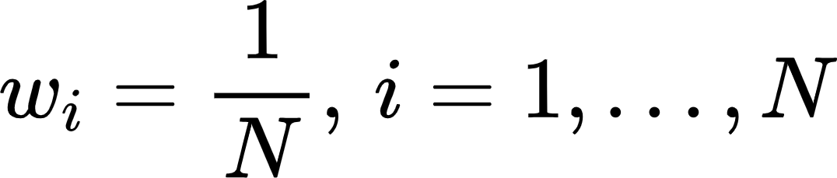

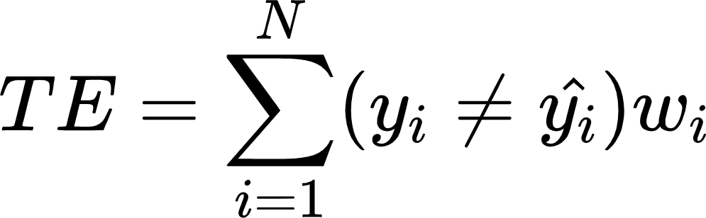

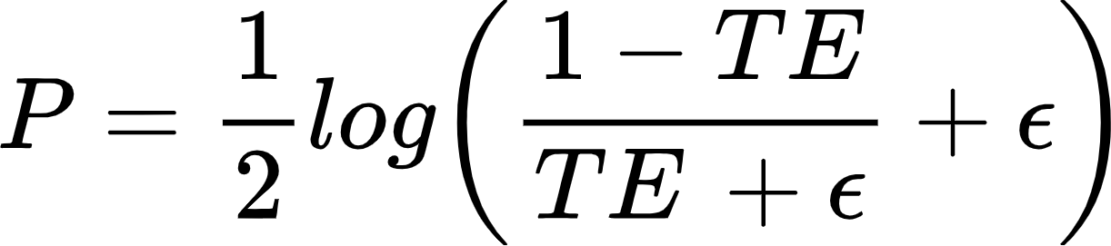

Machine Learning Models
b. Boosting Method( Adaboost)
step 1: Assign equal weights to each point in the dataset,
step 2: Create the first base learner.
step 3: Compute the total error,
step 4: Compute the performance of the model,

Slide 7
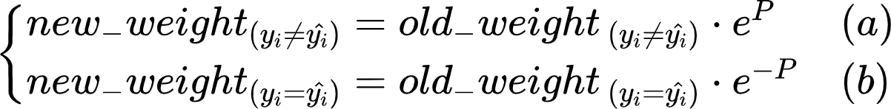

Machine Learning Models
step 5: Updating weight,
step 6:Randomly sample a new dataset.
step 7: Build a new model.
step 8: Repeat the same process from step 2 until the total number of fixed models.
step 9: Make predictions using test data.

Slide 8
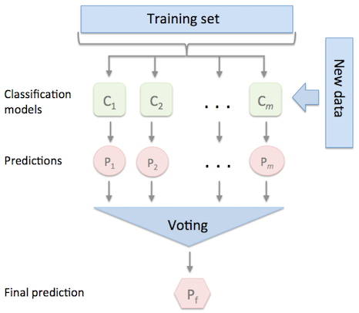
Machine Learning Models
c. Voting Method
Figure 4: Voting principle

Slide 9
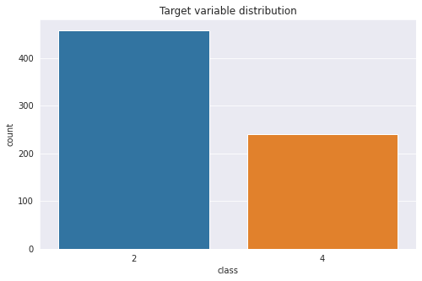
Data Preprocessing
Convert object feature to numerical values using one hot and label encoding.
Oversampling and undersampling techniques to solve the issue of imbalanced data.
Random Oversampler
Random Undersampling
Figure 5: Class representation

Slide 10
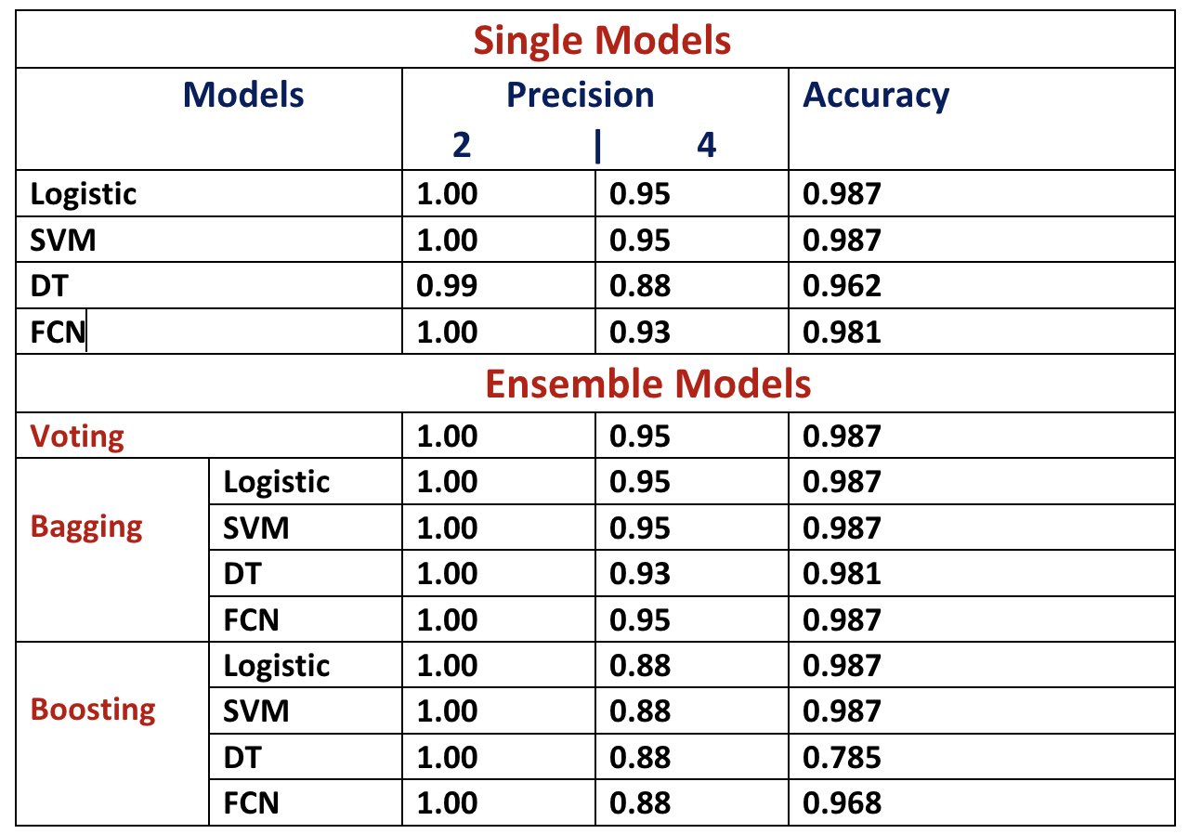
Results and Discussions
Figure 6: Models summary

Slide 11

Conclusion
Based on our findings, we can conclude that:
Label encoding performs better than the one hot encoding.
The oversampling approach performs better than the undersampling.
Having a good accuracy doesn’t always implies good model.
Ensembles methods improves the performance of a model, however, it is not guaranteed for all cases.

Slide 12

THANK YOU FOR YOUR ATTENTION

