Slide 1
Hotel Booking DApp Final Presentation
Author: NSA Team

Slide 2
Outline
Introduce team members
Blockchain concept
Advantages and Disadvantages
Technologies used
System overview
Application model
Demonstration

Slide 3
Introduction to Blockchain
Blockchain is a distributed digital ledger that stores data in linked blocks secured by cryptography.
Each block contains:
A timestamp
03
Transaction/data records
02
The hash of the previous block
01
Because the blocks are cryptographically connected, the data becomes transparent, tamper-resistant, and immutable. The ledger is shared across many network nodes, which use consensus algorithms to agree on its state without relying on a central authority.

Slide 4
Advantages
No middleman fees
High security
Immutable records
Global access

Slide 5
Limitations and Future Work
Gas fees
Scalability
Future: Finance & Payment, Digital Identity, Healthcare. NFT & Digital Ownership, ect

Slide 6

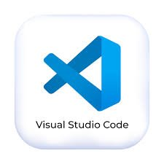


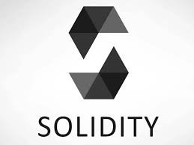
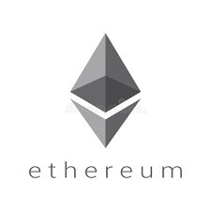
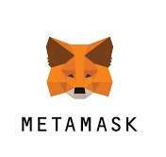
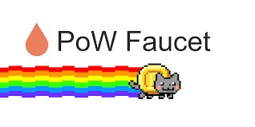
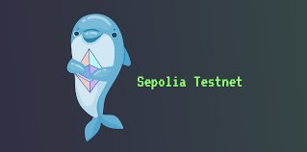
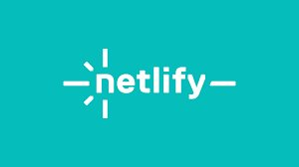
Technologies used
Development
Supporting tools
Deployment

Slide 7
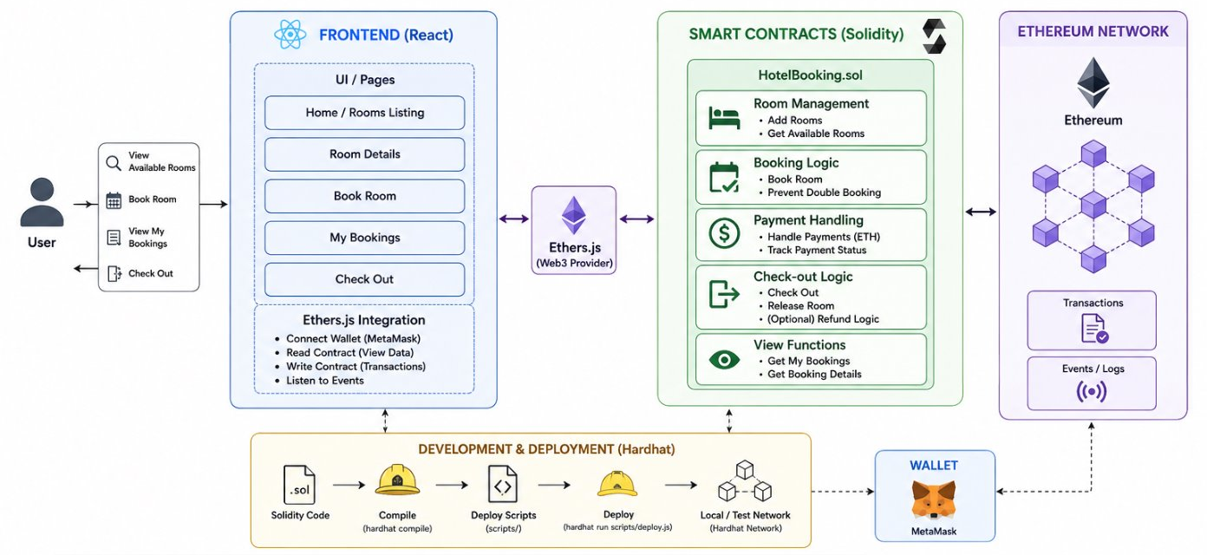
System Overview

Slide 8
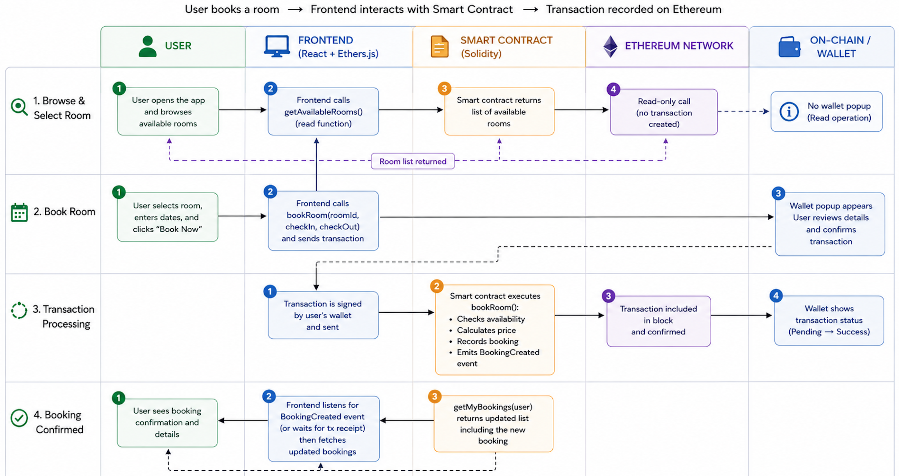
Application Model

Slide 9
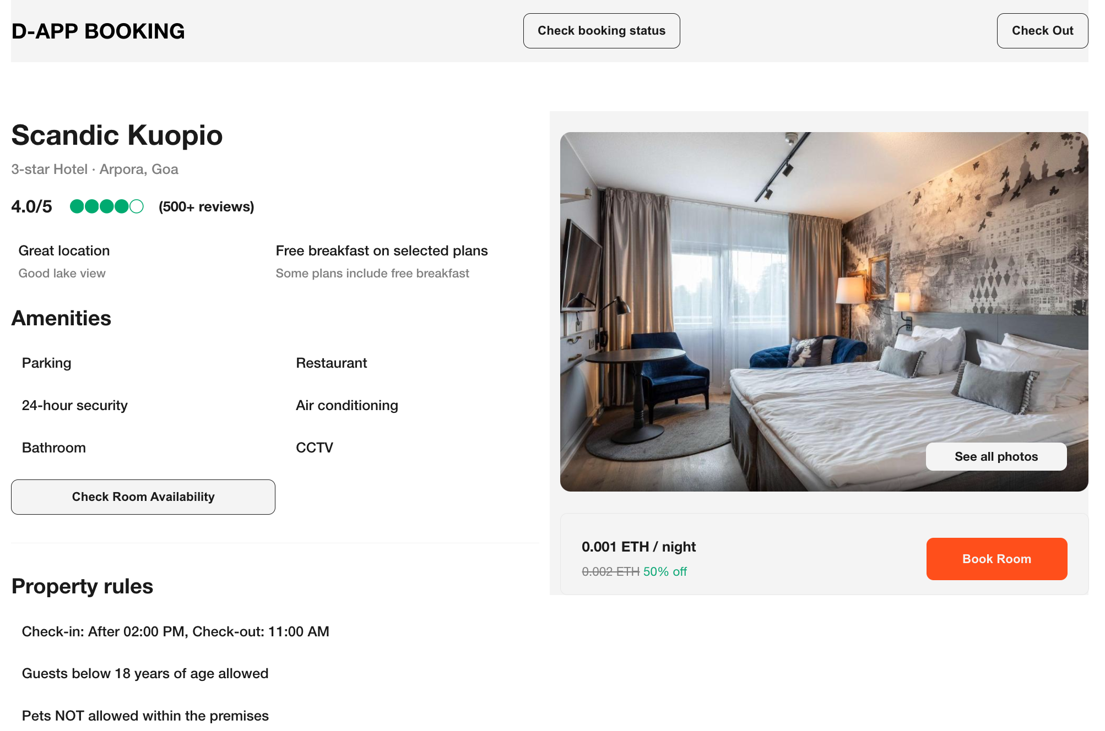
Demonstration

Slide 10
Thank you!

