Slide 1
NEPAJOBS – AN ONLINE JOB PORTAL
NEW SUMMIT COLLEGE

Slide 2
CONTENTS:
INTRODUCTION
STATEMENT OF THE PROBLEM
OBJECTIVES
SCOPE AND LIMITATION
METHODOLOGY
LITERATURE REVIEW
REQUIREMENT
FEASIBILITY
RESEARCH FINDINGS
CONCLUSION

Slide 3

INTRODUCTION
NEPAJOB is a digital platform that connect job seekers with employers.
It acts as a bridge between two parties.
Job seeker can search for the availability jobs at any moment.
A job seeker can directly visit the portal and view the available jobs.
User-friendly interface , quick navigation.
Each candidate will have their own account with their own home page.

Slide 4

STATEMENT OF THE PROBLEM
Difficulty connecting job seekers with relevant job opportunities.
Doesn’t have wide variety of job posting .
Lack of Customer Support, leaving user in frustration.
Difficulty verifying job posting and job applicants leading to a higher risk of fraud activity.
Outdated user interface, difficult to navigate.

Slide 5

OBJECTIVES
To provide a platform for job posting and job searching.
To enable employers to post vacancies and search for potential employees.
To facilitate communication between job seekers and employers.
To improve the quality of the hiring process.

Slide 6
SCOPE AND LIMITATIONS
Scope :
Advertisement of job openings.
Advanced search filters to refine job searches.
Detailed company profiles for employers.
Branding of the employers.
International job opportunities.
Feedback and reviews for transparency.
Limitations:
High competition for popular jobs.
Limited job options.
Job scams and fraud, trick job seekers.
Limited support and feedback
Data breaches or misuse of personal data.

Slide 7
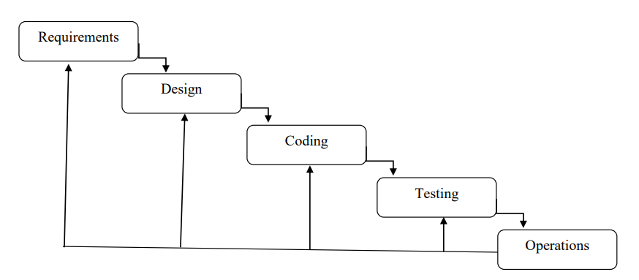
METHODOLOGY
Waterfall model used as development methodology.
Suitable for projects with well defined requirement.
Manage the complexity of online job portal
Linear process, making easier to communicate with stakeholders.

Slide 8

LITERATURE REVIEW
Employment recruitment agencies
Job fairs
Advertising in the mass media such as newspaper.
Management Consultants.
Advertisement in television and radio.
Existing employee contacts.
Worker or professional referrals.

Slide 9

FUNCTIONAL REQUIREMENT
User registration and login for both job seekers and employers.
Job search and filtering capabilities for job seekers.
Communication between job seekers and employers.
Job posting and search capabilities for employers.
User profile management for both job seekers and employers.
Job application Deadline management.

Slide 10
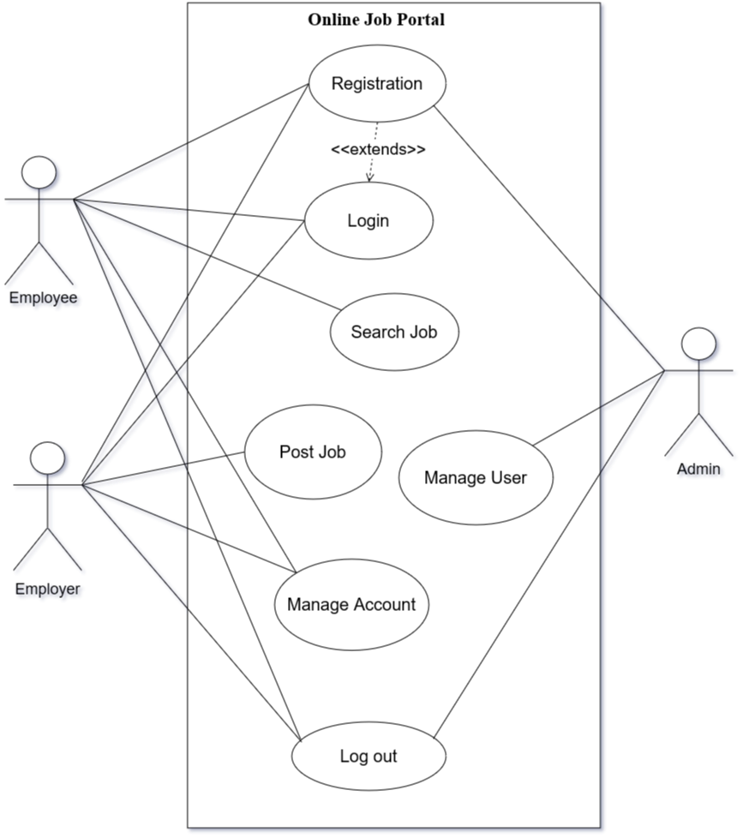
Use case Diagram

Slide 11

NON-FUNCTIONAL REQUIREMENT
User-friendly interface and design.
Secure login and data storage.
Fast loading and response times.
Reliable data storage and management.
Highly reliable with minimal time for maintenance.
Work well with different web browsers, OS and devices.

Slide 12

FEASIBILITY
Technical Feasibility :
Right tools, skills and resources to do a project
Required any devices with browser.
Operational Feasibility:
Possible to run project once it’s finished.
User Friendly, easy to use no training required.
Economical Feasibility:
Minimal cost
Schedule Feasibility:
Project complete on time

Slide 13
GANTT CHART
Working Time | 1th Jun | 10thJun | 20th Jun | 31th Jul | 10th Aug | 20th Aug
Requirement
Design
Coding
Testing
Operation & maintenance
Documentation

Slide 14
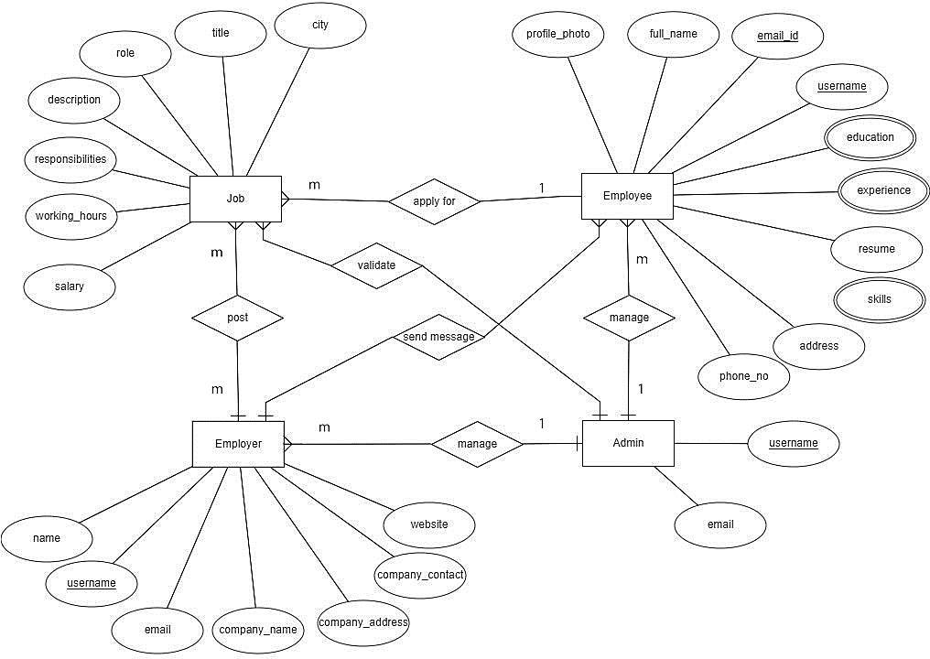
ER Diagram

Slide 15
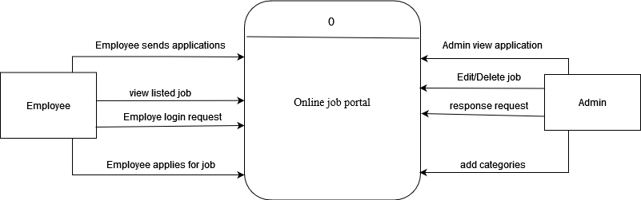
ZERO Level DFD

Slide 16
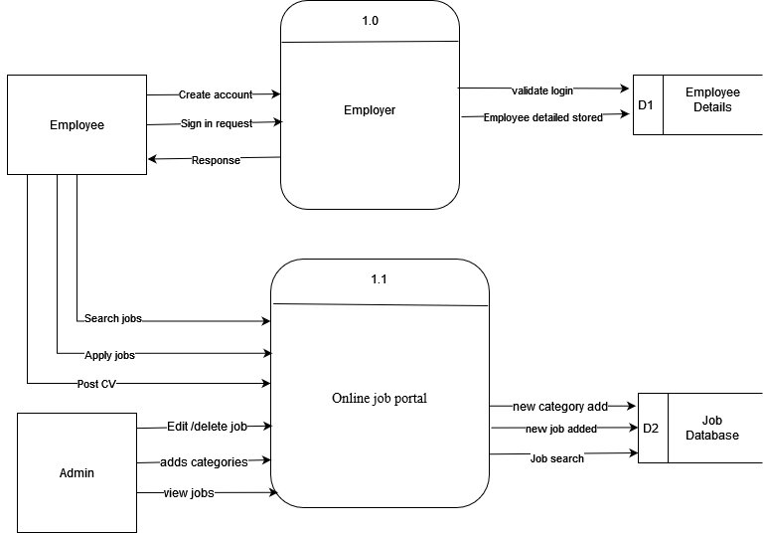
First level DFD

Slide 17
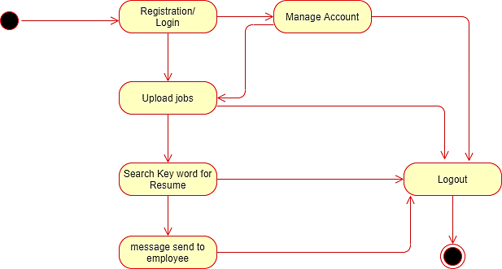
Employer Activity Diagram

Slide 18
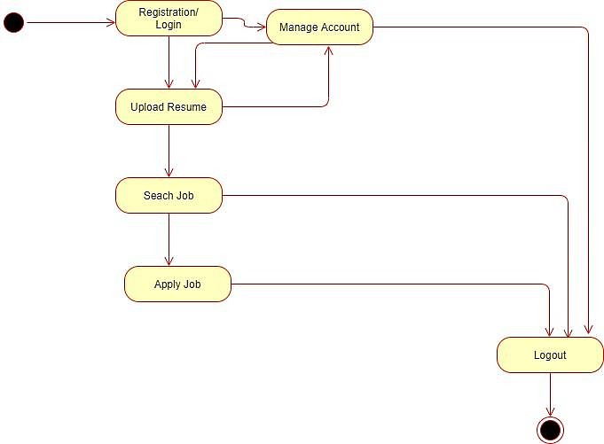
Employee Activity Diagram

Slide 19
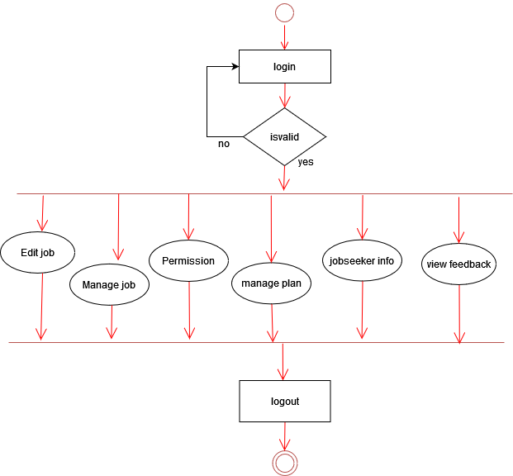
Admin Activity Diagram

Slide 20


IMPLEMENTATION
Tools used:
Front end
HTML
CSS
JavaScript
Bootstrap
Back end
PHP
MySql

Slide 21

TESTING
Unit Testing
Testing done during the development phase
Testing individual components to ensure work correctly
System Testing
Testing done after unit testing
Testing entire system integrated components

Slide 22

EXPECTED OUTCOME
Increased visibility for job openings
More job opportunities
Wide variety of job posting
Improved communication
Cost and Time saving
Increased user satisfaction
Continuous improvement

Slide 23

CONCLUSION
Cost-effective way for finding qualified candidates.
Faster process and more convenient, for finding jobs.
Easily searching suitable job positions for the job seeker.
Platform to explore a wide range of job opportunities.
User-friendly interfaces ensuring effortless navigation
Safeguard personal data and protect against fraud activities.
Better decision making for both job seekers and employers.

Slide 24

FUTURE RECOMMENDATIONS
Improve job matching algorithm, providing more accurate job recommendation.
Enhance user interface, easy to navigate and use.
Mobile-friendly applications for convenient access on smartphones.
Integrate with professional networking platforms like LinkedIn.
Offer skill development resources like online course and certifications.
Integrate with video interviewing platforms for virtual interviews.
Prioritize security and privacy to protect data.
Collaborate with educational institutions to connect students with internship.
Seek feedback from users and continuously improve the portal based on their input.

Slide 25



