Slide 1


CG_TEAM_IMART
Amazon Alexa Skills Challenge – Online Hackathon
Code Gladiators 2019

Slide 2

Problem at hand
Problem:
Voice Games:
Games provide a wide opportunity for developers. Transferring the experience to voice is just the next challenge to conquer. Build Alexa game skills and create entertaining, engaging, and educational voice gaming experiences. From storytelling and trivia games to quizzes and gaming accessories, your Alexa game skill can surprise and delight customers with interactive voice experiences.

Slide 3
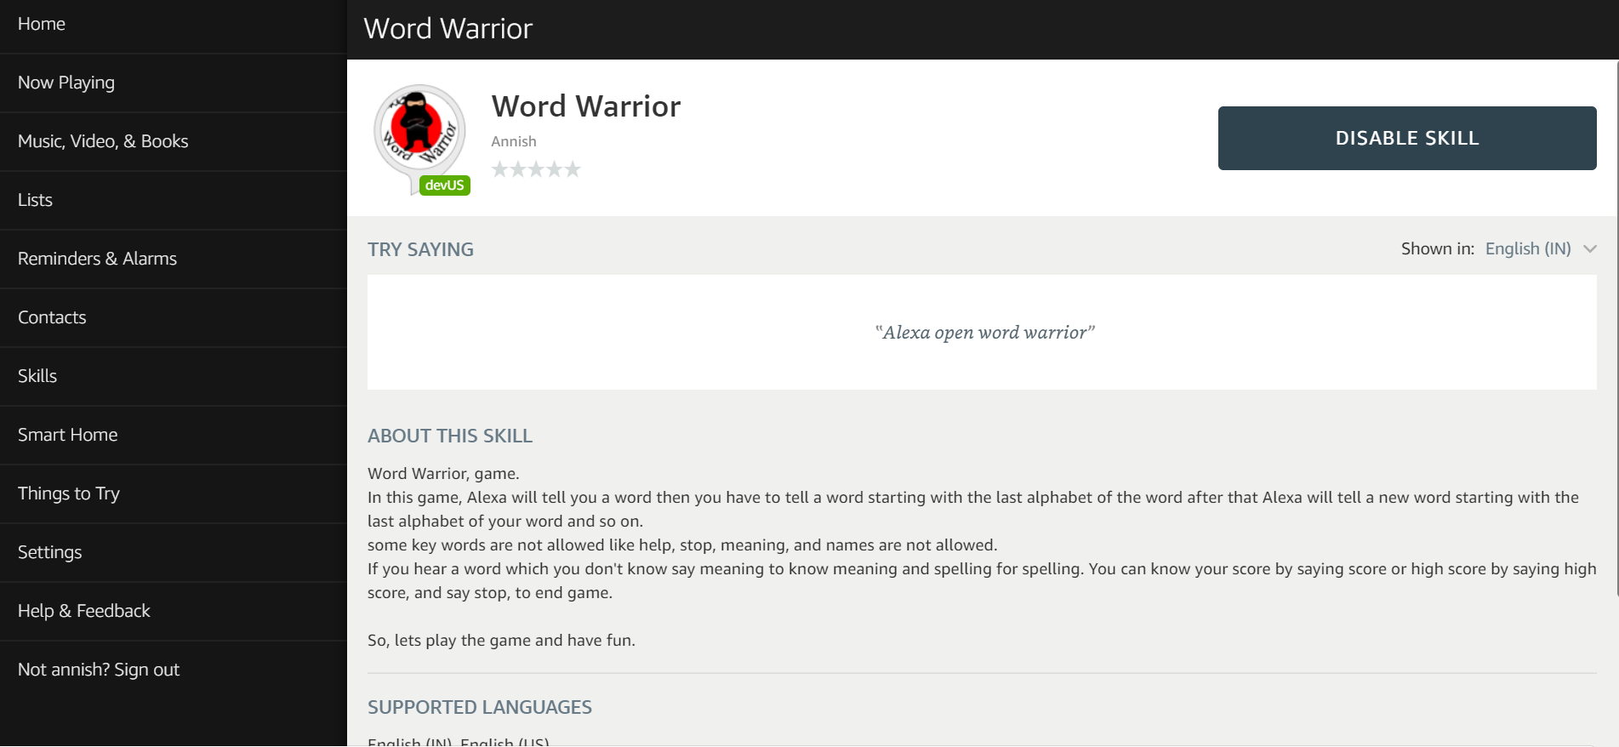
Solution
Alexa Voice game (Word Warrior)
This is a voice game for all age of people. Where everybody can learn new words while have fun.

Slide 4

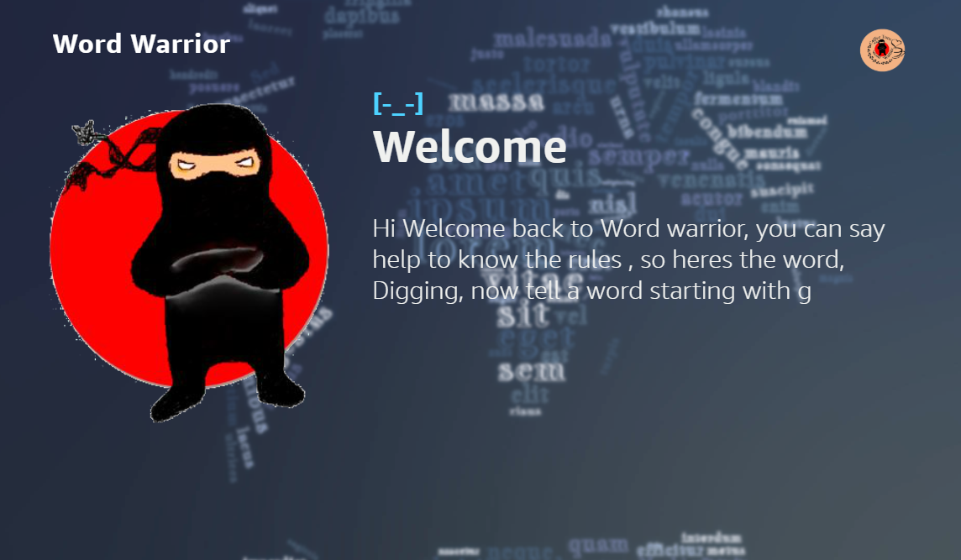

Demo/ Prototype
Link to the demo: https://www.youtube.com/watch?v=EJZ6bt8RPWo
Skill Link: https://www.amazon.in/dp/B07RXDMJ2S/ref=sr_1_1?keywords=word+warrior&qid=1558328986&s=digital-skills&sr=1-1-catcorr
Snapshots for reference:
Echo show view
Echo spot view

Slide 5
Approach
I wanted to create a voice game which would be fun easy and at the same time educational. So, I came up with the idea of word warrior.
First I wanted to use Node js to write the backend code and dynamoDB for storage but dynamoDB became a bit costlier for my use case as I need to store the complete English dictionary. So, Instead of going for this approach I used Python for coding and CSV files to store data and Panda’s data frame for data processing.

Slide 6
Technology Stack
Technologies used
I. Python: This language is used to create the backend code
Python Libraries used
1. Pandas: It is used to create and process data frames from CSV file data
2.Boto3: It is used to access CSV file stored in S3 bucket
II.AWS: It is used for backend service for Alexa skill
Services Used
1.Lambda: It is used for hosting the Alexa skill code
2.S3: It is used to store user data in CSV format. I have used this instead of dynamoDB because of the cost difference. I was able to over come the performance issue using Panda’s data frames.
3.CloudWatch: It is used for logs
III.AWS Developer Console: It is used to create conversation Model and deploy to Alexa Skill Kit
IV. APL: Used Alexa Presentation Language for Display Screens

Slide 7
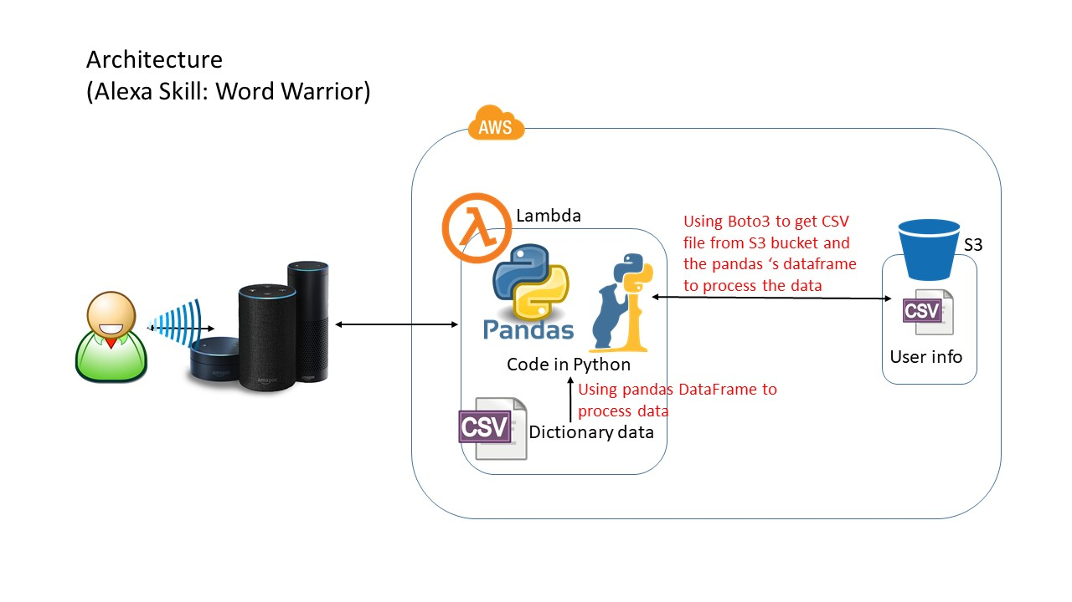

Slide 8
Why our team is the best!
Mention why your team should be selected for the finale.
Why I should be selected for finale is very hard question to answer.
But according to me I should be in the finale because this complete project is done by a single person in 12 days while managing a full time job.
Everything in this project is done by me from idea generation, technology stack selection, code creation, testing to even the logo creation. Everything is created from the scratch.

Slide 9
Associated attachments/ files
Alexa.docx

Slide 10
Thank you

Slide 11
Appendix

Slide 12
Challenges
I wanted to use Node js to write the backend code and dynamoDB for storage as I have worked on these two technologies before, but dynamoDB became a bit costlier for this use case as I need to store the complete English dictionary. So, Instead of going for this approach I used Python for coding and CSV files to store data and Panda’s data frame for data processing. Panda's Data Frame was a great alternative as I was able to run SQL like quires on such a huge data set without compromising on the speed.

Slide 13
Possible Improvements
In future Skill can support game play between two different users using this Alexa skill by using notification feature of Alexa.
It can be made more personalized by access the user data permissions from Alexa
It can have a global leader board and can tell the user their current position in the global leader board

