Slide 1


Unity 3D Course
Lection 4.GUI

Slide 2
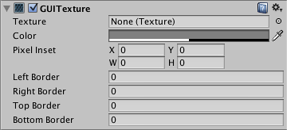
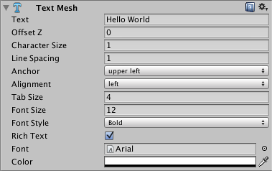
Unity GUI System
Lection 4.GUI
GuiTexture
GuiText
3DText
Notes:
Show everything in Unity(add remove script something)
http://docs.unity3d.com/Manual/class-GuiTexture.html
http://docs.unity3d.com/Manual/class-TextMesh.html
http://docs.unity3d.com/Manual/class-GuiText.html
Show detecting touch for GuiTexture ….

Slide 3
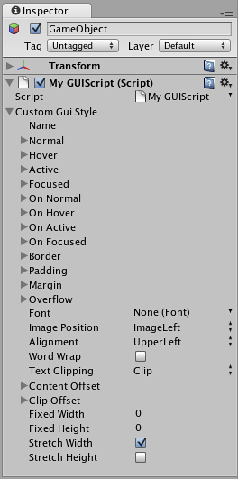
Unity GUI
Lection 4.GUI
OnGUI
Skin
Style
Button
Box
Label
TextArea
Notes:
Demonstrate scripting for OnGUI -- http://docs.unity3d.com/Manual/gui-Basics.html

Slide 4
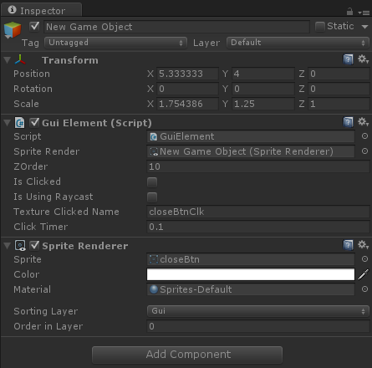
Custom GUI
Lection 4.GUI
Custom GUI
Nine slicing and scaling
Alternatives
Notes:
Make example class for button
Show detect touch types(raycast vs rectangle contain)
Few words about Sprites

Slide 5
New Unity UI
Lection 4.GUI
UI Canvas
UI Button
UI Image
UI Text
UI Events and Triggers
Notes:
Open new scene and make scene duplicate of the already prepared (NewUIScene)
Explain every UI component
Show some scripting using the public properties and methods of rectTransform.

Slide 6
New Unity UI
Lection 4.GUI
UI Slider
UI Transitions
UI Scroll Rect
UI Scrollbar
UI Mask
Notes:
Open new scene and make scene duplicate of the already prepared (NewUIScene)
Explain every UI component.
Show some scripting using the public properties and methods of rectTransform.

Slide 7
Useful links
http://docs.unity3d.com/Manual/class-GuiText.html
http://docs.unity3d.com/Manual/class-GuiTexture.html
http://docs.unity3d.com/Manual/gui-Basics.html
http://unity3d.com/learn/tutorials/modules/beginner/ui

