Slide 1


Unity 3D Course
Lection 2.Gameobject scripting

Slide 2
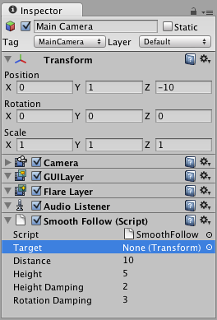
Inspector
Lection 2.Gameobject scripting
Manage Components
Tags
Layers
Sorting Layers
Notes:
Open unity and add gameobject… explain tag, layer, sorting layers. Use the example game

Slide 3
Prefabs and Resources
Lection 2.Gameobject scripting
What is prefab?
When to use prefab?
How to make and use prefabs?
Resources. Load vs Scene Pre-Load
Notes:
Make one prefab in the example game..

Slide 4
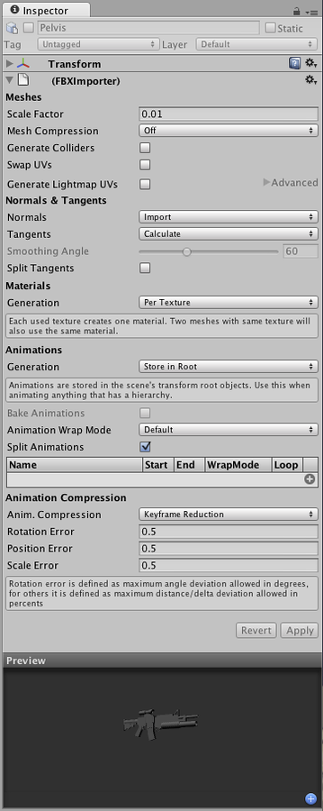
Import Settings
Lection 2.Gameobject scripting
What is Mesh?
Prefab vs Model
Unity Import capabilities
Notes:
Don’t miss import formats and 3d software
Show them in the example game
http://docs.unity3d.com/Manual/class-Mesh.html
http://docs.unity3d.com/Manual/Prefabs.html
http://docs.unity3d.com/Manual/HOWTO-importObject.html

Slide 5
Components Scripting
Lection 2.Gameobject scripting
Attach component
Get components
Manage Components
Notes:
Don’t miss to access remote scripts and their components
Show in the example game
http://docs.unity3d.com/ScriptReference/GameObject.GetComponent.html

Slide 6
Unity Input Scripting
Lection 2.Gameobject scripting
Input Manager
Input class and methods
Event. Current
Notes:
Don’t forget all axes added to input manager are visible in standalone and change-able. Mention other alternatives for controls as in the Andromeda (DB).
http://docs.unity3d.com/Manual/class-InputManager.html
http://docs.unity3d.com/ScriptReference/Input.html
Show touches .. Show detecting keys in Update method.
Show detecting keys with Event.current
Show using modifiers with Event.current
Show the code in the example game

Slide 7
Useful links
Lection 2.Gameobject scripting
http://docs.unity3d.com/Manual/Inspector.html
http://docs.unity3d.com/Manual/Prefabs.html
http://docs.unity3d.com/Manual/HOWTO-importObject.html
http://docs.unity3d.com/ScriptReference/Component.html
http://docs.unity3d.com/Manual/class-InputManager.html
http://docs.unity3d.com/ScriptReference/Input.html

Slide 8
Lab
Lection 2.Gameobject scripting

