Slide 1
RARE EVENTS • OPTICAL MAP
Why rare detections are hard to learn
Only 5 detections in
10,000 events
Three different problems
Misleading accuracy
Sparse evidence
Shifted probabilities
At a 0.05% detection rate, a network
can look excellent while missing every
positive event.
The goal: learn rare-event structure without distorting the population rate.
Illustrative examples • No experimental model ranking
1
Notes:
Numerical examples are analytical illustrations; they are not outcomes from the optical-map experiments.

Slide 2
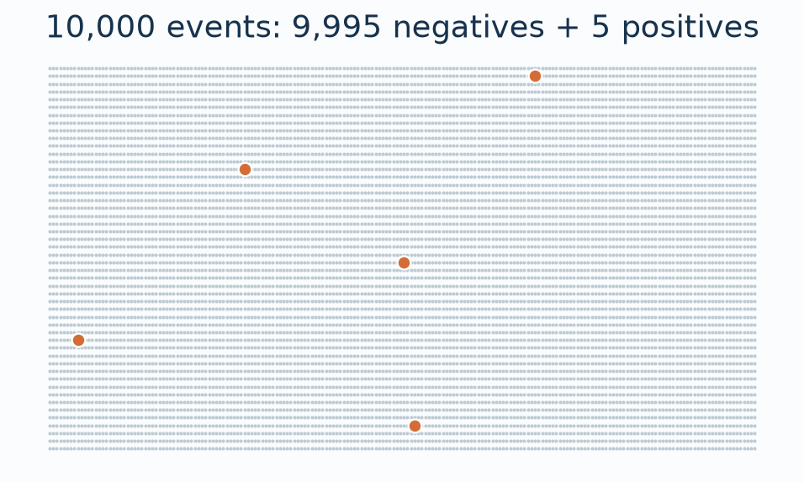
RARE EVENTS • OPTICAL MAP
99.95% accuracy — and zero detections found
Predict “negative” for all
Accuracy: 99.95%
Positive recall: 0%
Every detection is
missed.
Accuracy counts successes mostly on the abundant negative class.
Illustrative examples • No experimental model ranking
2
Notes:
Numerical examples are analytical illustrations; they are not outcomes from the optical-map experiments.

Slide 3
RARE EVENTS • OPTICAL MAP
A negative decision is not a zero probability
Classification decision
Probability estimate
“Does this event produce a hit?”
If the threshold is 50%, a score of
0.05% is classified as negative.
“How likely is a hit?”
A score of 0.05% for all events
predicts 5 hits per 10,000 on
average.
A model can have zero recall at threshold 0.5 and still estimate the mean rate.
Illustrative examples • No experimental model ranking
3
Notes:
For threshold 0.5, any q<0.5 produces a negative decision. Constant q=prevalence minimizes unweighted population BCE among constant predictors, but need not be optimal among feature-dependent predictors. Exact q=0 has infinite BCE if any positives occur.

Slide 4
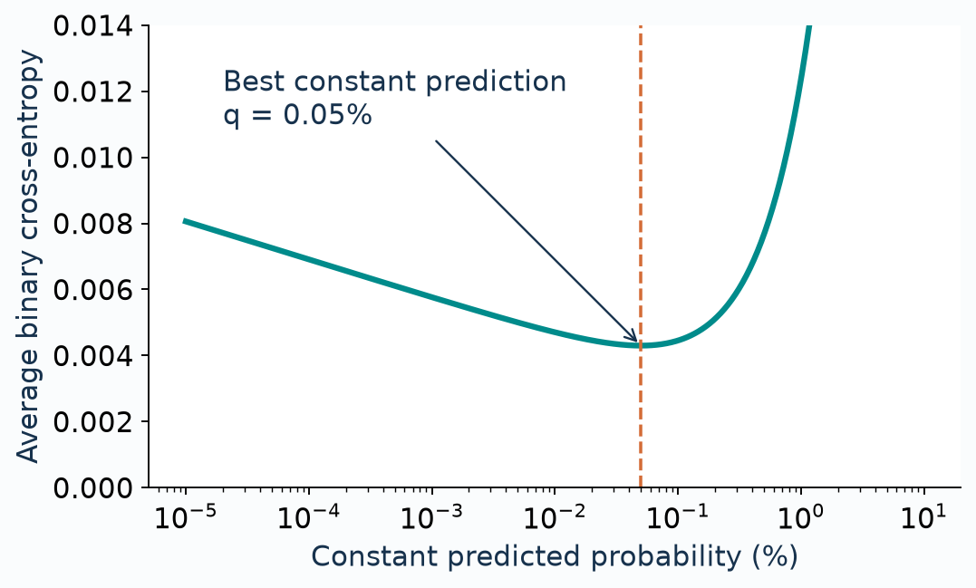
RARE EVENTS • OPTICAL MAP
BCE does not reward predicting exactly zero
A positive event has loss
−log(q).
As q approaches zero, that
penalty grows without
bound.
The best constant score is
the true positive fraction.
Near-zero scores can be sensible; failing to learn useful variation is the concern.
Illustrative examples • No experimental model ranking
4
Notes:
Analytical constant-predictor loss L(q)=-pi log(q)-(1-pi)log(1-q), pi=0.0005. Its unique minimum is q=pi. BCE gradient with respect to logit is q-y. At q=0 positive-event loss diverges. Numerically stable BCE with logits avoids explicit log(0); it does not rebalance classes.

Slide 5
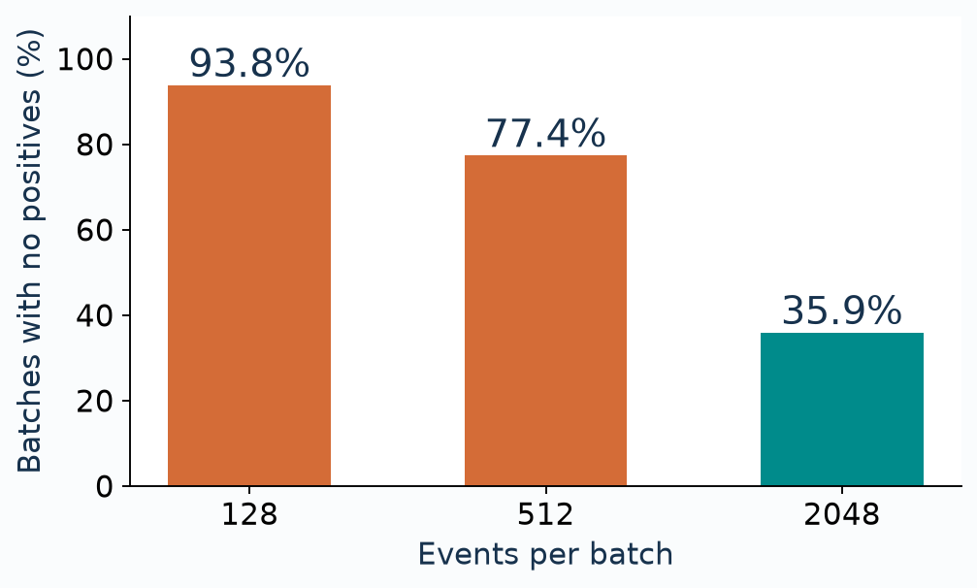
RARE EVENTS • OPTICAL MAP
Many small batches contain no positive example
At 0.05% positives:
A batch of 512 has only
0.256 positives on average.
Most such updates contain
only negative examples.
Larger or stratified batches improve exposure; they do not create new evidence.
Illustrative examples • No experimental model ranking
5
Notes:
Independent natural draws with prevalence pi=0.0005: P(no positives)=(1-pi)^B. Correlated/grouped sampling can change these numbers. Repeated epochs revisit the same dataset; they do not supply new independent positives.

Slide 6
RARE EVENTS • OPTICAL MAP
Early training can mostly learn “make scores
smaller”
9,995 negative events
5 positive events
Start with scores near 50%.
Together, negatives strongly push
the shared output bias downward.
Each positive pushes upward.
There are very few examples from
which to learn a generalizable
positive pattern.
As scores fall, easy-negative gradients shrink. This is not an unavoidable zero-loss trap.
Learning the overall rarity can be much easier than learning who is more likely.
Illustrative examples • No experimental model ranking
6
Notes:
For unweighted mean BCE with sigmoid logits z, dL/dz=q-y per example before averaging. Illustration assumes all q=0.5 and examines a shared output bias: 9995*0.5=4997.5, 5*(-0.5)=-2.5. Parameter gradients also depend on features/Jacobians. At q=pi=0.0005 the shared-bias contributions balance at +4.9975 and -4.9975; class counts alone do not imply permanent gradient domination.

Slide 7
RARE EVENTS • OPTICAL MAP
Oversampling makes positives visible — not more
diverse
Original data
Oversampled batches
Possible failure
5 distinct positives
A few examples of
what a detection looks
like.
The same 5 positives
appear repeatedly.
More training
exposure.
The model memorizes
those examples.
Unseen positives
remain difficult.
More repetitions help optimization; more independent positives help generalization.
Illustrative examples • No experimental model ranking
7
Notes:
Random positive oversampling repeats existing observations. It can improve optimizer exposure to minority patterns but does not increase the independent positive sample size. Risks described are conditional, not claims that oversampling always fails.

Slide 8
RARE EVENTS • OPTICAL MAP
Changing the class balance changes what scores
mean
Toy example: the features contain no information about the label.
Natural data
5% positive batches
25% positive
batches
0.05%
5%
25%
Best constant BCE score
100× the population rate
500× the population rate
Better positive recall can come with an upward bias in predicted detection rates.
Illustrative examples • No experimental model ranking
8
Notes:
Toy population with no informative features: natural prevalence pi=0.0005. BCE-trained constant predictors on sampled prevalences r=0.05 or 0.25 minimize loss at r, not pi. In a feature-dependent model pure class-dependent resampling shifts posterior odds. This does not imply every real trained model has a uniform 100x or 500x error.

Slide 9
RARE EVENTS • OPTICAL MAP
Reweighting also changes the training objective
What it does
Why it can disappoint
A positive mistake receives a larger
penalty.
This can encourage the network to
learn rare positive patterns.
A few positives can drive noisy
updates or overfitting.
The score is no longer automatically
a natural detection probability.
Weighting changes importance; it cannot add missing information.
Illustrative examples • No experimental model ranking
9
Notes:
Weighted BCE L=-w*y*log(q)-(1-y)*log(1-q), with constant positive weight w and negative weight 1. At true conditional probability p, optimum q=w*p/(1-p+w*p). At p=0.0005, w=100 gives 4.764%; w=1999 gives 50%. Correct inverse-sampling weights are different: they restore the natural expected loss. Large weights can increase stochastic gradient variance when positives are rare.

Slide 10
RARE EVENTS • OPTICAL MAP
Focal loss can focus on ambiguity as well as signal
Useful when…
Can fail when…
Many easy negatives consume
training attention.
Reducing their influence makes
harder examples matter more.
“Hard” means noisy or intrinsically
unpredictable.
The model spends capacity on
examples with little learnable signal.
Source: Lin et al. (2017). Optical-map implications are hypotheses to test.
A different loss cannot turn random outcomes into predictable events.
Illustrative examples • No experimental model ranking
10
Notes:
Reference: Lin et al., Focal Loss for Dense Object Detection, ICCV 2017, https://openaccess.thecvf.com/content_iccv_2017/html/Lin_Focal_Loss_for_ICCV_2017_paper.html . Focal loss downweights well-classified examples using (1-p_t)^gamma. Hard examples may include informative positives, ambiguous events or label errors. In inherently stochastic detection the irreducible component cannot be learned away. Risks are task-specific inferences, not experimental results from that paper.

Slide 11
RARE EVENTS • OPTICAL MAP
Mixup adds interpolation — not independent
detections
Positive (label 1) + negative (label 0) → synthetic event (label λ)
Why it can help
Why it can fail
Smoother predictions between
examples; less memorization of
individual training events.
Interpolated features may not
represent real events. Forced
positive–negative pairing changes
the label distribution.
If every pair is +/− and mean λ = 0.5, the synthetic mean label is 50%.
Natural pairing preserves the mean in expectation, but rarely includes positives.
Illustrative examples • No experimental model ranking
11
Notes:
Reference: Zhang et al., mixup: Beyond Empirical Risk Minimization, ICLR 2018, https://arxiv.org/abs/1710.09412 . x_tilde=lambda*x_plus+(1-lambda)*x_minus and y_tilde=lambda. If every pair is positive-negative and E[lambda]=0.5, mean synthetic label is 0.5. Natural independent pairs and label-independent lambda preserve prevalence in expectation. The derivation is our illustration; claims about unphysical interpolation are conditional on features/task.

Slide 12
RARE EVENTS • OPTICAL MAP
Some events may be impossible to classify reliably
Learnable structure
Unobserved randomness
Position or event features change
the chance of detection.
The network can learn which events
are more likely.
Similar recorded inputs can still
produce different outcomes.
No loss or sampler can reveal
information absent from the inputs.
Accurate probabilities can be achievable even when individual hit prediction is weak.
Illustrative examples • No experimental model ranking
12
Notes:
Conceptual distinction between Bayes uncertainty and insufficient data/model capacity. If relevant randomness is unobserved, P(Y=1|X) can remain small for all X. Balanced accuracy or rare-event recall may improve with an altered decision threshold; perfect classification is not implied by learning calibrated probabilities. This is a possible explanation, not a diagnosis of the optical dataset.

Slide 13
RARE EVENTS • OPTICAL MAP
For the optical map, protect the population mean
Training
Validation
Measure both
Improve exposure to
positives.
Retain a loss on naturally
sampled real events.
Tune augmentation
strength.
Use the natural class
balance.
Hold out whole voxels.
Compare several
seeds.
Event ranking:
precision–recall / AP
Population map:
mean bias, MAE and
spatial trend
Success means useful ranking AND trustworthy rates; accuracy alone proves neither.
Illustrative examples • No experimental model ranking
13
Notes:
Recommendations, not completed experiments. Evaluate on untouched natural prevalence, with spatially grouped train/validation/test splits. A separate real-data BCE plus weighted synthetic auxiliary loss anchors training but does not guarantee calibration. Mean bias is predicted minus observed fraction, preferably accompanied by MAE/trend and uncertainty. Average precision baseline equals prevalence for random ranking in the population limit.

Slide 14
RARE EVENTS • OPTICAL MAP
What would most directly improve the evidence?
At a true detection probability of 0.05%:
1,500 primaries
5,000 primaries
20,000 primaries
0.75 expected hits
47.2% chance of
zero hits
2.5 expected hits
8.2% chance of zero
hits
10 expected hits
<0.01% chance of
zero hits
More primaries reveal rare detections; more voxel locations reveal spatial structure.
Sampling tricks redistribute the evidence. Simulation supplies new evidence.
Illustrative examples • No experimental model ranking
14
Notes:
Analytical homogeneous-rate illustration pi=0.0005. Expected positives N*pi; P(zero)=(1-pi)^N. Values are not claims about every optical voxel, whose rates vary. Increasing primaries improves count precision; adding spatial locations improves coverage. The allocation tradeoff is an experimental design question.

Slide 15
TECHNICAL APPENDIX
Appendix: why weights and sampling bias
probabilities
Positive weight w changes the BCE optimum:
q* = w p / (1 − p + w p)
At p = 0.05%: w = 100 gives q* ≈ 4.76%; w = 1,999 gives q* = 50%.
Under pure class-dependent resampling:
logit(p) = logit(q) + logit(π) − logit(r)
π: natural positive fraction; r: sampled fraction; q: calibrated sampled score.
Requires unchanged within-class distributions; not a general mixup correction.
Correct sampling weights can restore the original objective; arbitrary class weights do not.
Illustrative examples • No experimental model ranking
15
Notes:
Analytical derivations: weighted BCE optimum found by setting derivative to zero. Prior-shift correction follows Bayes odds and requires class-only sampling with unchanged class-conditional features, a calibrated sampled posterior q and known natural prevalence pi. It is not generally valid for arbitrary mixup or within-voxel selection changes. Related reading: Menon et al., Long-tail learning via logit adjustment, ICLR 2021, https://research.google/pubs/long-tail-learning-via-logit-adjustment/ .

Slide 16
SOURCES & SPEAKER NOTES
References and scope
Lin et al. (2017) — Focal Loss for Dense Object Detection
openaccess.thecvf.com/content_iccv_2017/html/Lin_Focal_Loss_for_ICCV_2017_paper.html
Zhang et al. (2018) — mixup: Beyond Empirical Risk Minimization
https://arxiv.org/abs/1710.09412
Menon et al. (2021) — Long-tail learning via logit adjustment
https://research.google/pubs/long-tail-learning-via-logit-adjustment/
All numbers and diagrams here are illustrative calculations, not new training results.
Failure modes describe possibilities, not inevitable outcomes of these methods.
Detailed assumptions and derivations are included in the PowerPoint speaker notes.
Illustrative examples • No experimental model ranking
16
Notes:
Numerical examples are analytical illustrations; they are not outcomes from the optical-map experiments.

