Slide 1

Unit I Business Intelligence Concepts Business Intelligence and Data Analytics
Mrs. Madhuri Prashant Karnik
Department of Computer Engineering
BRACT’S, Vishwakarma Institute of Information Technology, Pune-48
(An Autonomous Institute affiliated to Savitribai Phule Pune University)
(NBA and NAAC accredited, ISO 9001:2015 certified)

Slide 2
Learning Objectives
1) To learn the basics of the Business intelligence Process.
2) To understand the Decision making support system.
3) To learn the design of data warehouse.
4)To learn modeling a web based social business problem
5)To design a dashboard using visualization technique.
6)To understand different analytics techniques.
Learning Outcome/Course Outcome
1. Remember the Business intelligence concept for projects.
2. Apply Decision support system techniques for BI applications.
3. Design the data warehouse technique for business intelligence.
4. Acquire the knowledge of emerging and critical area in social media analytics.
5.Apply contemporary visualization techniques and tool for real/distinguished
time applications.
6. Demonstrate analytical techniques for different case studies.
Department of Computer Engineering, VIIT , Pune-48

Slide 3
Unit I Business Intelligence Concepts
Introduction to data
Information and Knowledge
Operational and Informational data
Introduction to Business Intelligence
BI architecture and its components
BI opportunities, Benefits of BI
Role of mathematical model in BI
Factors Responsible for successful BI Project
Obstacle to Business Intelligence in an Organization
Department of Computer Engineering, VIIT , Pune-48

Slide 4
What is Data?
Data: Facts and figures which relay something specific, but which are not organized in any way and which provide no further information regarding patterns, context, etc.
Definition for data presented by Thierauf (1999): "unstructured facts and figures that have the least impact on the typical manager."
Department of Computer Engineering, VIIT , Pune-48

Slide 5
What is Information?
Information is a set of data that is processed in a meaningful way according to the given requirement. It is processed, structured, or presented in a given context to make it meaningful and useful.
Information assigns meaning and improves the reliability of the data. It helps to ensure undesirability and reduces uncertainty.
Therefore, when the data is transformed into information, it never has any useless details. It includes data that possess context, relevance, and purpose.
It also involves the manipulation of raw data which eventually becomes knowledge.
Department of Computer Engineering, VIIT , Pune-48

Slide 6
Data, information, and knowledge have significant and discrete meanings.
Data are specific, objective facts or observations
Information is defined as “data capable with relevance and purpose”.
Department of Computer_Engineering, VIIT , Pune-48
Notes:
6
6

Slide 7
What is Knowledge?
Knowledge is a combination of information, experience, and insight that helps the individual or the organization.
It is linked to doing and implies know-how and understanding. Knowledge is possessed by each individual and is an outcome of his or her experience.
It also covers the norms to evaluates new inputs from his surroundings.
Knowledge is a mix of related information, experiences, rules, and values.
Richer, deeper, and more valuable.
Department of Computer_Engineering, VIIT , Pune-48
Notes:
7
7

Slide 8
Tacit vs. Explicit Knowledge
Tacit knowledge is personal, context-specific and hard to formalize and communicate
A [knowledge] developed and internalized by the knower over a long period of time . . .’
Explicit knowledge can be easily collected, organized and transferred through digital means.
A theory of the world, conceived of as a set of all of the conceptual entities describing classes of objects, relationships, processes, and behavioral norms.
Department of Computer_Engineering, VIIT , Pune-48
Notes:
8
8

Slide 9
Tacit Knowledge Knowing how to identify the key issues necessary to solve a problem Applying similar experiences from past situations Estimating work required based on perception & experience Deciding on an appropriate course of action
Explicit Knowledge Procedures listed in a manual Books and articles News reports and financial statements Information left over from past projects
Examples of explicit and tacit knowledge
Department of Computer_Engineering, VIIT , Pune-48
Notes:
9
9

Slide 10
Information | Knowledge
Information is refined data | The knowledge is useful information
Data and context | Information, experience, and intuition
Comprehension of data is its outcome. | Understanding of information is its outcome.
Easily transferable | To transfer you require learning
Improves representation | Increases awareness
All information need not be knowledge. | All knowledge is information.
Information can be reproduced. | Knowledge reproduction is not possible.
Information alone is not sufficient to make any predictions. | Prediction is possible if one possesses the required knowledge.
A flow of meaningful messages | Beliefs and commitments created from these messages
A message used to change the receiver's perception | It contains experiences, values, insights, and contextual information
Department of Computer Engineering, VIIT , Pune-48

Slide 11
Information | Knowledge
Text that answers the questions a who, when, what, or where. | Text that answers the questions of why and how.
The information indicates the organized data about someone or something which is obtained from various sources like the internet, newspaper, television, etc. | Knowledge means the awareness or understanding of the subject obtained from the education or experience of a particular person.
Information is a refined form of data that is useful to understand the meaning. | knowledge is the relevant information that helps in drawing conclusions.
Processing results allow you to improve the representation and ensures an easy interpretation of the information. | Processing results in increased consciousness, therefore, enhance subject knowledge.
Information brings on comprehension of the figure and facts. | Knowledge can lead to an understanding of the subject.
The transfer of information is easy using different means. It can be verbal or non-verbal signals. | The transfer of knowledge is difficult, as it requires learning on the part of the receiver.
Department of Computer Engineering, VIIT , Pune-48

Slide 12
Examples given for data:
-4,8,12,16
-Dog, cat, cow
-161.2, 175.3, 166.4, 164.7, 169.3
Examples given for information:
-4, 8, 12 and 16 are the first four answers in the 4 x table
-Dog, cat, cow is a list of household pets
-165, 175.2, 186.3, 164.3, 169.3 are the height of 14-year old students.
Examples given for Knowledge:
-4, 8, 16 and 24 are the first four answers in the 4 x table (because the 4 x table starts at -four and goes up in four. Similarly the 5 x table must start at five and go up in fives)
-A tiger is not a household pet as it is not in the list, and it lives in the wild forest.
-The tallest student is 186.3cm.
Department of Computer Engineering, VIIT , Pune-48

Slide 13
Operational and Informational Data
Department of Computer Engineering, VIIT , Pune-48

Slide 14
Operational Systems : An operational system is a generally known term in data warehousing that specifies a system which is used to maintain records of daily business transactions in an organization. Operational system is also termed as Online Transaction Processing (OLTP). Operational systems have to deal with the running data values and consists of data like payroll, inventory, order ,purchase data and other daily operations on data.
Informational Systems : Informational systems are the standardized systems that are commonly implemented within the people, processes, and technology in an organization for improving the interaction. Informational systems are designed to deals with the collection, compilation of data and deriving information from that data.
Informational systems are used everywhere for increasing the performance of the businesses and organizations. For example, financial reporting produced by a company, status reports provide critical feedback and updates on products, feedback etc.
Department of Computer Engineering, VIIT , Pune-48

Slide 15
S.NO | OPERATIONAL SYSTEMS | INFORMATIONAL SYSTEMS
1. | Operational systems are designed to deal with the running values of data. | Informational Systems deals with the collection, compilation and deriving information from data.
2. | In operational systems, optimization of data structure is done for transactions. | In informational systems, optimization of data structure is done for complex queries.
3 | Operational systems are generally suited for small volumes of data. | Informational Systems are mainly designed for large volumes of data and hence convenient to use.
3. | Operational systems are process oriented. | While informational systems are subject oriented.
5. | Operational systems supports various data access operations such as read, update and delete. | Informational systems only supports read operation for data access.
Department of Computer Engineering, VIIT , Pune-48

Slide 16
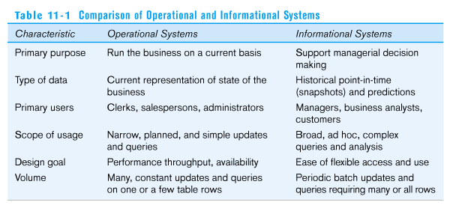
Operational System(Data) and Informational system(Data)
16
Notes:
16
16

Slide 17
Business Intelligence (BI)
BI is an umbrella term that combines architectures, tools, databases, analytical tools, applications and methodologies.BI helps us to convert data into information, information into knowledge and knowledge into plans that guides organizations for their betterment(DSS).
BI helps transform data, to information (and knowledge), to decisions and finally to action.
BI's major objective is to enable easy access to data (and models) to provide business managers with the ability to conduct analysis.
The purpose of Business Intelligence is to support better business decision making. Essentially, Business Intelligence systems are data-driven Decision Support Systems (DSS).
Department of Computer_Engineering, VIIT , Pune-48
Notes:
17
17
17

Slide 18
It is a suite of software and services to transform data into actionable intelligence and knowledge.
BI has a direct impact on organization's strategic, tactical and operational business decisions.
BI supports fact-based decision making using historical data rather than assumptions.
BI tools perform data analysis and create reports, summaries, dashboards, maps, graphs, and charts to provide users with detailed intelligence about the nature of the business.

Slide 19
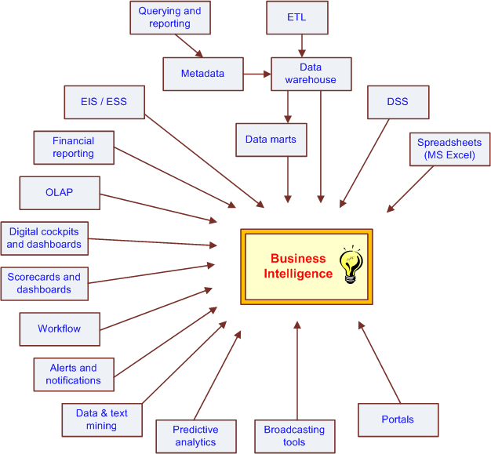
The Evolution of BI Capabilities
Executive Information system
Department of Computer_Engineering, VIIT , Pune-48
Notes:
19
19
19

Slide 20

Justify BI
It IS……
…more than faster reporting
Department of Computer_Engineering, VIIT , Pune-48
Notes:
This is where many customer successfully Justify
But…
It can be more and is more

Slide 21


Justify BI It’s ALL about profitability
Increasing revenue
Reducing Costs
Improving Efficiencies
Better Asset Management
Department of Computer_Engineering, VIIT , Pune-48
Notes:
Increasing and Reducing are always there
Improving and Better are Examples of more
Yours will be Increasing and Reducing PLUS

Slide 22
Changing Business Environment
Companies are moving aggressively to computerized support of their operations => Business Intelligence
Business Pressures–Responses–Support Model
Business pressures result of today's competitive business climate
Responses to oppose(answer) the pressures
Support to better facilitate the process
Department of Computer_Engineering, VIIT , Pune-48
Notes:
22
22
22

Slide 23
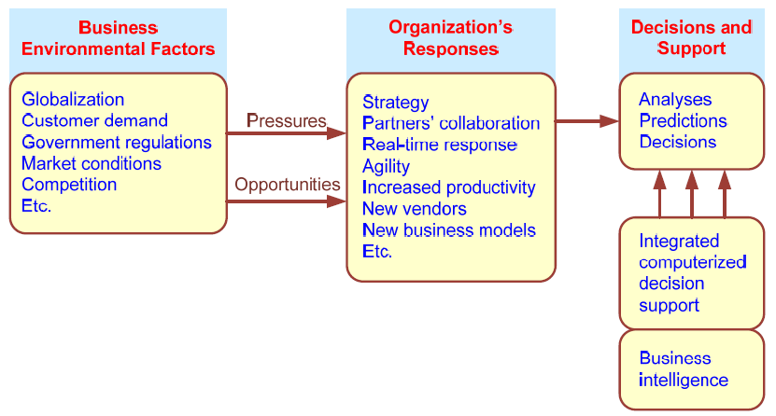
Business Pressures–Responses–Support Model
Department of Computer_Engineering, VIIT , Pune-48
Notes:
23
23
23

Slide 24
The Business Environment
The environment in which organizations operate today is becoming more and more complex, creating:
opportunities, and
problems
Example: globalization
Business environment factors:
markets, consumer demands, technology
Department of Computer_Engineering, VIIT , Pune-48
Notes:
24
24
24

Slide 25
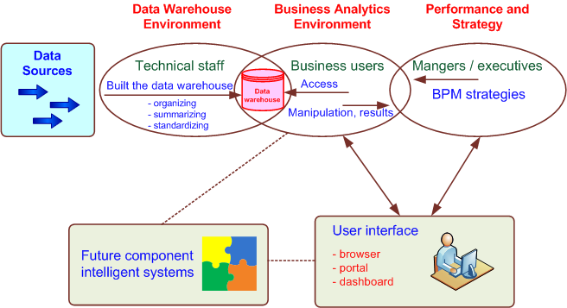
A High-Level Architecture of BI
Department of Computer Engineering, VIIT , Pune-48
Notes:
25
25
25

Slide 26
Components in a BI Architecture
The data warehouse is a large repository of well-organized historical data
Business analytics are the tools that allow transformation of data into information and knowledge. It is also a a collection of tools for manipulating, mining, and analyzing the data in the data warehouse.
Business performance management (BPM) allows monitoring, measuring, and comparing key performance indicators by introducing the concept of management and feedback.
User interface allows access and easy manipulation of other BI components. (e.g. portal, dashboard)
Department of Computer_Engineering, VIIT , Pune-48
Notes:
26
26
26

Slide 27
Example 1:
A hotel owner uses BI analytical applications to gather statistical information regarding average occupancy and room rate. It helps to find aggregate revenue generated per room.
It also collects statistics on market share and data from customer surveys from each hotel to decides its competitive position in various markets. By analyzing these trends year by year, month by month and day by day helps management to offer discounts on room rentals.
Example 2:
A bank gives branch managers access to BI applications. It helps branch manager to determine who are the most profitable customers and which customers they should work on.

Slide 28
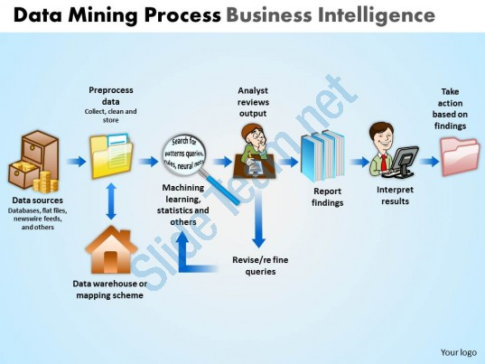
BI Cycle
8/18/2020
28
Department of Computer_Engineering, VIIT , Pune-48
Notes:
28
28

Slide 29
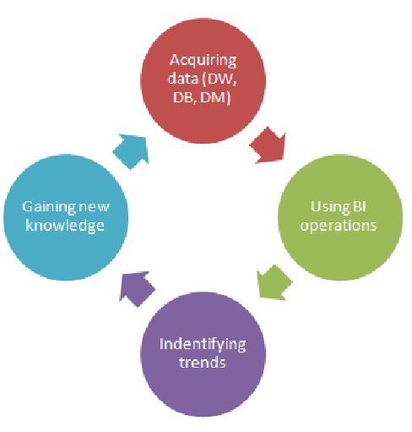
BI is a continuous cycle of analysis, insight, action and measurement.

Slide 30
Benefits of Business Intelligence
Improve Management Processes
planning, controlling, measuring and/or changing resulting in increased revenues and reduced costs
Improve Operational Processes
fraud detection, order processing, purchasing.. resulting in increased revenues and reduced costs
Predict the Future-Predictive analysis.
Better adjustment settings-competitor analysis, adjustment settings to changing trends.
Department of Computer_Engineering, VIIT , Pune-48

Slide 31
Benefits of Business Intelligence
It can eliminate a lot of the guesswork within an organization.
Enhance communication among departments while coordinating activities
Enable companies to respond quickly to changes in financial conditions, customer preferences, and supply chain operations.
BI improves the overall performance of the company using it.
8/18/2020
31
Department of Computer_Engineering, VIIT , Pune-48
Notes:
31
31

Slide 32
The DSS–BI Connection
First, their architectures are very similar because BI evolved from DSS.
Second, DSS directly support specific decision making, while BI provides accurate and timely information, and indirectly support decision making.
Third, BI has an executive and strategy orientation, especially in its BPM and dashboard components, while DSS, in contrast, is oriented toward analysts.
DSS were developed mostly in the academic world; BI were developed mostly by software companies.
Many tools used by BI are also considered DSS tools (e.g., data mining and predictive analysis )
Department of Computer_Engineering, VIIT , Pune-48
Notes:
32
32
32

Slide 33
Factors responsible for success of the BI Project:
Create a business case and outline the expected benefits
Have an enterprise-wide perspective
Establish criteria for success
Treat information as an asset
Adopt best practices and standards
Set up change management procedures
8/18/2020
33
Department of Computer_Engineering, VIIT , Pune-48
Notes:
33
33

Slide 34
BI strategy should align with the overall IT strategy and enterprise goals
Do a current state, future state, and gap analysis
Think about actionable steps
Use iterative implementation approach with parallel tracks
Work with frameworks and adopt proven methodologies
Assess BI readiness of the organization and identify related gaps and issues
Document and analyse the constraints and assumptions
Consider all BI components.
8/18/2020
34
Department of Computer_Engineering, VIIT , Pune-48
Notes:
34
34

Slide 35
Five major factors to consider in BI software
1)Platform. In all probability, your company could be using a number of different hardware / software combinations. In the future as well, your choice of specialist applications could dictate a different choice of platform to be used. Therefore, the BI solution you select must be able to support different platforms.
2)Applications. You could be running a number of different applications and some of them would be producing their own output and data. In addition, there could be large and complex applications like ERP or CRM applications running in your company.
Each of these applications will have to be studied on a case by case basis to determine the ease (or difficulty) of integrating its data with the BI solution you are planning to shortlist. In some cases, you might even have to change your applications or write bridging code to be able to integrate the solution with the application. Do remember that the lesser number of ad hoc patches you use, the more stable your final solution will be.

Slide 36
3)Data management. Your organization could have data in several different databases. These could be a mix of RDBMS as well as OLAP (on-line analytical processing) data. The solution you select must be able to handle data from all these sources, combine them after purification and store them in a data mart that it will then access for its queries.
4)Globalization. In case your organization has offices over several countries, the BI solution you choose must be capable of being deployed in several different languages and allow users to select from any of the languages it is capable of. Even if you do not have a presence in different countries today, you could need the solution tomorrow. Also with supply chains becoming global, it is quite possible that some of your suppliers could be in, say, Japan, in which case you may want to share some performance related data with them. At least consider having some of the major languages supported by your software.

Slide 37
5) Scalability. As your business grows, your needs will invariably grow as well. The solution must be able to handle a large number of users and larger datasets without requiring frequent addition of hardware. An important issue in today’s environment is a move to cloud computing. Even if you haven’t already done so, I anticipate that in the next two to three years, some part of your IT infrastructure would be cloud based.
Organizations generally start with storage and then move their applications and operations to the cloud as they gain more confidence. Since the move is nearly inevitable, you must anticipate this now. Check with your vendor and clarify issues about portability and what support would be forthcoming. You could even consider deploying your solution in the Internet Cloud to begin with. Doing this frees you entirely from any kind of upfront hardware investment and gives you nearly unlimited scalability.

Slide 38
Potential pitfalls to avoid when designing the BI strategy
Don’t start with a narrow vision. BI strategy needs to be prepared in the context of the wider BI definition.
Don’t plan to use any implementation approach. It has been proven that iterative implementation works better for BI initiatives.
BI iterations should not be done in the haphazard manner. BI strategy document is the necessary roadmap that you should follow as you begin designing BI environment.
Don’t adopt inflexible approach. BI strategy should be constantly tuned and adjusted to reflect the needs of your business.
Department of Computer_Engineering, VIIT , Pune-48
Notes:
38
38

Slide 39
Obstacles to BI in organization
1. The Effective Power Structure
In all of the public and private concerns from the junior to senior levels there is a kind of struggle for proving oneself better than others.
As every employee desires to undertake the best project and prove him more proficient than others and this may result as a conflict.
Business Intelligence often changes the dynamic strategies of organization and may cause a threat to the different positions and levels.
8/18/2020
39
Department of Computer Engineering, VIIT , Pune-48
Notes:
39
39

Slide 40
2. Recruitment and withholding of job
Hiring of personnel for BI applications is a responsible job.
These include crisis of the suitable resource, shortage of sufficient budget, restricted schedule.
Not only the recruitment as well as the retention plays a major role for the fruitful implication of BI solutions.
The employees often leave the job due to disappointment to the higher reporting authority.
This turns out to be as an unfavourable factor for administration of effective BI solution.
8/18/2020
40
Department of Computer_Engineering, VIIT , Pune-48
Notes:
40
40

Slide 41
4. Skills and Proficiency
The proven fact for the fulfilment of any particular business intelligence strategy considerably depends on the skills and proficiency of an employee.
Due to lack of manpower resources many times a skilful responsibility is given to someone who is definitely not suitable for it.
8/18/2020
41
Department of Computer_Engineering, VIIT , Pune-48
Notes:
41
41

Slide 42
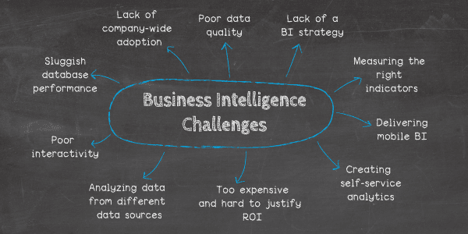
Department of Computer_Engineering, VIIT , Pune-48

Slide 43
References
Copyright © 2011 Pearson Education, Inc. Publishing as Prentice Hall
https://www.comparebusinessproducts.com/business-intelligence/five-factors-to-consider-in-businessintelligence-software
https://www.guru99.com/business-intelligence-definition-example.html
https://www.datapine.com/blog/business-intelligence-challenges/
Department of Computer_Engineering, VIIT , Pune-48

Slide 44
Text Books
1. R. Sharda, D. Delen, and E. Turban, Business Intelligence and Analytics. Systems for Decision Support,10th Edition. Pearson/Prentice Hall, 2015. ISBN-13: 978-0-13-305090-5, ISBN-10: 0-13- 305090-4; 3.
2. Introduction to business Intelligence and data warehousing, IBM, PHI, ISBN: 9788120339279
Department of Computer_Engineering, VIIT , Pune-48

Slide 45
Thank You
Department of Computer_Engineering, VIIT , Pune-48

