Slide 1

Unit-III: FinTech Innovation
Mrs.Disha S.Wakhede
Assistant Professor
Department of Computer Engineering
BRACT’S, Vishwakarma Institute of Information Technology, Pune-48
(An Autonomous Institute affiliated to Savitribai Phule Pune University)
(NBA and NAAC accredited, ISO 9001:2015 certified)

Slide 2
Objective/s of this session
To introduce FinTech Innovation
To illustrate various innovations done using latest technology trends in FinTech
To Describe the innovation in FinTech
To Introduce an innovative Fin Tech strategy
To Study the development of FinTech Application and about future trends in Fin Tech
After completion of the course, student will be able to
1. Understand what FinTech is and the sub sectors that comprise it.
2. Classify various models of the Fintech
3. Illustrate various innovations done using latest technology trends in FinTech.
4. State the Critical Success Factors in Fin Tech.
5. Be able to adopt an innovative Fin Tech strategy within their own organization to lead a digital transformation project.
6. Develop the application using the concepts of FinTech as a case study
Learning Outcome/Course Outcome

Slide 3
Unit 3 Contents
Part A :
Introduction,
Innovation and FinTech : Digital Transformation and FinTech,
A model for an integrated innovation strategy,
Types of Innovation : Product (or services),
Process, Organization, Business models
Examples of Innovation
Fintech business model canvas
Process Innovation : Big Data Analytics, Value Creation from Big Data Analytics
Kreditech’s self-learning algorithm
Internet of Things
Blockchain Technology
Organizational Innovation: Social Networks,
Business Model Innovation, Robots, The V4 business model framework for Kreditech, Virtual Currencies, Technology Acceptance Model.

Slide 4
Introduction
One of the critical aspects in finTech initiatives is their intrinsic .
This is a global phenomenon aiming to provide innovations in the financial services industry.
FinTech initiatives have been leveraging on innovation
Especially by means of new technologies : often delivered through online and mobile channels

Slide 5

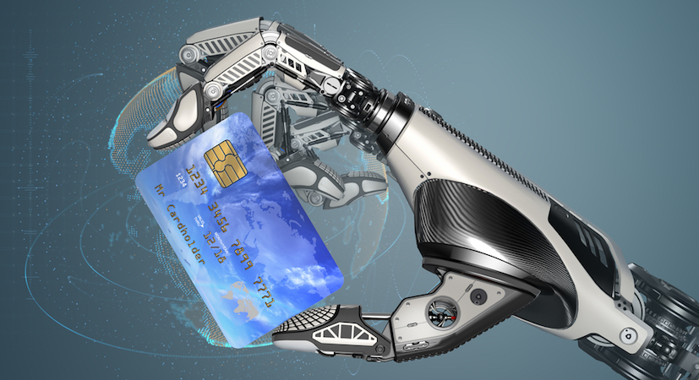
9 Fintech Innovations Impacting the Consumer Experience
Chatbots and virtual assistants for consumer education.
Artificial intelligence for predictive analytics

Slide 6
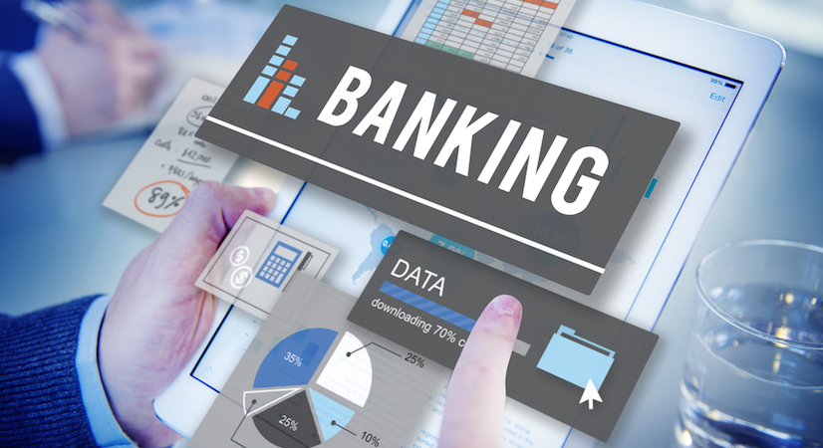

Digital-only banking
Blockchain

Slide 7


Augmented reality
Internet of things (IoT)

Slide 8


Quantum computing
Peer-to-peer (P2P) transaction technologies

Slide 9
Digital Transformation and Fintech
Simply a matter of using digital technologies to sell and service clients more effectively, more efficiently, and in a more customized way.
In the case of digital transformation, this would mean to answer the following questions:
• Why digital transforms the organization?
• For whom to do the transformation?
What is the product it should aim to provide?
• Where can it take place?
• When can it take place?
• How to implement a digital transformation?

Slide 10
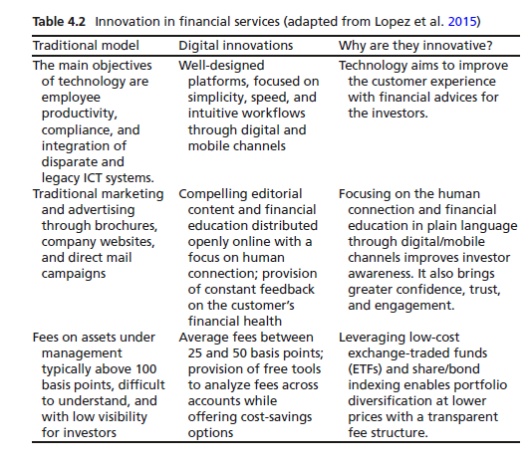

Slide 11
In dealing with this digital innovation, it is important to refer to a model of innovation (Nicoletti 2016).
Organizations should approach digital innovation in a holistic way.
To approach this challenge it is necessary to consider the four connected variables:
• Structure (organization)
• Processes
• Technology
• Persons

Slide 12
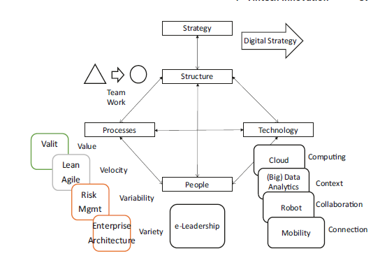

Slide 13
The financial services industry is on the brink of major innovation.
Development in this sector contributes to the economic growth.
From a practical point of view, the innovation can be in the following:
• Product (or services)
• Process
• Organization
• Business models

Slide 14
Examples of Innovation
The following sections present the relevant innovations exploited by fintech initiatives.
Product Innovation
Mobility is at in the center of several financial institutions’ business plans.
It is interesting to analyze what mobility is and why its adoption has
grown up at such an unpredictable pace.

Slide 15
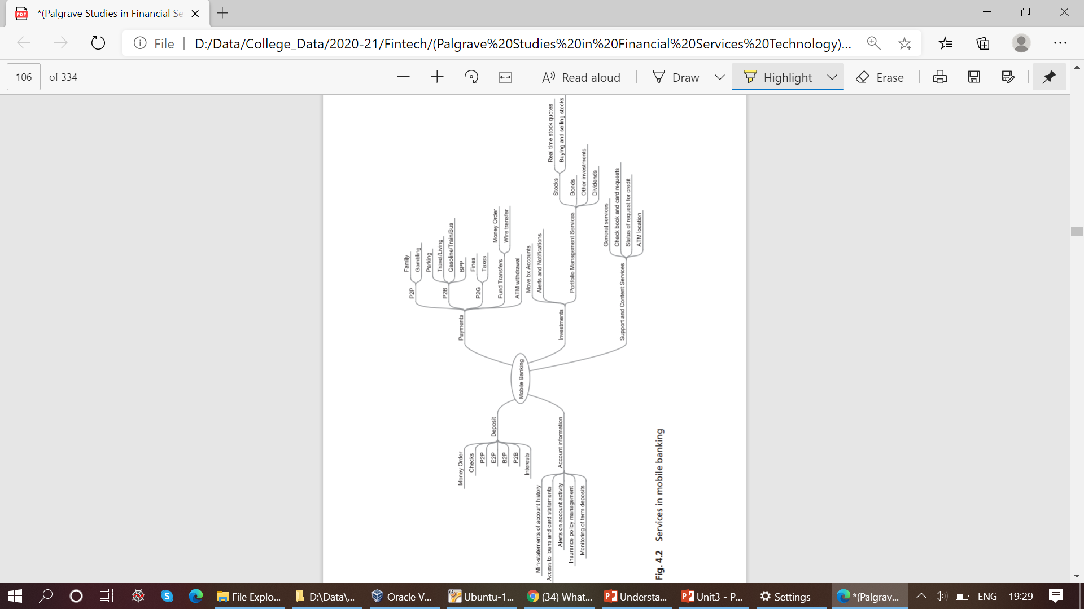
Services in mobile banking

Slide 16
Mobile Financial Services and Fintech
The Classification based on product innovation includes five areas:
• Account information
• Payments
• Deposits
• Investments
• Support and content services

Slide 17
Process Innovation
Big Data Analytics
Big Data Analytics is the use of a large collection of data gathered and collected from inside and outside the company. Making use of such datasets is generally a very complex thing to do and using traditional processing applications may not be enough. This gap in the traditional processing applications has actually stimulated the burgeoning and growth of multiple companies, interested in capitalizing on Big Data Analytics.

Slide 18
Big Data Analytics provides opportunities in existing environments.
Big Data Analytics are the solutions, processes, and procedures that allow an organization to create, manipulate, store, and manage a relatively large amount of data to get information
It also creates new opportunities for financial institutions’ stakeholders.
These opportunities were not possible by dealing with structured content in traditional ways. Big Data Analytics has three characteristics—the so-called
3 Vs: Volume Velocity and Variety

Slide 19
Big Data Analytics means:
• storing a large amount of data;
• examining (or mining) them;
• getting appropriate information; and
• identifying hidden patterns, unknown correlations, and similar things
in support of decision-making.

Slide 20
It is important to follow a correct process in storing Big Data Analytics:
• Selecting data sources for analysis
• Defining data models: key value, graphics, document
• Analyzing the characteristics of the data
• Improving the data quality, for instance, eliminating redundant or duplicated data

Slide 21
There are several actions important in storing large sets of data:
• Choosing the correct data stores based on the characteristics of the
data
• Moving code to data
• Implementing polyglot data store solutions
• Aligning business goals to the appropriate data store
• Integrating disparate data stores
• Mapping data to the programming framework
• Connecting and extracting data from storage
• Transforming data for processing
• Monitoring the progress of job flows
• Using advanced tools, such as D3.js

Slide 22
There are a certain number of questions that need to be answered when
dealing with Big Data Analytics:
• Which types of solutions to be used in Big Data Analytics?
• Where data are stored: centralized or distributed or cloud storage?
• Where processing is done: mainframe, distributed servers/cloud?
• How data are stored and indexed: high-performance schema-free
databases?
• What operations are performed on data: sequential, analytic, or semantic
processing?
• What are the risks?
• Are the right talents available capable of choosing the right data to
solve the right problem?

Slide 23
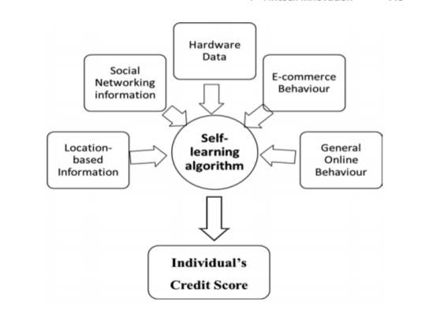
Kreditech’s self-learning algorithm

Slide 24
Internet of Things
Internet of (Everything)Things
One impressive development in technology is the IoT. Cisco calls it also the IoE.
IoT is the interconnection of uniquely identifiable embedded computing devices within the existing internet infrastructure. IoT allows using the internet to connect not only persons but also objects of any type.

Slide 25
Typically, IoT offers advanced connectivity of devices, systems, and services.
It covers a variety of protocols, domains, and applications.
The interconnection of these embedded devices (including smart objects) allows automation in nearly all fields.
In insurance, IoT can refer to a wide variety of devices, such as health monitoring implants, biochip transponders on farm animals, vehicles with built-in sensors, or field operation devices that assist in remote monitoring plenty of apparatus and situations.

Slide 26
Internet of Things and Fintech
It is interesting to analyze the general use of IoT in fintech.
IoT finds its best applications in the insurance industry.
IoT is a potential game-changing factor and a highly disruptive element in the financial services industry, similar to what have been smartphones and tablets
While, still today, most of the financial information needed by people for their decisions need to be accessed in some steps, in the era of IoT, they will most likely be retrieved in real time.

Slide 27
Perhaps one of the biggest potential benefits would be in claims management:
In insurance, by using IoT, it could be possible for insurance companies to use such sensors to record and possibly anticipate and prevent damage.
This might save costs in the end not just for reinsurers and investors, but also for individuals and communities.

Slide 28
Blockchain Technology
Blockchain was born in connection with Bitcoin, a virtual currency.
It is essentially a database for recording transactions in a secure way.
Blockchain technology has interesting potential in several fields and especially in the financial services industry.
Blockchain offers trust and provenance.
Blockchain is a distributed database, able to generate a public ledger of all the transactions, not entirely stored at a single physical location, but rather dispersed over a network of interconnected computers

Slide 29
Blockchain is a decentralized solution.
For instance, all participants of a P2P network have a copy of the full set of records.
Blockchain has much greater potential than digital currency alone, even if the concept was born in connection with Bitcoin
It enables point-to-point transactions without a clearing intermediary.
In this way, it reduces substantially transaction time, quality, and costs.
Blockchain makes it possible to issue automatically digital securities and trade financial derivatives.

Slide 30
In a distributed ledger, there are two types of records:
• Transactions
• Blocks
Transactions are at the core of the entire process.
In the case of the blockchain used for the virtual currency Bitcoin, a transaction is the transfer of a Bitcoin value between users. Blocks contain the correct amount and order of valid transactions—indelibly added to the database.

Slide 31
Different Types of Blockchain
Concerning access protocols, distributed ledgers can either be
• Public: Any user who wishes to do so can access the ledger and submit transactions for inclusion.
This is the blockchain technology used in Bitcoin.
Many consider this the truly democratized form of the ledger and the ideal system.
• Private: Only a select few participants can view as well as submit transactions.
Although the market can have many participants, only certain individuals or institutions will have access to the ledger and the development of the blockchain

Slide 32
In addition to public and private ledgers, blockchain falls under two
similar but independent categories
Permissionless means : permissionless ledger, anyone can choose to participate in this verification network and obtain potential rewards of participation.
The verification or mining process can be very complex.
Permissioned blockchain:Permissioned blockchains are gaining traction within financial institutions and digital ledger-based startups. A financial institution must verify non-cash payments between individuals for the transaction to be complete.

Slide 33
Main Potential Applications of Blockchain
It is possible to use blockchain as an open data affecting the interactions between financial institutions and third parties: agency networks, external vendors, and customers.
Distributed ledgers such as blockchain have numerous cross-industry
use opportunities.
These include distributed ledgers with limitations concerning verification, transaction recording, and access.

Slide 34
Organizational Innovation: Social Networks
McKinsey sees a very bright future for social technologies.
It defines social technologies as digital technologies used by people to interact socially and together to create, enhance, and exchange content
Social technologies distinguish themselves with the following
three characteristics:
• They are enabled by information technology.
• They provide distributed rights to create, add, and/or modify content
and communications.
• They enable distributed access to consume content and communications.

Slide 35
Business Model Innovation
A business model describes the rationale of how an organization creates, captures, and delivers value (Osterwalder et al. 2010).
The economic literature has identified the primary dimensions of a business model in the V4 business model framework (see Fig. 4.7):
• The value proposition
• The value architecture
• The value finance
• The value network

Slide 36
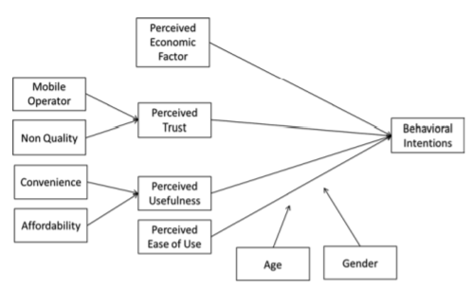
Technology Acceptance Model

