Slide 1

Unit III Requirement Engineering
Prof. M.P.Karnik
madhuri.chavan@viit.ac.in
Department of Computer Engineering
BRACT’S, Vishwakarma Institute of Information Technology, Pune-48
(An Autonomous Institute affiliated to Savitribai Phule Pune University)
(NBA and NAAC accredited, ISO 9001:2015 certified)

Slide 2
Contents
Requirements Elicitation : Concept of Software Requirement
Categories and types of Requirements
Elicitation Techniques- real life application case study.
Requirements Analysis and Documentation: Textual and Graphical Documentation
UML models: Use Case Diagram and class diagram
data modelling, data and control flow model
behavioral modelling using state diagrams - real life application case study
Software Requirement Specifications (SRS).
Department of Computer Engineering, VIIT, Pune-48

Slide 3
Requirements Elicitation : Concept of Software Requirement
The process to gather the software requirements from client, analyze and document them is known as requirement engineering.
The goal of requirement engineering is to develop and maintain sophisticated and descriptive ‘System Requirements Specification’ document.
Department of Computer Engineering, VIIT, Pune-48

Slide 4
Requirement Engineering Process
It is a four step process, which includes –
Feasibility Study- This feasibility study is focused towards goal of the organization. This study analyzes whether the software product can be practically materialized in terms of implementation, contribution of project to organization, cost constraints and as per values and objectives of the organization.
Requirement Gathering- If the feasibility report is positive towards undertaking the project, next phase starts with gathering requirements from the user. Analysts and engineers communicate with the client and end-users to know their ideas on what the software should provide and which features they want the software to include.
Department of Computer Engineering, VIIT, Pune-48

Slide 5
Software Requirement Specification: SRS defines how the intended software will interact with hardware, external interfaces, speed of operation, response time of system, portability of software across various platforms, maintainability, speed of recovery after crashing, Security, Quality, Limitations etc.
Software Requirement Validation: Requirements can be checked against following conditions -
If they can be practically implemented
If they are valid and as per functionality and domain of software
If there are any ambiguities
If they are complete
If they can be demonstrated
Department of Computer Engineering, VIIT, Pune-48

Slide 6
Requirement elicitation
Requirement elicitation is the process of collecting the requirements of a system or requirement gathering from user, customers and stakeholders by conducting meetings, interviews, questionnaires, brainstorming sessions, prototyping etc.
Department of Computer Engineering, VIIT, Pune-48

Slide 7
Elicitation is gathering of all the system requirements from the stakeholders and it encompasses all activities involved in discovering the requirements of a system.
The system developers and engineers work in a close relationship with the customers and end-users to determine more about the problem to be solved and to bridge the gap between the stakeholders and the developers.
Elicitation techniques facilitates this process by,
Finding out more about the problem to be solved.
Describing the functionalities of the system and non functional attributes.
Enhances the performance of the system.
Overcomes hardware constraints.
Bridges the gap between the stakeholders and the developers.
Department of Computer Engineering, VIIT, Pune-48

Slide 8
The requirement elicitation process involves effectively designing the requirements by thorough understanding. After thorough understanding of requirements, build a use case model which is a part of analysis model.
Once the use case model is defined it is expressed in terms of application domain objects which help in understanding the domain in which it has to be applied.
The definition of the use case model can facilitate the process of dividing the system into subsystems using block diagrams and it is done after the analysis phase.
In object design, the solutions provided by the domain objects can be realized from the plotting of the use case models.
Further from the use case models, it is easy to develop and to implement the source code by dividing each and every class; further more it helps us to verify by defining the test cases early in the development cycle.
Department of Computer Engineering, VIIT, Pune-48

Slide 9
Software Lifecycle Activities
Requirements
Elicitation
Requirements
Analysis
System
Design
Object
Design
Implemen-
tation
Testing
Implemented
By
Expressed in Terms Of
Structured By
Realized By
Verified
By
class...
class...
class...
?
class....
?
Use Case
Model
Application
Domain
Objects
Implementation Domain
Objects
SubSystems
Source
Code
Test
Cases
Department of Computer Engineering, VIIT, Pune-48

Slide 10

REQUIREMENT ELICITATION PROCESS
Requirement elicitation process can be depicted using the following diagram:
Requirements gathering - The developers discuss with the client and end users and know their expectations from the software.
Organizing Requirements - The developers prioritize and arrange the requirements in order of importance, urgency and convenience.
Department of Computer Engineering, VIIT, Pune-48

Slide 11
Negotiation & discussion - If requirements are ambiguous or there are some conflicts in requirements of various stakeholders, if they are, it is then negotiated and discussed with stakeholders. Requirements may then be prioritized and reasonably compromised.
The requirements come from various stakeholders. To remove the ambiguity and conflicts, they are discussed for clarity and correctness. Unrealistic requirements are compromised reasonably.
Documentation - All formal & informal, functional and non-functional requirements are documented and made available for next phase processing.
Department of Computer Engineering, VIIT, Pune-48

Slide 12
Requirement Elicitation Techniques
Requirements Elicitation is the process to find out the requirements for an intended software system by communicating with client, end users, system users and others who have a stake in the software system development.
There are various ways to discover requirements
Interviews
Interviews are strong medium to collect requirements. Organization may conduct several types of interviews such as:
Structured (closed) interviews, where every single information to gather is decided in advance, they follow pattern and matter of discussion firmly.
Non-structured (open) interviews, where information to gather is not decided in advance, more flexible and less biased.
Oral interviews
Department of Computer Engineering, VIIT, Pune-48

Slide 13
Written interviews
One-to-one interviews which are held between two persons across the table.
Group interviews which are held between groups of participants. They help to uncover any missing requirement as numerous people are involved.
Surveys
Organization may conduct surveys among various stakeholders by querying about their expectation and requirements from the upcoming system.
Questionnaires
A document with pre-defined set of objective questions and respective options is handed over to all stakeholders to answer, which are collected and compiled.
Department of Computer Engineering, VIIT, Pune-48

Slide 14
A shortcoming of this technique is, if an option for some issue is not mentioned in the questionnaire, the issue might be left unattended.
Task analysis
Team of engineers and developers may analyze the operation for which the new system is required. If the client already has some software to perform certain operation, it is studied and requirements of proposed system are collected.
Domain Analysis
Every software falls into some domain category. The expert people in the domain can be a great help to analyze general and specific requirements.
Brainstorming
An informal debate is held among various stakeholders and all their inputs are recorded for further requirements analysis.
Department of Computer Engineering, VIIT, Pune-48

Slide 15
Prototyping
Prototyping is building user interface without adding detail functionality for user to interpret the features of intended software product. It helps giving better idea of requirements. If there is no software installed at client’s end for developer’s reference and the client is not aware of its own requirements, the developer creates a prototype based on initially mentioned requirements. The prototype is shown to the client and the feedback is noted. The client feedback serves as an input for requirement gathering.
Observation
Team of experts visit the client’s organization or workplace. They observe the actual working of the existing installed systems. They observe the workflow at client’s end and how execution problems are dealt. The team itself draws some conclusions which aid to form requirements expected from the software.
Department of Computer Engineering, VIIT, Pune-48

Slide 16
ELICITATION TECHNIQUES
Interview
Questionnaire
Background Reading
Introspection
Social Analysis
Requirement workshop.
Brainstorming
Idea Generation
Story Boarding
Scripted Walkthrough
CRC Cards
Ethnography
Natural language descriptions
Form Analysis
Department of Computer Engineering, VIIT, Pune-48

Slide 17
PROBLEMS OF REQUIREMENT ELICITATION
Some of the problems encountered during requirement elicitation are as follows:
Stakeholders don’t know what they really want.
Stakeholders express requirements in their own terms.
Different stakeholders may have conflicting requirements.
Organizational and political factors may influence the system requirements.
The requirements change during the analysis process.
New stakeholders may emerge and business environment may also likely to change.
Department of Computer Engineering, VIIT, Pune-48

Slide 18
A complete Software Requirement Specifications must be:
Clear
Correct
Consistent
Coherent
Comprehensible
Modifiable
Verifiable
Prioritized
Unambiguous
Traceable
Credible source
Department of Computer Engineering, VIIT, Pune-48

Slide 19
Categories and types of Requirements
Functional Requirements
Requirements, which are related to functional aspect of software fall into this category. They define functions and functionality within and from the software system.
Examples -
Search option given to user to search from various invoices.
User should be able to mail any report to management.
Users can be divided into groups and groups can be given separate rights.
Should comply business rules and administrative functions.
Software is developed keeping downward compatibility intact.
A library system that provides a single interface to a number of databases of articles in different libraries. Users can search for, download and print these articles for personal study.
Department of Computer Engineering, VIIT, Pune-48

Slide 20
Non-Functional Requirements
Requirements, which are not related to functional aspect of software, fall into this category. They are implicit or expected characteristics of software, which users make assumption of.
Non-functional requirements include -
Security
Logging
Storage
Configuration
Performance
Cost
Interoperability
Flexibility
Disaster recovery
Accessibility
Department of Computer Engineering, VIIT, Pune-48

Slide 21
These define system properties and constraints e.g. reliability, response time and storage requirements. Constraints are I/O device capability, system representations, etc.
Process requirements may also be specified mandating a particular CASE system, programming language or development method.
Non-functional requirements may be more critical than functional requirements. If these are not met, the system is useless.
Department of Computer Engineering, VIIT, Pune-48

Slide 22
Non-functional classifications
Product requirements
Requirements which specify that the delivered product must behave in a particular way e.g. execution speed, reliability, etc.
Organisational requirements
Requirements which are a consequence of organisational policies and procedures e.g. process standards used, implementation requirements, etc.
External requirements
Requirements which arise from factors which are external to the system and its development process e.g. interoperability requirements, etc.
Department of Computer Engineering, VIIT, Pune-48

Slide 23
Non-functional requirement types
Department of Computer Engineering, VIIT, Pune-48

Slide 24
Non-functional requirements examples
Product requirement
The user interface for library system shall be implemented as simple HTML without frames or Java applets.
Organisational requirement
External requirement
The system shall not disclose any personal information about customers apart from their name and reference number to the operators of the system.
Department of Computer Engineering, VIIT, Pune-48

Slide 25
Functional and non-functional requirements
Functional requirements
Statements of services the system should provide, how the system should react to particular inputs and how the system should behave in particular situations.
Non-functional requirements
constraints on the services or functions offered by the system such as timing constraints, constraints on the development process, standards, etc.
Domain requirements
Requirements that come from the application domain of the system and that reflect characteristics of that domain.
Department of Computer Engineering, VIIT, Pune-48

Slide 26
Types of requirement
User requirements
Statements in natural language plus diagrams of the services the system provides and its operational constraints. Written for customers.
System requirements
A structured document setting out detailed descriptions of the system’s functions, services and operational constraints. Defines what should be implemented so may be part of a contract between client and contractor.
Department of Computer Engineering, VIIT, Pune-48

Slide 27
REQUIREMENT ANALYSIS
After requirement gathering, requirement analysis is done to check on why the product is needed. Requirement analysis includes:
Necessity checking – requirements that don’t contribute to the business goals of the organization or specific problem that has to be addressed by the system are checked for necessity for the development of the system.
Consistency and completeness checking – no contradictions and feasibility checking in terms of budget and schedule.
Requirement discussion – highlight the requirement and discussion of problematic elements through introspection and interviews.
Requirement prioritization – requirements are prioritized based on criticality and the highly complex and critical activities are identified for risk plot and low level activities are considered for easy implementation.
Requirement agreement – compromised set of requirements based on feasibility checking.
Department of Computer Engineering, VIIT, Pune-48

Slide 28
UML models: Use Case Diagram and class diagram
Department of Computer Engineering, VIIT, Pune-48

Slide 29
Unified modeling Language overview
UML stands for “Unified Modeling Language”
It is a industry-standard graphical language for specifying, visualizing, constructing, and documenting the objects of software systems
The UML uses mostly graphical notations to express the OO analysis and design of software projects.
Simplifies the complex process of software design.
The notation used for the COMET(Concurrent Object Modeling and Architectural Design Method ) method is the Unified Modeling Language (UML).
Department of Computer Engineering, VIIT, Pune-48

Slide 30
UML is not a language in the same way that we view programming languages such as ‘C++’, ‘Java’ or ‘Basic’.
UML is however a language in the sense that it has syntax and semantics which convey meaning, understanding and constraints (i.e. what is right and wrong and the limitations of those decisions) to the reader and thereby allows two people fluent in that language to communicate and understand the intention of the other.
UML represents a collection of essentially graphical (i.e. drawing) notations supplemented by textual descriptions designed to capture requirements and design alternatives.
Department of Computer Engineering, VIIT, Pune-48

Slide 31
Why UML for Modeling
Use graphical notation to communicate more clearly than natural language (imprecise) and code(too detailed).
Help acquire an overall view of a system.
UML is not dependent on any one language or technology.
UML moves us from fragmentation to standardization.
Department of Computer Engineering, VIIT, Pune-48
Notes:
. More precise than natural language … less detailed than source code
. Not dependent on any language
. Standardized by various groups

Slide 32
Open Standard, Graphical notation for
Specifying, visualizing, constructing, and documenting software systems
Language can be used from general initial design to very specific detailed design across the entire software development lifecycle.
Increase understanding/communication of product to customers and developers.
Support for UML in many software packages today (e.g. Rational, plugins for popular IDE’s like NetBeans, Eclipse).
Department of Computer Engineering, VIIT, Pune-48

Slide 33
UML Baseline
Use Case Diagrams
Class Diagrams
Package Diagrams
Interaction Diagrams
Sequence
Collaboration
Activity Diagrams
State Transition Diagrams
Deployment Diagrams
Department of Computer Engineering, VIIT, Pune-48

Slide 34
Classification of Diagram Types
Class
Diagram
Component
Diagram
Structure
Diagram
Composite
Structure Diagram
Deployment
Diagram
Object
Diagram
Package
Diagram
Diagram
Sequence
Diagram
Use Case
Diagram
Behavior
Diagram
Communication
Diagram
Activity
Diagram
Interaction
Overview
Diagram
Interaction
Diagram
State Machine
Diagram
Timing
Diagram
Department of Computer Engineering, VIIT, Pune-48

Slide 35
Basic Modeling Steps
Use Cases
Capture requirements
Analysis Model
Capture process, key classes
Design Model
Capture details and behaviors of use cases and domain objects
Add classes that do the work and define the architecture
Department of Computer Engineering, VIIT, Pune-48

Slide 36
Use Case Diagram
Used for describing a set of user scenarios
Mainly used for capturing user requirements
Work like a contract between end user and software developers
Department of Computer Engineering, VIIT, Pune-48

Slide 37
Use Case Diagrams
Used during requirements elicitation to represent external behavior.
Actors represent roles, that is, a type of user of the system.
Use cases represent a sequence of interaction for a type of functionality; summary of scenarios.
The use case model is the set of all use cases. It is a complete description of the functionality of the system and its environment
Passenger
PurchaseTicket
Department of Computer Engineering, VIIT, Pune-48

Slide 38
Actors
An actor models an external entity which communicates with the system:
User
External system
Physical environment
An actor has a unique name and an optional description.
Examples:
Passenger: A person in the train
GPS satellite: Provides the system with GPS coordinates
Passenger
Department of Computer Engineering, VIIT, Pune-48

Slide 39
Use Case
A use case represents a class of functionality provided by the system as an event flow.
A use case consists of:
Unique name
Participating actors
Entry conditions
Flow of events
Exit conditions
Special requirements
PurchaseTicket
Department of Computer Engineering, VIIT, Pune-48

Slide 40
The <<extends>> Relationship
<<extends>> relationships represent exceptional invoked cases.
Use cases representing exceptional flows can extend more than one use case.
The direction of a <<extends>> relationship is to the extended use case
Passenger
PurchaseTicket
<<extends>>
<<extends>>
<<extends>>
OutOfOrder
<<extends>>
TimeOut
Cancel
NoChange
Department of Computer Engineering, VIIT, Pune-48

Slide 41

Registration use case is complete and meaningful on its own. It could be extended with optional Get Help On Registration use case.
Department of Computer Engineering, VIIT, Pune-48

Slide 42
The <<includes>> Relationship
<<includes>> relationship represents behavior that is factored out of the use case.
<<includes>> behavior is factored out for reuse, not because it is an exception.
The direction of a <<includes>> relationship is to the using use case (unlike <<extends>> relationships).
Passenger
PurchaseMultiCard
Purchase Ticket
<<includes>>
<<includes>>
CollectMoney
Department of Computer Engineering, VIIT, Pune-48

Slide 43
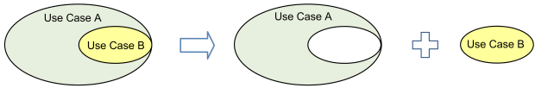
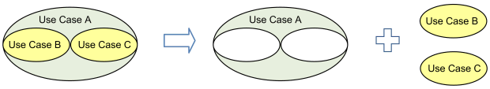
Use case B is extracted from larger use case A into a separate use case.
Use cases B and C are extracted from larger use case A into separate use cases.
Department of Computer Engineering, VIIT, Pune-48

Slide 44
Use Cases are useful to…
Determining requirements
New use cases often generate new requirements as the system is analyzed and the design takes shape.
Communicating with clients
Their notational simplicity makes use case diagrams a good way for developers to communicate with clients.
Generating test cases
The collection of scenarios for a use case may suggest a suite of test cases for those scenarios.
Department of Computer Engineering, VIIT, Pune-48

Slide 45
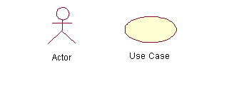
Use Case Diagram (core components)
Actors: A role that a user plays with respect to the system,including human users and other systems. e.g.,in animate physical objects (e.g. robot); an external system that needs some information from the current system.
Use case: A set of scenarios that describing an interaction between a user and a system, including alternatives.
System boundary: rectangle diagram representing the boundary between the actors and the system.
Department of Computer Engineering, VIIT, Pune-48

Slide 46
Use Case Diagram(core relationship)
Association: communication between an actor and a use case; Represented by a solid line.
Generalization: relationship between one general use case and a special use case (used for defining special alternatives)
Represented by a line with a triangular arrow head toward the parent use case.
Department of Computer Engineering, VIIT, Pune-48

Slide 47
Use Case Diagram(core relationship)
Include: a dotted line labeled <<include>> beginning at base use case and ending with an arrows pointing to the include use case. The include relationship occurs when a chunk of behavior is similar across more than one use case. Use “include” in stead of copying the description of that behavior.
<<include>>
Extend: a dotted line labeled <<extend>> with an arrow toward the base case. The extending use case may add behavior to the base use case. The base class declares “extension points”.
<<extend>>
Department of Computer Engineering, VIIT, Pune-48

Slide 48
Use Case Diagrams(cont.)
Pay Bill is a parent use case and Bill Insurance is the child use case. (generalization)
Both Make Appointment and Request Medication include Check Patient Record as a subtask.(include)
The extension point is written inside the base case
Pay bill; the extending class Defer payment adds the behavior of this extension point. (extend)
Department of Computer Engineering, VIIT, Pune-48

Slide 49
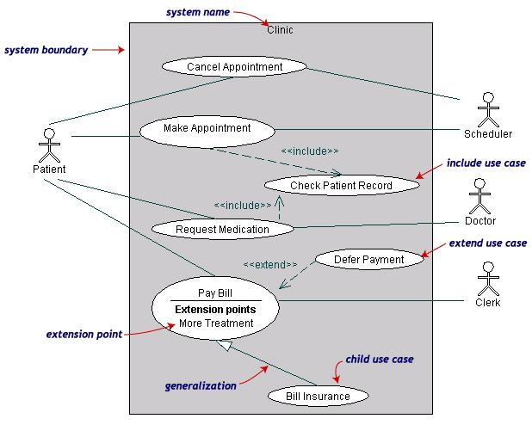
Use Case Diagrams(cont.)
Department of Computer Engineering, VIIT, Pune-48

Slide 50
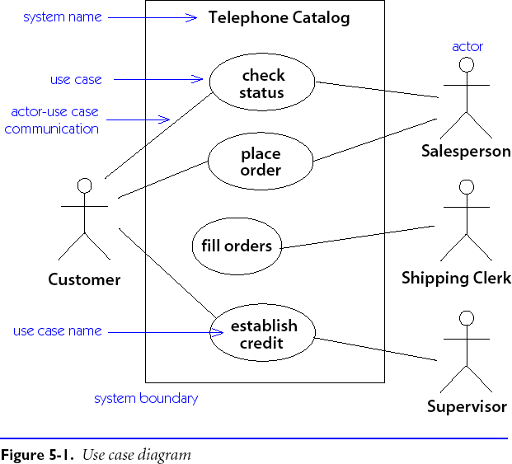
Use Case Diagrams
A use case is a generic description of an entire transaction involving several actors.
A use case diagram presents a set of use cases (ellipses) and the external actors that interact with the system.
Dependencies and associations between use cases may be indicated.
Department of Computer Engineering, VIIT, Pune-48

Slide 51
Use Case Diagram – Example1 (Library)
library system
borrow
client
employee
reserve
Order title
Fine payment
supervisor
A Library System.
Department of Computer Engineering, VIIT, Pune-48

Slide 52
Use Case Diagram for Student Assessment Management System
Grade system
Record grades
Student
View grades
Teacher
Distribute
Report cards
Create report cards
Printing administrator
Department of Computer Engineering, VIIT, Pune-48

Slide 53
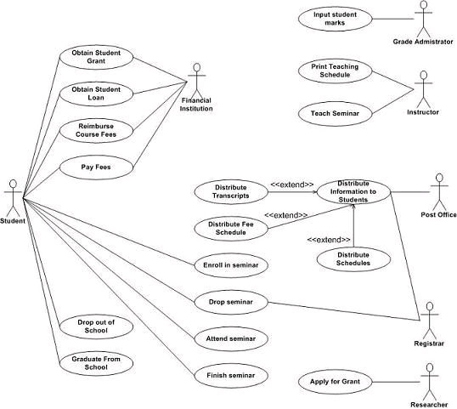
Example Use-case Diagram for a student database
Department of Computer Engineering, VIIT, Pune-48

Slide 54
Use Case Diagrams
Use Case
Boundary
Actor
Library System
Borrow
Employee
Client
Order Title
Fine Remittance
Supervisor
A generalized description of how a system will be used.
Provides an overview of the intended functionality of the system
Department of Computer Engineering, VIIT, Pune-48

Slide 55
Use Case Diagram
Use cases serve as a technique for capturing the functional requirements of a system
Describes the typical interactions between the users of a system and the system itself, providing a narrative of how a system is used
A use case consists of a set of one or more scenarios tied together by a common user goal
A scenario is a sequence of steps describing an interaction between a user and a system; some scenarios describe successful interaction; others describe failure or errors
Users are referred to as actors; an actor is a role that carries out a use case
An actor need not always be a person; it can also be an external system that is either automated or manual
Department of Computer Engineering, VIIT, Pune-48

Slide 56
A use case diagram is like a graphical table of contents of the use cases for a system
It shows the use cases, the actors, and the relationships between them
Use cases represent an external view of the system; consequently, they have no correlation to the classes in the system
They can serve as a starting point for writing software validation test cases
Department of Computer Engineering, VIIT, Pune-48

Slide 57
Example Use Case Diagram
Make automated menu
selections
Expert Menu
System
Order food and drink
Notify customer that
food and drink are ready
Cook
Customer
Pay for food and drink
Payment
System
Department of Computer Engineering, VIIT, Pune-48

Slide 58
Class diagram
Class diagram is a static diagram. It represents the static view of an application.
Class diagram is not only used for visualizing, describing, and documenting different aspects of a system but also for constructing executable code of the software application.
Class diagram describes the attributes and operations of a class and also the constraints imposed on the system. The class diagrams are widely used in the modeling of object oriented systems because they are the only UML diagrams, which can be mapped directly with object-oriented languages.
Class diagram shows a collection of classes, interfaces, associations, collaborations, and constraints. It is also known as a structural diagram.
Department of Computer Engineering, VIIT, Pune-48

Slide 59
What is Class?
A Class is a blueprint that is used to create Object. The Class defines what object can do.
What is Class Diagram?
Class Diagram gives the static view of an application. A class diagram describes the types of objects in the system and the different types of relationships that exist among them. This modeling method can run with almost all Object-Oriented Methods.
UML Class Diagram gives an overview of a software system by displaying classes, attributes, operations, and their relationships. This Diagram includes the class name, attributes, and operation in separate designated compartments.
Class Diagram helps construct the code for the software application development.
Department of Computer Engineering, VIIT, Pune-48

Slide 60
Benefits
Class Diagram Illustrates data models for even very complex information systems.
It provides an overview of how the application is structured before studying the actual code. This can easily reduce the maintenance time.
It helps for better understanding of general schematics of an application.
Allows drawing detailed charts which highlights code required to be programmed.
Helpful for developers and other stakeholders.
Department of Computer Engineering, VIIT, Pune-48

Slide 61
Essential elements of A UML class diagram are:
Class Name
Attributes
Operations
Department of Computer Engineering, VIIT, Pune-48

Slide 62
Classes
A class is a description of a set of
objects that share the same attributes,
operations, relationships, and semantics.
Graphically, a class is rendered as a
rectangle, usually including its name,
attributes, and operations in separate,
designated compartments.
ClassName
attributes
operations
Department of Computer Engineering, VIIT, Pune-48

Slide 63
Class Names
ClassName
The name of the class is the only required tag in the graphical representation of a class. It always appears in the top-most compartment.
attributes
operations
Department of Computer Engineering, VIIT, Pune-48

Slide 64
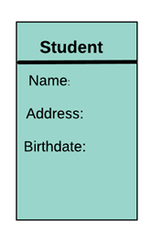
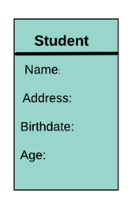
Attributes
An attribute is named property of a class which describes the object being modeled. In the class diagram, this component is placed just below the name-compartment.
A derived attribute is computed from other attributes. For example, an age of the student can be easily computed from his/her birth date.
Department of Computer Engineering, VIIT, Pune-48

Slide 65
Class Attributes
Person
An attribute is a named property of a
class that describes the object being modeled.
In the class diagram, attributes appear in
the second compartment just below the
name-compartment.
name : String
address : Address
birthdate : Date
ssn : Id
Department of Computer Engineering, VIIT, Pune-48

Slide 66
Class Attributes (Cont’d)
Attributes are usually listed in the form:
attributeName : Type
A derived attribute is one that can be
computed from other attributes, but
doesn’t actually exist. For example,
a Person’s age can be computed from
his birth date. A derived attribute is
designated by a preceding ‘/’ as in:
/ age : Date
Person
name : String
address : Address
birthdate : Date
/ age : Date
ssn : Id
Department of Computer Engineering, VIIT, Pune-48

Slide 67
Class Attributes (Cont’d)
Person
+ name : String
# address : Address
# birthdate : Date
/ age : Date
- ssn : Id
Attributes can be:
+ public
# protected
- private
/ derived
Department of Computer Engineering, VIIT, Pune-48

Slide 68
Relationships
There are mainly three kinds of relationships in UML:
Dependencies
Generalizations
Associations
Department of Computer Engineering, VIIT, Pune-48

Slide 69

Dependency
A dependency means the relation between two or more classes in which a change in one may force changes in the other. However, it will always create a weaker relationship. Dependency indicates that one class depends on another.
In the following example, Student has a dependency on College
Department of Computer Engineering, VIIT, Pune-48

Slide 70
Generalization:
A generalization helps to connect a subclass to its superclass.
A sub-class is inherited from its superclass. Generalization relationship can't be used to model interface implementation.
Class diagram allows inheriting from multiple superclasses.
It indicates that one of the two related classes (the subclass) is considered to be a specialized form of the other (the super type) and the superclass is considered a 'Generalization' of the subclass.
This means that any instance of the subtype is also an instance of the superclass.
The UML graphical representation of a Generalization is a hollow triangle shape on the superclass end of the line (or tree of lines) that connects it to one or more subtypes.
The generalization relationship is also known as the inheritance or "is a" relationship.
Department of Computer Engineering, VIIT, Pune-48

Slide 71
The superclass (base class) in the generalization relationship is also known as the "parent", superclass, base class, or base type.
The subtype in the specialization relationship is also known as the "child", subclass, derived class, derived type, inheriting class, or inheriting type.
A sub-class inherits from its super-class
Attributes
Operations
Relationships
A sub-class may
Add attributes and operations
Add relationships
Refine (override) inherited operations
Department of Computer Engineering, VIIT, Pune-48

Slide 72
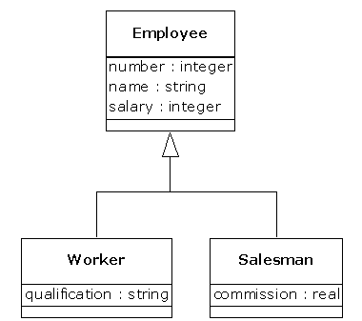
Example
Department of Computer Engineering, VIIT, Pune-48

Slide 73
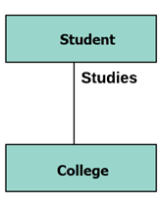
Association:
This kind of relationship represents static relationships between classes A and B. For example; an employee works for an organization. Here are some rules for Association:
Association is mostly verb or a verb phrase or noun or noun phrase.
It should be named to indicate the role played by the class attached at the end of the association path.
Mandatory for reflexive associations
In this example, the relationship between student and college is shown which is studies.
Department of Computer Engineering, VIIT, Pune-48

Slide 74
Association:
This kind of relationship represents static relationships between classes A and B. For example; an employee works for an organization. Here are some rules for Association:
Association is mostly verb or a verb phrase or noun or noun phrase.
It should be named to indicate the role played by the class attached at the end of the association path.
Mandatory for reflexive associations
In this example, the relationship between student and college is shown which is studies.
Department of Computer Engineering, VIIT, Pune-48

Slide 75
Association Relationships
If two classes in a model need to communicate with each other, there must be link between them.
An association denotes that link.
Student
Instructor
Department of Computer Engineering, VIIT, Pune-48

Slide 76
Association Relationships (Cont’d)
We can indicate the multiplicity of an association by adding multiplicity adornments to the line denoting the association.
The example indicates that a Student has one or more Instructors:
Student
Instructor
1..*
Department of Computer Engineering, VIIT, Pune-48

Slide 77
Association Relationships (Cont’d)
The example indicates that every Instructor has one or more Students:
Student
Instructor
1..*
Department of Computer Engineering, VIIT, Pune-48

Slide 78
Association Relationships (Cont’d)
We can also indicate the behavior of an object in an association (i.e., the role of an object) using rolenames.
learns from
Student
Instructor
1..*
1..*
Department of Computer Engineering, VIIT, Pune-48

Slide 79
Association Relationships (Cont’d)
We can also name the association.
membership
Student
Team
1..*
1..*
Department of Computer Engineering, VIIT, Pune-48

Slide 80
Association Relationships (Cont’d)
We can specify dual associations.
member of
Student
Team
1..*
1..*
1
president of
1..*
Department of Computer Engineering, VIIT, Pune-48

Slide 81
Association Relationships (Cont’d)
We can model objects that contain other objects by way of special associations called aggregations and compositions.
An aggregation specifies a whole-part relationship between an aggregate (a whole) and a constituent part, where the part can exist independently from the aggregate. Aggregations are denoted by a hollow-diamond adornment on the association.
Car
Engine
Transmission
Department of Computer Engineering, VIIT, Pune-48

Slide 82
Association Relationships (Cont’d)
Compositions are denoted by a filled-diamond adornment on the association.
Window
Scrollbar
1
1
Titlebar
1
1
Menu
1
1 .. *
Department of Computer Engineering, VIIT, Pune-48

Slide 83
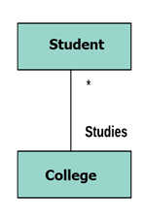
Multiplicity
A multiplicity specifies whether the association is mandatory or not. It has some lower bound and upper bound.
Let's say that that there are 100 students in one college. The college can have multiple students.
Department of Computer Engineering, VIIT, Pune-48

Slide 84
Association: Multiplicity and Roles
student
1
*
University
Person
0..1
*
employer
teacher
Role
Multiplicity
Symbol Meaning
1 One and only one
0..1 Zero or one
M..N From M to N (natural language)
* From zero to any positive integer
0..* From zero to any positive integer
1..* From one to any positive integer
Role
“A given university groups many people; some act as students, others as teachers. A given student belongs to a single university; a given teacher may or may not be working for the university at a particular time.”
Department of Computer Engineering, VIIT, Pune-48

Slide 85
Association types
Car
1
1
aggregation
aggregation: "is part of"
symbolized by a clear white diamond
composition: "is entirely made of"
stronger version of aggregation
the parts live and die with the whole
symbolized by a black diamond
dependency: "uses temporarily"
symbolized by dotted line
often is an implementation detail, not an core part of that object's state
Engine
Book
composition
1
*
Page
dependency
Lottery Ticket
Random
Department of Computer Engineering, VIIT, Pune-48

Slide 86
An example of an Order System of an application. It describes a particular aspect of the entire application.
First of all Order and Customer are identified as the two elements of the system and they have a one to many relationship because a customer can have multiple orders.
Keep Order class is an abstract class and it has two concrete classes (inheritance relationship) SpecialOrder and NormalOrder.
The two inherited classes have all the properties as the Order class. In addition they have additional functions like dispatch () and receive ().
Class Diagram-Example
Department of Computer Engineering, VIIT, Pune-48

Slide 87
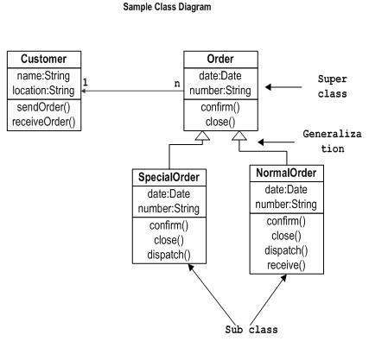
Class Diagram-Example
Department of Computer Engineering, VIIT, Pune-48

Slide 88
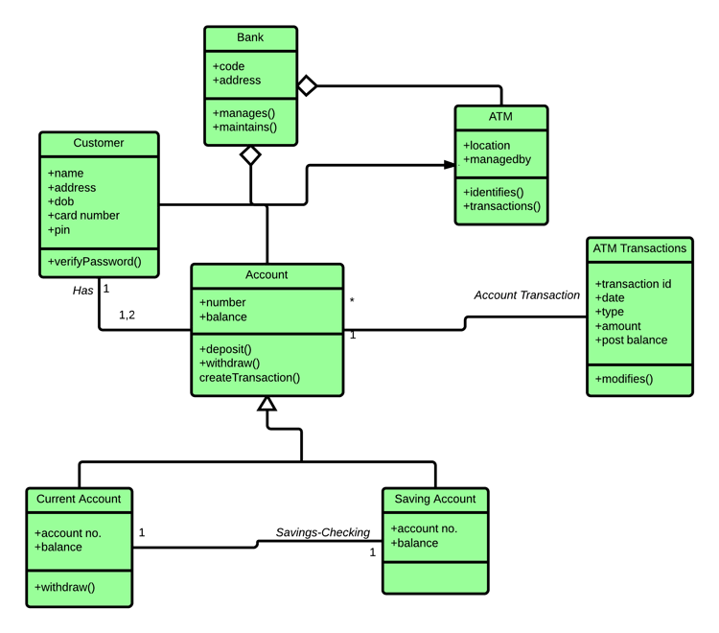
Department of Computer Engineering, VIIT, Pune-48

Slide 89
Behavioral modelling using state diagrams - real life application case study
A behavioral model shows the interactions between objects to produce some particular system behavior that is specified as a use-case, Sequence diagrams, Activity diagrams, state diagrams, collaboration diagrams etc.
Above diagrams are used to model interaction between objects.
Department of Computer Engineering, VIIT, Pune-48

Slide 90
UML State diagrams
A state diagram, also called a state machine diagram or statechart diagram, is an illustration of the states an object can attain as well as the transitions between those states in the Unified Modeling Language (UML).
The following are the basic notational elements that can be used to make up a diagram:
Filled circle, representing to the initial state. Hollow circle containing a smaller filled circle, indicating the final state (if any)
Rounded rectangle, denoting a state.
Top of the rectangle contains a name of the state.
Can contain a horizontal line in the middle, below which the activities that are done in that state are indicated.
Arrow, denoting transition. The name of the event (if any) causing this transition labels the arrow body.
90
Department of Computer Engineering, VIIT, Pune-48

Slide 91
Any real time system is expected to be reacted by some kind of internal/external events. These events are responsible for state change of the system.
Statechart diagram is used to represent the event driven state change of a system. It basically describes the state change of a class, interface etc.
State chart diagram is used to visualize the reaction of a system by internal/external factors.
Statechart diagram is used to describe the states of different objects in its life cycle. So the emphasis is given on the state changes upon some internal or external events.
These states of objects are important to analyze and implement them accurately.
91
Department of Computer Engineering, VIIT, Pune-48

Slide 92
Statechart diagrams are very important for describing the states. States can be identified as the condition of objects when a particular event occurs.
Before drawing a Statechart clear the following points:
Identify important objects to be analyzed.
Identify the states.
Identify the events.
92
Department of Computer Engineering, VIIT, Pune-48

Slide 93
State diagram example
An example of a Statechart diagram where the state of Order object is analyzed.
The first state is an idle state from where the process starts.
The next states are arrived for events like send request, confirm request, and dispatch order.
These events are responsible for state changes of order object.
During the life cycle of an object (here order object) it goes through the different states and there may be some abnormal exists also.
This abnormal exit may occur due to some problem in the system. When the entire life cycle is complete it is considered as the complete transaction.
The initial and final state of an object is also shown in fig.
93
Department of Computer Engineering, VIIT, Pune-48

Slide 94
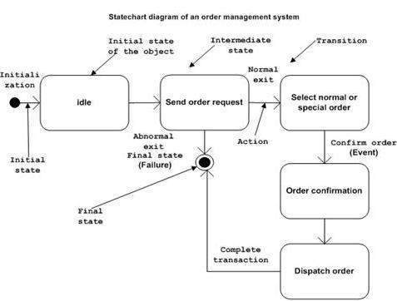
94
Department of Computer Engineering, VIIT, Pune-48

Slide 95
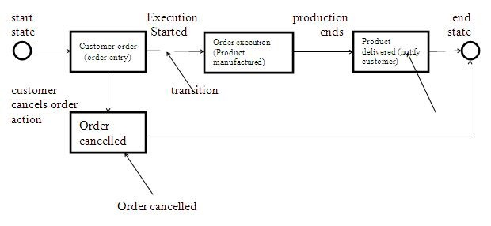
95
Department of Computer Engineering, VIIT, Pune-48

Slide 96
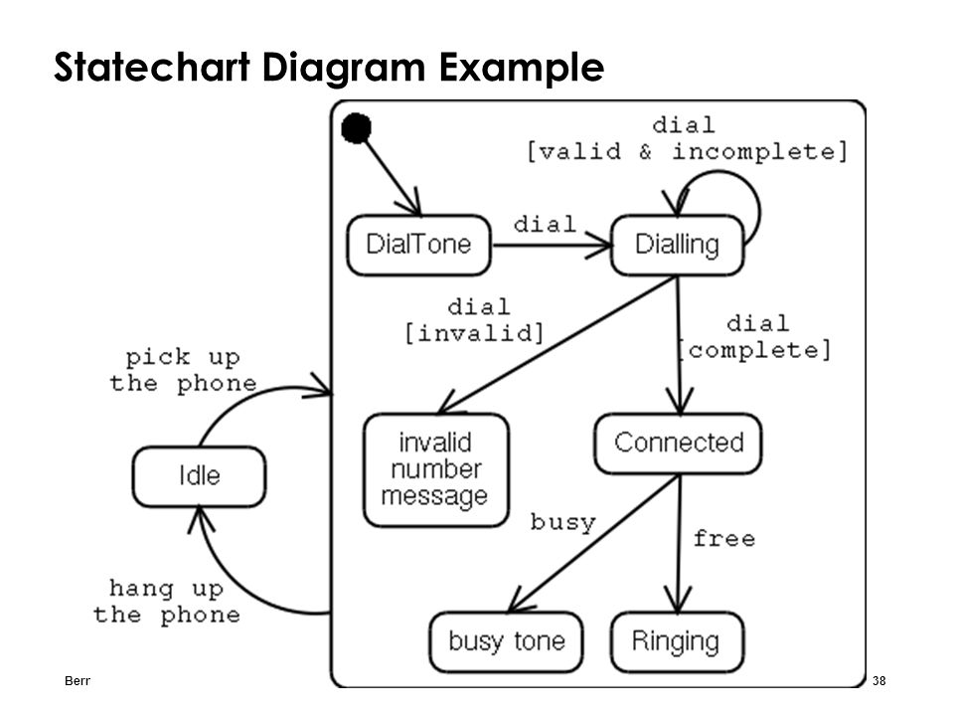
96
Department of Computer Engineering, VIIT, Pune-48

Slide 97
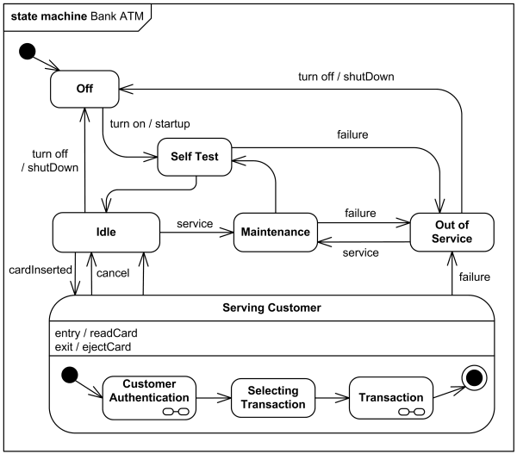
State diagram example
ATM software states at a bank
97
Department of Computer Engineering, VIIT, Pune-48

Slide 98
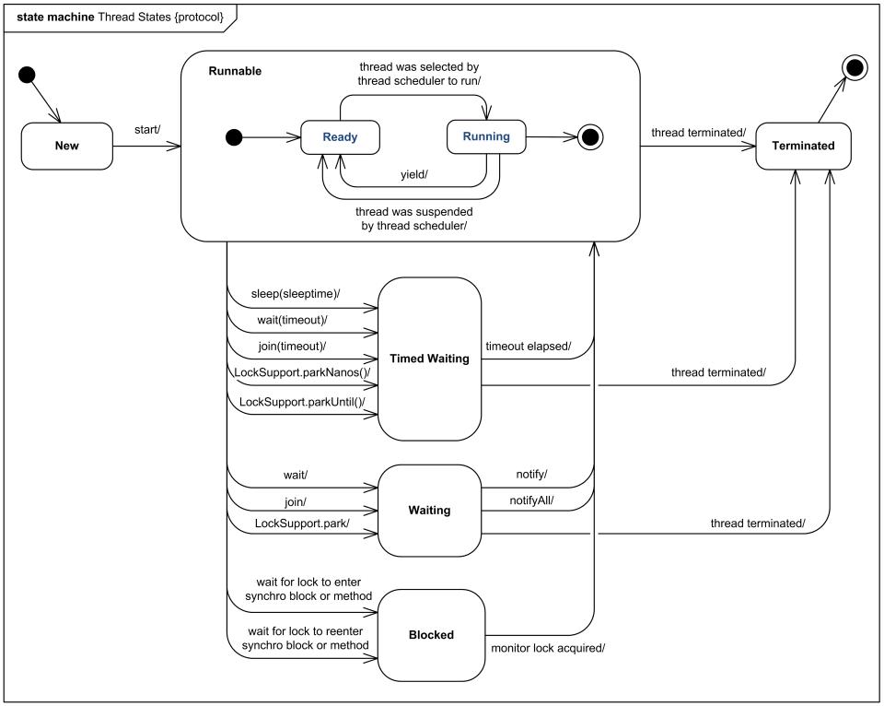
State diagram example
Java thread states
98
Department of Computer Engineering, VIIT, Pune-48

Slide 99
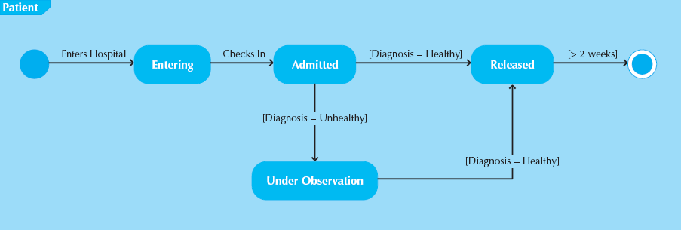
Sample State Diagram for Patient Class
Department of Computer Engineering, VIIT, Pune-48

Slide 100
Parts of a State Chart
Pseudo state – starting point of a statechart
State – condition that occurs during an object’s life when it satisfies some criteria, performs some action, or waits for an event
Transition – movement of object from one state to another state
Message event – trigger for the transition
Department of Computer Engineering, VIIT, Pune-48

Slide 101
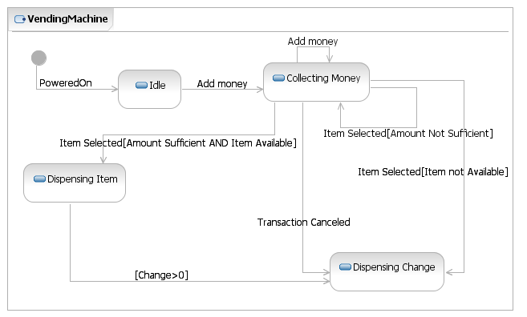
Vending Machine Example
Department of Computer Engineering, VIIT, Pune-48

Slide 102
State Machine
A state machine is a behavior which specifies the sequence of states an object visits during its lifetime in response to events, together with its responses to those event.
A state machine diagram models the behavior of a single object, specifying the sequence of events that an object goes through during its lifetime in response to events.
As an example, the following state machine diagram shows the states that a door goes through during its lifetime.
102
Department of Computer Engineering, VIIT, Pune-48

Slide 103
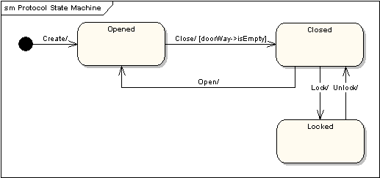
State Machine Diagrams
103
Department of Computer Engineering, VIIT, Pune-48

Slide 104
The door can be in one of three states: "Opened", "Closed" or "Locked". It can respond to the events Open, Close, Lock and Unlock.
Notice that not all events are valid in all states; for example, if a door is opened, you cannot lock it until you close it.
Also notice that a state transition can have a guard condition attached: if the door is Opened, it can only respond to the Close event if the condition doorWay->isEmpty is fulfilled.
The syntax and conventions used in state machine diagrams will be discussed in full in the following sections.
104
Department of Computer Engineering, VIIT, Pune-48

Slide 105
State Machine Diagrams
States - A state is denoted by a round-cornered rectangle with the name of the state written inside it.
Initial and Final States - The initial state is denoted by a filled black circle and may be labeled with a name. The final state is denoted by a circle with a dot inside and may also be labeled with a name.
105
Department of Computer Engineering, VIIT, Pune-48

Slide 106
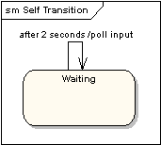
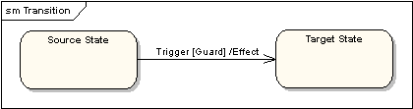
Transitions - Transitions from one state to the next are denoted by lines with arrowheads. A transition may have a trigger, a guard and an effect, as below.
Self-Transitions - A state can have a transition that returns to itself, as in the following diagram. This is most useful when an effect is associated with the transition.
"Trigger" is the cause of the transition, which could be a signal, an event, a change in some condition, or the passage of time. "Guard" is a condition which must be true in order for the trigger to cause the transition. "Effect" is an action which will be invoked directly on the object that owns the state machine as a result of the transition.
106
Department of Computer Engineering, VIIT, Pune-48

Slide 107
State Actions - In the transition example above, an effect was associated with the transition. If the target state had many transitions arriving at it, and each transition had the same effect associated with it, it would be better to associate the effect with the target state rather than the transitions. This can be done by defining an entry action for the state. The diagram below shows a state with an entry action and an exit action.
It is also possible to define actions that occur on events, or actions that always occur. It is possible to define any number of actions of each type.
107
Department of Computer Engineering, VIIT, Pune-48

Slide 108
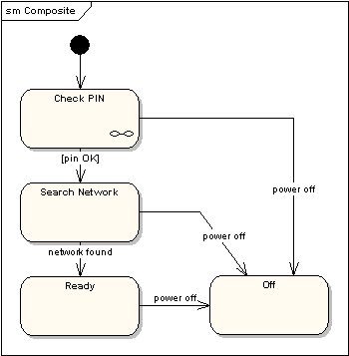
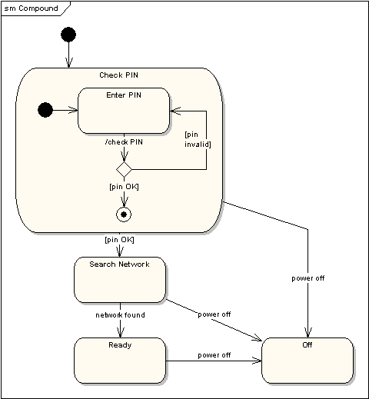
Compound States - A state machine diagram may include sub-machine diagrams, as in the example below.
Alternative way to show the same information
The ∞ symbol indicates that details of the Check PIN
sub-machine are shown in a separate diagram.
108
Department of Computer Engineering, VIIT, Pune-48

Slide 109
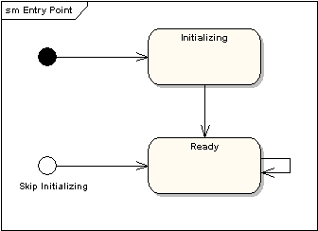
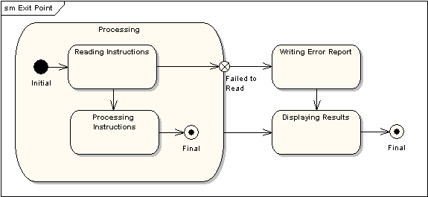
Entry Point - Sometimes you won’t want to enter a sub-machine at the normal initial state. For example, in the following sub-machine it would be normal to begin in the "Initializing" state, but if for some reason it wasn’t necessary to perform the initialization, it would be possible to begin in the "Ready" state by transitioning to the named entry point.
Exit Point - In a similar manner to entry points, it is possible to have named alternative exit points. The following diagram gives an example where the state executed after the main processing state depends on which route is used to transition out of the state.
109
Department of Computer Engineering, VIIT, Pune-48

Slide 110
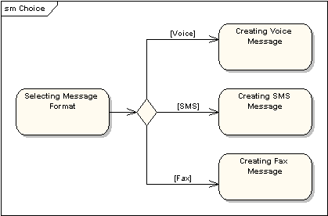
Choice Pseudo-State - A choice pseudo-state is shown as a diamond with one transition arriving and two or more transitions leaving. The following diagram shows that whichever state is arrived at, after the choice pseudo-state, is dependent on the message format selected during execution of the previous state.
110
Department of Computer Engineering, VIIT, Pune-48

Slide 111
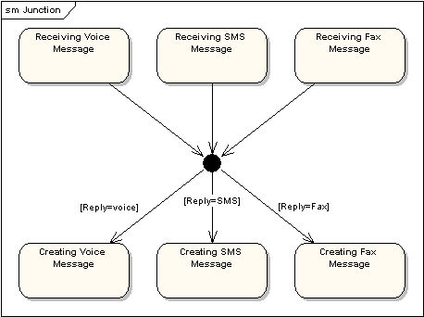
Junction Pseudo-State - Junction pseudo-states are used to chain together multiple transitions. A single junction can have one or more incoming, and one or more outgoing, transitions; a guard can be applied to each transition. Junctions are semantic-free. A junction which splits an incoming transition into multiple outgoing transitions realizes a static conditional branch, as opposed to a choice pseudo-state which realizes a dynamic conditional branch.
111

Slide 112
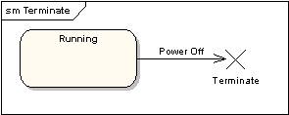
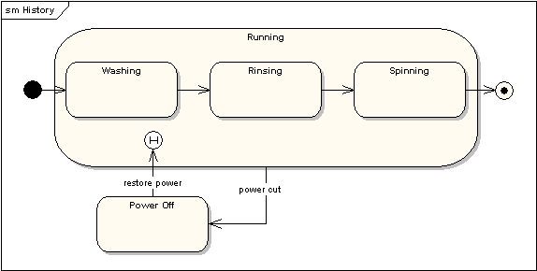
Terminate Pseudo-State - Entering a terminate pseudo-state indicates that the lifeline of the state machine has ended. A terminate pseudo-state is notated as a cross.
History States - A history state is used to remember the previous state of a state machine when it was interrupted. The following diagram illustrates the use of history states. The example is a state machine belonging to a washing machine.
112
Department of Computer Engineering, VIIT, Pune-48
Notes:
In this state machine, when a washing machine is running, it will progress from "Washing" through "Rinsing" to "Spinning". If there is a power cut, the washing machine will stop running and will go to the "Power Off" state. Then when the power is restored, the Running state is entered at the "History State" symbol meaning that it should resume where it last left-off.
112

Slide 113
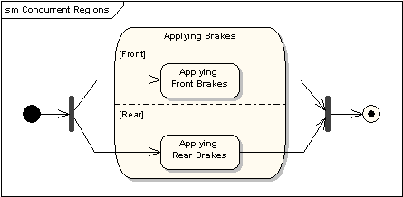
Concurrent Regions - A state may be divided into regions containing sub-states that exist and execute concurrently. The example below shows that within the state "Applying Brakes", the front and rear brakes will be operating simultaneously and independently. Notice the use of fork and join pseudo-states, rather than choice and merge pseudo-states. These symbols are used to synchronize the concurrent threads.
113
Department of Computer Engineering, VIIT, Pune-48

Slide 114
Data Flow Diagrams(DFDs)
A Data Flow Diagram (DFD) is a traditional visual representation of the information flows within a system. A neat and clear DFD can depict the right amount of the system requirement graphically. It can be manual, automated, or a combination of both.
It shows how data enters and leaves the system, what changes the information, and where data is stored.
The objective of a DFD is to show the scope and boundaries of a system as a whole. It may be used as a communication tool between a system analyst and any person who plays a part in the order that acts as a starting point for redesigning a system. The DFD is also called as a data flow graph or bubble chart.
Department of Computer Engineering, VIIT, Pune-48

Slide 115
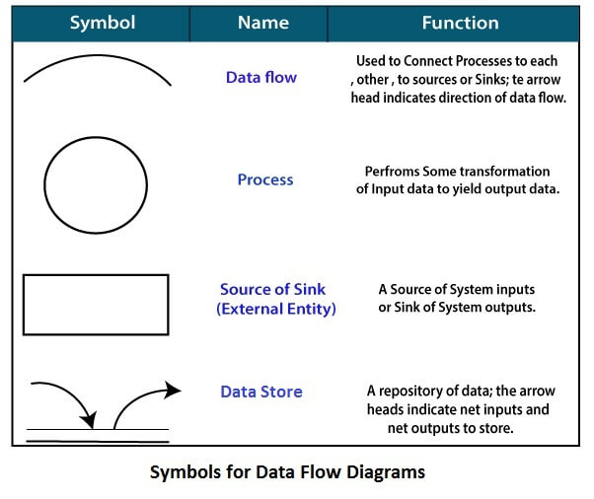
Circle: A circle (bubble) shows a process that transforms data inputs into data outputs.
Data Flow: A curved line shows the flow of data into or out of a process or data store.
Data Store: A set of parallel lines shows a place for the collection of data items. A data store indicates that the data is stored which can be used at a later stage or by the other processes in a different order. The data store can have an element or group of elements.
Source or Sink: Source or Sink is an external entity and acts as a source of system inputs or sink of system outputs.
Department of Computer Engineering, VIIT, Pune-48

Slide 116
Levels in Data Flow Diagrams (DFD)
The DFD may be used to perform a system or software at any level of abstraction. Infact, DFDs may be partitioned into levels that represent increasing information flow and functional detail. Levels in DFD are numbered 0, 1, 2 or beyond. Here, we will see primarily three levels in the data flow diagram, which are: 0-level DFD, 1-level DFD, and 2-level DFD.
0-level DFDM
It is also known as fundamental system model, or context diagram represents the entire software requirement as a single bubble with input and output data denoted by incoming and outgoing arrows. Then the system is decomposed and described as a DFD with multiple bubbles. Parts of the system represented by each of these bubbles are then decomposed and documented as more and more detailed DFDs.
Department of Computer Engineering, VIIT, Pune-48

Slide 117
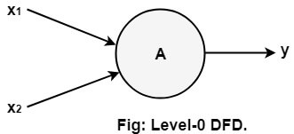
This process may be repeated at as many levels as necessary until the program at hand is well understood. It is essential to preserve the number of inputs and outputs between levels, this concept is called leveling by DeMacro. Thus, if bubble "A" has two inputs x₁ and x₂ and one output y, then the expanded DFD, that represents "A" should have exactly two external inputs and one external output as shown in fig:
The Level-0 DFD, also called context diagram. As the bubbles are decomposed into less and less abstract bubbles, the corresponding data flow may also be needed to be decomposed.
Department of Computer Engineering, VIIT, Pune-48

Slide 118
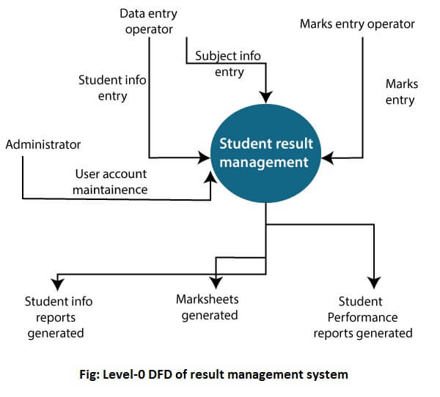
Department of Computer Engineering, VIIT, Pune-48

Slide 119
1-level DFD
In 1-level DFD, a context diagram is decomposed into multiple bubbles/processes. In this level, the main objectives of the system and breakdown the high-level process of 0-level DFD into subprocesses are highlighted.
Department of Computer Engineering, VIIT, Pune-48

Slide 120
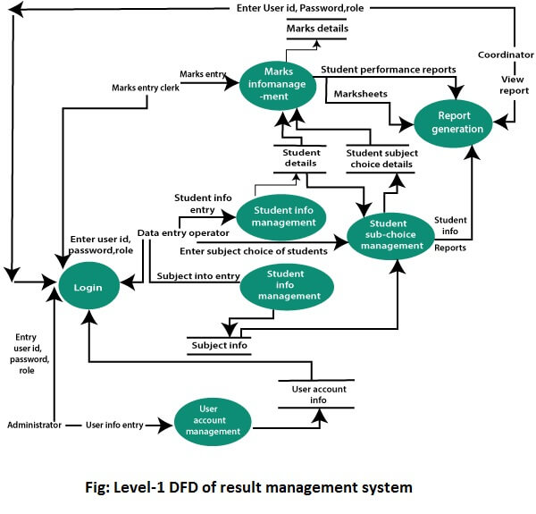
Department of Computer Engineering, VIIT, Pune-48

Slide 121
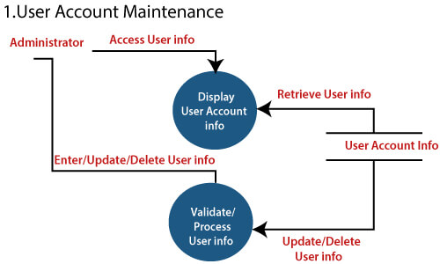
2-Level DFD
2-level DFD goes one process deeper into parts of 1-level DFD. It can be used to project or record the specific/necessary detail about the system's functioning.
Department of Computer Engineering, VIIT, Pune-48

Slide 122
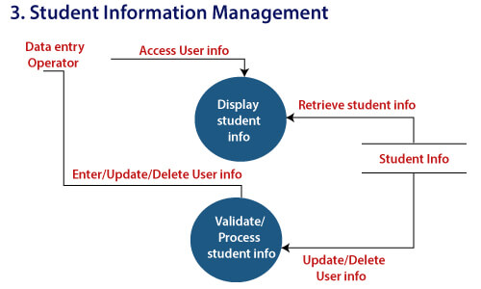
Department of Computer Engineering, VIIT, Pune-48

Slide 123
Control Flow Diagrams
A control-flow diagram can consist of a subdivision to show sequential steps, with if-then-else conditions, repetition, and/or case conditions.
There are several types of control-flow diagrams, for example:
Change-control-flow diagram, used in project management
Configuration-decision control-flow diagram, used in configuration management
Process-control-flow diagram, used in process management
Quality-control-flow diagram, used in quality control.
In software and systems development, control-flow diagrams can be used in control-flow analysis, data-flow analysis, algorithm analysis, and simulation.
Department of Computer Engineering, VIIT, Pune-48

Slide 124
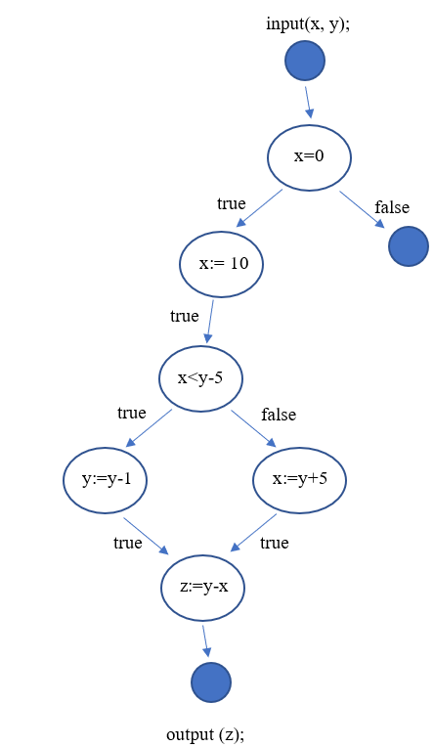
Department of Computer Engineering, VIIT, Pune-48

Slide 125
Software Requirement Specifications (SRS)
A software requirements specification (SRS) is a document that captures complete description about how the system is expected to perform. It is usually signed off at the end of requirements engineering phase.
A complete specification of what the proposed system should do.
Department of Computer Engineering, VIIT, Pune-48

Slide 126
Purpose of SRS document?
SRS establishes basis of agreement between the user and the supplier.
Users needs to be satisfied, but user may not understand software
Developers will develop the system, but may not know about problem domain
SRS is
the medium to bridge the communications gap, and
specifies user needs in a manner both can understand
Department of Computer Engineering, VIIT, Pune-48

Slide 127
Need for SRS…
Helps user understand his needs.
users do not always know their needs
must analyze and understand the potential
The requirement process helps clarify needs
SRS provides a reference for validation of the final product
Clear understanding about what is expected.
Validation - “ SW satisfies the SRS “
Department of Computer Engineering, VIIT, Pune-48

Slide 128
Need for SRS…
High quality SRS essential for high Quality SW
Requirement errors get manifested in final sw
To satisfy the quality objective, must begin with high quality SRS
Requirements defects cause later problems
Department of Computer Engineering, VIIT, Pune-48

Slide 129
Need for SRS…
Good SRS reduces the development cost
SRS errors are expensive to fix later
Req. changes can cost a lot (up to 40%)
Good SRS can minimize changes and errors
Substantial savings; extra effort spent during req. saves multiple times that effort
Department of Computer Engineering, VIIT, Pune-48

Slide 130
Systems Requirements Specification
Table of Contents
I. Introduction
II. General Description
III. Functional Requirements
IV. Non Functional Requirements
V. System Architecture
VI. System Models
VII. Appendices
Department of Computer Engineering, VIIT, Pune-48

Slide 131
Systems Requirements Specification
I. Introduction
A Purpose
B Scope
C Definition, Acronyms, or Abbreviations
D References
E Overview
Department of Computer Engineering, VIIT, Pune-48

Slide 132
Systems Requirements Specification
II. General Description
A Product Perspective
B Product Functions
C User Characteristics
D General Constraints
E Assumptions
Department of Computer Engineering, VIIT, Pune-48

Slide 133
Systems Requirements Specification
Data Model
Functional
Model
Behavioral
Model
The SRS is composed of the outer layer of the behavioral model, the functional model, then the data model.
Department of Computer Engineering, VIIT, Pune-48

Slide 134
Systems Requirements Specification
Correct Complete
Precise Organized
Unambiguous Verifiable
Consistent Understandable
Modifiable Traceable
Design Independent Annotated
Concise
Department of Computer Engineering, VIIT, Pune-48

Slide 135
Systems Requirements Specification
Correct -
specifies every true requirement known at that time and no incorrect specifications - no wrong data
Precise -
remember this must eventually turn to executable code, fuzzy words in requirements are not acceptable
Unambiguous
each requirement has only one interpretation - English interpretation
Complete -
everything included behavior (methods, use cases, systems, subsystems, business rules) and data (objects, attributes)
Department of Computer Engineering, VIIT, Pune-48

Slide 136
Systems Requirements Specification
Verifiable
is the software built what was specified in the SRS
Consistent
conflicting terms, characteristics
Understandable
question: are formal specifications understandable, are informal specifications understandable
Department of Computer Engineering, VIIT, Pune-48

Slide 137
Systems Requirements Specification
Modifiable
changing requirements easily modified when specifying, designing, coding, implementing
Traceable
can I locate the SRS origin of software components.
Design Independent
SRS should not specify a particular design
Department of Computer Engineering, VIIT, Pune-48

Slide 138
Systems Requirements Specification
Section One
Overview document for executives describing the system from a management perspective
Section Two
General Description describing the system from a user and system perspective in general terms.
Section Three
Detailed document for users and developers describing the system in detailed terms.
Department of Computer Engineering, VIIT, Pune-48

Slide 139
Systems Requirements Specification
I. Introduction
A Purpose
B Scope
C Definition, Acronyms, or Abbreviations
D References
E Overview
Department of Computer Engineering, VIIT, Pune-48

Slide 140
Systems Requirements Specification
Introduction
A Purpose
The purpose of this Software Requirements Specification document
Intended audience of this document
Department of Computer Engineering, VIIT, Pune-48
Notes:
There are many uses for a SRS
To define a whole system and plan for implementation (OUR USE)
Define subsystems for future development
To merge requirements with a previous SRS
To validate requirements already documented

Slide 141
Systems Requirements Specification
Introduction
A Purpose
The purpose of the Software Requirements Specification document is to clearly define the system under development, namely the Video Rental System (VRS). The intended audience of this document includes the owner of the video store, the clerks of the video store, and the end users of the VRS. Other intended audience includes the development team such as the requirements team, requirements analyst, design team, and other members of the developing organization.
Department of Computer Engineering, VIIT, Pune-48

Slide 142
Systems Requirements Specification
Introduction
B. Scope
Origin of need
High-level description of the system functionality
Goals of proposed system
Department of Computer Engineering, VIIT, Pune-48

Slide 143
Systems Requirements Specification
Introduction
B. Scope
Origin of the need
who and what triggered the request for this software development activity
gives developers an understanding of the goals for the proposed system
Department of Computer Engineering, VIIT, Pune-48

Slide 144
Systems Requirements Specification
Introduction
B. Scope
High-level functionality
defined for the system
usually in list separated by commas
Department of Computer Engineering, VIIT, Pune-48
Notes:
The scope of a system defines what are the boundaries of a system. These include what is inside the system - what will be designed and programmed.

Slide 145
Systems Requirements Specification
Introduction
B. Scope
Goals are general purposes of a system. They are fuzzy and non measurable.
A typical goal would be things like
Increase customer satisfaction
Make xyz easier for the customer
Improve customer relationships
Department of Computer Engineering, VIIT, Pune-48

Slide 146
Systems Requirements Specification
Introduction
B. Scope
The owner of a local video store wanted to create a new business plan where everything about renting a video (except the picking up and returning of videos) was done online. Therefore, the new VRS will allow the following functionality online: to search for videos, to become members, to rent videos, to modify membership information, and to pay overdue fees. The store personnel may use the VRS to process the rented or returned videos, to add or remove videos to/from his store’s video inventory and to update video information. The VRS is intended to increase the owner’s profit margin by increasing video sales with this unique business approach and by allowing him to reduce the staffing needed in his stores.
Department of Computer Engineering, VIIT, Pune-48

Slide 147
Systems Requirements Specification
Introduction
C. Definitions, Acronyms..
As you begin to define a system, you will encounter words which need definition and general usage acronyms. These should be documented for new personnel and for clarity of all concerned parties.
Department of Computer Engineering, VIIT, Pune-48

Slide 148
Systems Requirements Specification
I. Introduction C Definitions, Acronyms..
FSU – Florida State University
CS - Computer Science
MSES - Masters in Software Engineering Science
DOE - Department of Education
….
Department of Computer Engineering, VIIT, Pune-48

Slide 149
Systems Requirements Specification
Introduction
D. References
Many references may be used to define existing systems, procedures (both new and old), documents and their requirements, or previous system activities. These references are listed here for others.
If any of these references are provided in the appendices, it should be noted here.
Department of Computer Engineering, VIIT, Pune-48

Slide 150
Systems Requirements Specification
I. Introduction D References
Clerk - Personnel staff who is working in a video store
Customer - Anyone who interacts with the VRS with becoming a member
Functional requirement - A service provided by the software system
Member - Anyone who registers with the VRS to acquire membership in the video store
Department of Computer Engineering, VIIT, Pune-48

Slide 151
Section I of SRS
I.A Purpose | Paragraph form
I.B Scope of the System Specified | Paragraph form
I.C Definitions, Acronyms, and Abbreviations | Table form or bulleted list
I.D References to Supporting Documents | Bulleted list
I.E Overview of rest of SRS | Paragraph form
Department of Computer Engineering, VIIT, Pune-48

Slide 152
Introduction
E. Overview
This section defines the organization of the entire document. It will lay the framework for reading the document.
Department of Computer Engineering, VIIT, Pune-48

Slide 153
I. Introduction E Overview
Section 2 of the SRS describes the product in more detail. Section 3 provides a complete list of the functional requirements of the intended system. Section 4 provides the non-functional requirements. Section 5 shows the class diagram, and Section 6 the use case diagram. The appendices appear next.
Department of Computer Engineering, VIIT, Pune-48

Slide 154
Systems Requirements Specification
II. General Description
A Product Perspective
B Product Functions
C User Characteristics
D General Constraints
E Assumptions
Department of Computer Engineering, VIIT, Pune-48

Slide 155
II General Description
A Product Perspective
This defines the relationship this product has in the entire spectrum of products.
It defines who will be responsible for the product and what business purpose it serves.
It also defines what interfaces it may have to other systems.
Department of Computer Engineering, VIIT, Pune-48

Slide 156
II General Description
A Product Perspective
The VRS is a web-based system. The system interfaces with two other systems, the owner’s email system, the video distributor’s video system, and the browsers used by VRS customers. The system provides a secure environment for all financial transactions and for the storing and retrieving of confidential member information.
Department of Computer Engineering, VIIT, Pune-48

Slide 157
II. General Description B Product Functions
This section lists the major functions of the system.
It provides a summary of all the functions of the software. The functions should be organized in a way that makes the list of functions understandable to the customer or to anyone else reading the document for the first time.
This section should be consistent with the functional requirements defined in Section III.
Department of Computer Engineering, VIIT, Pune-48
Notes:
James Martin documented the major business functions of all businesses in his technique on Information Strategy. These include items such as accounts receivable, accounts payable, sales, administration, etc.

Slide 158
II. General Description – B Product Functions
The VRS allows customers to search the video inventory provided by this video store. To rent videos through the VRS, one must register as a member using the VRS. Upon becoming a member and logging into the VRS, the VRS provides the functionality for renting videos, modifying membership information, and paying overdue fines.
The clerks of the video store use VRS to process the return of rented videos. The owner of the video store uses VRS to add new videos into the system, remove videos from the system, and modify video information.
The VRS sends emails to members concerning video rentals. One day before a rented video is due to be returned, VRS emails the member a reminder of the due date for the video(s). For any overdue videos, VRS emails the member every 3rd day with overdue notices. At the 60-day limit for outstanding videos, VRS debits the member’s credit card with the appropriate charge and notifies the member of this charge.
Department of Computer Engineering, VIIT, Pune-48

Slide 159
II. General Description – C User Characteristics
List the users involved with the proposed system including the general characteristics of eventual users (for example, educational background, amount of product training).
List the responsibility of each type of user involved, if needed.
Department of Computer Engineering, VIIT, Pune-48

Slide 160
II. General Description – C User Characteristics
The three main groups of VRS users are customers, members, and store personnel. A customer is anyone who is not a member. The customer can only search through the video inventory. The amount of product training needed for a customer is none since the level of technical expertise and educational background is unknown. The only skill needed by a customer is the ability to browse a website.
Member is someone who has registered with VRS. A member can rent videos and pay fees online. As with a customer, these activities require no product training since the level of technical expertise and educational background of a member is unknown. The only skill needed by a member is the ability to browse a website.
The store personnel are divided into two groups: the clerk-level personnel and owner-level personnel. Their educational level is unknown and both group needs little to no training.
Department of Computer Engineering, VIIT, Pune-48

Slide 161
II. General Description – D General Constraints
In this section, the constraints of the system are listed. They include hardware, network, system software, and software constraints. It also includes user constraints, processing constraints, timing constraints, and control limits.
Department of Computer Engineering, VIIT, Pune-48

Slide 162
II. General Description – D General Constraints
This system provides web access for all customer and member functions. The user interface will be spontaneous enough so that no training is required by customers, members, or store personnel. All online financial transactions and the storage of confidential member information will be done in a secure environment. Persistent storage for membership, rental, and video inventory information will be maintained.
Department of Computer Engineering, VIIT, Pune-48

Slide 163
II General Description – D Assumptions and Dependencies
This includes assumptions made at the beginning of the development effort as well as those made during the development.
List and describe each of the factors that affect the requirements stated in the SRS. These factors are not design constraints on the software but any changes to them can affect the requirements in the SRS. For example, an assumption might be that a specific operating system will be available on the hardware designated for the software product. If, in fact, the operating system is not available, the SRS would then have to change.
Department of Computer Engineering, VIIT, Pune-48

Slide 164
Section II of SRS
II.A Product Perspective | Paragraph form
II.B Product Functions | Paragraph form
II.C User Characteristics | Paragraph form
II.D General Constraints | Paragraph form
II.E Assumptions and Dependencies | Paragraph form
Department of Computer Engineering, VIIT, Pune-48

Slide 165
III Functional Requirements
Functional requirements are those business functions which are included in this software under development. It describes the features of the product and the needed behavior.
The functional requirements are going to be written in narrative form identified with numbers. Each requirement is something that the system SHALL do. Thus, it has a common name of a shall list. You may provide a brief design rationale for any requirement which you feel requires explanation for how and/or why the requirement was derived.
Department of Computer Engineering, VIIT, Pune-48
Notes:
SEE VRS EXAMPLE

Slide 166
IV Non Functional Requirements
Non functional requirements are properties that the system must have such as performance, reusability, usability, user friendliness, etc.
The same format as the functional requirements is to be used for the non-functional requirements. You may provide a brief design rationale for any requirement which you feel requires explanation for how and/or why the requirement was derived.
Department of Computer Engineering, VIIT, Pune-48

Slide 167
V System Architecture
This section presents a high-level overview of the anticipated system architecture using a class diagram. It shows the fundamental objects/classes that must be modeled with the system to satisfy its requirements. Each class on the diagram must include the attributes related to the class. All the relationships between classes and their multiplicity must be shown on the class diagram. The classes specified in this document only are those directly derived from the application domain.
Department of Computer Engineering, VIIT, Pune-48

Slide 168
VI System Models
This section presents the use case diagram for the system under development. The use case diagram should be a complete version containing all the use cases needed to describe the functionality to be developed.
Department of Computer Engineering, VIIT, Pune-48

Slide 169
VII Appendixes
Appendix A. Data dictionary
Appendix B. Raw use case point analysis
Appendix C. Screens and reports with navigation matrix.
Appendix D. Scenario analysis tables
Appendix E. Screens/reports list
Appendix F and following. Other items needed
Department of Computer Engineering, VIIT, Pune-48

Slide 170
SRS Table of Contents
Introduction
Purpose
Scope
Definitions
References
Overview
General Description
Product Perspective
Product Functions
User Characteristics
General Constraints
Assumptions and Dependencies
Specific Requirements
Department of Computer Engineering, VIIT, Pune-48

Slide 171
3. Specific Requirements
3.1 Functional Requirements
3.1.1 Func Req 1
3.1.1.1 Introduction
3.1.1.2 Inputs
3.1.1.3 Processing
3.1.1.4 Outputs
3.1.2 Func Req 2
…
3.2 External Interface Requirements
3.2.1 User Interface
3.2.2 Hardware Interfaces
3.2.3 Software Interfaces
3.2.4 Communication Interfaces
3.3 Performance Requirements
3.4 Design Constraints
3.4.1 Standards Compliance
3.4.2 Hardware Limitations
3.5 Attributes
3.5.1 Security
3.5.2 Maintainability
3.6 Other Requirements
3.6.1 Database
Department of Computer Engineering, VIIT, Pune-48

Slide 172
Summary
Having a good quality SRS is essential.
The req. phase has 3 major sub phases
analysis , specification and validation
Analysis
for problem understanding and modeling
Key properties of an SRS: correctness, completeness, consistency, traceability, unambiguousness.
Specification
must contain functionality, performance , interfaces and design constraints
Mostly natural languages used
Validation - through reviews
Department of Computer Engineering, VIIT, Pune-48

Slide 173
References
SOFTWARE REQUIREMENT ELICITATION TECHNIQUES ...epgp.inflibnet.ac.in › epgpdata › uploads › epgp_content
https://www.tutorialspoint.com/software_engineering/software_requirements.htm
https://web.cs.dal.ca › ~hawkey › May17_SRS
https://www.javatpoint.com/software-engineering-data-flow-diagrams
SRS-www.cs.fsu.edu › ~baker › swe1 › restricted › notes › ppt › SRS
Department of Computer Engineering, VIIT, Pune-48

Slide 174
Behavioral Modeling: State Diagrams
CIS 4800
Kannan Mohan
Department of CIS
Zicklin School of Business, Baruch College
Copyright © 2009 John Wiley & Sons, Inc.
Copyright © 2005 Pearson Education
Copyright © 2009 Kannan Mohan
Department of Computer Engineering, VIIT, Pune-48

Slide 175
Thank You
Department of Computer Engineering, VIIT, Pune-48

Slide 176
Chapter 4, Requirements Elicitation

