Slide 1

Unit I-Introduction Design and Analysis of Algorithms
Mrs. Nivedita S. Bhirud Mr. Subhash S. Tatale nivedita.bhirud@viit.ac.in subhash.tatale@viit.ac.in
Department of Computer Engineering
BRACT’S, Vishwakarma Institute of Information Technology, Pune-48
(An Autonomous Institute affiliated to Savitribai Phule Pune University)
(NBA and NAAC accredited, ISO 9001:2015 certified)

Slide 2
Objective/s of this session
1. To analyze the performance of algorithms
2. To study algorithmic design strategies
3. To understand NP-Completeness and intractability
4. To study some advance algorithms
1. Formulate a problem and analyse the asymptotic performance of algorithms.
2. Decide and apply algorithmic strategies to solve a given problem
3. Identify intractable problems using concept of NP-Completeness
4. Use advance algorithms to solve problem which are intractable
Learning Outcome/Course Outcome
Department of Computer Engineering, VIIT , Pune-48

Slide 3
Content
Part –I
Analysis of Algorithms
Best, Average and Worst case running times of algorithms
Mathematical notations for running times O, Ω, Ɵ,
Part-II
Divide and Conquer strategy: Quick Sort
Divide and Conquer strategy: Merge Sort
Exponentiation Greedy Method: General Strategy
Part-III
Knapsack problem
Scheduling
Optimal merge patterns
Huffman code generation algorithm.
Department of Computer Engineering, VIIT, Pune-48

Slide 4
Definition [Algorithm]:
An algorithm is a finite set of instructions that, if followed, accomplishes particular task. In addition, all algorithms must satisfy the following criteria/properties:
1.Input:Zero or more quantities are externally supplied.
2. Output: At least one quantity is produced.
3.Definiteness: Each instruction is clear and unambiguous.
4.Finiteness:- If we trace out the instructions of an algorithm, then for all cases, the algorithm terminates after a finite number of steps.
5.Effectiveness: Every instruction must be very basics so that it can be carried out, by a person using only pencil and paper. It is not enough that each operation be definite as in criterion3; it also must be feasible.
Department of Computer Engineering, VIIT, Pune-48

Slide 5
An algorithm is composed of a finite set of steps, each of which may require one or more operations.
The possibility of a computer carrying out these operations necessitates that certain constraints be placed on the type of operations an algorithm can include.
A program is the expression of an algorithm in a programming language.
Sometimes words such as procedure, function, and subroutine are used synonymously for program.
Department of Computer Engineering, VIIT, Pune-48

Slide 6
Informally : What are Algorithms?
Any well-defined computational procedure that takes some value/set of values, as input and produces some value/set of values, as output.
An algorithm is thus a sequence of computational steps that transform the input into the output.
Department of Computer Engineering, VIIT, Pune-48

Slide 7
Algorithm Evolution stages
Prior tasks : more hardware based
1936 Alan Turing : Effective Procedures (before modern electronic computers were built)
Next Realized : Systematic methods were need
Structured Programming
With Critical Applications (in Physics, Engineering design, Meteorology, Optimization) came : Proof of Correctness of Algorithms
Research in Efficient Algorithms and in depth study of “hard” algorithms
Knuth coined term : “ Algorithm Analysis”.
Problems divided into 2 classes
Tractable and non-tractable
Tractable : hope to be solved in reasonable time even when scaled
Non-Tractable: cannot be solved in reasonable time when scaled
New Branch of study: Complexity theory; lower bound on running time
Department of Computer Engineering, VIIT, Pune-48

Slide 8
…contd.. Problems faced for proof of correctness
For large problems, proofs became lengthy.
Proofs of correctness of algorithm of real life problems were difficult to give and no assurance of correctness.
Strategies to solve the problem of proof of correctness
Automatic proof assistants (program to generate detailed proof for a given algorithm with help from human).
Algorithm developed in parallel with proof of correctness.
Department of Computer Engineering, VIIT, Pune-48

Slide 9
…contd.. Proof of correctness issues
“Formal method of Specification” of Algorithm: required because “proof of correctness” requires formally specified algorithms

Slide 10
…contd…Search for efficient solutions
Study for efficient algorithms led to : Time/Space tradeoff
For non-tractable but practical problems: Approximate Solutions (when degree of approximation known)
Randomness: can be aid to solving many difficult problems
Random numbers : should be considered as resource (like space/CPU time)
Algos that use randomness as a basic component : Genetic algorithm, Simulated Annealing and statistically defined algorithms.
Department of Computer Engineering, VIIT, Pune-48

Slide 11
Issues:
Design approach depends on model chosen
There can be more than 1 model for solving same problem
Choice will decide the effectiveness.
Need of Correctness of Algorithm:
Complex algorithm are be reliable only if they give correct result for all valid inputs.
However, checking result of all possible valid inputs is impossible.
By checking certain conditions, we can prove the algorithm correct and thus reliable.

Slide 12
Choose a Better Algorithm
Depends upon the problems and Instance
what is Problem, multiply two numbers is a problem
Two number whose multiplication is to calculate is an Instance
There are various ways to multiply two numbers we can design an Algorithm for those.
Efficiency of Algorithm
Depend upon the instance
Time and Space required to solve an Algorithms.
Even need to check an algorithms on different instance for its correctness.
Efficiency of An Algorithm also depends upon size of an Instance.
Department of Computer Engineering, VIIT, Pune-48

Slide 13
Analysis of Algorithms
Efficiency of an Algorithms depends upon size of Problem instance
we can consider an example of Insertion sort where it behaves in linear time for sorted i/p where as it takes quadratic time for unsorted or descending order i/p thus if t1(n) is time in 1st case and t2(n) in 2nd then its always t1(n)<=c.t2(n) where c is const.
Thus we can measure worst and best case scenarios depending upon the desc order and asec order i/p but for avg. case scenario, i/p can’t be defined.
Department of Computer Engineering, VIIT, Pune-48

Slide 14
Analysis of Algorithms
As an algorithm is executed, it makes use of the computer's central processing unit (cpu) to perform operations and it uses the memory (both immediate and auxiliary) to hold the program and its data.
Analysis of algorithms refers to the process of determining how much computing time and storage an algorithm will require.
Given an algorithm to be analyzed, the first task is to determine which operations are employed and what their relative costs are.
These operations may include the four basic arithmetic operations on integers: addition, subtraction, multiplication and division.
Department of Computer Engineering, VIIT, Pune-48

Slide 15
Analysis of Algorithms
As an algorithm is executed, it makes use of the computer's central processing unit (cpu) to perform operations and it uses the memory (both immediate and auxiliary) to hold the program and its data.
Analysis of algorithms refers to the process of determining how much computing time and storage an algorithm will require.
Given an algorithm to be analyzed, the first task is to determine which operations are employed and what their relative costs are.
These operations may include the four basic arithmetic operations on integers: addition, subtraction, multiplication and division.
Department of Computer Engineering, VIIT, Pune-48

Slide 16
For example, a comparison of two character strings may use a character compare instruction which may, in turn, use a shift and bit-compare instruction.
The total time for the comparison of two strings will depend upon their lengths, while the time for each character compare is bounded by a constant.
The second task is to determine a sufficient number of data sets which cause the algorithm to exhibit all possible patterns of behavior.
This is one of the important and creative tasks of algorithm analysis. It requires us to understand the workings of the algorithm well enough to formulate the data configurations which produce the best or worst or typical behavior.
Department of Computer Engineering, VIIT, Pune-48

Slide 17
A complete analysis of the computing time of an algorithm is distinguished between two phases: a priori analysis and a posteriori testing.
In a priori analysis we obtain a function (of some relevant parameters) which bounds the algorithm's computing time.
In a posteriori testing we collect actual statistics about the algorithm's consumption of time and space, while it is executing.
Suppose there is the statement x - x + y somewhere in the middle of a program. We wish to determine the total time that statement will spend executing, given some initial state of input data.
Department of Computer Engineering, VIIT, Pune-48

Slide 18
This requires essentially two items of information, the statement's frequency count (i.e. the number of times the statement will be executed) and the time for one execution.
The product of these two numbers is the total time.
Since the time per execution depends on both the machine being used and the programming language together with its compiler, an a priori analysis limits itself to determining the frequency count of each statement.
This number can be determined directly from the algorithm, independent of the machine it will be executed on and the programming language the algorithm is written in.
Department of Computer Engineering, VIIT, Pune-48

Slide 19
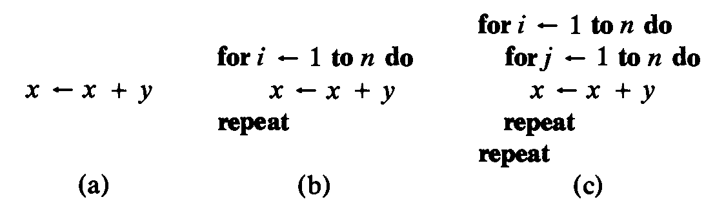
For example consider the three program segments a,b,c:
Department of Computer Engineering, VIIT, Pune-48

Slide 20
For each segment we assume the statement x - x + y is contained within no other loop than what is already visible. Thus for segment (a) the frequency count of this statement is 1. For segment (b) the count is n and for segment (c) it is n2.
These frequencies 1, n, n2 are said to be different, increasing orders of magnitude.
In an algorithm analysis, the order of magnitude of a statement refers to its frequency of execution, while the order of magnitude of an algorithm refers to the sum of the frequencies of all of its statements.
Given three algorithms for solving the same problem whose orders of magnitude are n, n 2, and n 3, naturally we will prefer the first since the second and third are progressively slower.
Department of Computer Engineering, VIIT, Pune-48

Slide 21
Analysis of Algorithms
Measure the resource required in an algorithm
Time
Running time
Disk access
Space
Memory
When to measure
Best case
Lower Bound
for best instance
Worst case
Upper bound
Mostly used, in general
Often occur
Average case
Often close to worst case
Used for randomized algorithm
Department of Computer Engineering, VIIT, Pune-48

Slide 22
Analysis of Algorithms
Algorithm Analysis
Counting the number of operations
How to count
Worst case
Average case
Best case
Asymptotic notations
Upper bounds
Lower bounds
Tight bounds
Asymptotic notations
Big "O" Order of or Upper Bound
Big "Ώ" Omega Lower Bound
Big "Θ" Theta
As we know as I/P increases time of execution increases thus for an algorithm.
Department of Computer Engineering, VIIT, Pune-48

Slide 23
Asymptotic Notation
A priori analysis of computing time ignores all of the factors which are machine or programming language dependent and concentrates on determining the order of magnitude of the frequency of execution of statements.
There are several kinds of mathematical notation which are very useful for this kind of analysis. One of these is the 0-notation.
Definition f(n) = O(g(n)) iff there exist positive constants c and n₀ such that f(n) ≤ cg(n) for all n, n ≥ n₀.
Department of Computer Engineering, VIIT, Pune-48

Slide 24
Suppose we are determining the computing time, f(n), of some algorithm.
The variable n might be the number of inputs or outputs, their sum or the
magnitude of one of them.
Since f(n) is machine dependent, an a priori analysis will not suffice to determine it. However, an a priori analysis can be used to determine a g(n) such that f(n) = O(g(n)).
When we say that an algorithm has computing time O(g(n)) we mean that if the algorithm is run on some computer on the same type of data but for increasing values of n, the resulting times will always be less than some constant times I g(n) I .
When determining the order of magnitude of f(n) we shall always try to obtain the smallest g(n) such that f(n) = O(g(n)).
Department of Computer Engineering, VIIT, Pune-48

Slide 25
Performance Analysis of an Algorithm :
There are many criteria upon which we can judge an algorithm. For example :
Does it do what we want it to do? Results
Does it work correctly according to original specifications of the task? Quality
Is there documentation that describes how to use it and how it works? Documentation
Are procedures created in such a way that they perform logical sub-functions? Modularity
Is the code readable? Readability
These criteria are all important when it comes to writing software for large systems.
*** There are other criteria for judging algorithms that have a more direct relationship to performance. These have to do with their computing time and storage requirements. ***
Department of Computer Engineering, VIIT, Pune-48

Slide 26
Performance Analysis of an Algorithm – contd. :
Space Complexity : The space complexity of an algorithm is the amount of memory it needs to run to completion.
S(P) = c + Sp (instance characteristics) where,
c = space for (instructions, simple variables, fixed size aggregates)
Sp = variable part depends upon problem instance characteristics
Time Complexity : The time complexity of an algorithm is the amount of computer time it needs to run to completion.
T(P) = compile time + run time (execution time)
Compile time is constant or same program is executed many times, hence run time of a program (t_{p}) is important which depends upon instance characteristics
Performance Evaluation consists of :
A Priory Estimates or performance or asymptotic analysis
A Posteriori Testing or performance measurement
Department of Computer Engineering, VIIT, Pune-48

Slide 27
Priori Estimates: For any instruction in a program:
Total Computation Time = Time required to execute the instruction *
Number of times the instruction is executed in a program (i.e. frequency count).
Time required to execute the instruction depends upon:
- Speed of processor (Clock frequency)
- Instruction set of the machine language
- Time required (processor cycles) to execute an instruction
- Compiler used to translate high level instructions to m/c language
All above criteria differ from installation to installation. Therefore for priori estimates frequency count of each statement is most important factor while analyzing an algorithm or program.
Frequency count : It is the number of times an instruction is executed in the execution of a program. Example
Department of Computer Engineering, VIIT, Pune-48

Slide 28
Priori Estimates: Example
Consider the following construct of a program:
{ for (i = 1; i ≤ n; i++) …. 1
for ( j = 1; j ≤ i; j++) …. 2
for (k = 1; k ≤ j; k++) …. 3
x = x+1; } …. 4
Statement # 1 : (Σ 1 ) + 1 = n + 1 ^{1<= i<= n}
Statement # 2 : Σ [(Σ 1 ) + 1] = [n(n + 1)/2] + n ^{1<= i<= n} ^{1<= j<= i}
Statement # 3 : Σ [(Σ (Σ 1 ) + 1] = [n(n + 1)(n+5)/6]
^{1<= i<= n} ^{1<= j<= i} ^{1<= k<= j}
Statement # 4 : Σ [(Σ (Σ 1 ) + 1] = [n(n + 1)(n+2)/6]
^{1<= i<= n} ^{1<= j<= i} ^{1<= k<= j}
Department of Computer Engineering, VIIT, Pune-48

Slide 29
Priori Estimates: Example contd…
Frequency Count of each statement:
Statement # 1 : n + 1
Statement # 2 : n² /2 + 3n/2
Statement # 3 : n³/6 + n² + 5n/6
Statement # 3 : n³/6 + n²/2+ n/3
Total Frequency Count = (n³ +6n² +11n +3)/3 = O(n³)
Department of Computer Engineering, VIIT, Pune-48

Slide 30
Asymptotic notations
Big "O" Order of or Upper Bound
Big "Ώ" Omega Lower Bound
Big "Θ" Theta
As we know as I/P increases time of execution increases thus for an algorithm
so for an algorithm,to calculate the time complexity and asymptotic behviour of an algo as a fun of time
Department of Computer Engineering, VIIT, Pune-48

Slide 31
Asymptotic Notations: To enable us to make meaningful statements about the time and space complexities of an algorithm , asymptotic notations (O, o, Ω, ω, θ) are used.
Big “Oh” : The function f(n) = O(g(n)), to be read as “ f of n is Big Oh of g of n”, if and only if there exist positive constants c and n₀ such that, f(n) ≤ c*g(n) for all n≥n₀, for example,
i. f(n) = 3n + 2 ≤ 4n for all n ≥ 2.
Here c = 4, g(n) = n and n₀ = 2.
ii. f(n) = (n³ + 6n² + 11n +3) ≤ 2n³ for all n ≥ 8.
Here c = 2, g(n) = n³ and n₀ ₌ 8.
Thus f(n) = O(g(n)) states that g(n) is an upper bound on the value of f(n) for all n≥n₀.
Department of Computer Engineering, VIIT, Pune-48

Slide 32
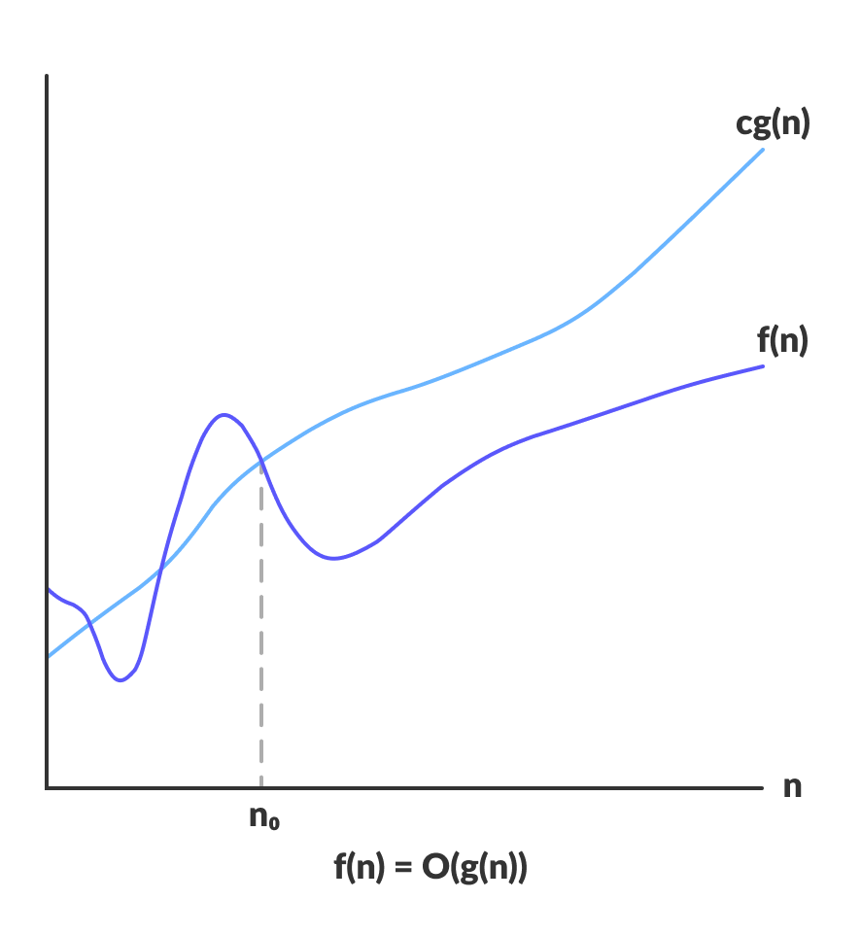
" O " (Big Oh) is the most commonly used notation.
A fns can be represented is the order of g(n) that is O(g(n)), if there exists a value of positive integer n as n0 and a positive constant c such that
f(n)⩽c.g(n) for n>n0 in all case
Hence, function g(n) is an upper bound for function f(n), as g(n) grows faster than f(n).
Department of Computer Engineering, VIIT, Pune-48

Slide 33
consider f(n)=3n+2 & g(n)=n
so to satisfy f(n)⩽c.g(n)
we can write 3n+2 ⩽ C.n
The above condition is true when C=4 or more than that thus we can write
3n+2 ⩽ 4.n
As f(n)=O g(n) i.e f(n) is bounding g(n) it means f(n)=O g(n) is true for all n & higher values of n like ,n² or n³....
Thus this is Upper bound of a function.
Department of Computer Engineering, VIIT, Pune-48

Slide 34
Omega (Ω ): The function f(n) = Ω(g(n)), to be read as “ f of n is omega of g of n, if and only if there exist positive constants c and n₀ such that, f(n) ≥ c*g(n) for all n≥n₀, for example,
i. f(n) = 3n + 2 ≥ 3n for all n ≥ 0.
Here c = 3, g(n) = n and n₀ ₌ 0.
ii. f(n) = (n³ + 6n² + 11n +3) ≥ n³ for all n ≥ 0.
Here c = 1, g(n) = n³ and n₀ ₌ 0.
Thus f(n) = Ω(g(n)) states that g(n) is an lower bound on the value of f(n) for all n≥n₀.
Department of Computer Engineering, VIIT, Pune-48

Slide 35
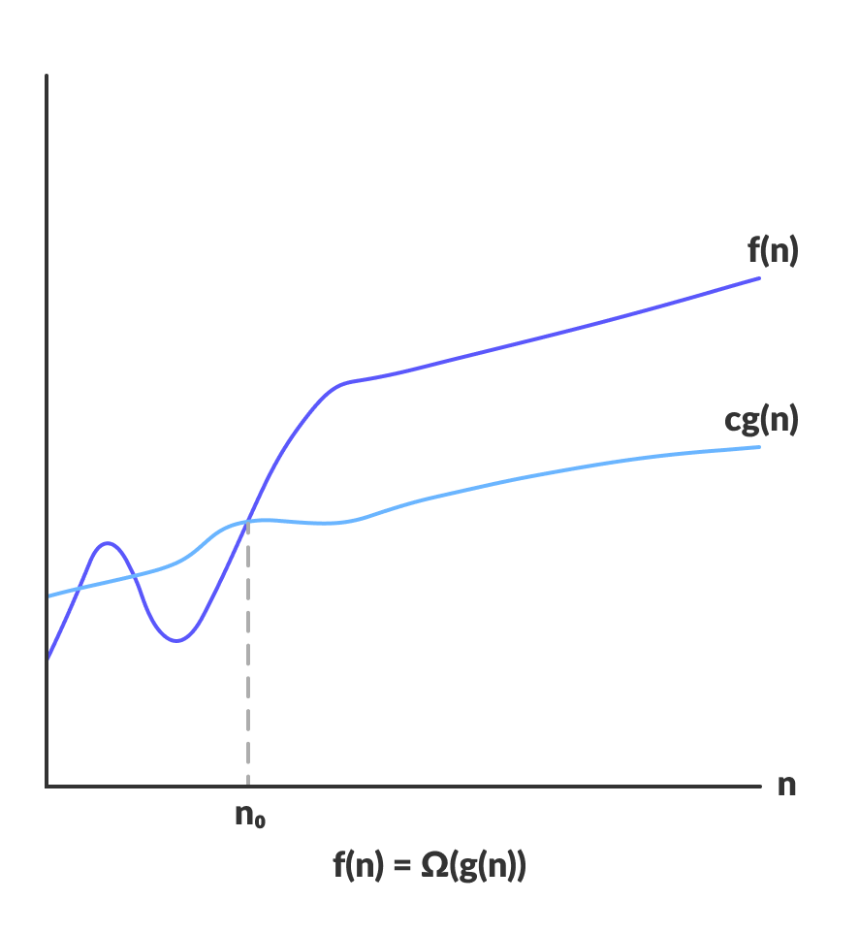
" Ώ " Omega Big (Ω )
f(n)=Ω(g(n)) when there exists constant c that
f(n)⩾c.g(n) for all large value of n.where n⩾1
Ώ notation represents the lower bound of the running time of an algorithm. it provides best case complexity of an algorithm.
Department of Computer Engineering, VIIT, Pune-48
Department of Computer Engineering, VIIT, Pune-48

Slide 36
consider f(n)=3n+2 & g(n)=n
so to satisfy f(n)⩾c.g(n)
we can write 3n+2 ⩾C.n
The above condition is true when C=1 or more than that thus we can write
3n+2 ⩾ 1.n
As f(n)=Ώ g(n) i.e f(n) is bounding g(n) it means f(n)=Ώ g(n) is true for all n or less than that like log(n) or log(log(n))
As we want tighest bound we consider the nearest funs i.e. f(n)=Ώ g(n)
Thus this is Lower bound of a function.
Department of Computer Engineering, VIIT, Pune-48

Slide 37
Theta (θ ): The function f(n) = θ(g(n)), to be read as “ f of n is theta of g of n, if and only if there exist positive constants c₁ , c₂ and n₀ such that, c₁g(n) ≤ f(n) ≤ c₂*g(n) for all n≥n₀, for example,
i. f(n) = 3n + 2 then
3n ≤ 3n + 2 ≤ 4n for all n≥2
Here c₁ = 3, c₂ = 4, g(n) = n and n₀ ₌ 2.
ii. f(n) = (n³ + 6n² + 11n +3) then
n³ ≤ (n³ + 6n² + 11n +3) ≤ 2n³ for all n ≥ 8.
Here c₁ = 1, c₂ = 2, g(n) = n³ and n₀ ₌ 8.
Thus f(n) = θ(g(n)) states that g(n) is both upper & lower bound on the value of f(n) for all n≥n₀.
Department of Computer Engineering, VIIT, Pune-48

Slide 38
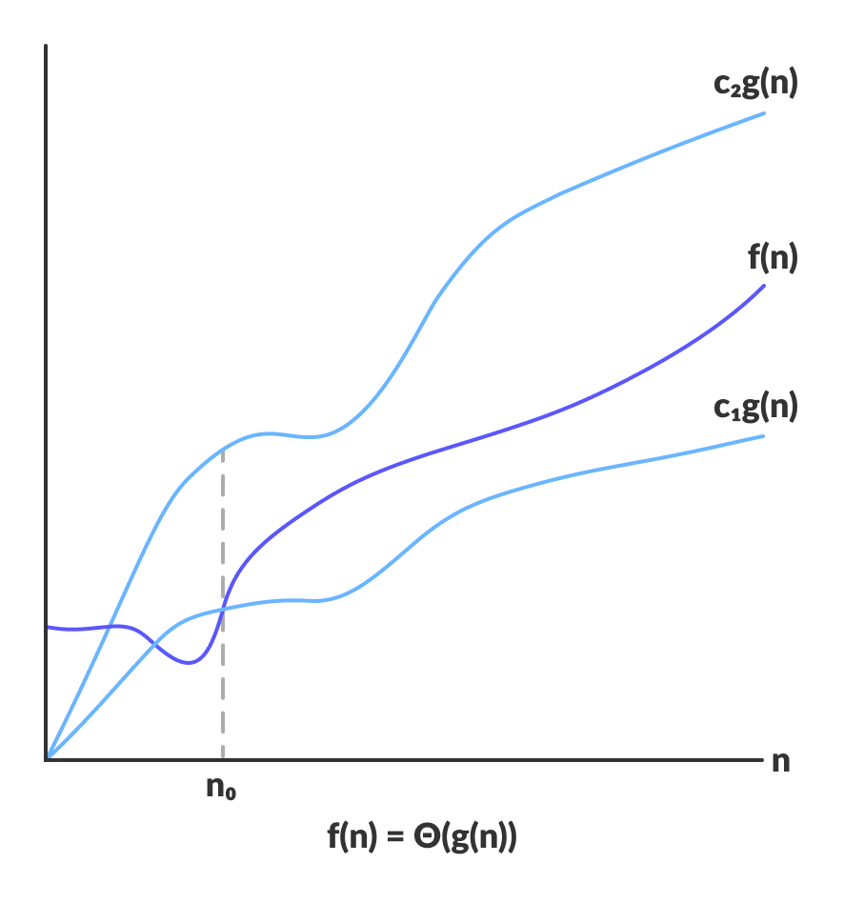
"θ" Theta Big(θ)
We say that f(n)=θ(g(n)) when there exist constants c1 and c2 that
c1.g(n)⩽f(n)⩽c2.g(n) for all large value of n. Here n⩾1
it provides avg case complexity of an algorithm.
Department of Computer Engineering, VIIT, Pune-48

Slide 39
Little “oh” : The function f(n) = o(g(n)), to be read as “ f of n is little oh of g of n, if and only if Lim f(n) / g(n) = 0
^{n → ∞}
i. f(n) = 3n + 2 = o(n²) or o(nlogn)
ii. f(n) = (n³ + 6n² + 11n +3) = o(n⁴) or o(n³logn)
Little omega : The function f(n) = ω(g(n)), to be read as “ f of n is little omega of g of n, if and only if Lim g(n) / f(n) = 0
^{n → ∞}
i. f(n) = 3n + 2 = ω(1)
ii. f(n) = (n³ + 6n² + 11n +3) = ω(n²)
Department of Computer Engineering, VIIT, Pune-48

Slide 40
Nomenclature used to represent time and space complexity:
For a given size ‘n’ of a problem :
Complexity | Nomenclature | Values for n = 32
O(1) | Constant | 1
O(logn) | Logarithmic | 5
O(n) | Linear | 32
O(nlogn) | Linear Logarithmic | 160
O(n²) | Quadratic | 1,024
O(n³) | Cubic | 32,768
O(2^{n}) | Exponential | 2,147,483,648
Department of Computer Engineering, VIIT, Pune-48

Slide 41
Best, Average and Worst case running times of algorithm
We have 3 cases to analyze an algorithm:
Best case
Average case
Worst case
Department of Computer Engineering, VIIT, Pune-48

Slide 42
Best, Worst and Average case analysis of an algorithm:
Best Case analysis : Best case is that input to the algorithm which takes minimum time for execution of it. Best case analysis of an algorithm is the asymptotic analysis of an algorithm for best case input.
Examples :
Binary search algorithm : Best case is to search the element positioned at the middle of the sorted array and Asymptotic time (Time complexity) required is O(1)
Insertion sort algorithm : Best case is sorted input in the required order and Asymptotic time (Time complexity) required is O(n)
Department of Computer Engineering, VIIT, Pune-48

Slide 43
Worst Case analysis : Worst case is that input to the algorithm which takes maximum time for execution of it. Worst case analysis of an algorithm is the asymptotic analysis of an algorithm for worst case input.
Examples :
Binary search algorithm : Worst case is to search the last element or the element which is absent in sorted array and Asymptotic time (Time complexity) required is O(logn)
Insertion sort algorithm : Worst case is sorted input in the reverse order and Asymptotic time (Time complexity) required is O(n²)
Department of Computer Engineering, VIIT, Pune-48

Slide 44
Average Case analysis : For average case analysis all possible sequences of size ‘n’ are input to the algorithm and average asymptotic time of the algorithm is computed.
Examples :
Binary search algorithm : For average case analysis all elements of sorted array of size ‘n’ are searched one by one and total number of comparisons are computed. Average computation time = Total time / n is represented using asymptotic notation. Asymptotic time (Time complexity) required is O(logn). Proof
Example,
Position : 1 2 3 4 5 6 7 8 9 10 11 12 13 14
Numbers : -15 -6 0 7 9 23 54 82 101 112 125 131 142 151
Comparisons : 3 4 2 4 3 4 1 4 3 4 2 4 3 4
Department of Computer Engineering, VIIT, Pune-48

Slide 45
Divide and Conquer strategy: Quick Sort
Given a function to compute on n inputs the divide-and-conquer strategy suggests splitting the inputs into k distinct subsets, 1 < k ~ n yielding k subproblems.
These subproblems must be solved and then a method must be found to combine subsolutions into a solution of the whole.
If the subproblems are still relatively large, then the divide-and-conquer strategy may possibly be reapplied.
Often the subproblems resulting from a divide and- conquer design are of the same type as the original problem.
For those cases the reapplication of the divide-and-conquer principle is naturally expressed by a recursive procedure.
Now smaller and smaller subproblems of the same kind are generated, eventually producing subproblems that are small enough to be solved without splitting.
Department of Computer Engineering, VIIT, Pune-48

Slide 46
Generally, divide-and-conquer algorithms have three parts −
Divide the problem into a number of sub-problems that are smaller instances of the same problem.
Conquer the sub-problems by solving them recursively. If they are small enough, solve the sub-problems as base cases.
Combine the solutions to the sub-problems into the solution for the original problem.
Pros and cons of Divide and Conquer Approach
Divide and conquer approach supports parallelism as sub-problems are independent. Hence, an algorithm, which is designed using this technique, can run on the multiprocessor system or in different machines simultaneously.
In this approach, most of the algorithms are designed using recursion, hence memory management is very high. For recursive function stack is used, where function state needs to be stored.
Department of Computer Engineering, VIIT, Pune-48

Slide 47
Divide-and-Conquer
Divide and Conquer technique mostly use for recursive algorithms
Binary Search
Merge Sort
Quick Sort
The Problem is decomposed into number of smaller subinstances of same Problem solving them independent and combine a solution to get solution of original problem.
Department of Computer Engineering, VIIT, Pune-48

Slide 48
Control Abstraction for Divide and Conquer :
Algorithm DandC (P)
{ if small (P) then return S(P);
else
{ divide P into smaller instances
P₁, P₂, … P_{k}, where k ≥1;
apply DandC to each of these subproblems;
return Combine (DandC(P₁), DandC(P₂), … DandC(P_{k}));
}
}
Department of Computer Engineering, VIIT, Pune-48

Slide 49
Merge Sort :
Basic step of Merge sort :
In merge sort, a partition is divided (divide) into two partitions of equal size.
This process of division is continued until partition size is 1, i.e. finally we get all partitions of size 1 which are already sorted (conquer).
Then the solution to original problem is obtained by combining (combine) these sorted partitions recursively, to get the final partition of size n in sorted order. Merge sort is an example of Divide and Conquer strategy.
Department of Computer Engineering, VIIT, Pune-48

Slide 50
Merge Sort : Algorithm
Algorithm merge (low, mid, high)
// array a[low : high] is a global array containing two sorted subsets in a[low : mid] and a[mid+1 : high]. This algorithm merges these sets into a single set residing in a[low : high]. B[ ] is an auxiliary global array.
{ h = low; i = low; j = mid + 1;
while ((h ≤ mid) and (j ≤ high)) do
{ if a[h] ≤ a[j]
{ b[i] = a[h];
h = h + 1; }
else
{ b[i] = a[j]
j = j + 1; }
i = i + 1;
}
Department of Computer Engineering, VIIT, Pune-48

Slide 51
Merge Sort : Algorithm
Algorithm merge (low, mid, high) … contd.
if (h > mid)
{ for k = j to high do
{ b[i] = a[k];
i = i +1; }
}
else
{ for k = h to mid do
{ b[i] = a[k];
i = i +1; }
}
for k = low to high do
a[k] = b[k];
}
Department of Computer Engineering, VIIT, Pune-48

Slide 52
Algorithm mergesort (low, high)
// a[low:high] is a global array to be sorted
{ if (low < high) // more than one element
{ // create sub-partitions
mid = lower ceil of (low+high)/2;
// solve subproblems
mergesort (low, mid);
mergesort (mid+1, high);
// combine
merge (low, mid, high)
}
}
Department of Computer Engineering, VIIT, Pune-48

Slide 53
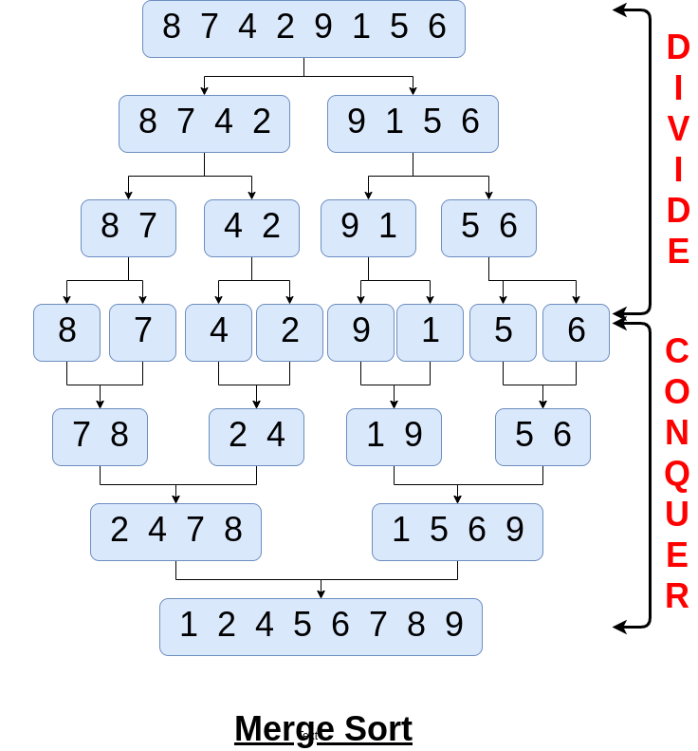
Department of Computer Engineering, VIIT, Pune-48

Slide 54
Merge Sort : Analysis
Mergesort works blindly while dividing, conquering and combining the solution. Order of elements in a instance is immaterial. Therefore there is no best, worst or average case and computation time remains same in all cases and it is stable.
The recurrence equation for mergesort is:
Time Complexity :
T(n) = 2 T(n/2) + n given that T(1) = 0
Replace n with 2^{i} reduces it to:
t_{i} = 2t_{i-1} + 2^{i}, char. equation is x² – 4x + 4 = 0 = (x-2)²
General solution is: t_{i} = c₁2^{i} + c₂.i.2^{i}
T(n) = c₁n + c₂.logn.n c₁ = 0 and c₂= 1
T(n) = O(nlog n) … best, worst and average case
Space Complexity :
O(logn) – space required for implicit stack (Recursive)
Department of Computer Engineering, VIIT, Pune-48

Slide 55
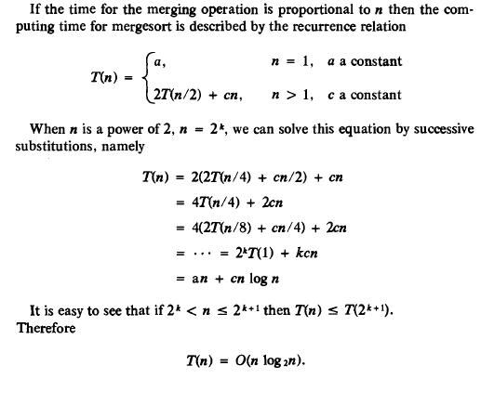
Department of Computer Engineering, VIIT, Pune-48

Slide 56
Divide and Conquer –Applications
Binary search
Merge sort
Quick sort
Finding convex hull
Algorithm for fast Fourier transform
Find the closest pair of points
Department of Computer Engineering, VIIT, Pune-48

Slide 57
Quick Sort
Basic step of Quick sort :
Generally 1st element is selected as pivot. Pivot is compared with the elements from 2nd position onwards until pivot ≥ i^{th} element in array. Then pivot is compared with elements starting from end of the partition backward until pivot ≤ j^{th} element.
Then i^{th} and j^{th} elements are interchanged if i < j, otherwise process is continued until i > j. Finally pivot and j^{th} elements are interchanged, thus positioning pivot at its final position in sorted output and dividing the input in two partitions [1: j-1] and [( j+1):n].
Same procedure is applied recursively to sort these partitions independently so that we get the final output in sorted order.
Quick sort is an example of Divide and Conquer strategy.
Department of Computer Engineering, VIIT, Pune-48

Slide 58
Given an array of n elements (e.g., integers):
If array contains only one element, return
Else
pick one element to use as pivot.
Partition elements into two sub-arrays:
Elements less than or equal to pivot
Elements greater than pivot
Quicksort two sub-arrays
Return results
Department of Computer Engineering, VIIT, Pune-48

Slide 59
Quick Sort
PARTITION(A, p, q) ⊳ A[p . . q]
x ← A[p] ⊳ pivot = A[p]
i ← p
for j ← p + 1 to q
do if A[j] ≤ x
then i ← i + 1
exchange A[i] ↔ A[j]
exchange A[p] ↔ A[i]
return i
Department of Computer Engineering, VIIT, Pune-48

Slide 60
QUICKSORT(A, p, r)
if p < r
then q ← PARTITION(A, p, r)
QUICKSORT(A, p, q–1)
QUICKSORT(A, q+1, r)
Initial call: QUICKSORT(A, 1, n)
As a Analysis of Quick Sort Same tree Will be applicable
T(n)=Θ(n lgn)
Department of Computer Engineering, VIIT, Pune-48

Slide 61
Quick Sort :
Algorithm partition (a, m, p)
// a[m:p] is a global array. 1st element in the array is a[m] and last
//element in the array is a[p-1] and a[p] ≥ a[m,…,p-1]. Pivot is
// the 1st element i.e. a[m]. After completion of algorithm it returns
// position where the pivot is placed in an array
{ v = a[m]; i = m; j = p
repeat
{ repeat
i = i +1;
until (a[i] ≥ v);
repeat
j = j -1;
until (a[j] ≤ v);
Department of Computer Engineering, VIIT, Pune-48

Slide 62
Quick Sort : Algorithm
Algorithm partition (a, m, p) … contd.
if (i < j)
{ p = a[i];
a[i] = a[j];
a[j] = p;
}
} until (i ≥ j);
a[m] = a[j]
a[j] = v;
return j;
}
Department of Computer Engineering, VIIT, Pune-48

Slide 63
Quick Sort : Algorithm
Algorithm quicksort (p, q)
// a[1:n+1] is global array. Sorts elements a[p], … , a[q] in
// non-decreasing order stored in array a[1:n]. a[n+1] is > all
// elements in a[1:n]
{ if (p < q) // there are more than 1 items
{ j = partition [a, p, q+1] // divides in two partitions
quicksort (p, j-1);
quicksort (j+1, q);
}
}
Department of Computer Engineering, VIIT, Pune-48

Slide 64
Quick Sort : Analysis
Best case : Every time partition is divided into two partitions of equal size. Recurrence equation for this is:
T(n) = 2T(n/2) + n given that T[1] = 0
Time complexity = O(nlog n) … refer merge sort
Space complexity is storage required for variables i, j, p, v and space required for implicit stack = O(log n)
Worst case : Instance is already in sorted order.
Recurrence equation for this is:
T(n) = T(n - 1) + n given that T[1] = 0
Time complexity = O(n²)
Space complexity is storage required for variables i, j, p, v and space required for implicit stack = O(n)
Department of Computer Engineering, VIIT, Pune-48

Slide 65
Quick Sort : Analysis
Average case : Any random input.
Average computation time is given by:
t(n) = (1/n) Σ (g(n) + t(k-1) + t(n - k))
^{1≤ k ≤ n}
where g(n) = time required to partition = O(n)
(1: k-1) and (k+1: n) are two partitions created and k can take value from 1 to n to consider all n possibilities
Time complexity = O(nlog n)
Space complexity is storage required for variables i, j, p, v and space required for implicit stack = O(n)
Note : QUICK SORT is not a STABLE one.
Department of Computer Engineering, VIIT, Pune-48

Slide 66
Complexity Analysis of Quick Sort
For an array, in which partitioning leads to unbalanced subarrays, to an extent where on the left side there are no elements, with all the elements greater than the pivot, hence on the right side.
And if keep on getting unbalanced subarrays, then the running time is the worst case, which is O(n²)
Where as if partitioning leads to almost equal subarrays, then the running time is the best, with time complexity as O(n*log n).
Worst Case Time Complexity [ Big-O ]: O(n²)
Best Case Time Complexity [Big-omega]: O(n*log n)
Average Time Complexity [Big-theta]: O(n*log n)
Space Complexity: O(n*log n)
Department of Computer Engineering, VIIT, Pune-48

Slide 67
Analysis Summary of Algorithms:
Algorithm | Case | Instance | Recurrence Equation | Time Complexity | Space Complexity
Binary Search | Best | Middle element | T(n) = 1 | O(1) | Rec:O(logn) Iter: O(1)
 | Worst | Last Element | T(n) = T(n/2) + 1 | O(logn)
 | Average | All elements | As = (1+1/n) Au -1 | O(logn)
Quick Sort | Best | Pivot at middle | T(n) = 2T(n/2) + n | O(nlogn) | Rec:O(logn) Iter: O(1)
 | Worst | Already sorted | T(n) = T(n-1) + n | O(n²) | Rec:O(n) Iter: O(1)
 | Average | All permutations | T(n) ≤ dn + 2Σ t(k)/n ^{0<= k<= n} | O(logn) | Rec:O(logn) Iter: O(1)
Merge Sort | Best | Any Input | T(n) = 2T(n/2) + n | O(nlonn) | Rec:O(logn) Iter: O(1)
 | Worst
 | Average
Department of Computer Engineering, VIIT, Pune-48

Slide 68
Exponentiation Greedy Method: General Strategy
Among all the algorithmic approaches, the simplest approach is the Greedy method. In this approach, the decision is taken on the basis of current available information without worrying about the effect of the current decision in future.
Greedy algorithms build a solution part by part, choosing the next part in such a way, that it gives an immediate benefit. This approach never reconsiders the choices taken previously.
This approach is mainly used to solve optimization problems. Greedy method is easy to implement and quite efficient in most of the cases. It follows local optimal choice at each step with the hope of finding global optimal solution.
In many problems, it does not produce an optimal solution though it gives an approximate (near optimal) solution in a reasonable time.
Department of Computer Engineering, VIIT, Pune-48

Slide 69
Greedy strategy :
Greedy method is perhaps the most straightforward design technique for solving problems, in which optimum (min. or max.) solution is desired from the given input.
Characteristics :
There are ‘n’ inputs
Objective is to find out a subset that satisfies some constraints
Any subset that satisfies these constraints is called a feasible solution
We need to find out a feasible solution that either minimizes or maximizes a given objective function
There is usually an obvious way to determine a feasible solution but not necessarily an optimal solution
Examples : Knapsack problem, Job sequencing with deadlines, Optimal Merge Patterns, Minimum Spanning Trees (Prim and Kruskal) and Shortest path problem (Dijkstra’s algorithm).
Department of Computer Engineering, VIIT, Pune-48

Slide 70
Greedy strategy : Algorithm Design
Greedy algorithm works in stages, considering one input at a time.
At each stage a decision is made regarding whether a particular input is a part of an optimal solution (Partial Optimal Solution).
Selection procedure is used to consider a particular input , and if the inclusion of selected input into the partially constructed optimal solution will result in feasible solution then this input is included in the partial solution, otherwise it is not included into partially constructed solution.
Selection procedure itself is based on some optimization measure and this measure may be the objective function.
Department of Computer Engineering, VIIT, Pune-48

Slide 71
Greedy strategy : General Template
Algorithm greedy (a, n)
// array a[1:n] contains ‘n’ inputs
{ solution = Φ; // initialize the solution set
for i = 1 to n do
{ x = SELECT (a);
if FEASIBLE (solution, x) then
solution = UNION (solution, x):
}
return (solution);
}
Department of Computer Engineering, VIIT, Pune-48

Slide 72
The function SELECT selects an input from A, removes it and assigns its value to x.
FEASIBLE is a Boolean-valued function which determines if x can be included into the solution vector.
UNION actually combines x with solution and updates the objective function.
Procedure GREEDY describes the essential way that a greedy based algorithm will look, once a particular problem is chosen and the procedures SELECT, FEASIBLE and UNION are properly implemented.
Department of Computer Engineering, VIIT, Pune-48

Slide 73
Components of Greedy Algorithm
Greedy algorithms have the following five components −
A candidate set − A solution is created from this set.
A selection function − Used to choose the best candidate to be added to the solution.
A feasibility function − Used to determine whether a candidate can be used to contribute to the solution.
An objective function − Used to assign a value to a solution or a partial solution.
A solution function − Used to indicate whether a complete solution has been reached.
Department of Computer Engineering, VIIT, Pune-48

Slide 74
The problems have n inputs and require us to obtain a subset that satisfies some constraints.
Any subset that satisfies these constraints is called a feasible solution. We are required to find a feasible solution that either maximizes or minimizes a given objective function.
A feasible solution that does this is called an optimal solution. There is usually an obvious way to determine a feasible solution, but not necessarily an optimal solution.
The greedy method suggests that one can devise an algorithm which works in stages, considering one input at a time.
Department of Computer Engineering, VIIT, Pune-48

Slide 75
At each stage, a decision is made regarding whether or not a particular input is in an optimal solution.
This is done by considering the inputs in an order determined by some selection procedure.
If the inclusion of the next input into the partially constructed optimal solution will result in an infeasible solution, then this input is not added to the partial solution.
The selection procedure itself is based on some optimization measure. This measure may or may not be the objective function.
Department of Computer Engineering, VIIT, Pune-48

Slide 76
Areas of Application
Greedy approach is used to solve many problems, such as
Finding the shortest path between two vertices using Dijkstra’s algorithm.
Finding the minimal spanning tree in a graph using Prim’s /Kruskal’s algorithm, etc.
Where Greedy Approach Fails
In many problems, Greedy algorithm fails to find an optimal solution, moreover it may produce a worst solution. Problems like Travelling Salesman and Knapsack cannot be solved using this approach.
Department of Computer Engineering, VIIT, Pune-48

Slide 77
Examples
The vehicle routing problem (VRP)
A number of goods need to be moved from certain pickup locations to other delivery locations. The goal is to find optimal routes for a fleet of vehicles to visit the pickup and drop-off locations.
Travelling salesman problem
Given a list of cities and their pair wise distances, the task is to find a shortest possible tour that visits each city exactly once.
Coin Change
(making change for n $ using minimum number of coins)
The knapsack problem
The Shortest Path Problem
Department of Computer Engineering, VIIT, Pune-48

Slide 78
Greedy strategy : Knapsack Problem
Problem Statement : We are given ‘n’ objects and a knapsack or a bag. Object ‘i’ has a weight w_{i}, 1≤i≤n, and the knapsack has a capacity ‘m’ (maximum weight the knapsack can hold). If a fraction x_{i}, 0≤x_{i}≤1, of object x_{i} is placed into the knapsack then a profit of p_{i}x_{i} is earned. The objective is to obtain a filling of the knapsack that maximizes the total profit earned. Since the knapsack capacity is ‘m’, total weight of chosen objects should not exceed ‘m’. Profits and weights are positive numbers
Mathematical Model of Knapsack Problem :
maximize Σ p_{i}x_{i} …….. (1)
^{1≤ i≤ n}
subject to Σ w_{i}x_{i} ≤ m …….. (2)
^{1≤ i≤ n}
0≤x_{i}≤1, 1≤i≤n ..….…(3)
p_{i} ≥ 0, w_{i}≥0 .……..(4)
Department of Computer Engineering, VIIT, Pune-48

Slide 79
Greedy strategy : Knapsack Problem
Algorithm knapsack (w, p, n, m)
// w and p are arrays of size ‘n’ containing weights and profits of each object respectively. ‘m’ is the capacity of the knapsack. Objects are sorted in non-increasing order of pi / wi , 1 ≤ i ≤ n.
{ for i = 1 to n do
x[i] = 0;
weight = 0;
while weight < m do // greedy loop
{ i = the best remaining objects // selection criteria
if (weight + w[i]) ≤ m
{ x[i] = 1;
weight = weight + w[i];}
else {x[i] = (m – weight) / w[i]; weight = m;}
}
return x; // x is an array of size ‘n’
}
Department of Computer Engineering, VIIT, Pune-48

Slide 80
Greedy strategy : Knapsack Problem
Selection Criteria for selecting the best from remaining objects
Most profitable object from the remaining objects
Lightest object from the remaining objects – slow filling of knapsack so that maximum number of objects get selected
Highest profit / unit weight object from the remaining objects
For example, let n = 5 and m = 100
OBJECTS |  |  |  | GREEDY BY
i | w_{i} | p_{i} | p_{i} / w_{i} | Profit | weight | p_{i} / w_{i}
1 | 10 | 20 | 2.0 |  | 1 | 1
2 | 20 | 30 | 1.5 |  | 1 | 1
3 | 30 | 66 | 2.2 | 1 | 1 | 1
4 | 40 | 40 | 1.0 | 0.5 | 1
5 | 50 | 60 | 1.2 | 1 |  | 0.8
TOTAL WEIGHT |  |  |  | 100 | 100 | 100
TOTAL PROFIT EARNED |  |  |  | 146 | 156 | 164
Department of Computer Engineering, VIIT, Pune-48

Slide 81
Selection Criteria for selecting the best remaining objects … contd.
“If objects are selected in non-increasing order of p_{i} / w_{i} , then
algorithm knapsack finds an optimal solution”.
Analysis of Algorithm knapsack :
To sort the objects in non-increasing order of p_{i} / w_{i} ,
computation time = O(nlogn)
2. While loop will be executed ‘n’ times in worst case, so the computation time = O(n)
3. Time complexity = O(nlogn)
4. Space complexity = c + space required for x[1:n] = O(n)
Department of Computer Engineering, VIIT, Pune-48

Slide 82
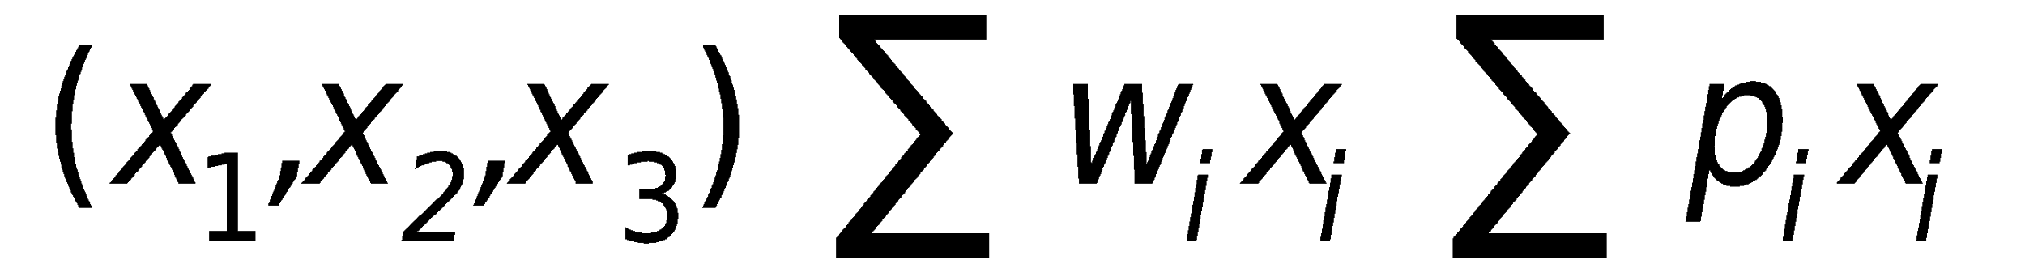
Refrence Horowitz & Sahani
Example
n=3, m=20, (p₁,p₂,p₃)=(25,24,15), (w₁,w₂,w₃)=(18,15,10)
1. (1/2, 1/3, 1/4) 16.5 24.25
2. (1, 2/15, 0) 20 28.2
3. (0, 2/3, 1) 20 31
4. (0, 1, 1/2) 20 31.5
Lemma 4.1
In case the sum of all the weights is ≤ m, then x_{i} = 1, 1 ≤ i ≤ n is an optimal solution.
Lemma 4.2
All optimal solutions will fill the knapsack exactly. Knapsack problem fits the subset paradigm
Department of Computer Engineering, VIIT, Pune-48
Notes:
82
82
82

Slide 83
Knapsack Algorithm
E.g. n=7, w1……w7 = 2,3,5,7,1,4,1
p1…….p7 = 10,5,15,7,6,18,3 M=15
Note: Give priority to weights having greater p/w ratio.
P1/w1 = 10/2 = 5, p2/w2 = 5/3 = 1.66
P3/w3 = 15/5 = 3, p4/w4 = 7/7 = 1
P5/w5 = 6/1 = 6, p6/w6 = 18/4 = 4.5
P7/w7 = 3/1 = 3.
6+10+18+15+3+2/3*5 = 55.33
Optimal solution: (1,2/3,0,1,1,1,1)
Note:
if p₁/w₁ >= p₂/w₂ >= p₃/w₃…>= p_{n}/w_{n} .i.e. inputs are already in this form then no need of sorting.
Therefore best time complexity = n.
If inputs are not sorted as stated above then,
Time complexity = nlog₂n
Therefore complexity of Greedy knapsack = nlogn
Design and Analysis of Algorithms
83
Department of Computer Engineering, VIIT, Pune-48
Notes:
83
83
83

Slide 84
Greedy strategy : Job Scheduling with Deadlines
Problem :
We have a set of ‘n’ jobs to execute, each of which takes one unit of time. At any time T = 1,2, … we can execute exactly one job. Job i earns us a profit g_{i} > 0 if and only if it is executed no later than deadline d_{i}. Problem is to find the job sequence which will earn us maximum profit.
Example :
Let n = 4 and the values of profits and deadlines are,
jobs | i | 1 | 2 | 3 | 4
profits | g_{i} | 50 | 10 | 15 | 30
deadline | d_{i} | 2 | 1 | 2 | 1
SEQ | 1 | 2 | 3 | 4 | 1 , 3 | 2 , 1 | 2 , 3 | 3 , 1 | 4 , 1 | 4 , 3
PROFIT | 50 | 10 | 15 | 30 | 65 | 60 | 25 | 65 | 80 | 45
Department of Computer Engineering, VIIT, Pune-48

Slide 85
Greedy strategy : Job Scheduling with Deadlines
Feasible Sequences :
All other possible sequences are infeasible, and the feasible sequence 4, 1 earns us maximum profit. To maximize a profit in this example, we should execute the schedule 4, 1. i.e. job 4 is executed at time t = 1 (its deadline = 1) and job 1 would be executed at time t = 2 (its deadline = 2).
Lemma : Let J be a set of k jobs and without loss of generality, jobs are numbered so that d₁ ≤ d₂ ≤ … ≤ d_{k}. Then the set J is feasible if and only if the sequence 1, 2, … , k is feasible. Proof
Department of Computer Engineering, VIIT, Pune-48

Slide 86
Greedy strategy : Job Scheduling with Deadlines
Algorithm Sequence1 : Refer T-1 for detailed pseudo code
Arrange the jobs in non-increasing order of profits
Generate the sequence by adding one job at a time in the schedule
Check the sequence selected so far for its feasibility.
If the schedule is not feasible then reject the job, otherwise add the selected job in schedule i.e. J = J U {j}
Repeat steps 2 thru 4 for all jobs in J
Set J contains the solution.
Example :
Jobs | i | 1 | 2 | 3 | 4 | 5 | 6
Profit | g_{i} | 20 | 15 | 10 | 7 | 5 | 3
Deadlines | d_{i} | 3 | 1 | 1 | 3 | 1 | 3
Department of Computer Engineering, VIIT, Pune-48

Slide 87
Greedy strategy : Job Scheduling with Deadlines
Algorithm Sequence1 :
Analysis :
Sorting of jobs in non-increasing order of profits will take O(nlogn) time
In worst case to check feasibilty and insertion of job in schedule obtained so far will take total O(n²) time
Time complexity = O(n²)
Space complexity = O(n)
Department of Computer Engineering, VIIT, Pune-48

Slide 88
Algorithm Sequence2 : Refer T-1 for detailed pseudo code
A more efficient (fast) algorithm is possible if we use different technique to verify whether a given set is feasible.
Lemma : A set of ‘n’ jobs J is feasible if and only if we can construct a feasible sequence including all the jobs in J as follows. Start with an empty schedule of length n, then for each job i € J in turn, schedule i at time t, where t is the largest integer such that 1≤ t ≤ min(n, d_{i}) and the job to be executed at time t is not yet decided.
Example : Consider the same example solved using sequenc1 algorithm and apply the above lemma to solve the same.
Department of Computer Engineering, VIIT, Pune-48

Slide 89
Algorithm Sequence2 :
Analysis :
Sorting of jobs in non-increasing order of profits will take O(nlogn) time
At most 2n find and n merge operations required = O(n)
Time complexity = O(nlogn)
Space complexity = O(n)
Department of Computer Engineering, VIIT, Pune-48

Slide 90
Greedy strategy : Optimal Merge Patterns
To merge two sorted files of size ‘m’ and ‘n’ records takes time of the order O(m+n). When more than two sorted files are to be merged together, the merge can be obtained by repeatedly merging sorted files in pairs.
For example, let x₁ , x₂ and x₃ be three sorted files of size 30, 20 & 10 records respectively. We can do this in three ways:
(x₁ + x₂) + x₃ = (30+20) + (30+20) + 10 = 110 moves
(x₁ + x₃) + x₂ = (30+10) + (30+10) + 20 = 100 moves
(x₂ + x₃) + x₁ = (20+10) + (20+10) + 30 = 90 moves
In above example 3rd merge pattern is the fastest and optimal. It is
easy to obtain an optimal merge of minimal moves.
“At each step merge the two smallest size files together”.
Example : Construct two way optimal merge tree for the 5 sorted
files, (x₁, x₂, x₃, x₄, x₅) with size (20, 30, 10, 5, 30).
Department of Computer Engineering, VIIT, Pune-48

Slide 91
Optimal merge patterns
Two sorted files containing n & m records respectively could be merged together to obtain one sorted file in time O(n+m).
When more than two sorted files are to be merged together, the merge can be accomplished by repeatedly merging sorted files in pairs.
Thus if x1,x2,x3 & x4 are to be merged then we could first merge x1 & x2 to get file y1, then y1 & x3 to get y2 & finally y2 & x4 to get the desired sorted file.
We could also merge y1 & y2 & get desired sorted file.
Thus for n sorted files, different pairings require differing amounts of computing time.
Thus the problem we address here is that of determining an optimal way (one requiring the fewest comparisons) to pairwise merge n sorted files.
Department of Computer Engineering, VIIT, Pune-48
Notes:
91
91
91

Slide 92
Optimal Merge Patterns
E.g. Files x1,x2 & x3 are three sorted files of length 30,20 & 10 records each.
Merging x1 & x2 requires 50 record moves.
Merging the result with x3 requires another 60 moves.
The total no. of record moves required to merge the three files is 110.
Thus if we first merge x2 & x3 (taking 30 moves) & then x1 (taking 60 moves), the total record moves made is only 90. Hence, the second merge pattern is faster than the first.
Since merging an n-record file & m-record file requires possibly n+m record moves, the obvious choice for a selection criteria is at each step merge the two smallest size files together.
92
Department of Computer Engineering, VIIT, Pune-48
Notes:
92
92
92

Slide 93
Optimal Merge Patterns
55
25
30
10
15
x= 10 , y= 30 , z= 15
Sum of internal nodes:
OMP= 25+55 = 80
Design and Analysis of Algorithms
93
Department of Computer Engineering, VIIT, Pune-48
Notes:
93
93
93

Slide 94
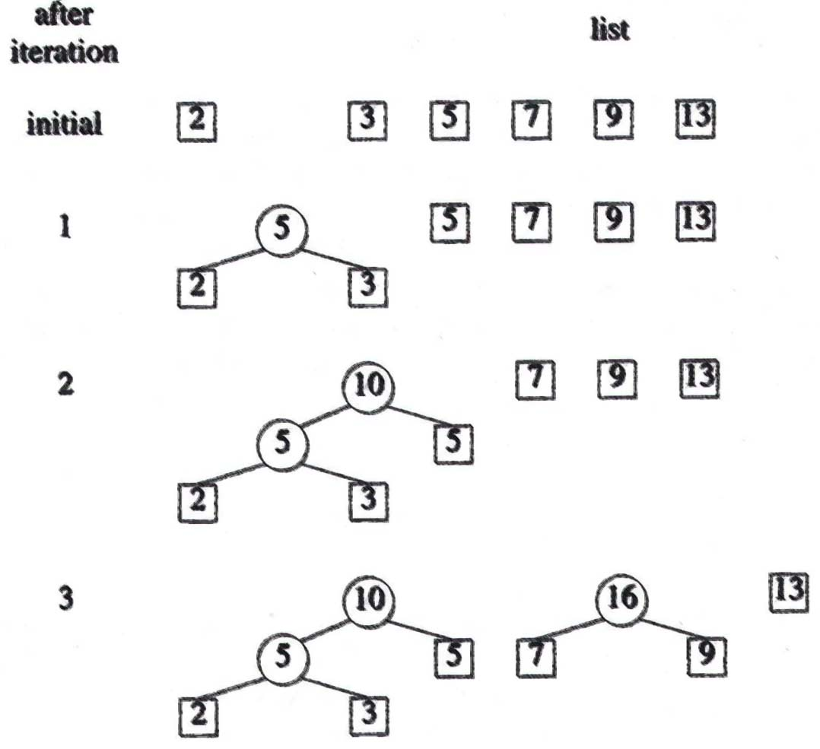
Optimal Merge Patterns
Design and Analysis of Algorithms
Department of Computer Engineering, VIIT, Pune-48
Notes:
94
94
94

Slide 95
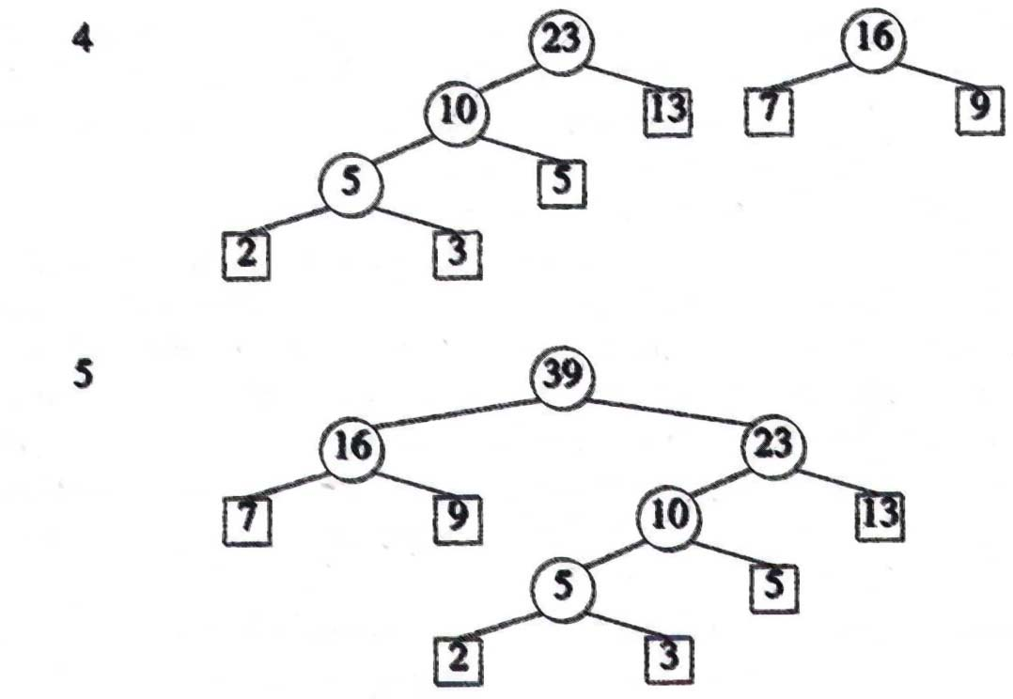
Optimal Merge Patterns
Time
If list is kept in nondecreasing order: O(n2)
If list is represented as a minheap: O(n log n)
Design and Analysis of Algorithms
Department of Computer Engineering, VIIT, Pune-48
Notes:
95
95
95

Slide 96
Huffman code generation algorithm
Huffman coding is a lossless data compression algorithm. In this algorithm, a variable-length code is assigned to input different characters.
The code length is related to how frequently characters are used. Most frequent characters have the smallest codes and longer codes for least frequent characters.
There are mainly two parts. First one to create a Huffman tree, and another one to traverse the tree to find codes.
For an example, consider some strings “YYYZXXYYX”, the frequency of character Y is larger than X and the character Z has the least frequency. So the length of the code for Y is smaller than X, and code for X will be smaller than Z.
Department of Computer Engineering, VIIT, Pune-48

Slide 97
Basics : Huffman codes
Huffman codes are codes for CHARACTER ENCODING data files for compression
Data is considered as a sequence of characters
It is an OPTIMAL encoding scheme
Huffman codes compress data very effectively: savings of 20% to 90% are typical results.
Purpose: Proposed by Dr. David A. Huffman in 1952
“A Method for the Construction of Minimum Redundancy Codes”
Applicable to many forms of data transmission
Our example: text files
Department of Computer Engineering, VIIT, Pune-48

Slide 98
The (Real) Basic Algorithm
1. Scan text to be compressed and tally occurrence of all characters.
2. Sort or prioritize characters based on number of occurrences in text.
3. Build Huffman code tree based on prioritized list.
4. Perform a traversal of tree to determine all code words.
5. Scan text again and create new file using the Huffman codes.
Department of Computer Engineering, VIIT, Pune-48

Slide 99
Huffman code construction
In the pseudocode that follows in next slide:
C =set of n characters .
Each character c belonging to C has c.freq associated with it, giving its frequency.
Algorithm builds tree T in a bottom-up manner corresponding to the optimal code.
It begins with a set of |C| leaves and performs a sequence of |C|- 1 “merging” operations to create the final tree.
The algorithm uses a min-priority queue Q, keyed on the freq attribute, to identify the two least-frequent objects to merge together.
When we merge two objects, the result is a new object whose frequency is the sum of the frequencies of the two objects that were merged.
Department of Computer Engineering, VIIT, Pune-48

Slide 100
Algorithm: Huffman Code Generation
HUFFMAN(C)
1 n =|C|
2 Q = C
3 for i = 1 to n - 1
4 allocate a new node z
5 z.left = x = EXTRACT-MIN(Q)
6 z.right = y =EXTRACT-MIN(Q)
7 z.freq = x.freq + y.freq
8 INSERT(Q,z)
9 return EXTRACT-MIN(Q) // return the root of the tree
Department of Computer Engineering, VIIT, Pune-48

Slide 101
Building a Tree Scan the original text
Consider the following short text:
Eerie eyes seen near lake.
Count up the occurrences of all characters in the text
Department of Computer Engineering, VIIT, Pune-48

Slide 102
Building a Tree Scan the original text
Eerie eyes seen near lake.
What characters are present?
E e r i space
y s n a r l k .
Department of Computer Engineering, VIIT, Pune-48

Slide 103
Building a Tree Scan the original text
Eerie eyes seen near lake.
What is the frequency of each character in the text?
Char Freq. Char Freq. Char Freq.
E 1 y 1 k 1
e 8 s 2 . 1
r 2 n 2
i 1 a 2
space 4 l 1
Department of Computer Engineering, VIIT, Pune-48

Slide 104
Building a Tree Prioritize characters
Create binary tree nodes with character and frequency of each character
Place nodes in a priority queue
The lower the occurrence, the higher the priority in the queue
Department of Computer Engineering, VIIT, Pune-48

Slide 105
Building a Tree
Enqueue priority queue with all characters, as per frequency count.
While priority queue contains two or more nodes
Create new node
Dequeue node and make it left subtree
Dequeue next node and make it right subtree
Frequency of new node equals sum of frequency of left and right children
Enqueue new node back into queue

Slide 106
Building a Tree
The queue after inserting all nodes
Null Pointers are not shown
E
1
i
1
y
1
l
1
k
1
.
1
r
2
s
2
n
2
a
2
sp
4
e
8
Department of Computer Engineering, VIIT, Pune-48

Slide 107
Building a Tree
While priority queue contains two or more nodes
Create new node
Dequeue node and make it left subtree
Dequeue next node and make it right subtree
Frequency of new node equals sum of frequency of left and right children
Enqueue new node back into queue
Department of Computer Engineering, VIIT, Pune-48

Slide 108
Building a Tree
E
1
i
1
y
1
l
1
k
1
.
1
r
2
s
2
n
2
a
2
sp
4
e
8
Department of Computer Engineering, VIIT, Pune-48

Slide 109
Building a Tree
y
1
l
1
k
1
.
1
r
2
s
2
n
2
a
2
sp
4
e
8
2
E
1
i
1
Department of Computer Engineering, VIIT, Pune-48

Slide 110
Building a Tree
y
1
l
1
k
1
.
1
r
2
s
2
n
2
a
2
2
sp
4
e
8
E
1
i
1
Department of Computer Engineering, VIIT, Pune-48

Slide 111
Building a Tree
k
1
.
1
r
2
s
2
n
2
a
2
2
sp
4
e
8
E
1
i
1
2
y
1
l
1
Department of Computer Engineering, VIIT, Pune-48

Slide 112
Building a Tree
k
1
.
1
r
2
s
2
n
2
a
2
2
2
sp
4
e
8
y
1
l
1
E
1
i
1
Department of Computer Engineering, VIIT, Pune-48

Slide 113
Building a Tree
r
2
s
2
n
2
a
2
2
2
sp
4
e
8
y
1
l
1
E
1
i
1
2
k
1
.
1
Department of Computer Engineering, VIIT, Pune-48

Slide 114
Building a Tree
r
2
s
2
n
2
a
2
2
2
sp
4
e
8
2
E
1
i
1
y
1
l
1
k
1
.
1
Department of Computer Engineering, VIIT, Pune-48

Slide 115
Building a Tree
n
2
a
2
2
sp
4
e
8
2
2
E
1
i
1
y
1
l
1
k
1
.
1
4
r
2
s
2
Department of Computer Engineering, VIIT, Pune-48

Slide 116
Building a Tree
n
2
a
2
2
sp
4
e
8
2
2
4
E
1
i
1
y
1
l
1
k
1
.
1
r
2
s
2
Department of Computer Engineering, VIIT, Pune-48

Slide 117
Building a Tree
2
4
e
8
2
2
sp
4
y
1
l
1
k
1
.
1
r
2
s
2
E
1
i
1
4
n
2
a
2
Department of Computer Engineering, VIIT, Pune-48

Slide 118
Building a Tree
2
4
4
e
8
2
2
sp
4
y
1
l
1
k
1
.
1
r
2
s
2
n
2
a
2
E
1
i
1
Department of Computer Engineering, VIIT, Pune-48

Slide 119
Building a Tree
4
4
e
8
2
sp
4
k
1
.
1
r
2
s
2
n
2
a
2
4
2
2
E
1
i
1
y
1
l
1
Department of Computer Engineering, VIIT, Pune-48

Slide 120
Building a Tree
2
4
4
4
sp
4
e
8
2
2
k
1
.
1
r
2
s
2
n
2
a
2
E
1
i
1
y
1
l
1
Department of Computer Engineering, VIIT, Pune-48

Slide 121
Building a Tree
4
4
4
e
8
2
2
r
2
s
2
n
2
a
2
E
1
i
1
y
1
l
1
6
2
sp
4
k
1
.
1
Department of Computer Engineering, VIIT, Pune-48

Slide 122
Building a Tree
4
4
4
6
e
8
2
sp
4
r
2
s
2
n
2
a
2
2
2
k
1
.
1
E
1
i
1
y
1
l
1
What is happening to the characters with a low number of occurrences?
Department of Computer Engineering, VIIT, Pune-48

Slide 123
Building a Tree
4
6
e
8
2
2
2
sp
4
E
1
i
1
y
1
l
1
k
1
.
1
8
4
4
r
2
s
2
n
2
a
2
Department of Computer Engineering, VIIT, Pune-48

Slide 124
Building a Tree
4
6
e
8
8
2
2
2
sp
4
4
4
E
1
i
1
y
1
l
1
k
1
.
1
r
2
s
2
n
2
a
2
Department of Computer Engineering, VIIT, Pune-48

Slide 125
Building a Tree
e
8
8
4
4
10
r
2
s
2
n
2
a
2
4
6
2
2
2
sp
4
E
1
i
1
y
1
l
1
k
1
.
1
Department of Computer Engineering, VIIT, Pune-48

Slide 126
Building a Tree
e
8
8
10
4
4
4
6
n
2
a
2
2
2
2
r
2
s
2
sp
4
E
1
i
1
y
1
l
1
k
1
.
1
Department of Computer Engineering, VIIT, Pune-48

Slide 127
Building a Tree
10
16
4
6
2
2
2
e
8
8
sp
4
E
1
i
1
y
1
l
1
k
1
.
1
4
4
r
2
s
2
n
2
a
2
Department of Computer Engineering, VIIT, Pune-48

Slide 128
Building a Tree
10
16
4
6
e
8
8
2
2
2
sp
4
4
4
E
1
i
1
y
1
l
1
k
1
.
1
r
2
s
2
n
2
a
2
Department of Computer Engineering, VIIT, Pune-48

Slide 129
Building a Tree
26
16
10
4
e
8
8
6
2
2
2
sp
4
4
4
E
1
i
1
y
1
l
1
k
1
.
1
r
2
s
2
n
2
a
2
Department of Computer Engineering, VIIT, Pune-48

Slide 130
Building a Tree
After enqueueing this node there is only one node left in priority queue.
26
16
10
4
e
8
8
6
2
2
2
sp
4
4
4
E
1
i
1
y
1
l
1
k
1
.
1
r
2
s
2
n
2
a
2
Department of Computer Engineering, VIIT, Pune-48

Slide 131
Building a Tree
Dequeue the single node left in the queue.
This tree contains the new code words for each character.
Frequency of root node should equal number of characters in text.
26
16
10
4
e
8
8
6
2
2
2
4
sp
4
4
E
1
i
1
y
1
l
1
k
1
.
1
r
2
s
2
n
2
a
2
Eerie eyes seen near lake.  26 characters
Department of Computer Engineering, VIIT, Pune-48

Slide 132
Encoding the File Traverse Tree for Codes
Perform a traversal of the tree to obtain new code words
Going left is a 0 going right is a 1
code word is only completed when a leaf node is reached
26
16
10
4
e
8
8
6
2
2
2
4
sp
4
4
E
1
i
1
y
1
l
1
k
1
.
1
r
2
s
2
n
2
a
2
Department of Computer Engineering, VIIT, Pune-48

Slide 133
Encoding the File Traverse Tree for Codes
Char Code
E 0000
i 0001
y 0010
l 0011
k 0100
. 0101
space 011
e 10
r 1100
s 1101
n 1110
a 1111
26
16
10
4
e
8
8
6
2
2
2
4
sp
4
4
E
1
i
1
y
1
l
1
k
1
.
1
r
2
s
2
n
2
a
2
Department of Computer Engineering, VIIT, Pune-48

Slide 134
Encoding the File
Char Code
E 0000
i 0001
y 0010
l 0011
k 0100
. 0101
space 011
e 10
r 1100
s 1101
n 1110
a 1111
Rescan text and encode file using new code words
Eerie eyes seen near lake.
0000101100000110011100010101101101001111101011111100011001111110100100101
Why is there no need for a separator character?
.
Department of Computer Engineering, VIIT, Pune-48

Slide 135
Encoding the File Results
Have we made things any better?
73 bits to encode the text
ASCII would take 8 * 26 = 208 bits
0000101100000110011100010101101101001111101011111100011001111110100100101
If modified code used 4 bits per
character are needed. Total bits
4 * 26 = 104. Savings not as great.
Department of Computer Engineering, VIIT, Pune-48

Slide 136
Decoding the File
How does receiver know what the codes are?
Tree constructed for each text file.
Considers frequency for each file
Big hit on compression, especially for smaller files
Tree predetermined
based on statistical analysis of text files or file types
Data transmission is bit based versus byte based
Department of Computer Engineering, VIIT, Pune-48

Slide 137
Decoding the File
Once receiver has tree it scans incoming bit stream
0 ⇒ go left
1 ⇒ go right
26
16
10
4
e
8
8
6
2
2
2
4
sp
4
4
10100011011110111101111110000110101
E
1
i
1
y
1
l
1
k
1
.
1
r
2
s
2
n
2
a
2
Department of Computer Engineering, VIIT, Pune-48

Slide 138
Summary of Huffman Coding
Huffman coding is a technique used to compress files for transmission
Uses statistical coding
more frequently used symbols have shorter code words
Works well for text and fax transmissions
An application that uses several data structures
Department of Computer Engineering, VIIT, Pune-48

Slide 139
References
1) Merge sort Example:-
https://afteracademy.com/blog/divide-and-conquer-approach-in-programming.
2)Huffman Code Generation
www.utdallas.edu › ~daescu › huffman
3) Tutorial Point https://www.tutorialspoint.com/design_and_analysis_of_algorithms/index.htm
Department of Computer Engineering, VIIT, Pune-48

Slide 140
Related outcomes
Outcome
Formulate a problem and analyse the asymptotic performance of algorithms
Department of Computer Engineering, VIIT, Pune-48

Slide 141
Thank You
Department of Computer Engineering, VIIT, Pune-48

