Slide 1

20
Unified Inbox Platform
-Attack Capital
ANKIT RAWAT
ankit2001rawat@gmail.com

Slide 2
Problem Statement – Why this POC is needed.
Solution Overview – High-level idea.
How It Works (3-Tier Architecture) – Flow & process.
Benefits & Next Steps – Why it matters and what’s next.
AGENDA
01
Solution Overview
02
High Level Architecture
03
Further improvement
04
Demo

Slide 3
SOLUTION OVERVIEW
Build a unified communication platform using Next.js that aggregates messages from SMS (Twilio), WhatsApp (Twilio API),(optional email, and social media (e.g., Twitter/X, Facebook Messenger)) into a single inbox.

Slide 4
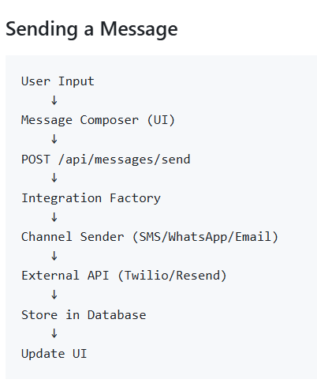
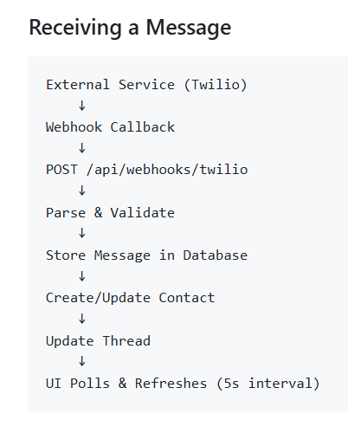
HIGH LEVEL ARCHITECTURE

Slide 5
FURTHER IMPROVEMENTS
Real time engagement with Websocket
Incorporate analytics: Track engagement metrics like open rates, response times, and conversion funnels in a dashboard.
Schedule Automations (CRON Jobs) and attach file (store in AWS S3 Bucket)

Slide 6

https://main.d3obozl55frgfu.amplifyapp.com/
DEMO TIME

Slide 7
THANK YOU
Email
Website
https://ankit2001rawat@gmail.com
https://ankitrawat.cloud

