Slide 1
R You Ready for Some R & R?: An Intro to R Programming & Data Analysis
Laura Walker
Northeast Association for Institutional Research
Tools to See Workshop Series
July 28, 2020

Slide 2
Why R?
Started working with R in 2016
The work I need to do can not be done in Excel.
Getting data from various sources
Cleaning the data
Transforming the data
Communicate inferences
Plus—it’s free!

Slide 3
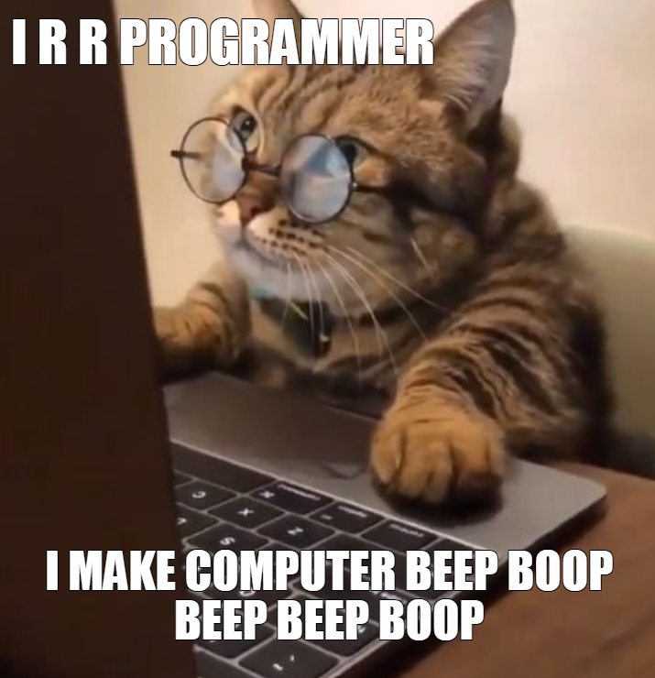
Learning Outcomes & Outline
Become familiar with the R environment and customize it
Load data into the R environment from the computer and internet.
Perform a variety of analytic functions on IPEDS data
Renaming
Rearranging
Sorting
Filtering
Creating new variables
Summarizing

Slide 4
Software
You’ll need BOTH of these software:
R for Statistical Computing
RStudio Desktop
For this session, we’ll primarily use RStudio.
Why both?
R for Statistical Computing allows RStudio to run.
RStudio is an integrated development environment (IDE) that provides a more user-friendly way to code in R.
https://moderndive.com/1-getting-started.html

Slide 5
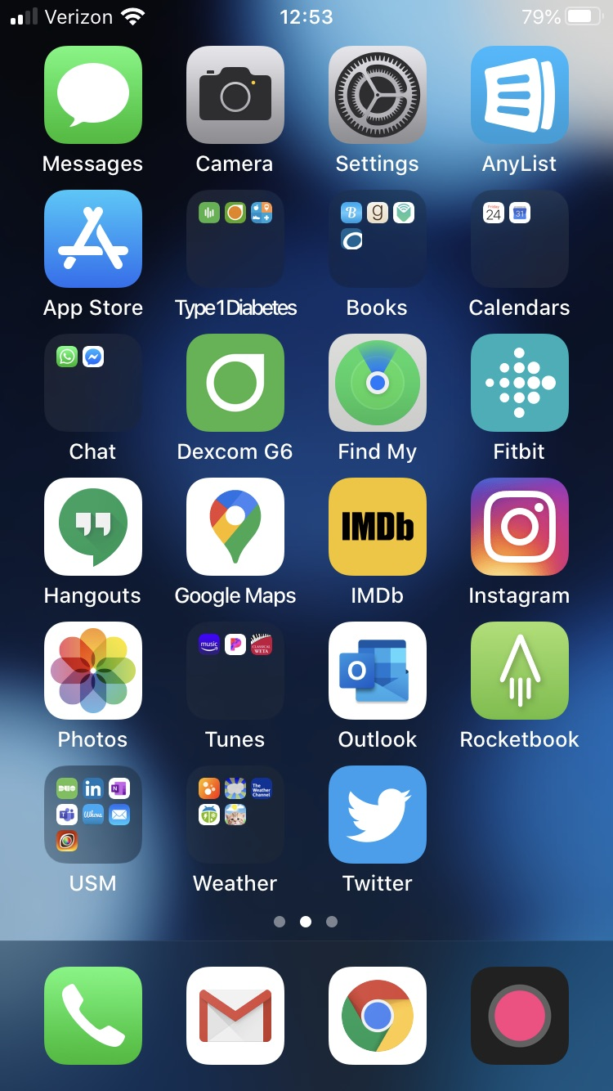
R Packages
Think of packages like we may think of apps on our cell phones.
RStudio is the cell phone.
Packages are its apps.
Packages have a similar focus:
Manipulating Data
dplyr– Allows us to subset, summarize, rearrange and join datasets.
Visualizing Data
ggplot2—Allows us to create impressive graphics after analysis is conducted
Reporting Results
RMarkdown—Allows you to store reproducible code and can produce Word, PDF

Slide 6
R Files
Two types of files beginners often create:
R scripts
Rmarkdowns
Why?
Personal preference—chunks
Reproducible
“Knitting” the file together to get HTML, MS Word, PDF, etc.

Slide 7
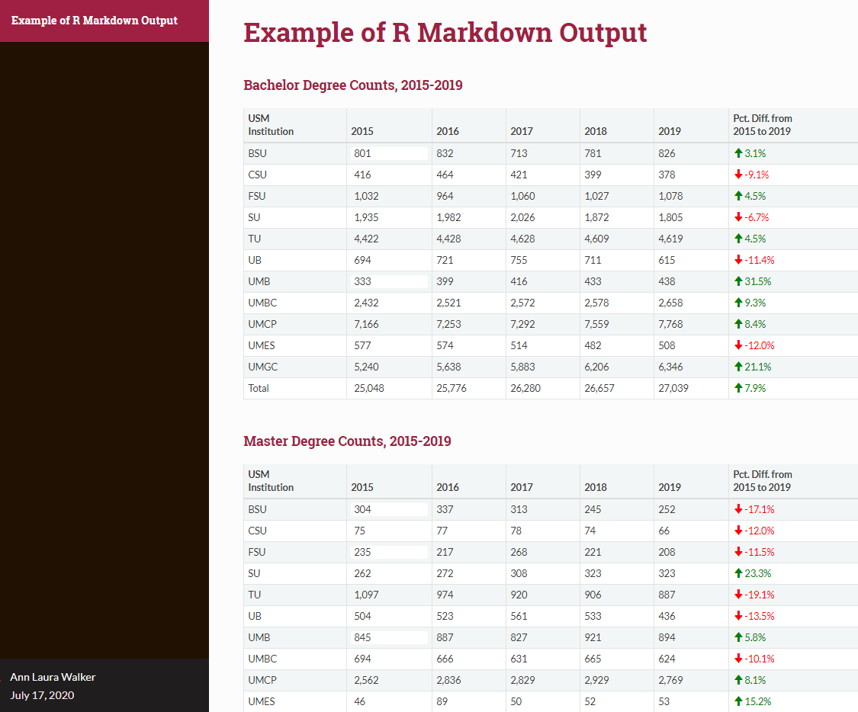
Data were extracted from: https://www.usmd.edu/IRIS/DataJournal/Degrees/?report=Degrees-Awarded

Slide 8
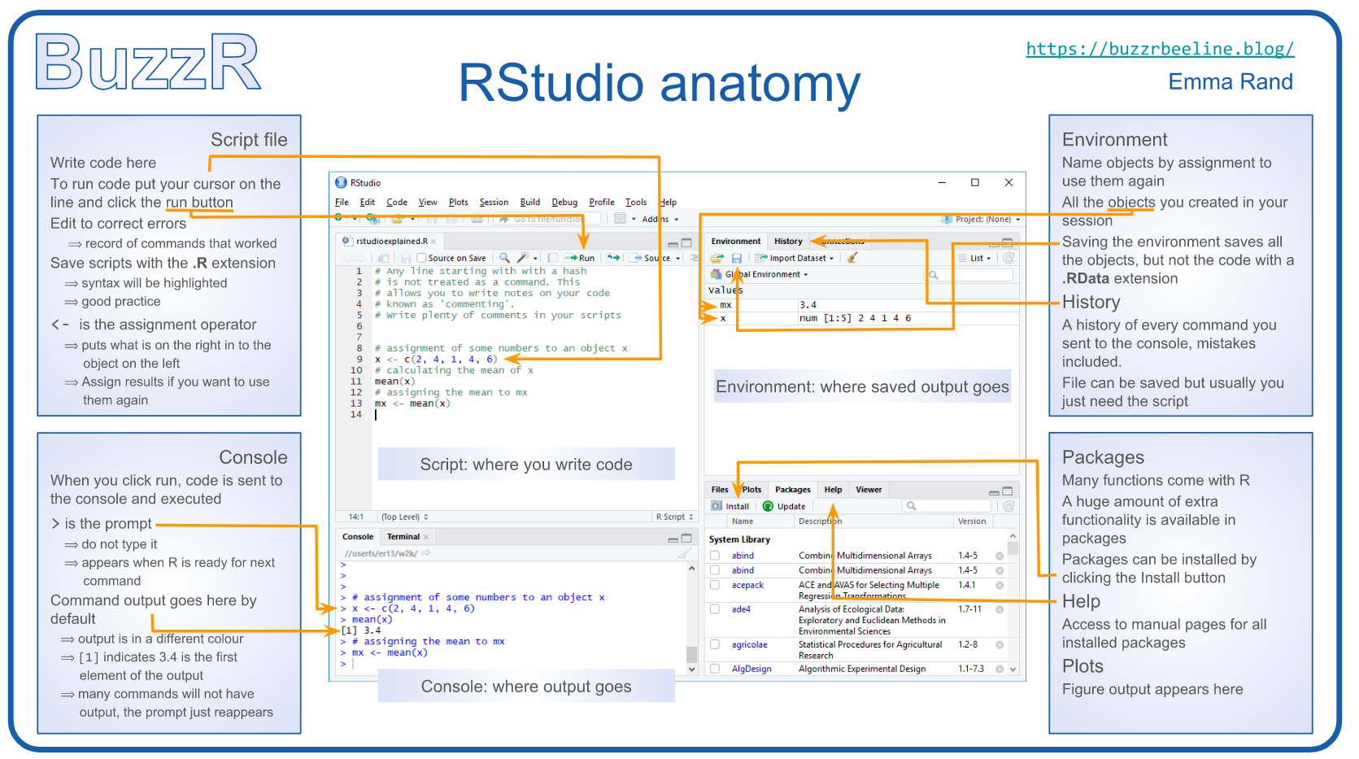
Image Credit: https://buzzrbeeline.blog/2018/07/04/rstudio-anatomy/

Slide 9
Laura Walker
Senior Institutional Research Data Analyst
University System of Maryland
alwalker@usmd.edu

