Slide 1

Business Analytics
Employee Satisfaction for Varks.am
Instructor: Hrant Davtyan
Group Members: Anna Chokandaryan
Ani Manukyan
Ani Tovmasyan

Slide 2
Problems
Employee satisfaction level
Reasons behind
Motivation factors
Reward System

Slide 3
Solution/Milestones
Anonymous Survey
General satisfaction questions
Factors impacting the satisfaction level
A/B testing and NPS for reward system
Tools used: Google Forms, Excel, Python

Slide 4
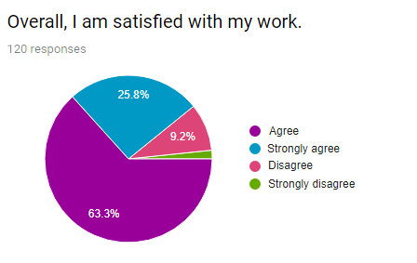
Results

Slide 5
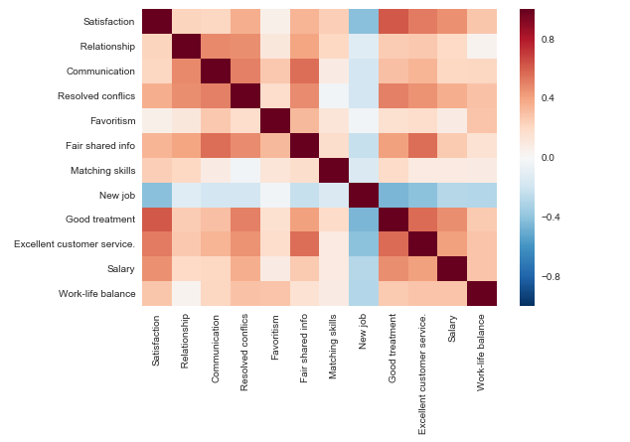
Results
 | Satisfaction
Satisfaction | 1.000000
Relationship | 0.224286
Communication | 0.211335
Resolved conflicts | 0.361592
Favoritism | 0.061749
Fair shared info | 0.336457
Matching skills | 0.249095
New job | -0.417001
Good treatment | 0.623698
Excellent customer service | 0.519598
Salary | 0.457713
Work-life balance | 0.273622

Slide 6
Results
Variables affecting employee satisfaction, based on their level of importance:
Good treatment | 0.534621
Relationship | 0.098511
Excellent customer service | 0.092089
Work-life balance | 0.075999
Matching skills | 0.075485
Salary | 0.047092
New job | 0.043134
Communication | 0.021567
Resolved conflicts | 0.011503
Favoritism | 0.000000
Fair shared info | 0.000000

Slide 7
Which will increase motivation and force employees to work harder?
Monetary Rewards in terms of commissions?
Or non-monetary rewards (such as insurance, training, "best employee of the month" reward)?

Slide 8
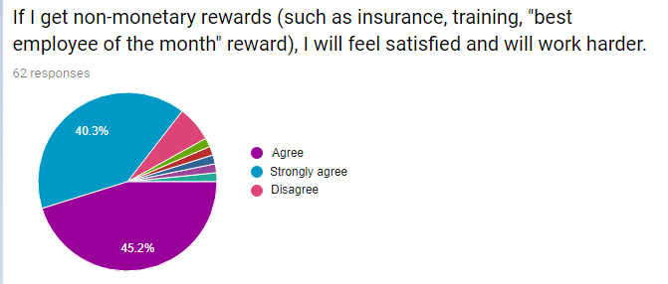
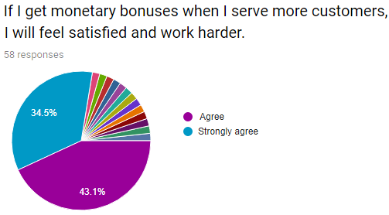
Reward System
85.5 %
77.6%

Slide 9


Here is the decision based on quantitative data
Based on A/B testing and NPS results, among people who agreed that rewards will motivate them and increase satisfaction, we have the following:
If I get non-monetary rewards (such as insurance, training, "best employee of the month" reward), I will feel satisfied and will work harder.
If I get monetary bonuses when I serve more customers, I will feel satisfied and work harder
NPS of 8.89%
NPS of 52.83%

Slide 10
Conclusion
Train managers to treat their subordinates better
Implement non-monetary reward system
Show how much they care about their employees

Slide 11

Thank you!
Any Questions?

