Slide 1

From Data to Strategy: Building Operational Intelligence for Qantas
A portfolio of analytical thinking, strategic design, and data-driven decision making.

Slide 2


The Business Problem
Reliability = Brand Equity
Airline on-time performance directly drives customer satisfaction, repeat business, and competitive reputation.
Disruptions Cascade
A single delay triggers crew conflicts, resource misallocation, and system-wide ripple effects across the network.
Post-COVID Imperative
Recovery demands data-driven insights to close performance gaps and compete in a reshaped aviation market.

Slide 3

Strategic Approach: Scope Evolution
From Single-Airline to Market Intelligence
The analysis evolved beyond exploratory single-airline review into competitive market intelligence — a deliberate design choice to deliver executive-grade context.
Shifted from exploratory to competitive benchmarking scope
Designed four integrated visualizations as a cohesive executive narrative
Blended 22 years of historical context with 2025 operational data for trend validation and current-state insight

Slide 4

Insight 1: Long-Term Reliability Trends
Disruption Era
2017–2022 COVID impact and recovery
Competitive Benchmarking
Historical Baseline
2004–2016 structural patterns
2023–2026 Qantas vs competitors
A 22-year lens separates structural operational challenges from temporary disruptions — distinguishing noise from signal and revealing where Qantas stands relative to its domestic competitors.

Slide 5
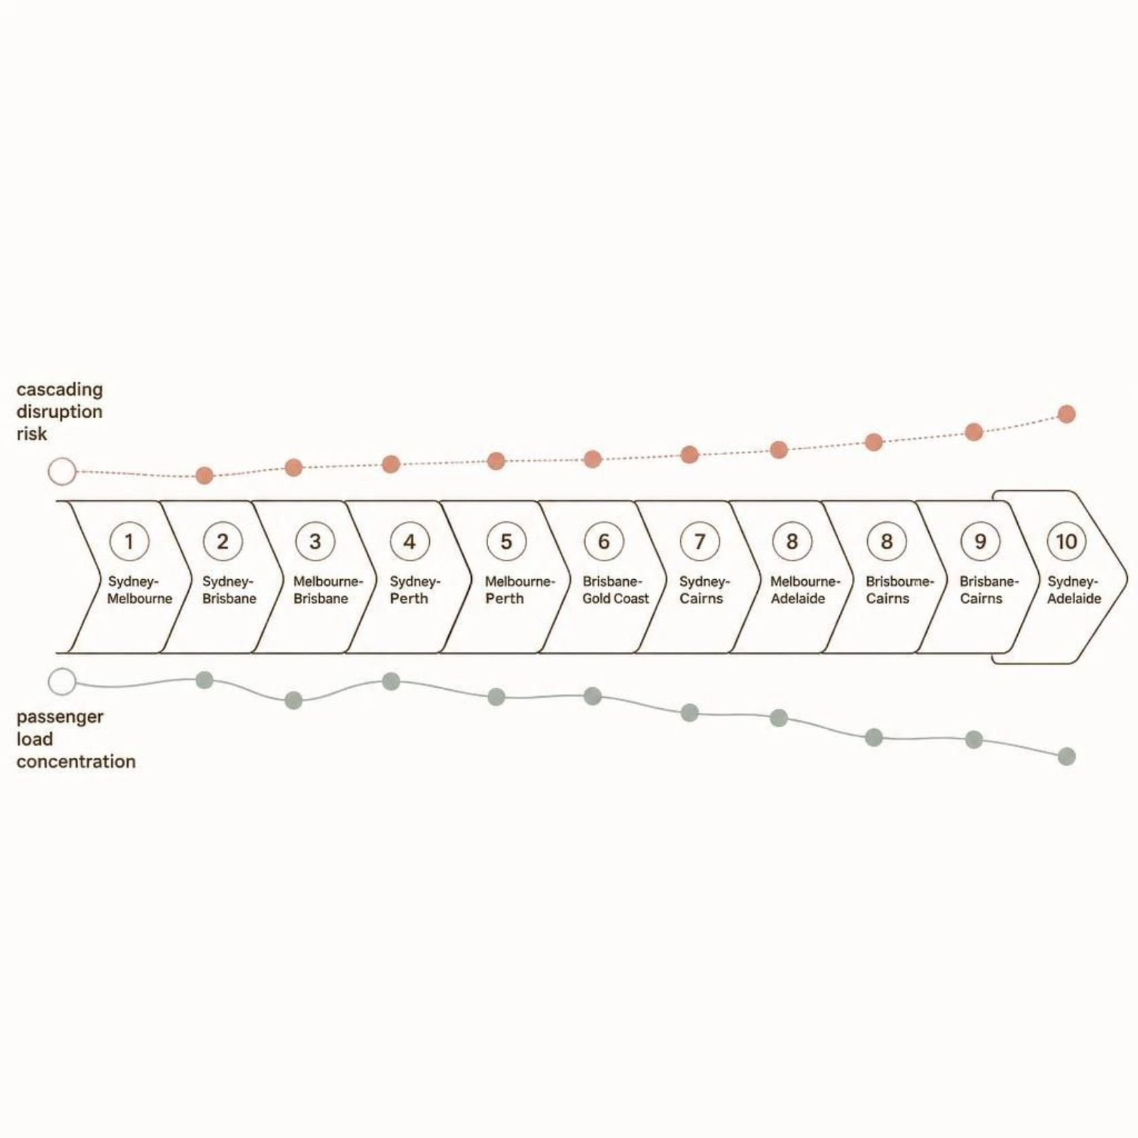
Insight 2: Route-Level Impact Analysis
Where Disruption Hurts Most
The top 10 high-volume domestic routes carry a disproportionate share of total passenger load. A single disruption on these corridors cascades to thousands of passengers and triggers system-wide knock-on effects.
Network criticality mapped by volume and connectivity
Disruption consequences quantified at the route level
Enables precise resource allocation and operational prioritization

Slide 6

Insight 3: Operational Risk Correlation
Delay–Cancellation Interaction
Pressure Concentration Points
Analyzed the relationship between delay frequency and cancellation rates to surface hidden disruption patterns.
Pinpoints exactly where operational stress accumulates and where consequences escalate most severely.
Recovery Strategy Input
Findings directly inform risk mitigation protocols and service recovery prioritization frameworks.

Slide 7
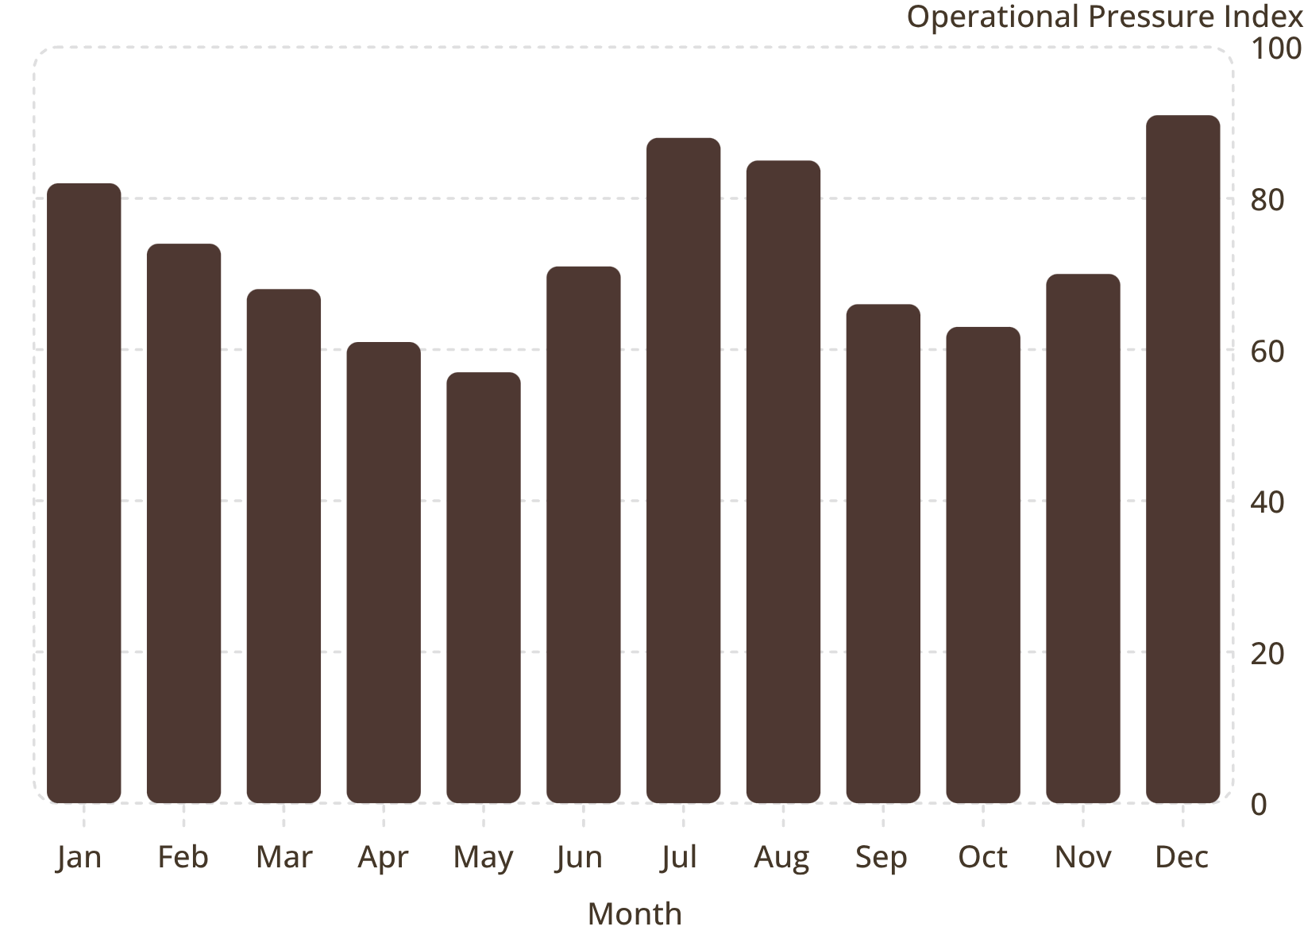

Insight 4: Seasonal Operational Dynamics
Predict, Prepare, Perform
Monthly delay patterns expose when operational pressure peaks — turning seasonal history into a forward-looking planning tool.
Peak pressure months identified for proactive workforce scheduling
Resource allocation aligned to high-risk seasonal windows
Capacity planning grounded in demonstrated operational cycles
Illustrative index based on seasonal delay pattern methodology — not sourced BITRE values.

Slide 8
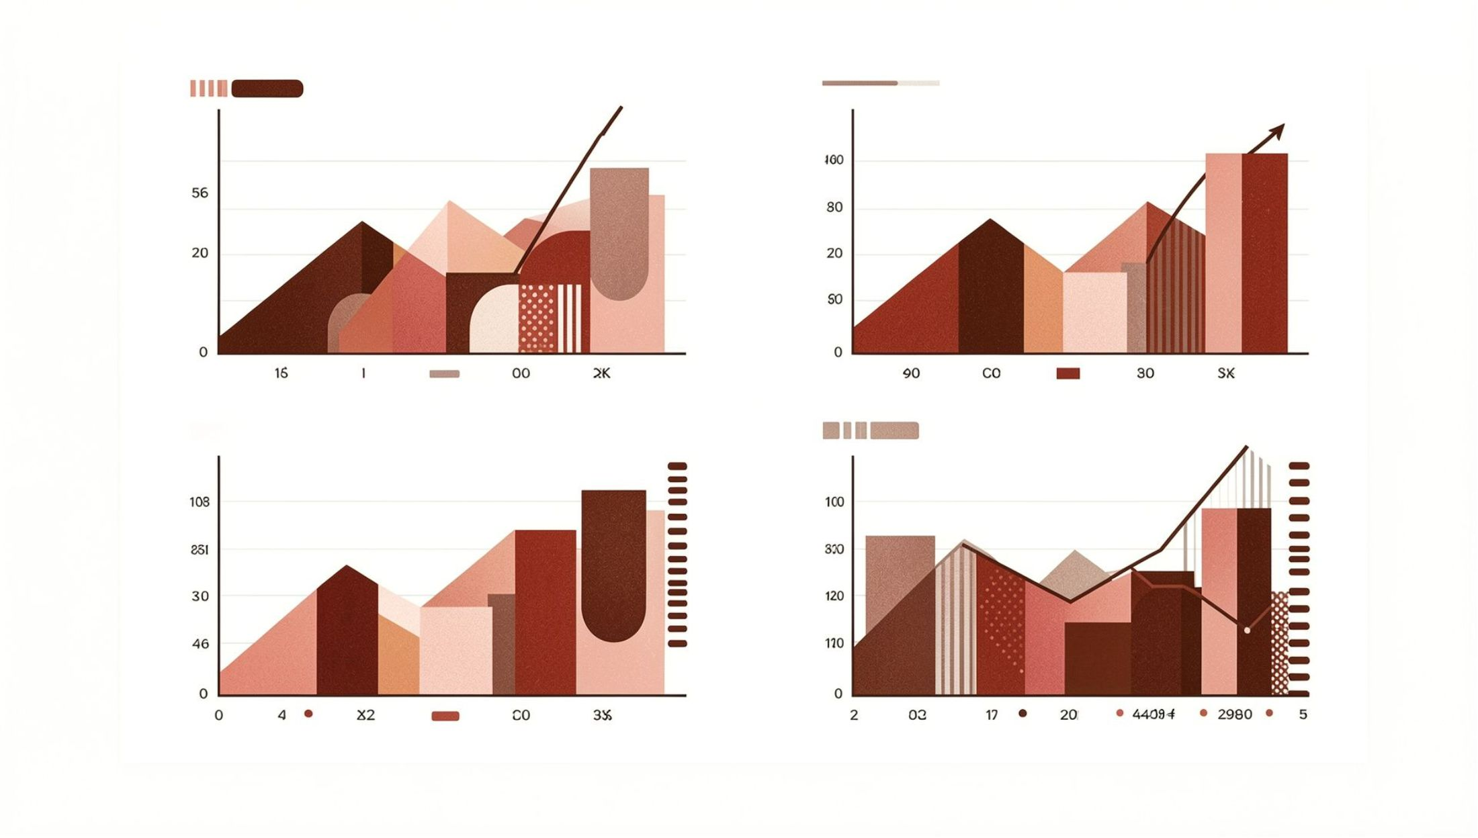
Design Philosophy: Clarity Over Complexity
Every Design Choice Is a Strategic Choice
Four targeted visualizations eliminate exploratory clutter. Only decision-critical insights made the cut.
01
02
Macro Trends
Route Impact
Long-term competitive benchmarking establishes the strategic backdrop.
Network-level risk surfaces where disruption consequences are greatest.
03
04
Risk Metrics
Seasonal Outlook
Correlation analysis reveals operational pressure concentration points.
Monthly patterns enable predictive, proactive planning decisions.

Slide 9




Business Impact & Strategic Recommendations
Long-Term Positioning
Network Investment
Trend analysis informs competitive strategy and reveals where Qantas must close structural performance gaps.
Route-level insights direct capital and resource priorities toward highest-impact corridors.
Proactive Operations
Seasonal forecasting enables workforce and capacity planning before pressure peaks — not after.

Slide 10
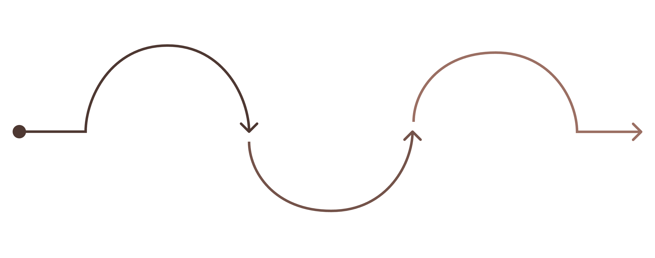
Evolution Roadmap: From Retrospective to Predictive
Phase 1: Current State
Phase 3: Predictive Intelligence
Phase 2: Enhanced Analytics
Month-route aggregation and historical BITRE
Live system integration, monitoring, rapid response
Integrate real-time ops, weather; forecasting
The dashboard is designed to grow. Each phase increases analytical maturity — shifting Qantas operations from rear-view reporting to forward-looking intelligence that enables real-time decisions.

Slide 11


Ethical Data Practice & Governance
Trust Is Built Into the Methodology
Rigorous data governance is not a footnote — it is central to the analytical design.
Public Data Foundation
Contextualized Metrics
Full Transparency
Built entirely on publicly available BITRE data — zero privacy or compliance exposure.
All indicators are contextualized to prevent misinterpretation; single-metric conclusions are explicitly avoided.
Complete source documentation enables stakeholder verification and builds lasting analytical credibility.

