Slide 1
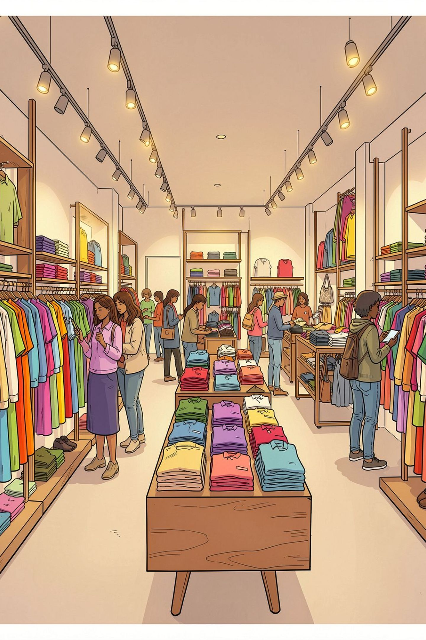
Customer Shopping Behavior Analysis
3,900 transactions · 18 features · Python · SQL · Power BI

Slide 2
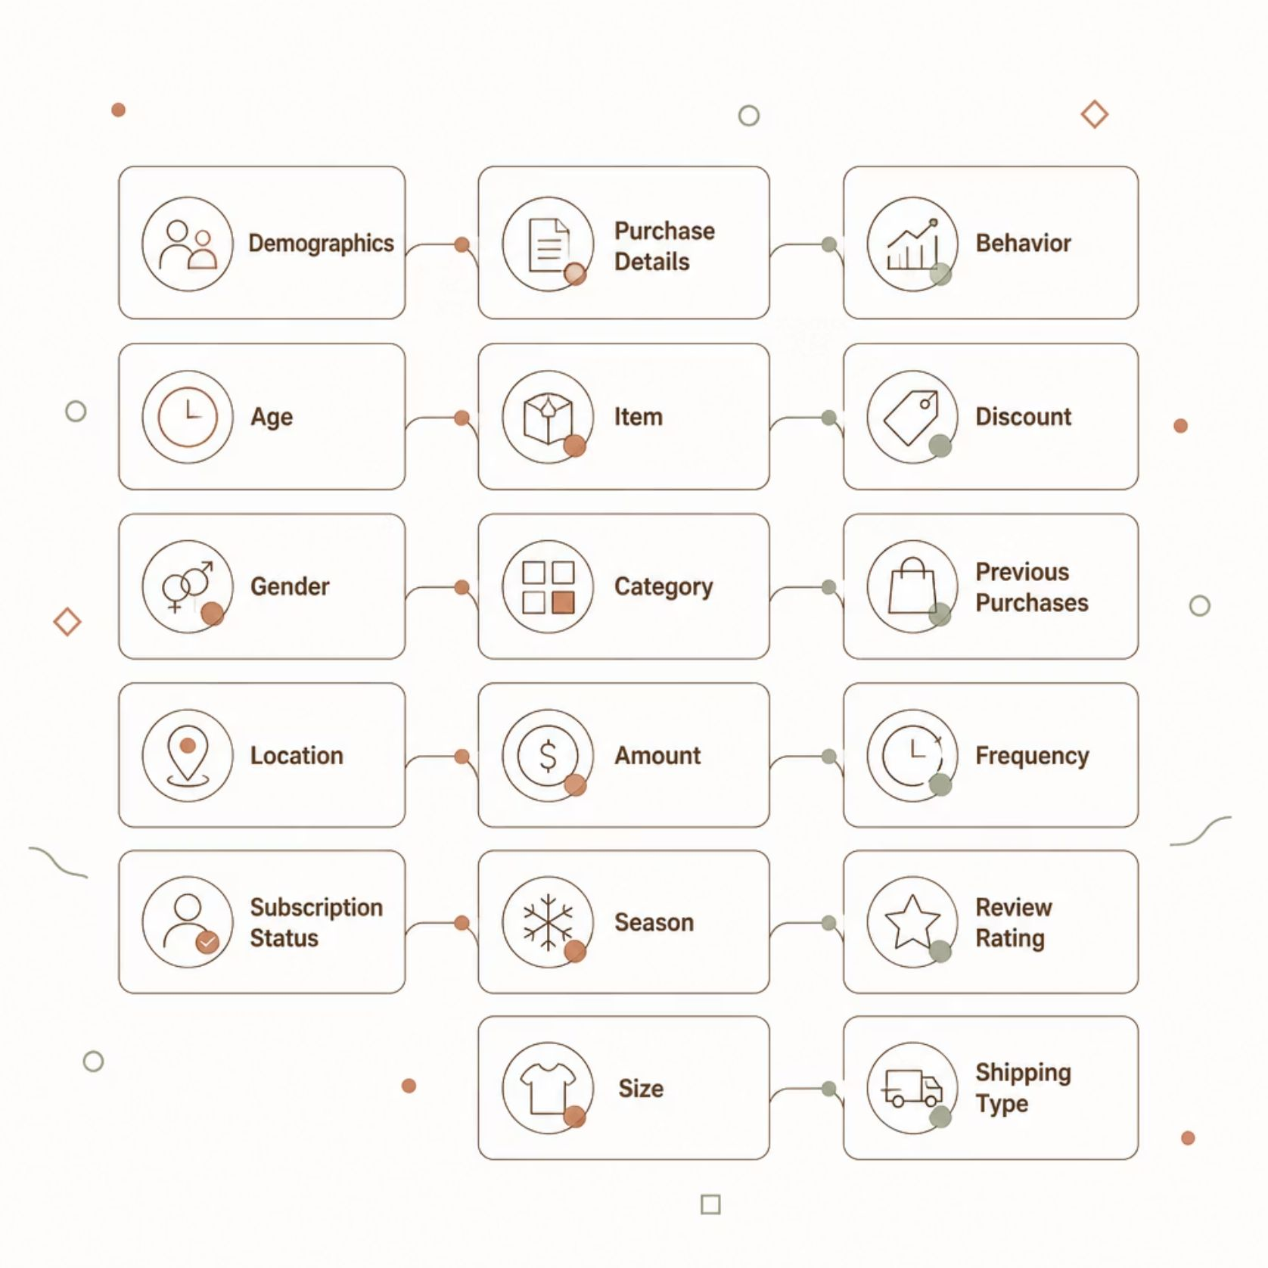
Dataset at a Glance
3,900
18
Transactions
Features
37
$59.76
Missing Ratings
Avg Purchase
Key Feature Groups
Demographics — Age, Gender, Location, Subscription
Purchase Details — Item, Category, Amount, Season
Behavior — Discount, Frequency, Rating, Shipping

Slide 3

Data Preparation in Python
01
Load & Explore
pandas · df.info() · describe()
02
Clean
Imputed Review Rating (median by category)
03
Standardize
Snake case · Dropped redundant promo_code_used
04
Engineer & Load
age_group · purchase_frequency_days → PostgreSQL

Slide 4
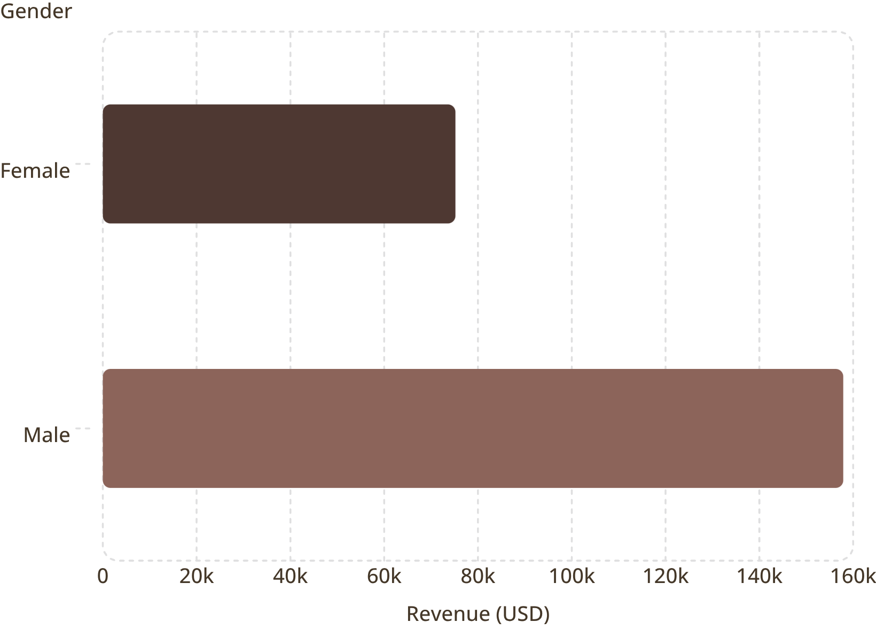

Revenue by Gender
Key Insight
Male customers generated 2.1× more revenue than female customers — driven by higher purchase volume, not spend per transaction.
Avg spend per transaction is nearly identical across genders.

Slide 5
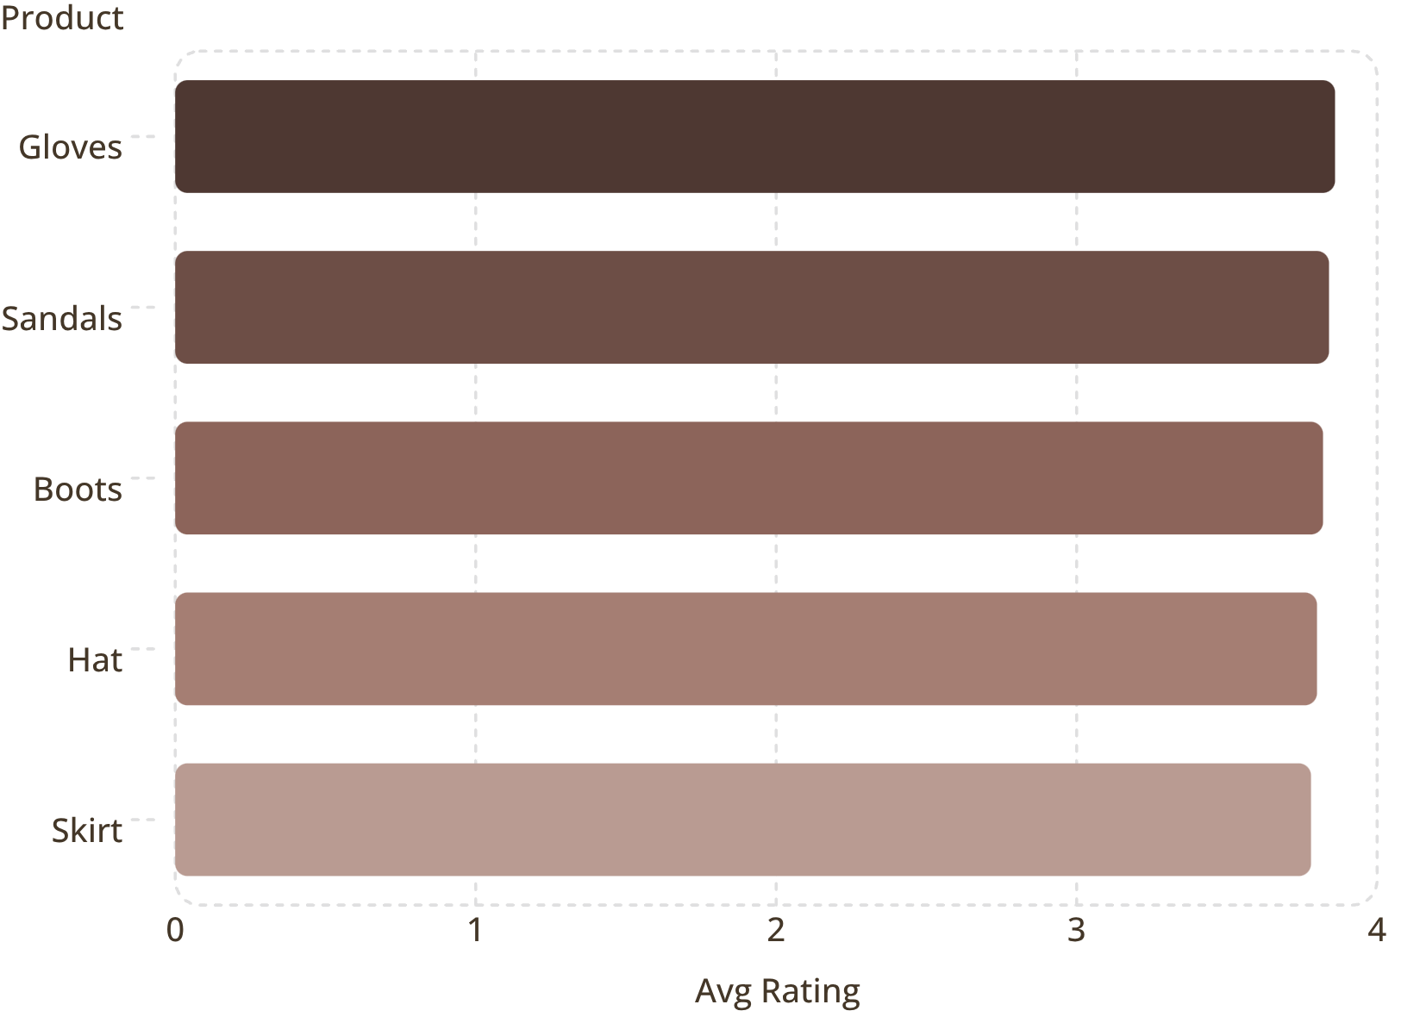
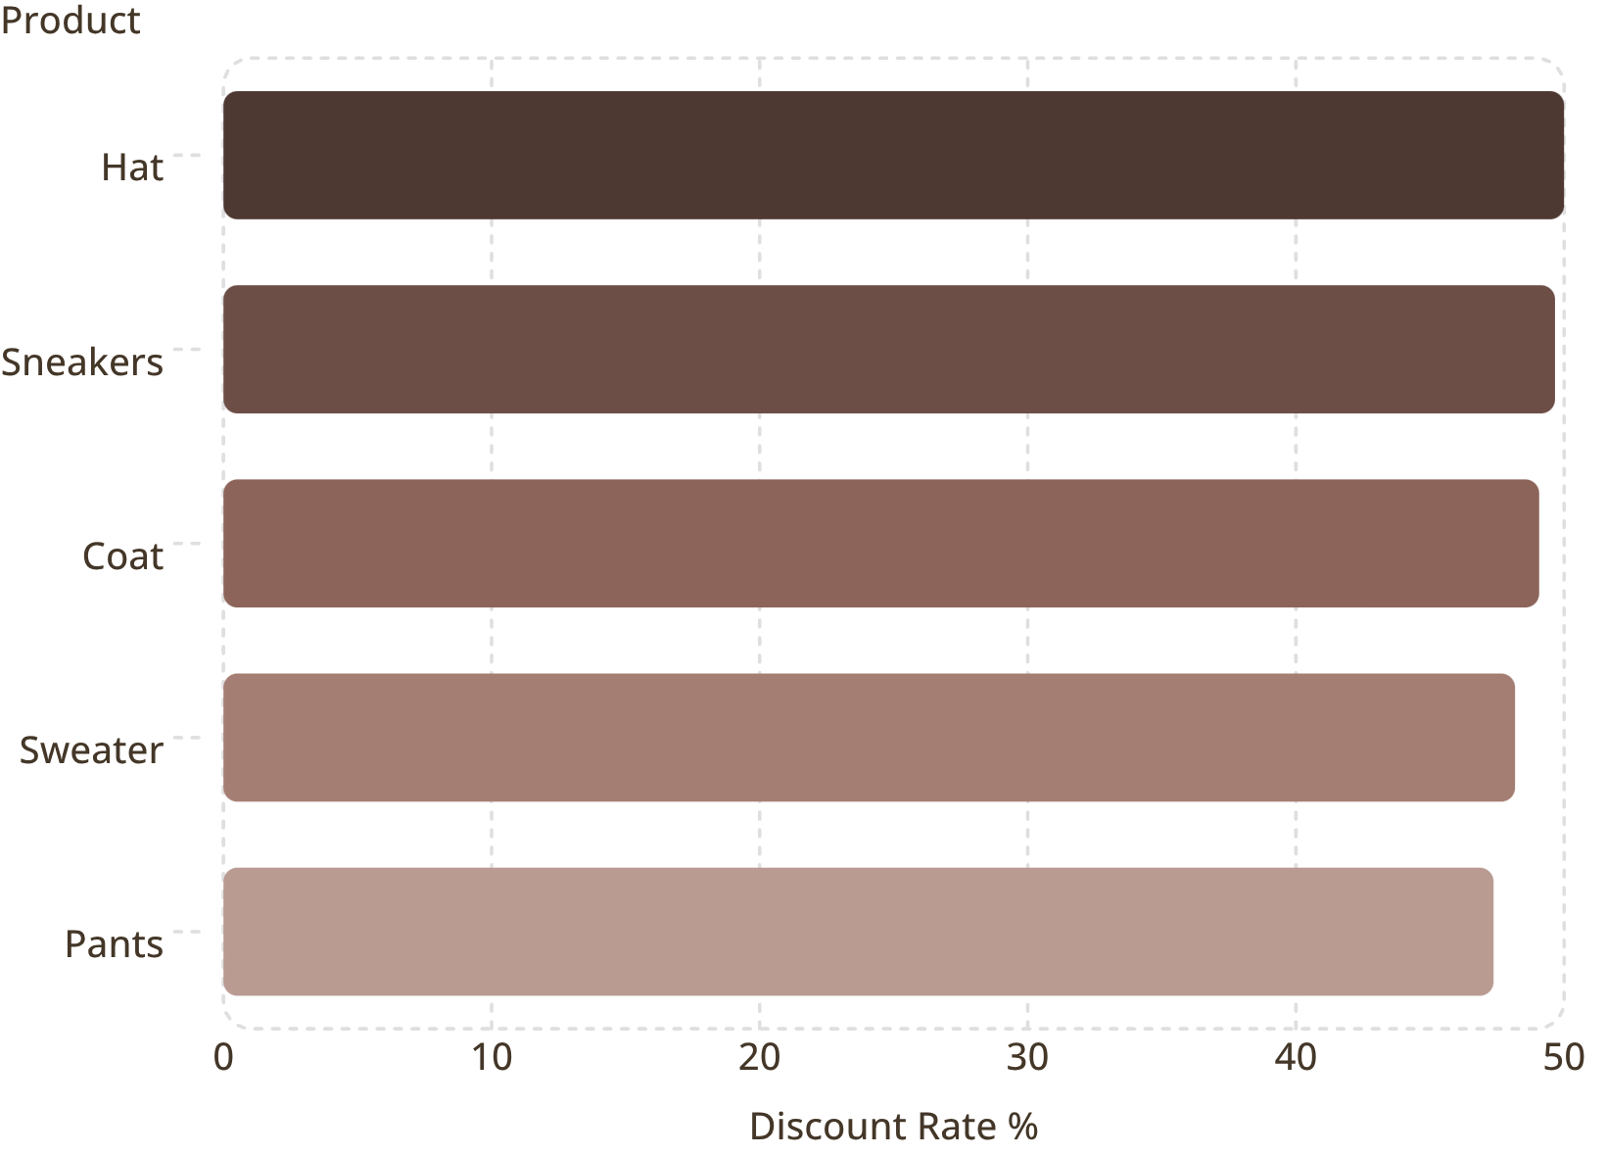
Product Ratings & Discount Dependency
Top 5 by Review Rating
Most Discount-Dependent Products

Slide 6
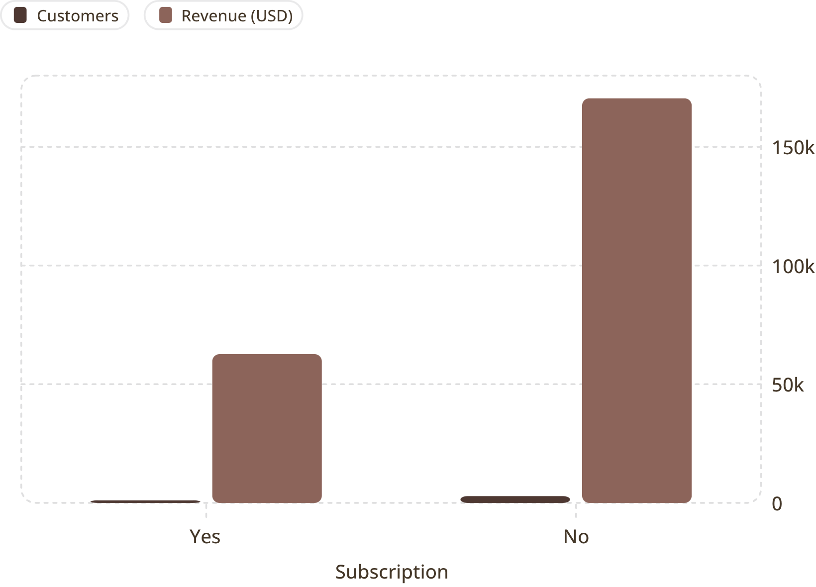
Subscribers vs. Non-Subscribers
Key Findings
73% non-subscribers · 27% subscribers
Avg spend nearly identical (~$59.50)
Non-subs drive 73% of total revenue
958 repeat buyers are subscribers

Slide 7
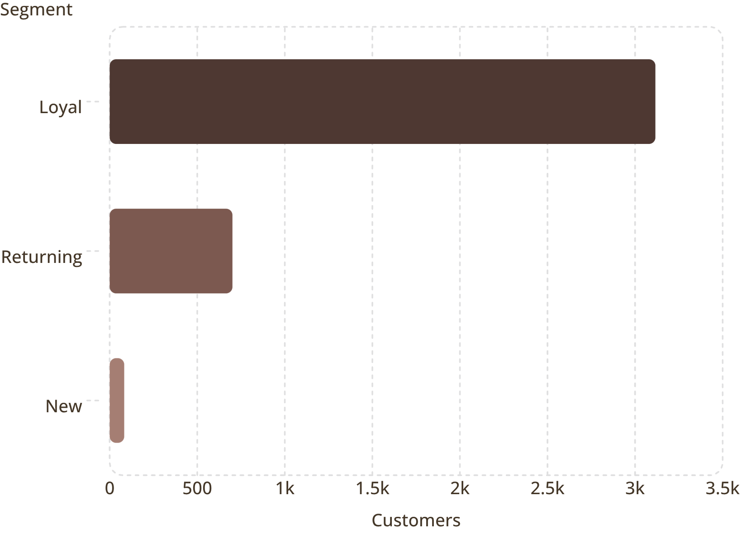
Customer Segmentation
Segment Breakdown
Loyal (80%) — 3,116 customers
Returning (18%) — 701 customers
New (2%) — 83 customers
Strong loyalty base — opportunity to convert Returning → Loyal.

Slide 8
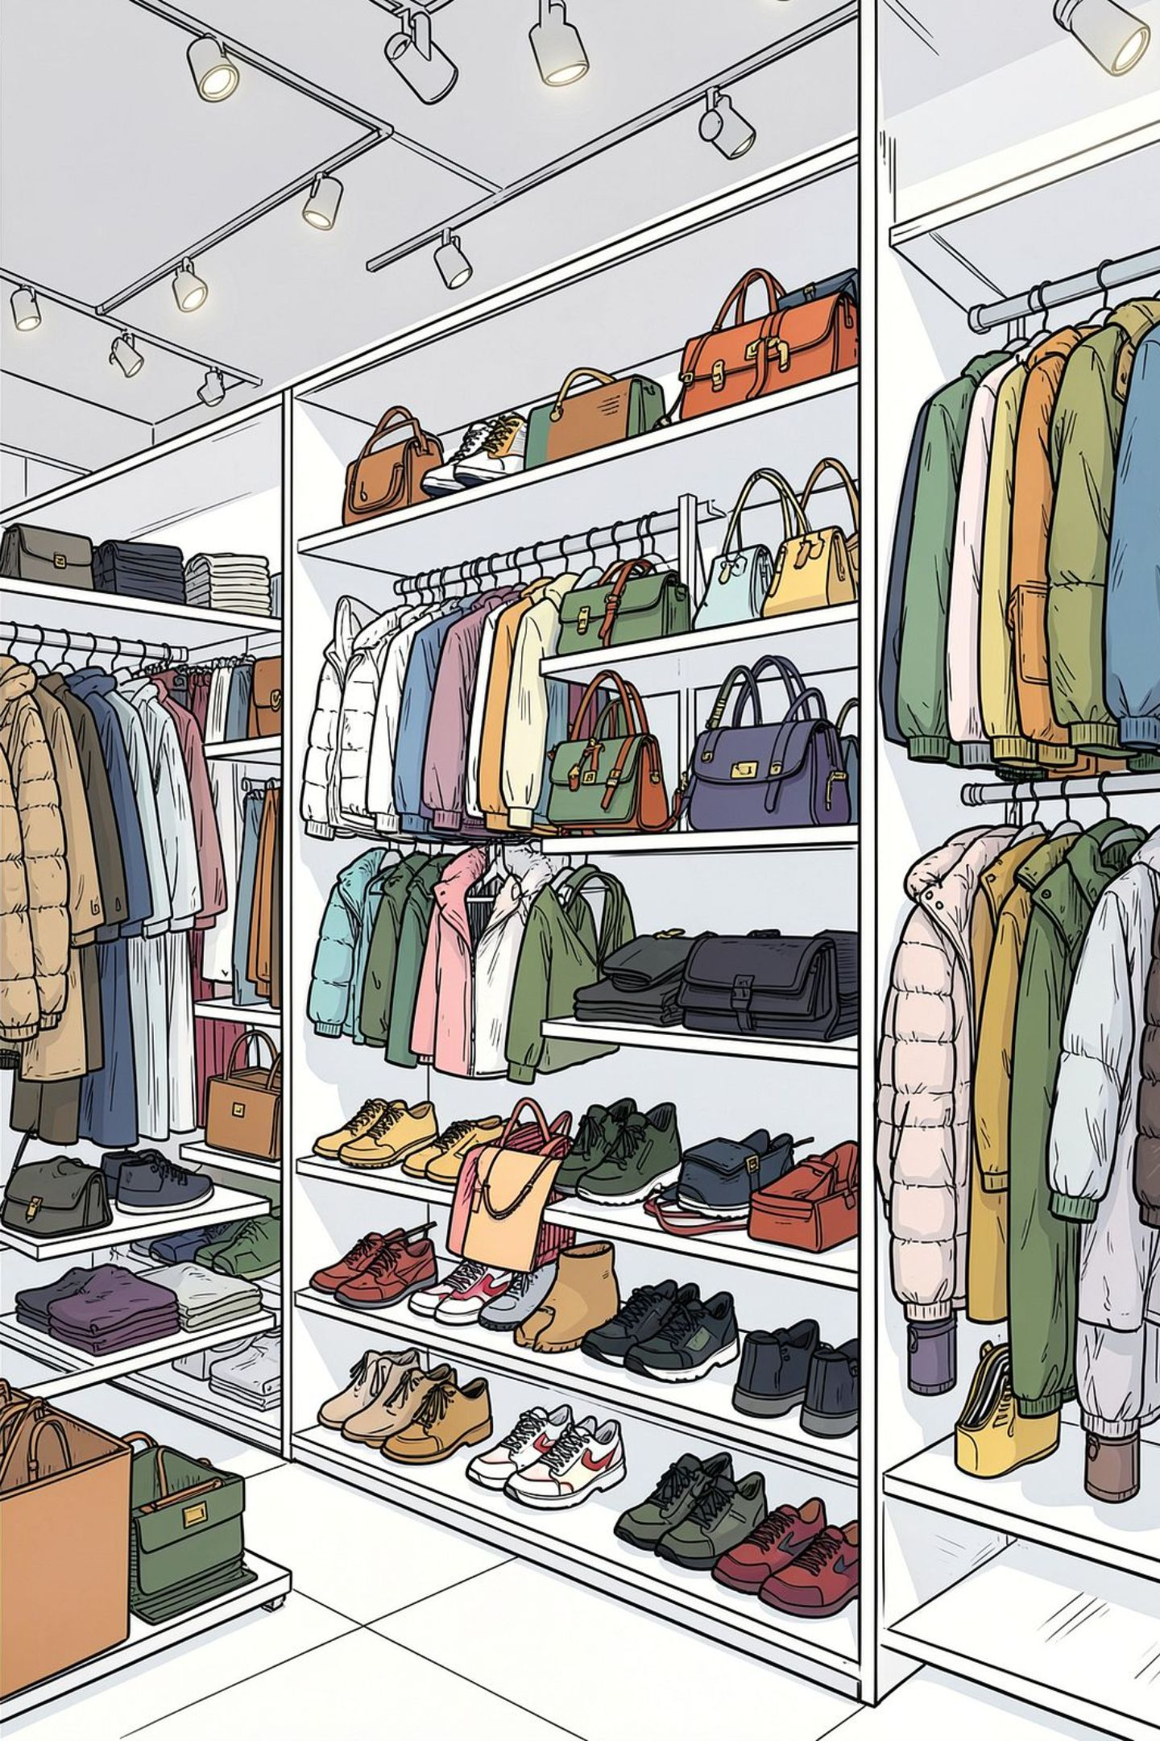
Top Products by Category
Accessories
Jewelry · Sunglasses · Belt
Clothing
Blouse · Pants · Shirt
Footwear
Sandals · Shoes · Sneakers
Outerwear
Jacket · Coat

Slide 9
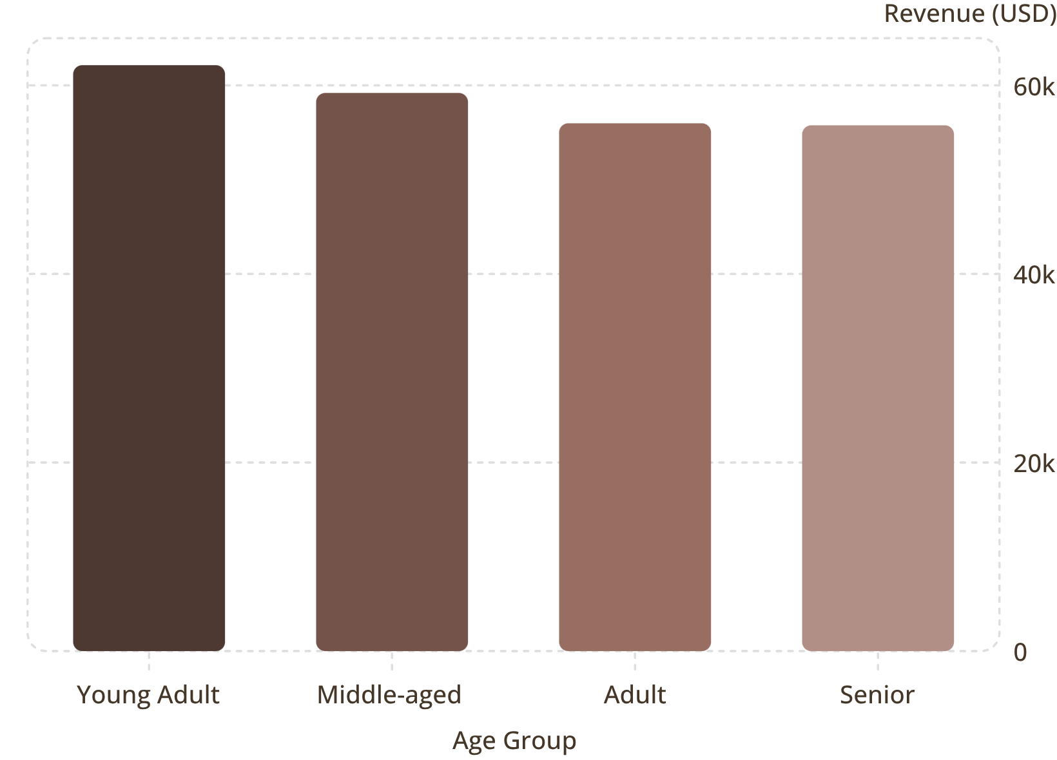
Revenue by Age Group
Age Group Insights
Young Adults lead in revenue ($62K) and sales volume
Revenue gap across age groups is relatively narrow
Express shipping avg: $60.48 vs Standard $58.46
839 high-spending discount users identified

Slide 10





Business Recommendations
Boost Subscriptions
Promote exclusive subscriber benefits
Loyalty Programs
Reward repeat buyers → Loyal segment
Review Discount Policy
Balance sales boosts with margin control
Targeted Marketing
Focus on high-revenue age groups & express-shipping users

