Slide 1
Analysis Results from Folder - B3_B15_11.35_13.28

Slide 2
Analysis Results:
Metric | Value
Date and Time | 2024-03-12 11:35:09.335000 to 2024-03-12 13:29:38.656000
Total time taken for the ride | 0 days 01:54:30.161000
Actual Ampere-hours (Ah) | 33.27927277777778
Actual Watt-hours (Wh) | 1717.139885148611
Starting SoC (Ah) | 4.697
Ending SoC (Ah) | 4.135
Starting SoC (%) | 100.0
Ending SoC (%) | 10.0
Total distance covered (km) | 56.04125756068157
Total energy consumption(WH/KM) | 30.64063798513602
Total SOC consumed(%) | 90.0
Mode | Eco mode 99.75% Sports mode 0.04% Custom mode 0.04%
Peak Power(kW) | 2471.347216

Slide 3
Analysis Results:
Metric | Value
Average Power(kW) | -904.6836801602516
Total Energy Regenerated(kWh) | 79.19017365777778
Regenerative Effectiveness(%) | 4.408442272039773
Highest Cell Voltage(V) | 3.382
Lowest Cell Voltage(V) | 3.125
Difference in Cell Voltage(V) | 0.2570000000000001
Minimum Temperature(C) | 28.0
Maximum Temperature(C) | 46.0
Difference in Temperature(C) | 18.0
Maximum Fet Temperature-BMS(C) | 57.0
Maximum Afe Temperature-BMS(C) | 61.0
Maximum PCB Temperature-BMS(C) | 59.0
Maximum MCU Temperature(C) | 45.0

Slide 4
Analysis Results:
Metric | Value
Maximum Motor Temperature(C) | 0.0
Abnormal Motor Temperature Detected(C) | False
highest cell temp(C) | 46.0
lowest cell temp(C) | 28.0
Difference between Highest and Lowest Cell Temperature at 100% SOC(C) | 18.0
Battery Voltage(V) | 55.0
Total energy charged(kWh) | 1.8303600027777778
Electricity consumption units(kW) | 7.400776333405215e-08
Cycle Count of battery | 115.0
Idling time percentage | 2.7237479806138936
Time spent in 0-10 km/h | 18.177705977382878
Time spent in 10-20 km/h | 3.6478190630048464
Time spent in 20-30 km/h | 7.846526655896607

Slide 5
Analysis Results:
Metric | Value
Time spent in 30-40 km/h | 45.86914378029079
Time spent in 40-50 km/h | 20.29886914378029
Time spent in 50-60 km/h | 0.0
Time spent in 60-70 km/h | 0.0
Time spent in 70-80 km/h | 0.0
Time spent in 80-90 km/h | 0.0

Slide 6
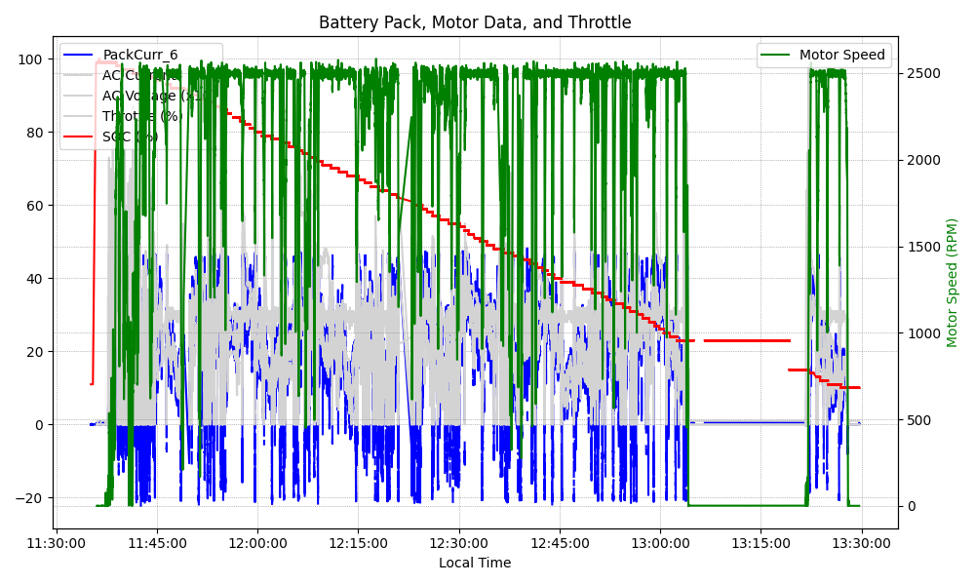
Graph Analysis

