Slide 1
Analysis Results from Folder - B4_B02_06.55_07.43

Slide 2
Analysis Results:
Metric | Value
Date and Time | 2024-03-12 06:55:31.324000 to 2024-03-12 07:43:09.542000
Total time taken for the ride | 0 days 00:47:24.599000
Actual Ampere-hours (Ah) | 27.709410833333333
Actual Watt-hours (Wh) | 1390.2002717922223
Starting SoC (Ah) | 39.497
Ending SoC (Ah) | 10.219
Starting SoC (%) | 99.0
Ending SoC (%) | 25.0
Total distance covered (km) | 28.79475029579625
Total energy consumption(WH/KM) | 48.279643251331755
Total SOC consumed(%) | 74.0
Mode | Custom mode 95.48% Eco mode 3.00%
Peak Power(kW) | 5458.56792

Slide 3
Analysis Results:
Metric | Value
Average Power(kW) | -1767.8279683687745
Total Energy Regenerated(kWh) | 0.011607947777777777
Regenerative Effectiveness(%) | 0.0008349768799234199
Highest Cell Voltage(V) | 3.357
Lowest Cell Voltage(V) | 2.988
Difference in Cell Voltage(V) | 0.3690000000000002
Minimum Temperature(C) | 24.0
Maximum Temperature(C) | 39.0
Difference in Temperature(C) | 15.0
Maximum Fet Temperature-BMS(C) | 62.0
Maximum Afe Temperature-BMS(C) | 59.0
Maximum PCB Temperature-BMS(C) | 57.0
Maximum MCU Temperature(C) | 55.0

Slide 4
Analysis Results:
Metric | Value
Maximum Motor Temperature(C) | 93.0
Abnormal Motor Temperature Detected(C) | False
highest cell temp(C) | 44.0
lowest cell temp(C) | 24.0
Difference between Highest and Lowest Cell Temperature at 100% SOC(C) | 20.0
Battery Voltage(V) | 53.0
Total energy charged(kWh) | 1.4685987741666666
Electricity consumption units(kW) | 1.4344026158058549e-07
Cycle Count of battery | 44.0
Idling time percentage | 37.44252152830031
Time spent in 0-10 km/h | 3.072485578128919
Time spent in 10-20 km/h | 3.2062536577209264
Time spent in 20-30 km/h | 5.09154752947078

Slide 5
Analysis Results:
Metric | Value
Time spent in 30-40 km/h | 6.993562411169635
Time spent in 40-50 km/h | 8.067887300392943
Time spent in 50-60 km/h | 7.779449878772677
Time spent in 60-70 km/h | 12.791572610985705
Time spent in 70-80 km/h | 15.429311930440598
Time spent in 80-90 km/h | 0.0

Slide 6
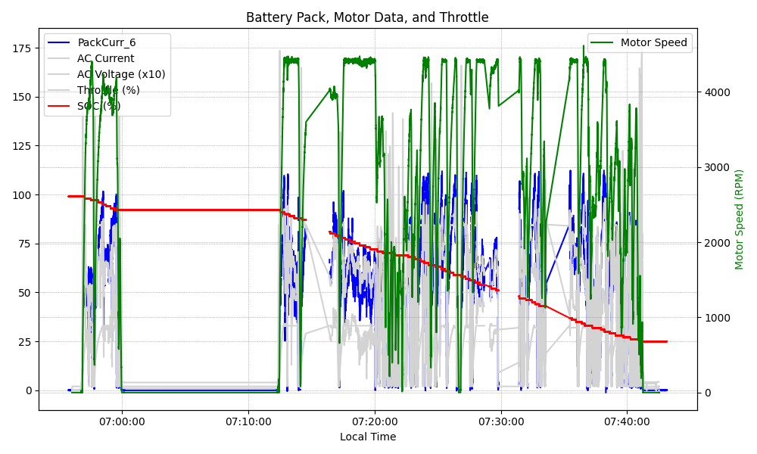
Graph Analysis

