Slide 1
Analysis Results from Folder - B4_B03_05.22_06.06

Slide 2
Analysis Results:
Metric | Value
Date and Time | 2024-03-12 05:24:20.075000 to 2024-03-12 06:06:59.586000
Total time taken for the ride | 0 days 00:44:15.811000
Actual Ampere-hours (Ah) | 28.259706944444442
Actual Watt-hours (Wh) | 1428.2919918925
Starting SoC (Ah) | 39.388
Ending SoC (Ah) | 9.852
Starting SoC (%) | 99.0
Ending SoC (%) | 24.0
Total distance covered (km) | 29.620325344960253
Total energy consumption(WH/KM) | 48.21999675082963
Total SOC consumed(%) | 75.0
Mode | Custom mode 95.06% Eco mode 4.11% Sports mode 0.04%
Peak Power(kW) | 5529.002210000001

Slide 3
Analysis Results:
Metric | Value
Average Power(kW) | -1948.4089317214853
Total Energy Regenerated(kWh) | 0.0
Regenerative Effectiveness(%) | 0.0
Highest Cell Voltage(V) | 3.336
Lowest Cell Voltage(V) | 3.013
Difference in Cell Voltage(V) | 0.32299999999999995
Minimum Temperature(C) | 26.0
Maximum Temperature(C) | 38.0
Difference in Temperature(C) | 12.0
Maximum Fet Temperature-BMS(C) | 57.0
Maximum Afe Temperature-BMS(C) | 54.0
Maximum PCB Temperature-BMS(C) | 52.0
Maximum MCU Temperature(C) | 48.0

Slide 4
Analysis Results:
Metric | Value
Maximum Motor Temperature(C) | 81.0
Abnormal Motor Temperature Detected(C) | False
highest cell temp(C) | 38.0
lowest cell temp(C) | 26.0
Difference between Highest and Lowest Cell Temperature at 100% SOC(C) | 12.0
Battery Voltage(V) | 53.0
Total energy charged(kWh) | 1.4977644680555555
Electricity consumption units(kW) | 1.5670270642975055e-07
Cycle Count of battery | 52.0
Idling time percentage | 4.459798994974874
Time spent in 0-10 km/h | 4.0703517587939695
Time spent in 10-20 km/h | 5.397822445561139
Time spent in 20-30 km/h | 10.737018425460636

Slide 5
Analysis Results:
Metric | Value
Time spent in 30-40 km/h | 19.12060301507538
Time spent in 40-50 km/h | 27.349246231155778
Time spent in 50-60 km/h | 20.050251256281406
Time spent in 60-70 km/h | 7.24036850921273
Time spent in 70-80 km/h | 1.4614740368509211
Time spent in 80-90 km/h | 0.0

Slide 6
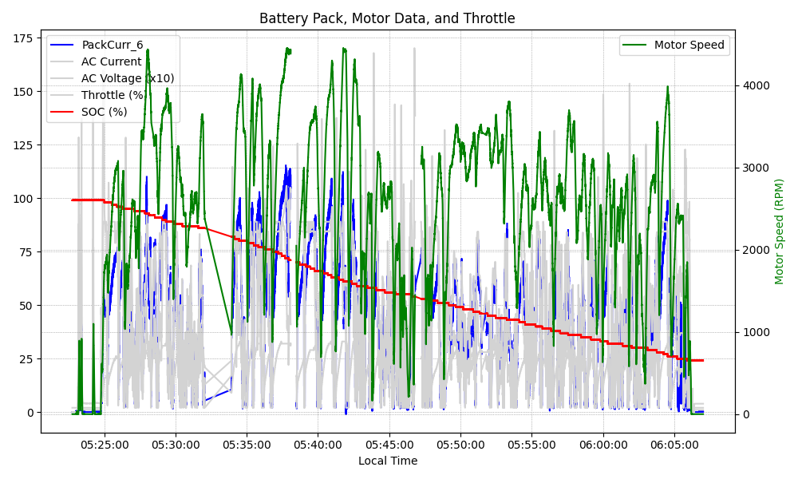
Graph Analysis

