Slide 1
Analysis Results from Folder - B4_B03_10.41_11.48

Slide 2
Analysis Results:
Metric | Value
Date and Time | 2024-03-12 10:41:58.064000 to 2024-03-12 11:48:27.259000
Total time taken for the ride | 0 days 01:06:30.855000
Actual Ampere-hours (Ah) | 32.33816583333333
Actual Watt-hours (Wh) | 1642.2231010166665
Starting SoC (Ah) | 7.43
Ending SoC (Ah) | 7.051
Starting SoC (%) | 99.0
Ending SoC (%) | 17.0
Total distance covered (km) | 36.218297428121346
Total energy consumption(WH/KM) | 45.34236056445818
Total SOC consumed(%) | 82.0
Mode | Custom mode 79.89% Eco mode 18.74% Sports mode 0.03%
Peak Power(kW) | 5233.3208

Slide 3
Analysis Results:
Metric | Value
Average Power(kW) | -1489.9201521320563
Total Energy Regenerated(kWh) | 3.3656821438888893
Regenerative Effectiveness(%) | 0.20452753314377137
Highest Cell Voltage(V) | 3.491
Lowest Cell Voltage(V) | 3.032
Difference in Cell Voltage(V) | 0.4590000000000001
Minimum Temperature(C) | 31.0
Maximum Temperature(C) | 47.0
Difference in Temperature(C) | 16.0
Maximum Fet Temperature-BMS(C) | 60.0
Maximum Afe Temperature-BMS(C) | 63.0
Maximum PCB Temperature-BMS(C) | 60.0
Maximum MCU Temperature(C) | 59.0

Slide 4
Analysis Results:
Metric | Value
Maximum Motor Temperature(C) | 98.0
Abnormal Motor Temperature Detected(C) | False
highest cell temp(C) | 47.0
lowest cell temp(C) | 31.0
Difference between Highest and Lowest Cell Temperature at 100% SOC(C) | 16.0
Battery Voltage(V) | 54.0
Total energy charged(kWh) | 1.7462609549999997
Electricity consumption units(kW) | 1.215720520050125e-07
Cycle Count of battery | 53.0
Idling time percentage | 24.735965941653248
Time spent in 0-10 km/h | 5.108752012662719
Time spent in 10-20 km/h | 6.153972109270529
Time spent in 20-30 km/h | 9.349671151379527

Slide 5
Analysis Results:
Metric | Value
Time spent in 30-40 km/h | 14.190977812951996
Time spent in 40-50 km/h | 8.708348115601888
Time spent in 50-60 km/h | 6.5360368965423135
Time spent in 60-70 km/h | 14.48571350599023
Time spent in 70-80 km/h | 10.61867205196081
Time spent in 80-90 km/h | 0.0

Slide 6
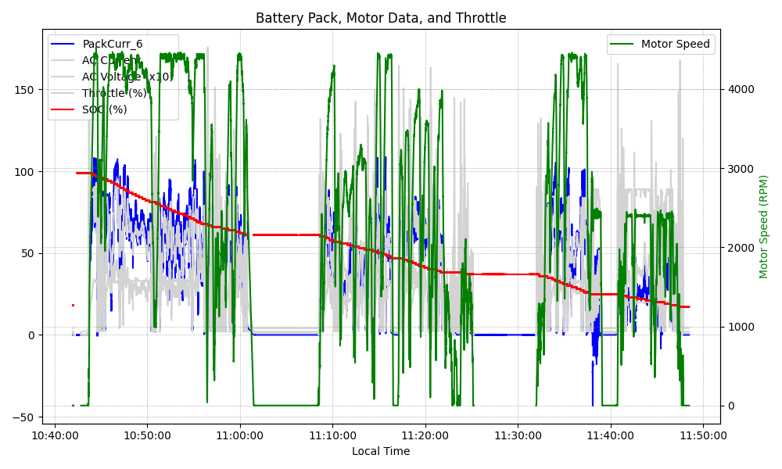
Graph Analysis

