Slide 1
Analysis Results from Folder - B4_B03_14.51_15.56

Slide 2
Analysis Results:
Metric | Value
Date and Time | 2024-03-12 14:51:07.889000 to 2024-03-12 15:56:34.474000
Total time taken for the ride | 0 days 01:05:10.305000
Actual Ampere-hours (Ah) | 29.43661194444444
Actual Watt-hours (Wh) | 1512.064054262222
Starting SoC (Ah) | 39.501
Ending SoC (Ah) | 6.339
Starting SoC (%) | 99.0
Ending SoC (%) | 16.0
Total distance covered (km) | 41.788590328413825
Total energy consumption(WH/KM) | 36.183657844856896
Total SOC consumed(%) | 83.0
Mode | Sports mode 49.66% Custom mode 26.73% Eco mode 20.63%
Peak Power(kW) | 4515.103889999999

Slide 3
Analysis Results:
Metric | Value
Average Power(kW) | -1395.3936414621892
Total Energy Regenerated(kWh) | 0.11584599972222223
Regenerative Effectiveness(%) | 0.007660860966486528
Highest Cell Voltage(V) | 3.414
Lowest Cell Voltage(V) | 3.107
Difference in Cell Voltage(V) | 0.30699999999999994
Minimum Temperature(C) | 36.0
Maximum Temperature(C) | 46.0
Difference in Temperature(C) | 10.0
Maximum Fet Temperature-BMS(C) | 63.0
Maximum Afe Temperature-BMS(C) | 63.0
Maximum PCB Temperature-BMS(C) | 60.0
Maximum MCU Temperature(C) | 54.0

Slide 4
Analysis Results:
Metric | Value
Maximum Motor Temperature(C) | 93.0
Abnormal Motor Temperature Detected(C) | False
highest cell temp(C) | 46.0
lowest cell temp(C) | -1.0
Difference between Highest and Lowest Cell Temperature at 100% SOC(C) | 47.0
Battery Voltage(V) | 53.0
Total energy charged(kWh) | 1.5601404330555553
Electricity consumption units(kW) | 1.1083691624435602e-07
Cycle Count of battery | 54.0
Idling time percentage | 8.756917108791146
Time spent in 0-10 km/h | 9.695361971589938
Time spent in 10-20 km/h | 3.465685435563923
Time spent in 20-30 km/h | 5.125791545438987

Slide 5
Analysis Results:
Metric | Value
Time spent in 30-40 km/h | 21.672656740259
Time spent in 40-50 km/h | 10.040504307148154
Time spent in 50-60 km/h | 34.391579667978775
Time spent in 60-70 km/h | 6.768783159335958
Time spent in 70-80 km/h | 0.0
Time spent in 80-90 km/h | 0.0

Slide 6
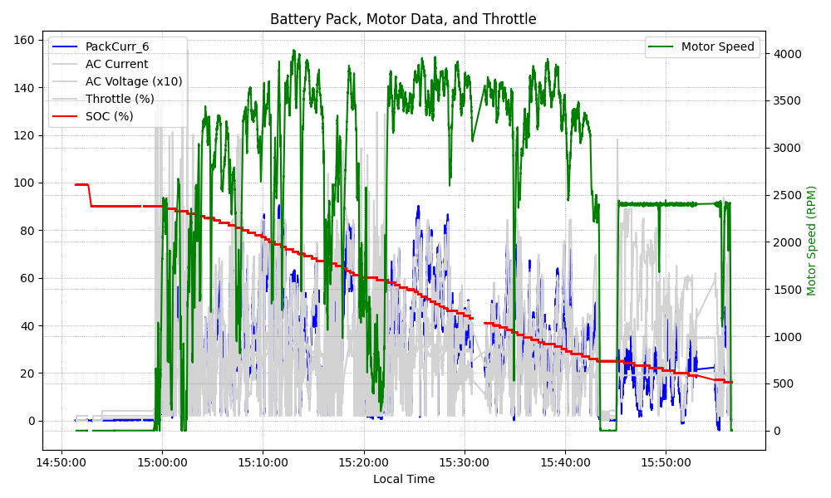
Graph Analysis

