Slide 1
Analysis Results from Folder - B4_BT03_14.54_15.49

Slide 2
Analysis Results:
Metric | Value
Date and Time | 2024-03-11 14:55:04.329000 to 2024-03-11 15:49:13.490000
Total time taken for the ride | 0 days 00:54:10.980000
Actual Ampere-hours (Ah) | 33.50618638888889
Actual Watt-hours (Wh) | 1709.0979718525
Starting SoC (Ah) | 37.269
Ending SoC (Ah) | 3.638
Starting SoC (%) | 94.0
Ending SoC (%) | 9.0
Total distance covered (km) | 37.58353708281574
Total energy consumption(WH/KM) | 45.47464407318778
Total SOC consumed(%) | 85.0
Mode | Custom mode 67.79% Eco mode 32.21%
Peak Power(kW) | 4552.1056

Slide 3
Analysis Results:
Metric | Value
Average Power(kW) | -1900.75770734291
Total Energy Regenerated(kWh) | 2.3885110119444444
Regenerative Effectiveness(%) | 0.13955769068925933
Highest Cell Voltage(V) | 3.349
Lowest Cell Voltage(V) | 3.047
Difference in Cell Voltage(V) | 0.30200000000000005
Minimum Temperature(C) | 37.0
Maximum Temperature(C) | 47.0
Difference in Temperature(C) | 10.0
Maximum Fet Temperature-BMS(C) | 70.0
Maximum Afe Temperature-BMS(C) | 67.0
Maximum PCB Temperature-BMS(C) | 65.0
Maximum MCU Temperature(C) | 68.0

Slide 4
Analysis Results:
Metric | Value
Maximum Motor Temperature(C) | 100.0
Abnormal Motor Temperature Detected(C) | False
highest cell temp(C) | 47.0
lowest cell temp(C) | 37.0
Difference between Highest and Lowest Cell Temperature at 100% SOC(C) | 10.0
Battery Voltage(V) | 53.0
Total energy charged(kWh) | 1.7758278786111115
Electricity consumption units(kW) | 1.5178016056505226e-07
Cycle Count of battery | 51.0
Idling time percentage | 0.8162224206096161
Time spent in 0-10 km/h | 2.7930110955235303
Time spent in 10-20 km/h | 3.7527101135059304
Time spent in 20-30 km/h | 12.418696594822089

Slide 5
Analysis Results:
Metric | Value
Time spent in 30-40 km/h | 37.855503124601455
Time spent in 40-50 km/h | 13.148833057008035
Time spent in 50-60 km/h | 17.48820303532713
Time spent in 60-70 km/h | 9.21757428899375
Time spent in 70-80 km/h | 2.426348680015304
Time spent in 80-90 km/h | 0.0

Slide 6
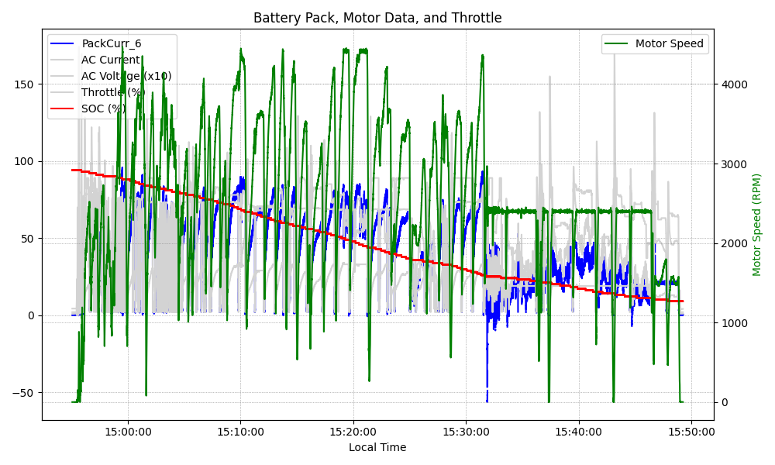
Graph Analysis

