Slide 1
Analysis Results from Folder - B3_B04_09.05_10.20

Slide 2
Analysis Results:
Metric | Value
Date and Time | 2024-03-12 09:19:48.749000 to 2024-03-12 10:20:02.465000
Total time taken for the ride | 0 days 01:14:17.096000
Actual Ampere-hours (Ah) | 34.34780416666667
Actual Watt-hours (Wh) | 1732.0194386866667
Starting SoC (Ah) | 38.28
Ending SoC (Ah) | 3.652
Starting SoC (%) | 96.0
Ending SoC (%) | 9.0
Total distance covered (km) | 38.289858767393895
Total energy consumption(WH/KM) | 45.23441700865151
Total SOC consumed(%) | 87.0
Mode | Custom mode 66.05% Eco mode 30.54% Sports mode 0.09%
Peak Power(kW) | 6125.566505

Slide 3
Analysis Results:
Metric | Value
Average Power(kW) | -1406.240410300406
Total Energy Regenerated(kWh) | 112.39954932722223
Regenerative Effectiveness(%) | 6.094035577472369
Highest Cell Voltage(V) | 3.337
Lowest Cell Voltage(V) | 2.921
Difference in Cell Voltage(V) | 0.41600000000000037
Minimum Temperature(C) | 21.0
Maximum Temperature(C) | 45.0
Difference in Temperature(C) | 24.0
Maximum Fet Temperature-BMS(C) | 72.0
Maximum Afe Temperature-BMS(C) | 66.0
Maximum PCB Temperature-BMS(C) | 64.0
Maximum MCU Temperature(C) | 51.0

Slide 4
Analysis Results:
Metric | Value
Maximum Motor Temperature(C) | 0.0
Abnormal Motor Temperature Detected(C) | False
highest cell temp(C) | 45.0
lowest cell temp(C) | 21.0
Difference between Highest and Lowest Cell Temperature at 100% SOC(C) | 24.0
Battery Voltage(V) | 55.0
Total energy charged(kWh) | 1.8891292291666668
Electricity consumption units(kW) | 1.1773796706595535e-07
Cycle Count of battery | 137.0
Idling time percentage | 13.487162820929477
Time spent in 0-10 km/h | 13.264311249361624
Time spent in 10-20 km/h | 5.148799851432286
Time spent in 20-30 km/h | 8.284971447142393

Slide 5
Analysis Results:
Metric | Value
Time spent in 30-40 km/h | 21.607316959933147
Time spent in 40-50 km/h | 14.78016621013046
Time spent in 50-60 km/h | 9.814754631134221
Time spent in 60-70 km/h | 10.51812990389526
Time spent in 70-80 km/h | 2.414225358651748
Time spent in 80-90 km/h | 0.03714192859464228

Slide 6
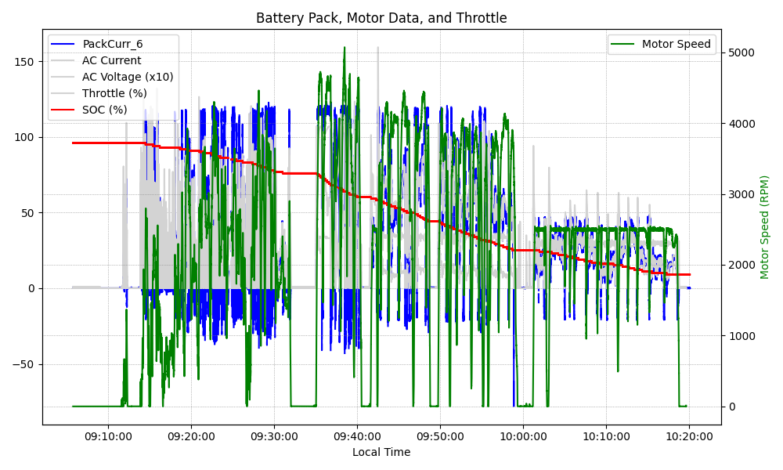
Graph Analysis

