Slide 1
Analysis Results from Folder - B4_B04_12.49_13.49

Slide 2
Analysis Results:
Metric | Value
Date and Time | 2024-03-12 12:46:03.339000 to 2024-03-12 13:49:05.835000
Total time taken for the ride | 0 days 01:03:04.977000
Actual Ampere-hours (Ah) | 32.194902500000005
Actual Watt-hours (Wh) | 1649.5346833119445
Starting SoC (Ah) | 39.46
Ending SoC (Ah) | 7.847
Starting SoC (%) | 99.0
Ending SoC (%) | 19.0
Total distance covered (km) | 41.76006180344882
Total energy consumption(WH/KM) | 39.50029315272026
Total SOC consumed(%) | 80.0
Mode | Custom mode 75.45% Eco mode 14.88%
Peak Power(kW) | 4299.58034

Slide 3
Analysis Results:
Metric | Value
Average Power(kW) | -1574.3173011460765
Total Energy Regenerated(kWh) | 0.2063263922222222
Regenerative Effectiveness(%) | 0.012506592914194505
Highest Cell Voltage(V) | 3.46
Lowest Cell Voltage(V) | 3.095
Difference in Cell Voltage(V) | 0.36499999999999977
Minimum Temperature(C) | 36.0
Maximum Temperature(C) | 45.0
Difference in Temperature(C) | 9.0
Maximum Fet Temperature-BMS(C) | 60.0
Maximum Afe Temperature-BMS(C) | 59.0
Maximum PCB Temperature-BMS(C) | 59.0
Maximum MCU Temperature(C) | 52.0

Slide 4
Analysis Results:
Metric | Value
Maximum Motor Temperature(C) | 91.0
Abnormal Motor Temperature Detected(C) | False
highest cell temp(C) | 45.0
lowest cell temp(C) | 36.0
Difference between Highest and Lowest Cell Temperature at 100% SOC(C) | 9.0
Battery Voltage(V) | 54.0
Total energy charged(kWh) | 1.7385247350000002
Electricity consumption units(kW) | 1.2762249933932348e-07
Cycle Count of battery | 40.0
Idling time percentage | 16.955087985525434
Time spent in 0-10 km/h | 3.1867394286047803
Time spent in 10-20 km/h | 3.318061108354977
Time spent in 20-30 km/h | 2.9678699623544516

Slide 5
Analysis Results:
Metric | Value
Time spent in 30-40 km/h | 14.217760527621326
Time spent in 40-50 km/h | 9.656520850964485
Time spent in 50-60 km/h | 42.17468701666326
Time spent in 60-70 km/h | 7.409460997461115
Time spent in 70-80 km/h | 0.0
Time spent in 80-90 km/h | 0.0

Slide 6
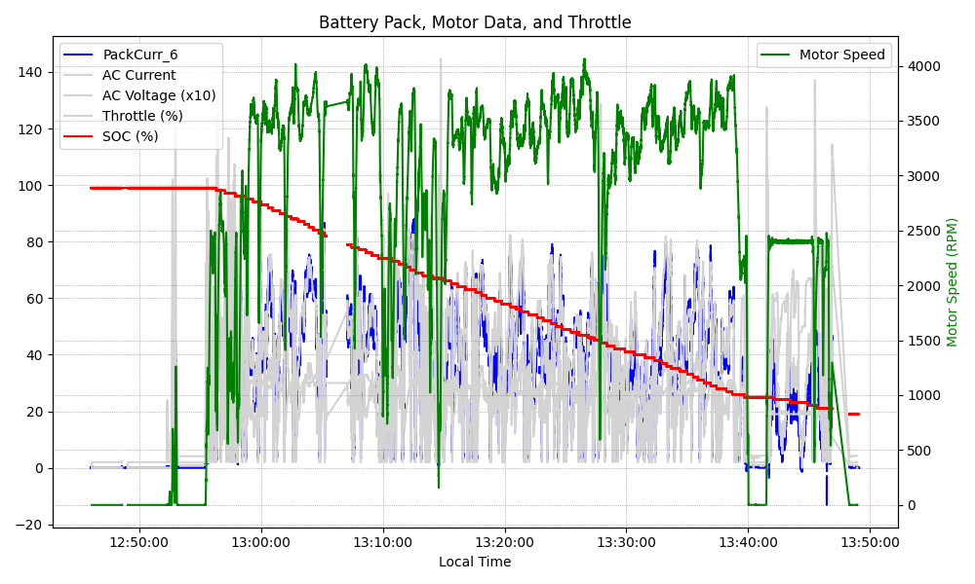
Graph Analysis

