Slide 1
Analysis Results from Folder - B4_BT06_09.00_09.55

Slide 2
Analysis Results:
Metric | Value
Date and Time | 2024-03-11 09:07:22.099000 to 2024-03-11 09:55:59.893000
Total time taken for the ride | 0 days 00:50:09.776000
Actual Ampere-hours (Ah) | 27.755521666666667
Actual Watt-hours (Wh) | 1385.7406769913891
Starting SoC (Ah) | 38.746
Ending SoC (Ah) | 10.259
Starting SoC (%) | 97.0
Ending SoC (%) | 25.0
Total distance covered (km) | 27.14685761272991
Total energy consumption(WH/KM) | 51.04608042521935
Total SOC consumed(%) | 72.0
Mode | Custom mode 90.09% Eco mode 8.86% Sports mode 0.07%
Peak Power(kW) | 5724.067349

Slide 3
Analysis Results:
Metric | Value
Average Power(kW) | -1668.4503134344484
Total Energy Regenerated(kWh) | 0.024432869166666666
Regenerative Effectiveness(%) | 0.0017631320772050073
Highest Cell Voltage(V) | 3.326
Lowest Cell Voltage(V) | 2.963
Difference in Cell Voltage(V) | 0.363
Minimum Temperature(C) | 25.0
Maximum Temperature(C) | 40.0
Difference in Temperature(C) | 15.0
Maximum Fet Temperature-BMS(C) | 70.0
Maximum Afe Temperature-BMS(C) | 63.0
Maximum PCB Temperature-BMS(C) | 64.0
Maximum MCU Temperature(C) | 60.0

Slide 4
Analysis Results:
Metric | Value
Maximum Motor Temperature(C) | 95.0
Abnormal Motor Temperature Detected(C) | False
highest cell temp(C) | 40.0
lowest cell temp(C) | 25.0
Difference between Highest and Lowest Cell Temperature at 100% SOC(C) | 15.0
Battery Voltage(V) | 55.0
Total energy charged(kWh) | 1.5265536916666667
Electricity consumption units(kW) | 1.4092478967418733e-07
Cycle Count of battery | 37.0
Idling time percentage | 25.377675199328575
Time spent in 0-10 km/h | 8.203944607637432
Time spent in 10-20 km/h | 6.602322003077353
Time spent in 20-30 km/h | 7.508043082948664

Slide 5
Analysis Results:
Metric | Value
Time spent in 30-40 km/h | 8.354315288851588
Time spent in 40-50 km/h | 11.637991327458385
Time spent in 50-60 km/h | 8.106028815218911
Time spent in 60-70 km/h | 12.750034969925863
Time spent in 70-80 km/h | 11.31626800951182
Time spent in 80-90 km/h | 0.0

Slide 6
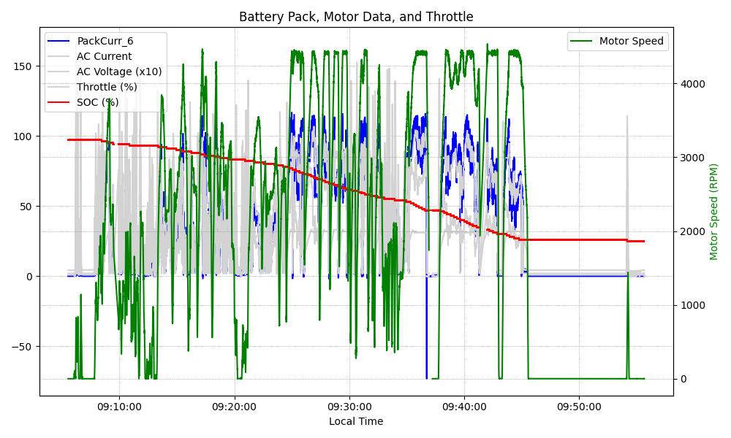
Graph Analysis

