Slide 1
Analysis Results from Folder - B4_BT06_13.03_13.56

Slide 2
Analysis Results:
Metric | Value
Date and Time | 2024-03-11 13:06:03.902000 to 2024-03-11 13:56:16.218000
Total time taken for the ride | 0 days 00:50:13.716000
Actual Ampere-hours (Ah) | 27.04170027777778
Actual Watt-hours (Wh) | 1368.2177338797221
Starting SoC (Ah) | 37.854
Ending SoC (Ah) | 10.0
Starting SoC (%) | 95.0
Ending SoC (%) | 25.0
Total distance covered (km) | 26.02395091125489
Total energy consumption(WH/KM) | 52.575327187848046
Total SOC consumed(%) | 70.0
Mode | Custom mode 71.62% Eco mode 8.79% Sports mode 0.07%
Peak Power(kW) | 5454.527923

Slide 3
Analysis Results:
Metric | Value
Average Power(kW) | -1637.4946283134973
Total Energy Regenerated(kWh) | 0.6062592772222223
Regenerative Effectiveness(%) | 0.044290520932789554
Highest Cell Voltage(V) | 3.345
Lowest Cell Voltage(V) | 3.0
Difference in Cell Voltage(V) | 0.3450000000000002
Minimum Temperature(C) | 37.0
Maximum Temperature(C) | 47.0
Difference in Temperature(C) | 10.0
Maximum Fet Temperature-BMS(C) | 70.0
Maximum Afe Temperature-BMS(C) | 65.0
Maximum PCB Temperature-BMS(C) | 66.0
Maximum MCU Temperature(C) | 68.0

Slide 4
Analysis Results:
Metric | Value
Maximum Motor Temperature(C) | 99.0
Abnormal Motor Temperature Detected(C) | False
highest cell temp(C) | 47.0
lowest cell temp(C) | 37.0
Difference between Highest and Lowest Cell Temperature at 100% SOC(C) | 10.0
Battery Voltage(V) | 53.0
Total energy charged(kWh) | 1.4332101147222225
Electricity consumption units(kW) | 1.321320679575748e-07
Cycle Count of battery | 38.0
Idling time percentage | 23.58145099887604
Time spent in 0-10 km/h | 11.899496029875639
Time spent in 10-20 km/h | 5.337007360139226
Time spent in 20-30 km/h | 6.8235379427867

Slide 5
Analysis Results:
Metric | Value
Time spent in 30-40 km/h | 10.66313766723469
Time spent in 40-50 km/h | 11.029331786374678
Time spent in 50-60 km/h | 13.407780718610637
Time spent in 60-70 km/h | 15.343896160400275
Time spent in 70-80 km/h | 1.8128421739603349
Time spent in 80-90 km/h | 0.0

Slide 6
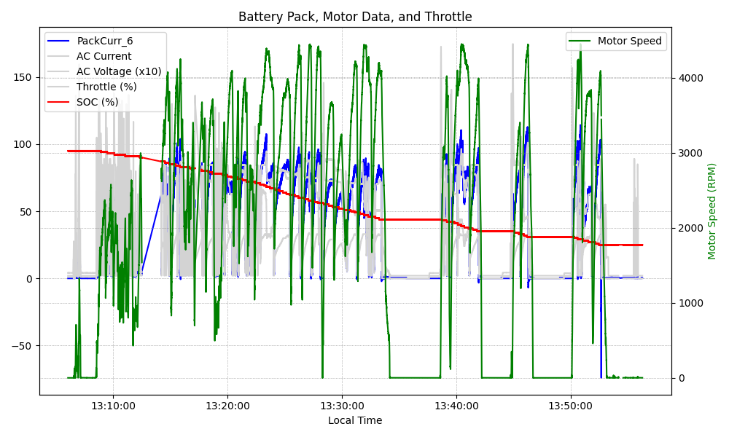
Graph Analysis

