Slide 1
Analysis Results from Folder - B4_BT02_13.59_14.50

Slide 2
Analysis Results:
Metric | Value
Total time taken for the ride | 0 days 00:52:44.491000
Actual Ampere-hours (Ah) | 33.510839722222215
Actual Watt-hours (Wh) | 1708.2951099241668
Starting SoC (Ah) | 39.374
Ending SoC (Ah) | 6.547
Starting SoC (%) | 16.0
Ending SoC (%) | 99.0
Total distance covered (in kilometers) | 32.76320401356542
WH/KM | 52.14066088337565
Total SOC consumed | 83.0
Mode | Custom mode 77.01% Eco mode 22.80% Sports mode 0.06%
Peak Power | 5428.3737
Average Power | -1951.0984758017132

Slide 3
Analysis Results:
Metric | Value
Total Energy Regenerated | 0.07929685166666668
Regenerative Effectiveness | -0.00464165532755325
Lowest Cell Voltage | 3.088
Highest Cell Voltage | 3.435
Difference in Cell Voltage | 0.347
Minimum Temperature | 38.0
Maximum Temperature | 47.0
Difference in Temperature | nan
Maximum Fet Temperature | 68.0
Maximum Afe Temperature | 67.0
Maximum PCB Temperature | 65.0
Maximum MCU Temperature | 71.0
Maximum Motor Temperature | 101.0

Slide 4
Analysis Results:
Metric | Value
Abnormal Motor Temperature Detected | False
lowest cell temp | 47.0
highest cell temp | 38.0
Difference between Highest and Lowest Cell Temperature at 100% SOC | 9.0
Maximum BMS Temperature in C | 68.0
Battery Voltage | 5.4
Total energy charged in kWh | 0.1809585345
Electricity consumption units in kW | 1.588693412873999e-08
Idling time percentage | 4.033601777284088
Time spent in 0-10 km/h | 8.65037489586226
Time spent in 10-20 km/h | 7.730491530130519
Time spent in 20-30 km/h | 15.315190224937517
Time spent in 30-40 km/h | 25.461677311857816

Slide 5
Analysis Results:
Metric | Value
Time spent in 40-50 km/h | 11.982782560399889
Time spent in 50-60 km/h | 12.43751735628992
Time spent in 60-70 km/h | 9.615384615384617

Slide 6
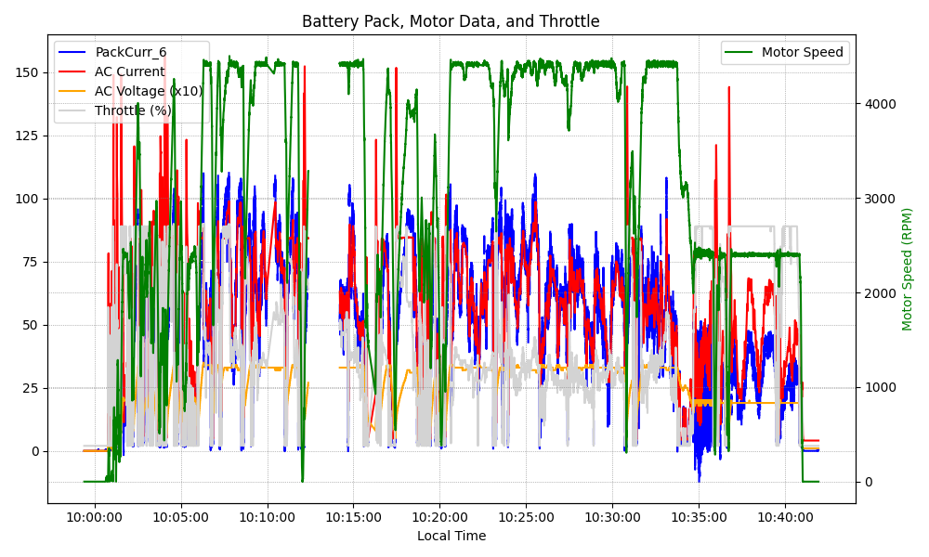
Graph Analysis

