Slide 1
Analysis Results from Folder - B4_BT04_15.52_16.57

Slide 2
Analysis Results:
Metric | Value
Total time taken for the ride | 0 days 00:52:10.640000
Actual Ampere-hours (Ah) | 32.97601722222222
Actual Watt-hours (Wh) | 1673.844472675
Starting SoC (Ah) | 39.268
Ending SoC (Ah) | 7.33
Starting SoC (%) | 18.0
Ending SoC (%) | 99.0
Total distance covered (in kilometers) | 30.986615690755627
WH/KM | 54.01830549614895
Total SOC consumed | 81.0
Mode | Custom mode 69.63% Eco mode 18.00% Sports mode 0.06%
Peak Power | 5421.410500000001
Average Power | -1935.0803152312137

Slide 3
Analysis Results:
Metric | Value
Total Energy Regenerated | 1.4474072980555555
Regenerative Effectiveness | -0.08639732069129558
Lowest Cell Voltage | 3.071
Highest Cell Voltage | 3.332
Difference in Cell Voltage | 0.2609999999999997
Minimum Temperature | 38.0
Maximum Temperature | 48.0
Difference in Temperature | nan
Maximum Fet Temperature | 70.0
Maximum Afe Temperature | 66.0
Maximum PCB Temperature | 65.0
Maximum MCU Temperature | 68.0
Maximum Motor Temperature | 100.0

Slide 4
Analysis Results:
Metric | Value
Abnormal Motor Temperature Detected | False
lowest cell temp | 48.0
highest cell temp | 38.0
Difference between Highest and Lowest Cell Temperature at 100% SOC | 10.0
Maximum BMS Temperature in C | 70.0
Battery Voltage | 5.3
Total energy charged in kWh | 0.17477289127777776
Electricity consumption units in kW | 1.551055123160967e-08
Idling time percentage | 15.930131004366812
Time spent in 0-10 km/h | 24.349344978165938
Time spent in 10-20 km/h | 3.8148471615720525
Time spent in 20-30 km/h | 8.988646288209607
Time spent in 30-40 km/h | 17.788646288209605

Slide 5
Analysis Results:
Metric | Value
Time spent in 40-50 km/h | 11.839301310043668
Time spent in 50-60 km/h | 11.744978165938864
Time spent in 60-70 km/h | 13.977292576419215

Slide 6
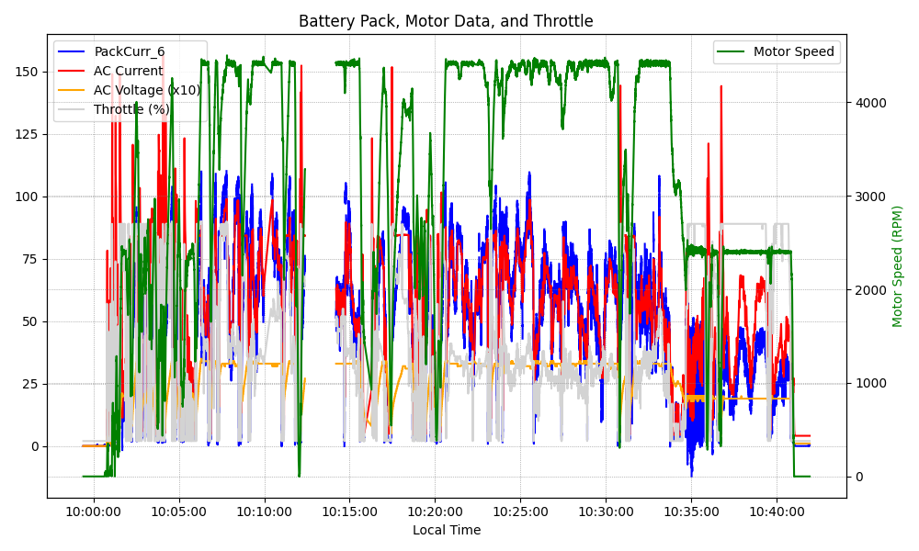
Graph Analysis

