Slide 1
Analysis Results from Folder - B4_BT05_11.47_12.42

Slide 2
Analysis Results:
Metric | Value
Total time taken for the ride | 0 days 00:44:26.820000
Actual Ampere-hours (Ah) | 27.482442499999998
Actual Watt-hours (Wh) | 1392.5128395005554
Starting SoC (Ah) | 38.734
Ending SoC (Ah) | 11.11
Starting SoC (%) | 28.0
Ending SoC (%) | 97.0
Total distance covered (in kilometers) | 28.990432993729527
WH/KM | 48.03353022708382
Total SOC consumed | 69.0
Mode | Custom mode 94.60% Eco mode 3.25% Sports mode 0.11%
Peak Power | 5527.275720000001
Average Power | -1882.48074434923

Slide 3
Analysis Results:
Metric | Value
Total Energy Regenerated | 0.12604075305555557
Regenerative Effectiveness | -0.009050497931854558
Lowest Cell Voltage | 3.06
Highest Cell Voltage | 3.328
Difference in Cell Voltage | 0.2679999999999998
Minimum Temperature | 28.0
Maximum Temperature | 45.0
Difference in Temperature | nan
Maximum Fet Temperature | 70.0
Maximum Afe Temperature | 67.0
Maximum PCB Temperature | 66.0
Maximum MCU Temperature | 64.0
Maximum Motor Temperature | 102.0

Slide 4
Analysis Results:
Metric | Value
Abnormal Motor Temperature Detected | False
lowest cell temp | 45.0
highest cell temp | 28.0
Difference between Highest and Lowest Cell Temperature at 100% SOC | 17.0
Maximum BMS Temperature in C | 70.0
Battery Voltage | 5.3
Total energy charged in kWh | 0.14565694524999998
Electricity consumption units in kW | 1.5176392561682085e-08
Idling time percentage | 13.871710925184916
Time spent in 0-10 km/h | 19.23527747463724
Time spent in 10-20 km/h | 6.802473626773373
Time spent in 20-30 km/h | 10.027888929307627
Time spent in 30-40 km/h | 11.001980518168223

Slide 5
Analysis Results:
Metric | Value
Time spent in 40-50 km/h | 9.16696980720262
Time spent in 50-60 km/h | 15.573339800331434
Time spent in 60-70 km/h | 15.088314942807484

Slide 6
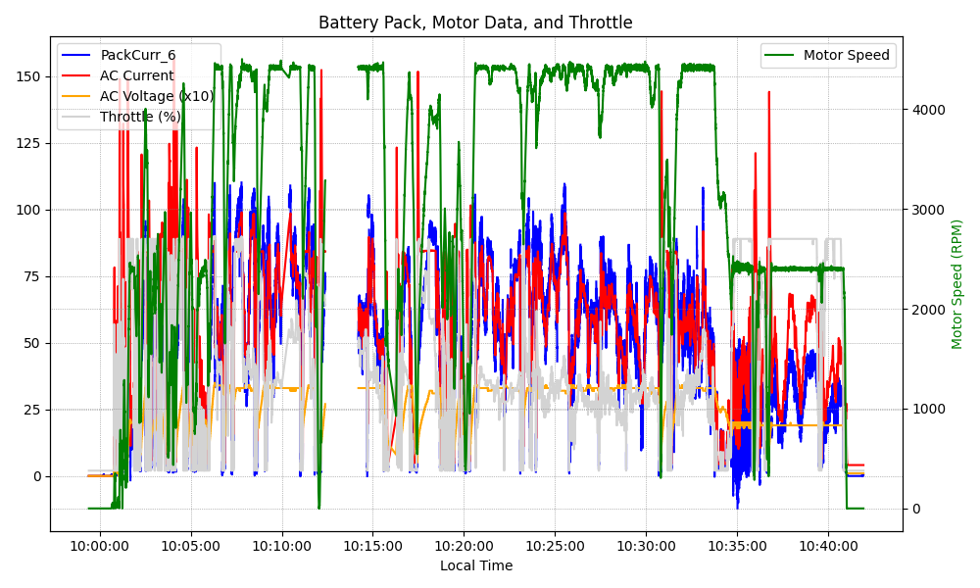
Graph Analysis

