Slide 1
Analysis Results from Folder - B4_B03_05.22_06.06

Slide 2
Analysis Results:
Metric | Value
Total time taken for the ride | 0 days 00:44:15.811000
Actual Ampere-hours (Ah) | 28.259706944444442
Actual Watt-hours (Wh) | 1428.2919918925
Starting SoC (Ah) | 39.388
Ending SoC (Ah) | 9.852
Starting SoC (%) | 24.0
Ending SoC (%) | 99.0
Total distance covered (in kilometers) | 29.620325344960253
WH/KM | 48.21999675082963
Total SOC consumed | 75.0
Mode | Custom mode 95.06% Eco mode 4.11% Sports mode 0.04%
Peak Power | 5529.002210000001
Average Power | -1948.4089317214853

Slide 3
Analysis Results:
Metric | Value
Total Energy Regenerated | 0.0
Regenerative Effectiveness | -0.0
Lowest Cell Voltage | 3.013
Highest Cell Voltage | 3.336
Difference in Cell Voltage | 0.32299999999999995
Minimum Temperature | 26.0
Maximum Temperature | 38.0
Difference in Temperature | nan
Maximum Fet Temperature | 57.0
Maximum Afe Temperature | 54.0
Maximum PCB Temperature | 52.0
Maximum MCU Temperature | 48.0
Maximum Motor Temperature | 81.0

Slide 4
Analysis Results:
Metric | Value
Abnormal Motor Temperature Detected | False
lowest cell temp | 38.0
highest cell temp | 26.0
Difference between Highest and Lowest Cell Temperature at 100% SOC | 12.0
Maximum BMS Temperature in C | 57.0
Battery Voltage | 5.3
Total energy charged in kWh | 0.14977644680555555
Electricity consumption units in kW | 1.567027064297505e-08
Idling time percentage | 4.455611390284757
Time spent in 0-10 km/h | 8.525963149078727
Time spent in 10-20 km/h | 5.402010050251256
Time spent in 20-30 km/h | 10.74539363484087
Time spent in 30-40 km/h | 19.141541038525965

Slide 5
Analysis Results:
Metric | Value
Time spent in 40-50 km/h | 27.382747068676714
Time spent in 50-60 km/h | 20.06281407035176
Time spent in 60-70 km/h | 7.2571189279732

Slide 6
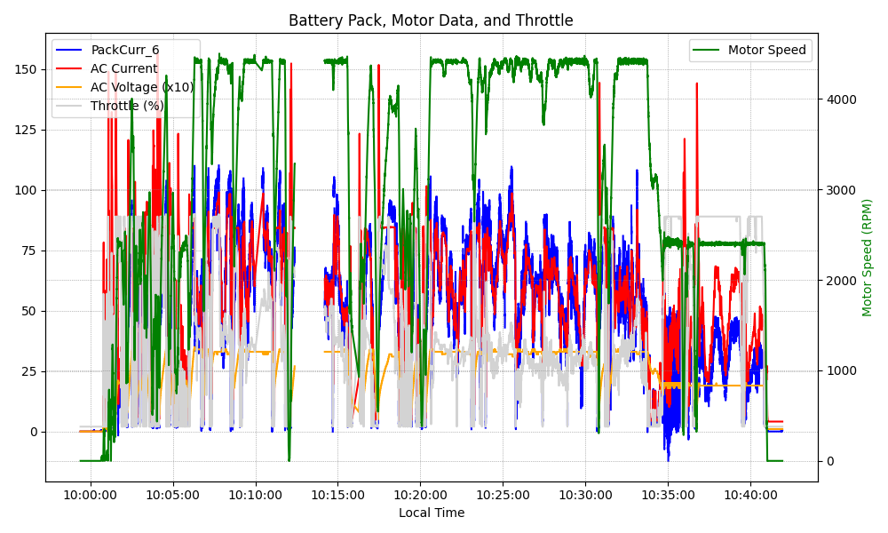
Graph Analysis

