Slide 1
Analysis Results from Folder - B4_B03_14.51_15.56

Slide 2
Analysis Results:
Metric | Value
Total time taken for the ride | 0 days 01:05:10.305000
Actual Ampere-hours (Ah) | 29.43661194444444
Actual Watt-hours (Wh) | 1512.064054262222
Starting SoC (Ah) | 39.501
Ending SoC (Ah) | 6.339
Starting SoC (%) | 16.0
Ending SoC (%) | 99.0
Total distance covered (in kilometers) | 41.788590328413825
WH/KM | 36.183657844856896
Total SOC consumed | 83.0
Mode | Sports mode 49.66% Custom mode 26.73% Eco mode 20.63%
Peak Power | 4515.103889999999
Average Power | -1395.3936414621892

Slide 3
Analysis Results:
Metric | Value
Total Energy Regenerated | 0.11584599972222223
Regenerative Effectiveness | -0.007660860966486528
Lowest Cell Voltage | 3.107
Highest Cell Voltage | 3.414
Difference in Cell Voltage | 0.30699999999999994
Minimum Temperature | 36.0
Maximum Temperature | 46.0
Difference in Temperature | nan
Maximum Fet Temperature | 63.0
Maximum Afe Temperature | 63.0
Maximum PCB Temperature | 60.0
Maximum MCU Temperature | 54.0
Maximum Motor Temperature | 93.0

Slide 4
Analysis Results:
Metric | Value
Abnormal Motor Temperature Detected | False
lowest cell temp | 46.0
highest cell temp | -1.0
Difference between Highest and Lowest Cell Temperature at 100% SOC | 47.0
Maximum BMS Temperature in C | 63.0
Battery Voltage | 5.3
Total energy charged in kWh | 0.15601404330555554
Electricity consumption units in kW | 1.1083691624435601e-08
Idling time percentage | 8.069484853671058
Time spent in 0-10 km/h | 17.764846825260996
Time spent in 10-20 km/h | 3.4685378515602716
Time spent in 20-30 km/h | 5.131496377431684
Time spent in 30-40 km/h | 21.681213988248047

Slide 5
Analysis Results:
Metric | Value
Time spent in 40-50 km/h | 10.054766387129899
Time spent in 50-60 km/h | 34.40013691596783
Time spent in 60-70 km/h | 6.811569399281191

Slide 6
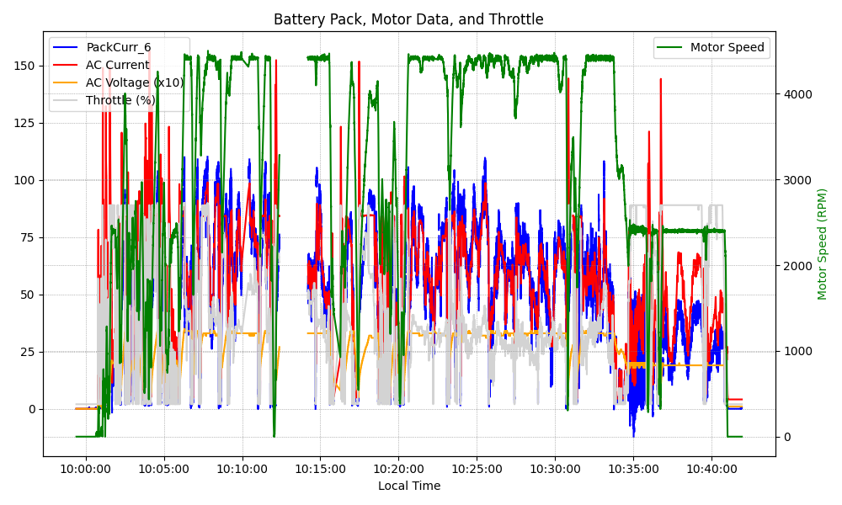
Graph Analysis

