Slide 1
Analysis Results from Folder - B4_B05_06.07_06.55

Slide 2
Analysis Results:
Metric | Value
Total time taken for the ride | 0 days 00:48:16.837000
Actual Ampere-hours (Ah) | 28.521484166666667
Actual Watt-hours (Wh) | 1436.9600906974997
Starting SoC (Ah) | 9.852
Ending SoC (Ah) | 10.197
Starting SoC (%) | 24.0
Ending SoC (%) | 99.0
Total distance covered (in kilometers) | 29.81116975955862
WH/KM | 48.20206997200284
Total SOC consumed | 1.0
Mode | Custom mode 74.60% Eco mode 20.45% Sports mode 0.04%
Peak Power | 5563.598616
Average Power | -1797.4483413867267

Slide 3
Analysis Results:
Metric | Value
Total Energy Regenerated | 0.7363970408333332
Regenerative Effectiveness | -0.05122061903286506
Lowest Cell Voltage | 3.021
Highest Cell Voltage | 3.335
Difference in Cell Voltage | 0.31400000000000006
Minimum Temperature | 25.0
Maximum Temperature | 43.0
Difference in Temperature | nan
Maximum Fet Temperature | 71.0
Maximum Afe Temperature | 65.0
Maximum PCB Temperature | 64.0
Maximum MCU Temperature | 54.0
Maximum Motor Temperature | 92.0

Slide 4
Analysis Results:
Metric | Value
Abnormal Motor Temperature Detected | False
lowest cell temp | 43.0
highest cell temp | 25.0
Difference between Highest and Lowest Cell Temperature at 100% SOC | 18.0
Maximum BMS Temperature in C | 71.0
Battery Voltage | 5.3
Total energy charged in kWh | 0.15116386608333332
Electricity consumption units in kW | 1.4499296547281051e-08
Idling time percentage | 8.495411299149618
Time spent in 0-10 km/h | 14.553338385114087
Time spent in 10-20 km/h | 3.2794476719710364
Time spent in 20-30 km/h | 5.4475035783447
Time spent in 30-40 km/h | 10.499284331060032

Slide 5
Analysis Results:
Metric | Value
Time spent in 40-50 km/h | 8.832196682663973
Time spent in 50-60 km/h | 17.651763913446157
Time spent in 60-70 km/h | 14.448092952765851

Slide 6
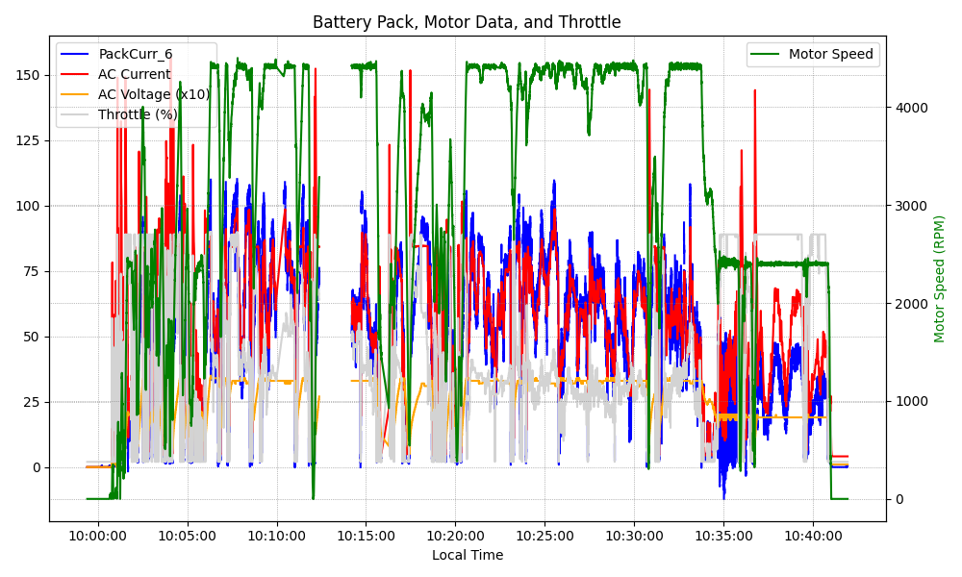
Graph Analysis

