Slide 1
Analysis Results from Folder - B3_B03_13.15_15.30

Slide 2
Analysis Results:
Metric | Value
Total time taken for the ride | 0 days 02:16:27.789000
Actual Ampere-hours (Ah) | 35.83509361111111
Actual Watt-hours (Wh) | 1842.9312340324998
Starting SoC (Ah) | 38.646
Ending SoC (Ah) | 3.126
Starting SoC (%) | 0.0
Ending SoC (%) | 97.0
Total distance covered (in kilometers) | 69.78145244294669
WH/KM | 26.410044066355315
Total SOC consumed | 97.0
Mode | Eco mode 98.43%
Peak Power | 2438.510646
Average Power | -813.6561739657836

Slide 3
Analysis Results:
Metric | Value
Total Energy Regenerated | 22.40473596861111
Regenerative Effectiveness | -1.2011099517154418
Lowest Cell Voltage | 2.985
Highest Cell Voltage | 3.339
Difference in Cell Voltage | 0.3540000000000001
Minimum Temperature | 23.0
Maximum Temperature | 44.0
Difference in Temperature | nan
Maximum Fet Temperature | 58.0
Maximum Afe Temperature | 62.0
Maximum PCB Temperature | 57.0
Maximum MCU Temperature | 42.0
Maximum Motor Temperature | 0.0

Slide 4
Analysis Results:
Metric | Value
Abnormal Motor Temperature Detected | False
lowest cell temp | 44.0
highest cell temp | 0.0
Difference between Highest and Lowest Cell Temperature at 100% SOC | 44.0
Maximum BMS Temperature in C | 58.0
Battery Voltage | 5.5
Total energy charged in kWh | 0.19709301486111114
Electricity consumption units in kW | 6.687194293836812e-09
Idling time percentage | 17.45556834164429
Time spent in 0-10 km/h | 22.21582917785449
Time spent in 10-20 km/h | 1.6647487533563483
Time spent in 20-30 km/h | 3.1223628691983123
Time spent in 30-40 km/h | 41.71205728167753

Slide 5
Analysis Results:
Metric | Value
Time spent in 40-50 km/h | 30.447513105740953
Time spent in 50-60 km/h | 0.0
Time spent in 60-70 km/h | 0.0

Slide 6
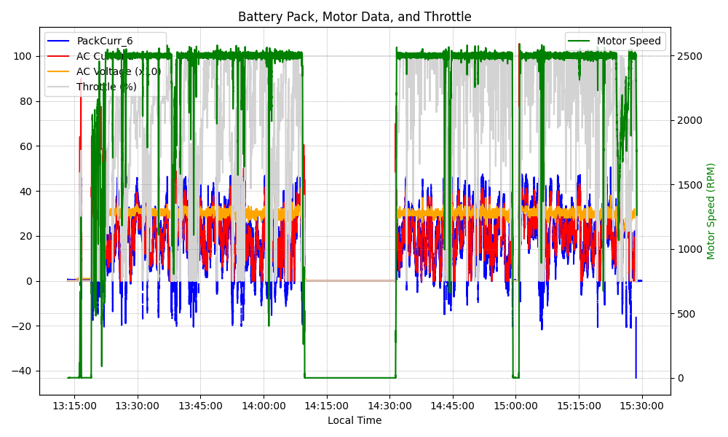
Graph Analysis

